Slide 1
Control for the Tilt Table and Cup Car
Microcomputer Systems II

Slide 2
Topics
Calibrating the touch panel
Cover the linear algebra
PID Control for the tilt table
Brief introduction

Slide 3
Calibrating the Touch Panel
Physically measure a number of points on the panel (Arbitrary >=3)
Center of touch panel. This is also useful for calibrating the servos.
Four corners approximately 2% inside of each edge because edges don’t sense.
Mid-points of each side.
Must have 3 points but at least nine points are suggested.
Get a voltage reading (x, y) for each point.
Two lists of (x, y) points: Idealized and (electrically) measured.

Slide 4
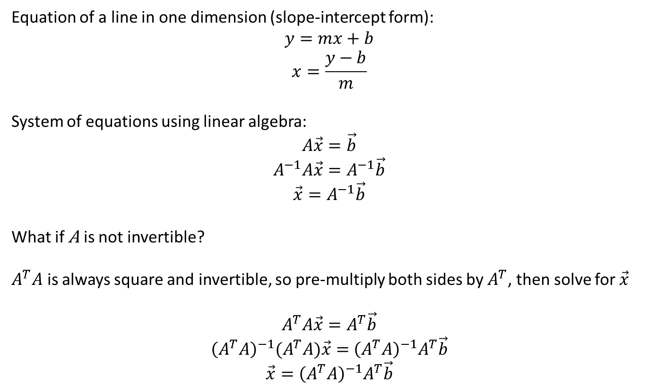
Linear Algebra Is Your Friend
Equation of a line in one dimension (slope-intercept form):
$$y=mx+b$$
$$x=\frac{y−b}{m}$$
System of equations using linear algebra:
$$A\vec{x}=\vec{b}$$
$$A^{−1}A\vec{x}=A^{−1}\vec{b}$$
$$\vec{x}=A^{−1}\vec{b}$$
What if A is not invertible?
$A^{T}A$ is always square and invertible, so pre-multiply both sides by $A^{T}$, then solve for $\vec{x}$
$$A^{T}A\vec{x}=A^{T}\vec{b}$$
${\left(A^{T}A\right)}^{−1}{(A}^{T}A)\vec{x}=$ ${\left(A^{T}A\right)}^{−1}A^{T}\vec{b}$
$$\vec{x}={\left(A^{T}A\right)}^{−1}A^{T}\vec{b}$$

Slide 5
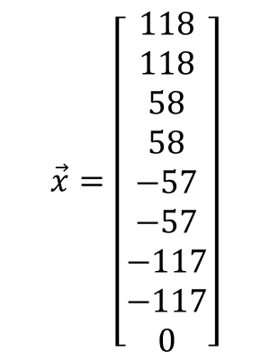
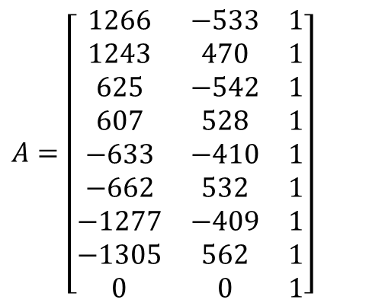
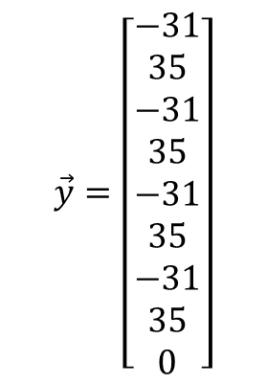
Example
Example: Actual point is (118, -31) and the sensor (after centering) reads: (1266, -533):
$A=\left[\begin{matrix}1266 & −533 & 1 \\ 1243 & 470 & 1 \\ 625 & −542 & 1 \\ 607 & 528 & 1 \\ −633 & −410 & 1 \\ −662 & 532 & 1 \\ −1277 & −409 & 1 \\ −1305 & 562 & 1 \\ 0 & 0 & 1\end{matrix}\right]$
$$\vec{x}=\left[\begin{matrix}118 \\ 118 \\ 58 \\ 58 \\ −57 \\ −57 \\ −117 \\ −117 \\ 0\end{matrix}\right]$$
$$\vec{y}=\left[\begin{matrix}−31 \\ 35 \\ −31 \\ 35 \\ −31 \\ 35 \\ −31 \\ 35 \\ 0\end{matrix}\right]$$

Slide 6
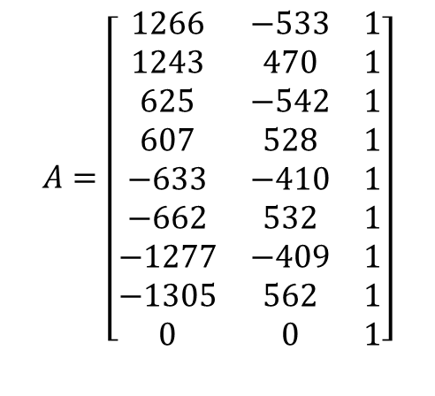
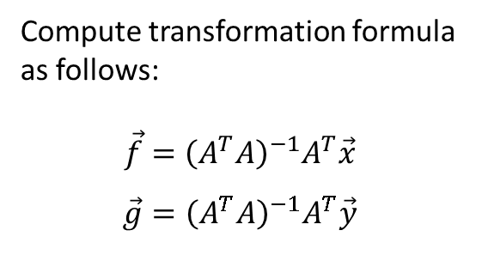
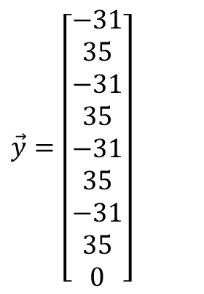
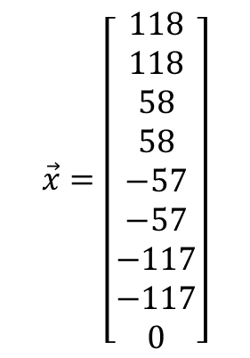
Example (cont.)
Compute transformation formula as follows:
$$\vec{f}={\left(A^{T}A\right)}^{−1}A^{T}\vec{x}$$
$$\vec{g}={\left(A^{T}A\right)}^{−1}A^{T}\vec{y}$$
MATLAB Commands:
f = inv(A'*A)*A’*x
f =
0.0922
0.0023
1.7871
g = inv(A'*A)*A’*y
g =
0.0030
0.0661
0.3671
You can adjust these two values without redoing the whole calculation to re-center the panel calibration.
$$A=\left[\begin{matrix}1266 & −533 & 1 \\ 1243 & 470 & 1 \\ 625 & −542 & 1 \\ 607 & 528 & 1 \\ −633 & −410 & 1 \\ −662 & 532 & 1 \\ −1277 & −409 & 1 \\ −1305 & 562 & 1 \\ 0 & 0 & 1\end{matrix}\right]$$
$$\vec{x}=\left[\begin{matrix}118 \\ 118 \\ 58 \\ 58 \\ −57 \\ −57 \\ −117 \\ −117 \\ 0\end{matrix}\right]$$
$\vec{y}=\left[\begin{matrix}−31 \\ 35 \\ −31 \\ 35 \\ −31 \\ 35 \\ −31 \\ 35 \\ 0\end{matrix}\right]$

Slide 7
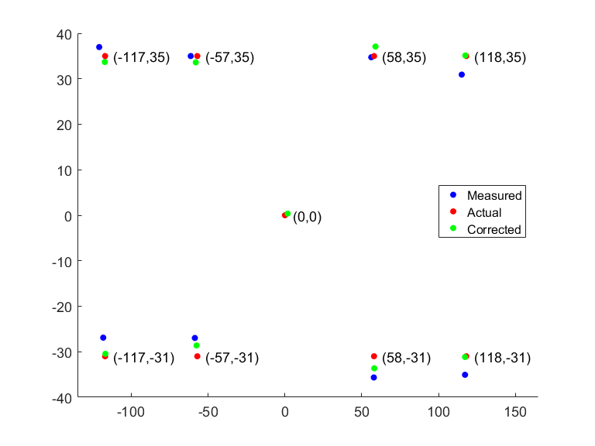
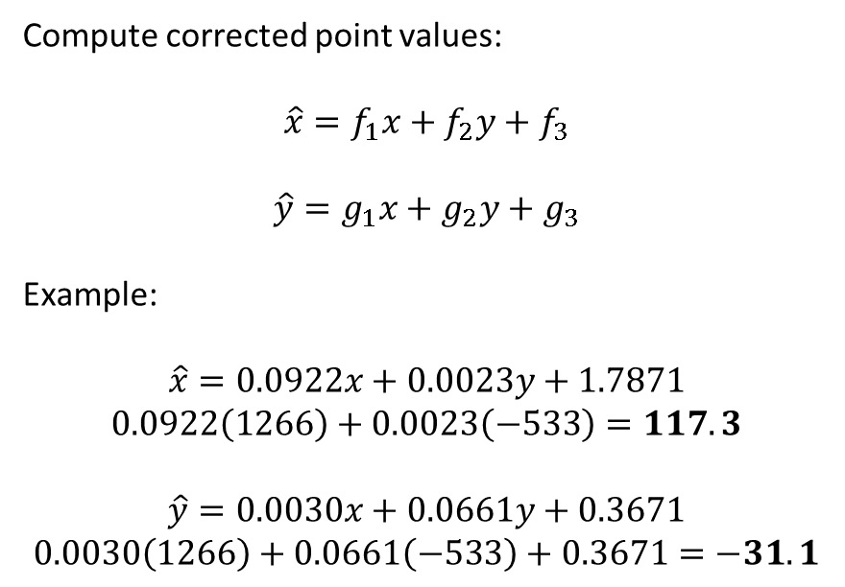
Calibration Transform
For this point, the correction is worse than measured, but overall, the correction is better
Compute corrected point values:
$$\hat{x}=f_{1}x+f_{2}y+f_{3}$$
$$\hat{y}=g_{1}x+g_{2}y+g_{3}$$
Example:
$$\hat{x}=0.0922x+0.0023y+1.7871$$
$$0.0922\left(1266\right)+0.0023\left(−533\right)=117.3$$
$$\hat{y}=0.0030x+0.0661y+0.3671$$
$$0.0030\left(1266\right)+0.0661\left(−533\right)+0.3671=−31.1$$
(1266, -533)
Accuracy seems to be related to how long the voltage is applied before the measurement is taken (capacitance in touch panel)

Slide 8
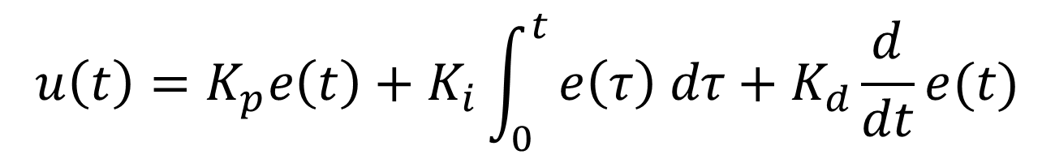
PID Control
Proportional Term
Integral Term
Derivative Term
Proportional
Integral
Derivative
In each dimension (x and y):
Two inputs
Setpoint (desired outcome)
Measured outcome (AKA process variable)
One output
Drives the actuator (servo)
$$u\left(t\right)=K_{p}e\left(t\right)+K_{i}\int_{0}^{t}{e\left(τ\right) dτ+K_{d}\frac{d}{dt}e(t)}$$
error = setpoint – measured value
Error can be positive or negative

Slide 9
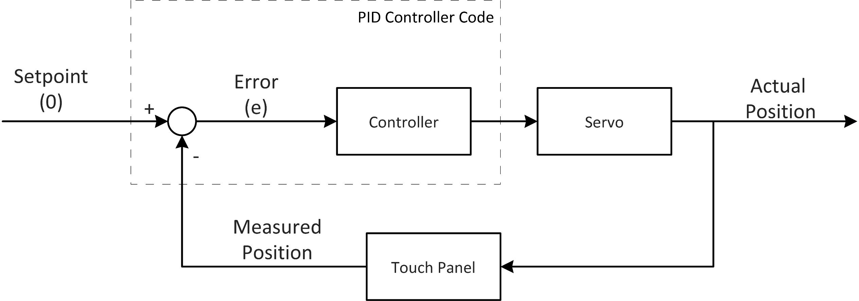
Tilt table control

Slide 10
Proportional Control
Error

Slide 11
Proportional Control
v
Ke
e = Error

Slide 12
Proportional Control
v
Ke
e

Slide 13
Proportional Control
v
Ke = 0
e = 0

Slide 14
Proportional Control
v
Ke (opposite sign)
e (opposite sign)

Slide 15
Proportional Control
Ke
e

Slide 16
Proportional-Derivative (PD) Control
e

Slide 17
PD Control
v
K_{p}e
e

Slide 18
PD Control
v
K_{p}e
Δe
e

Slide 19
PD Control
v
K_{p}e + K_{d}Δe
Δe
e

Slide 20
PD Control
e = 0

Slide 21
Integral Term
Not needed for tilt table or cup car steering, but greatly improves cup car speed control
Based on accumulated error (i.e. the sum of the error -> “integral”)
Eliminates steady-state error, such as when going up or down a hill

Slide 22
Incorporating PID Controller
int Kp = 10, Ki = 0, Kd = 10;
PID *xPID, *yPID;
xPID = InitPIDI();
yPID = InitPIDI();
SetPIDIGain(xPID, Kp, Ki, Kd);
SetPIDIGain(yPID, Kp, Ki, Kd);
SetPIDIGainFactor(xPID, 1, 1, 100);
SetPIDIGainFactor(yPID), 1, 1, 100);
for (;;)
{
…
Px = GetPIDIOutput(xPID, x, dTime);
Py = GetPIDIOutput(yPID, y, dTime);
…
}
Outside of loop:
Call initialization function
Set controller gains
Set controller gain factors (optional)
Inside loop:
Get coordinates from touch panel (x, y values)
Transform to “actual” values
Call PID controller
Update servo with PID output

Slide 23
Getting the Delta Time
Delta time is needed by the PID controller.
Ideally, the delta time is always the same; this make the PID controller more consistent.
However, small variations may occur and it is best to get an accurate delta time.
int time, lastTime = 0;
for(;;)
{
…
time = Ticker[0];
dTime = time – lastTime;
lastTime = time;
…
}

Slide 24
Tuning the PID Controller
Start with small proportional gain (Kp) only
Increase Kp until some oscillation
Slowly increase derivative gain (Kd), oscillation should dampen
Slowly increase Kp and Kd alternately until desired behavior
Usually more of one is needed than the other, e.g. a small increase in Kp may require a larger increase in Kd
Too much of either Kp or Kd will result in instability: oscillation out of control. Too little of either will result in inadequate response.

Slide 25
Questions

Slide 26
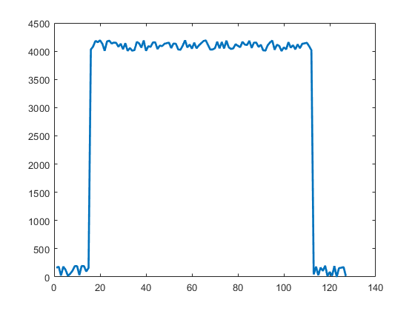
Camera Output
1 row x 128 pixels
Need to identify the edges
Noise reduction would also be helpful!

Slide 27
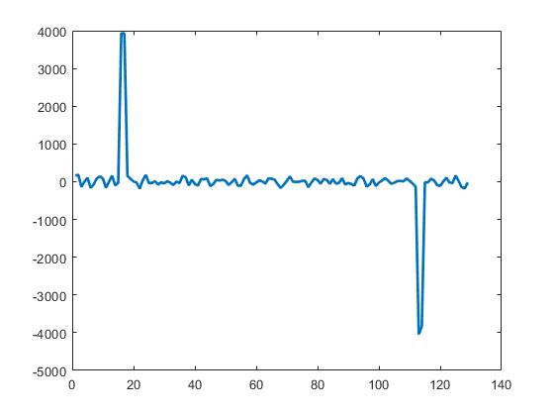
Sobel Operator
Convolve image data with a simple vector: [ 1 2 0 -2 -1 ]
Computes derivative and smooths out noise in one operation

Slide 28
Sobel (cont.)
Sample code
Two for loops to perform the convolution.
Result is truncated to fit same size array as original (int[128]).
// Sobel operator: original image is img[]
// Output is D1[]
int sobel[5] = {1, 2, 0, -2, -1};
int i, j;
int D1[128];
memset(D1, 0, sizeof(D1));
for (i = 2; i < 125; i++)
{
for (j = 0; j < 5; j++)
{
D1[i] += sobel[j] * img[i+j-2];
}
}

Slide 29
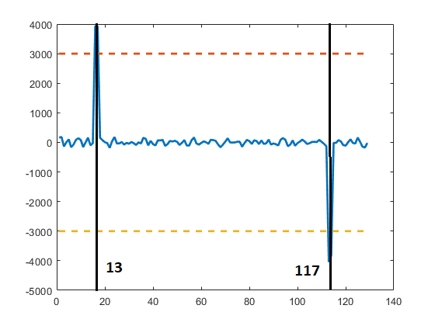
Thresholding
Pick a threshold value. 75% of maximum is a good starting point.
The left side will be the opposite sign of the right side. This is useful to know which line you are working with.
Scan the derivative for a value exceeding the threshold. The indices represent the edge lines.
65

Slide 30
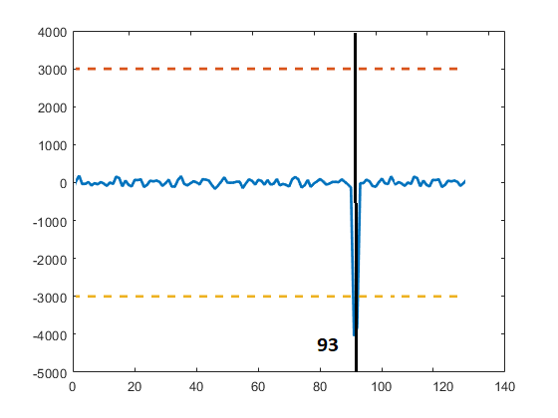
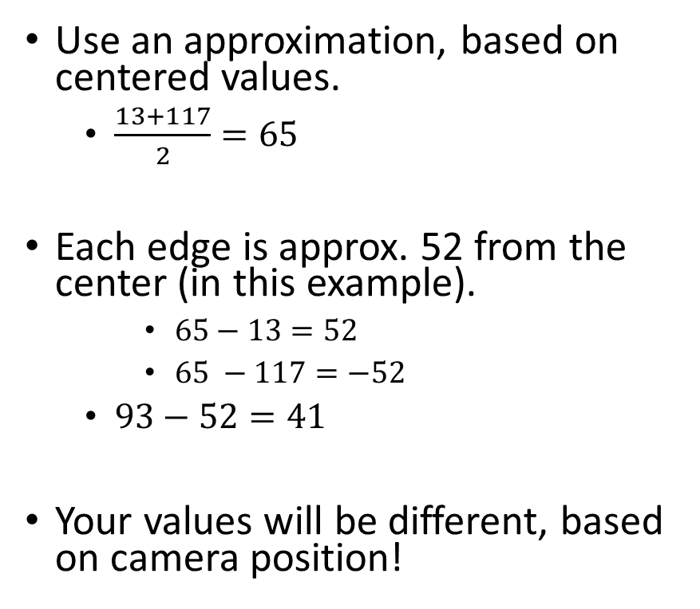
What if only one edge is visible?
Use an approximation, based on centered values.
$\frac{13+117}{2}=65$
Each edge is approx. 52 from the center (in this example).
$65−13=52$
$65 −117=−52$
$93−52=41$
Your values will be different, based on camera position!
41

Slide 31
Steering PID
Use results as input into PD controller, just like with tilt table.
Scale the output to match servo PWM control. You’ll have to experiment with that value.
Tune steering PD control in similar manner to tilt table.
Maintain camera at fixed point ahead of vehicle.
It should not be too far ahead; start with 6-8 inches.
If you are frequently changing the look-ahead distance, you’ll find it very difficult to tune the controller.

Slide 32
Questions?
If you have questions or problems getting the tilt table or cup car working, contact me at: bob@applonie.net

