Slide 1
Docker Part Ⅰ
What is Docker
What can I use Docker for
Docker VS VM
Docker Engine
Demo

Slide 2
What is Docker
Docker is an open platform for developing, shipping, and running applications
Containers are great for continuous integration and continuous delivery (CI/CD) workflows.

Slide 3
What can I use Docker for
Your developers write code locally and share their work with their colleagues using Docker containers.
They use Docker to push their applications into a test environment and execute automated and manual tests.
When developers find bugs, they can fix them in the development environment and redeploy them to the test environment for testing and validation.
When testing is complete, getting the fix to the customer is as simple as pushing the updated image to the production environment.

Slide 4
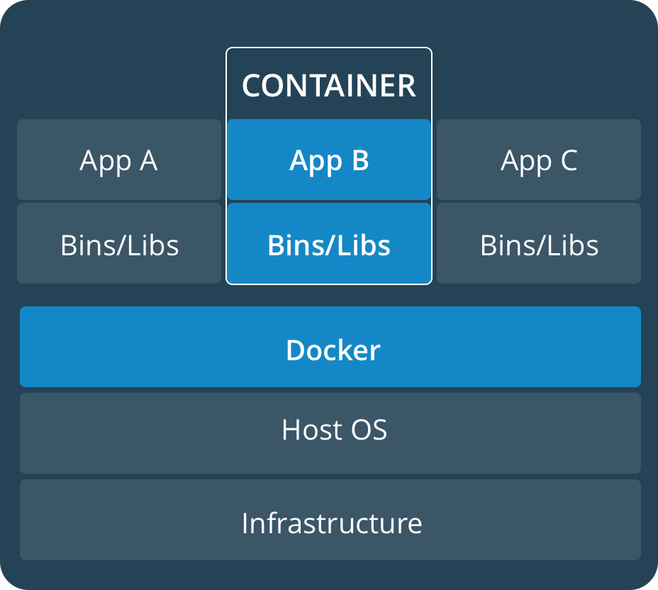
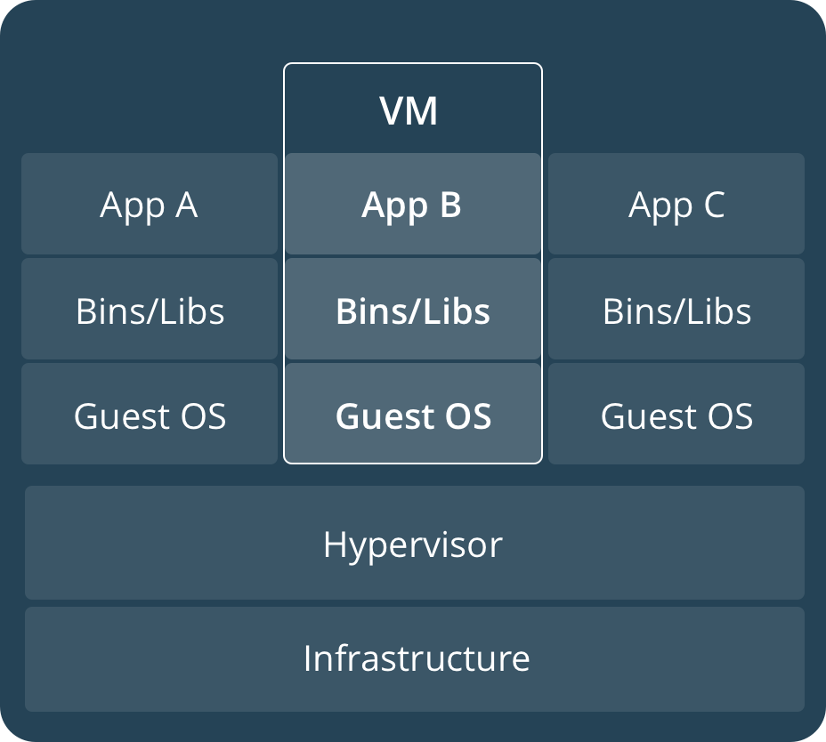
Docker VS VM

Slide 5
Diff: VMs vs Containers
VMs | Containers
Heavyweight | Lightweight
Limited performance | Native performance
Each VM runs in its own OS | All containers share the host OS
Hardware-level virtualization | OS virtualization
Startup time in minutes | Startup time in milliseconds
Allocates required memory | Requires less memory space
Fully isolated and hence more secure | Process-level isolation, possibly less secure

Slide 6
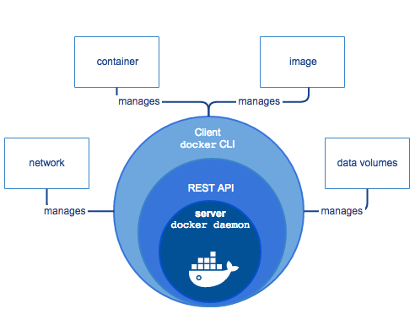
Docker Engine
Docker Engine is a client-server application with these major components:
A server which is a type of long-running program called a daemon process (the dockerd command).
A REST API which specifies interfaces that programs can use to talk to the daemon and instruct it what to do.
A command line interface (CLI) client (the docker command).

Slide 7
Demo
Demo1: Docker Mount
Asp.Net Core with mount(output log from docker container)
Demo2: Network Sharing()
Communicate between containers
Communicate between host and container

