Slide 1


MaMMOGRAM MASS PREDICTION
4ai3 PROJECT
Group: Mingming Zhang; Hua Yao
Notes:
Hello everyone. My name is Mingming Zhang.
It’s an honor for us to give you a brief overview of our project: Mammogram mass prediction.

Slide 2
Analysis – mammogram mass
The statistics of the breast cancer
Effective detection method - mammography
AI algorithms
Notes:
Our project is designed to train benign and malignant based on mammography.
Because, Globally, breast cancer is the most common form of cancer in women, accounting for 25 percent.
Mammography is an effective way to detect breast cancer, but there is some error in distinguishing benign from malignant.
Using machine learning to train and predict would be a reliable method to solve this problem.

Slide 3
AI Algorithms
Decision Tree
KNN
Naive Bayes
HNSW
Random Forest
Logistic Regression
ANN
SVM
Notes:
Therefore, we would use different AI algorithms to interpret this kind of case.
These are the algorithms we prepare to use.
##These algorithms include Decision tree, K nearest neighbor, Hierarchical Navigable Small World, Naïve Bayes, SVM, Logistic Regression and Artificial Neuron Network.
To evaluate which algorithm is the winner under this topic, needs some metrics.

Slide 4
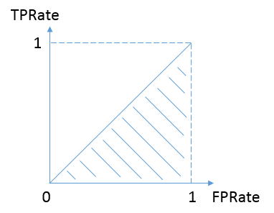
Evaluate algorithms
Metrics:
Classification Accuracy
K-fold Cross Validation
Area Under ROC Curve
Confusion Matrix
 | Benign 0 | Malignant 1
Prediction 0 | True Negative | False Negative (Type II)
Prediction 1 | False Positive (Type I) | True Positive
Notes:
Among these algorithms, we will use K-fold cross-validation metric to compare the accuracy.
Other than that, we utilize the ROC related to confusion matrix to evaluate classifier output quality by using the Area Under Curve, which is larger is better.
For each algorithm model, it separate the dataset into many groups, train and test each group to get the accuracy, then average them to get the mean accuracy, which is higher is better.
Divide the dataset into K equal parts on average;
Use 1 piece of data as test data, and the rest as training data
Calculate test set accuracy
Utilize different test sets, repeat the previous steps
Average test set accuracy as an estimate of the accuracy of predictions of unknown data.
Other than that, we utilize the receiving operating characteristic related to confusion matrix to evaluate classifier output quality by using the area under the curve, as known as AUC, which is larger is better.
true positive rate = TP/(TP+FN): it's the train class 1 with prediction probability as 1
false positive rate = FP/(FP+TN)： it's the train class 0 with prediction probability as 1
Other metrics are Logarithmic Loss, Classfication Report

Slide 5
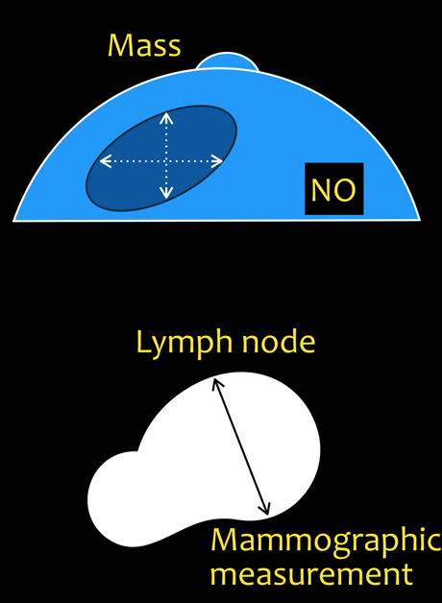
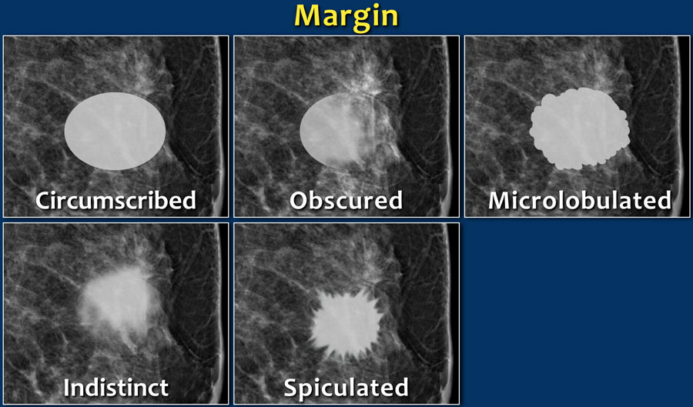
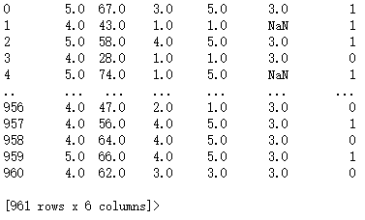
Uci DATASET
Notes:
Regarding the dataset that we used is retrieved from UCI machine learning repository.
#before we train the model, we have to distinguish the available input features and output. Also, clean up the data is necessary as well.
#From the capture of the data, we can see some values are missing.
#We used two different methods to deal with the integrity of the dataset, one is filling the mean value to keep the maximum of the data size, the other way is dropping the missing rows to keep the data’s accuracy.

Slide 6

Load dataset
Validate the Value
Convert to Numpy Arrays
Normalization
Fill & Drop the Missing Data
Notes:
To deal with the data, we have to validate the value first.
Then, we have to normalize the data to avoid certain features with a huge scale outweighing other features with tiny scales.
Once data is ready, we can put them into the models.
Next, I’ll pass to Hua to talk about the different algorithms we used in the project.

Slide 7
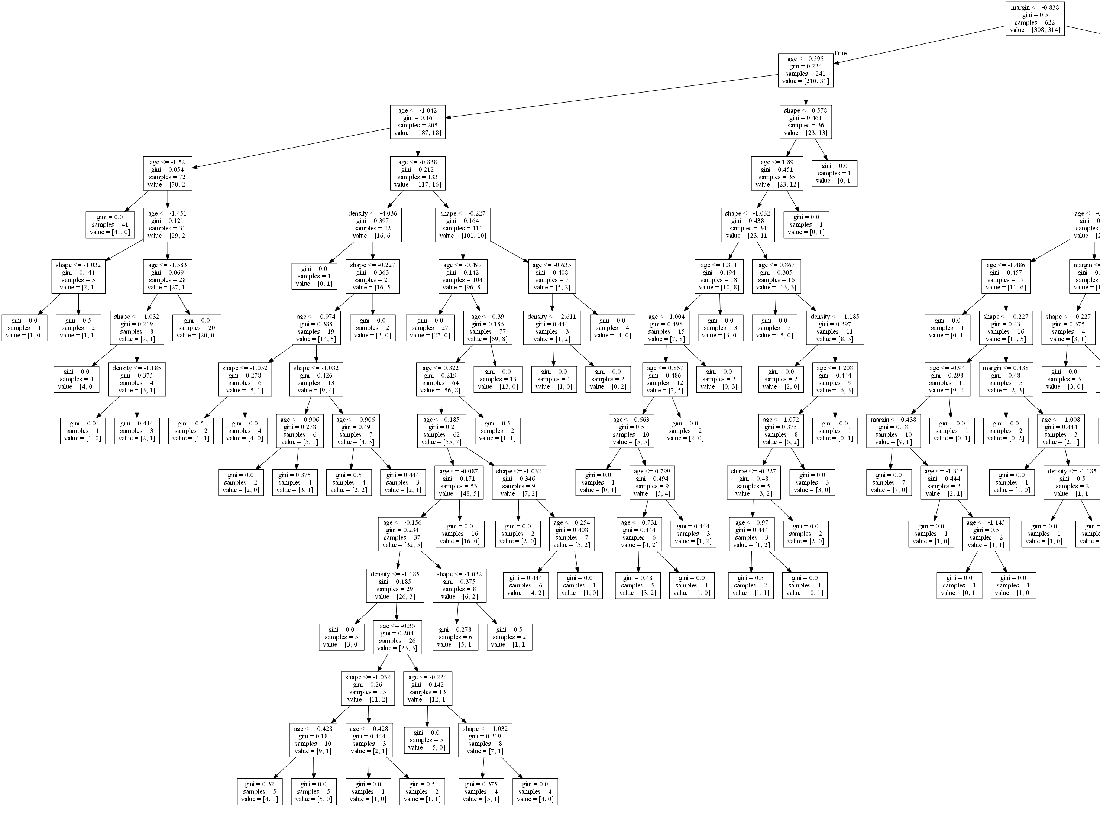
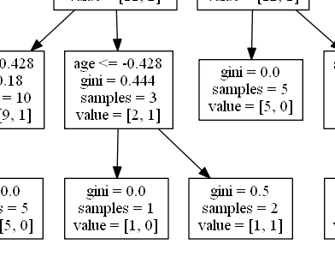
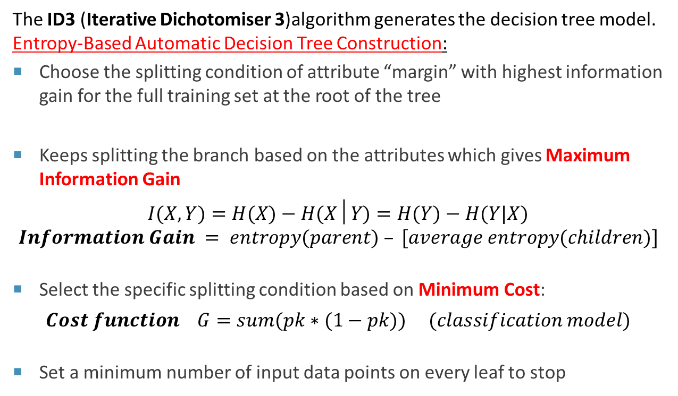
Decision tree
The ID3 (Iterative Dichotomiser 3)algorithm generates the decision tree model.
Entropy-Based Automatic Decision Tree Construction:
Choose the splitting condition of attribute “margin” with highest information gain for the full training set at the root of the tree
Keeps splitting the branch based on the attributes which gives Maximum Information Gain
$$I(X,Y)=H(X)−H(X│Y)=H(Y)−H(Y|X)$$
$$Information Gain = entropy(parent) – [average entropy(children)]$$
Select the specific splitting condition based on Minimum Cost:
$$Cost function G=sum(pk∗(1−pk)) (classification model)$$
Set a minimum number of input data points on every leaf to stop
Notes:
Decision tree model is established on the Iterative Dichotomiser algorithm, which employs a top-down, greedy search through the space of possible branches with no backtracking.
This process is called an Entropy-Based Automatic Decision Tree Construction.
We first start the root node using the attribute which gives us a highest information gain value.
Similarly, we keep splitting the node to sub-branches. In this process, the maximum information gain value gives us the attribute and the minimum cost function values gives us the splitting point value.
Finally, we set a minimum number of data points on the leaf node to stop growing the tree.

Slide 8
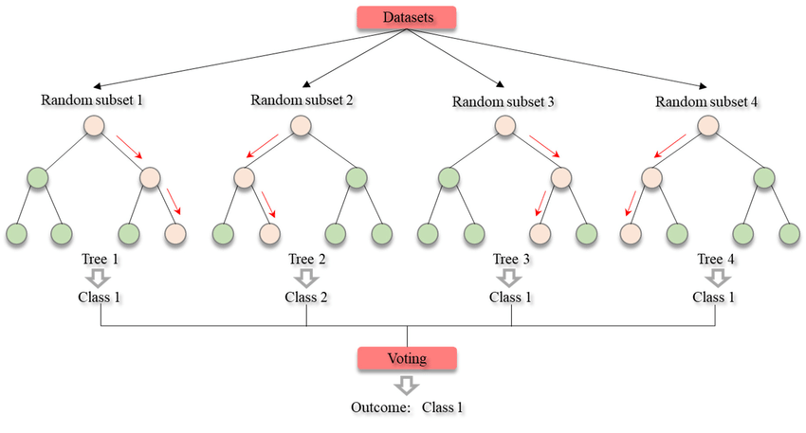
Random forest
A Random Forest Tree consists of many random trees with two types of random ness. First, each trees is built on random sample of original data. Second, each tree node uses a random selected feature to generate best split.
In a classification problem, each tree predict a classification of a test record. The final classification of the test record would be the classification wins the majority vote across the trees sets.
Notes:
A Random Forest Tree consists of many random decision trees with two types of random ness. Using individual models to induce the final prediction is called Ensemble Learning.
There are two types of ensemble methods. One is called bagging, which means training individual models in a parallel way using random selected data. Random Forest is this type.
Another type called boosting. This type trains the individual models in a sequential way. The next module learns the error made by the previous model.

Slide 9
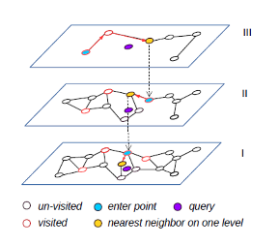
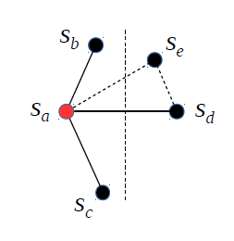
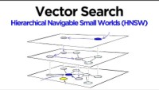
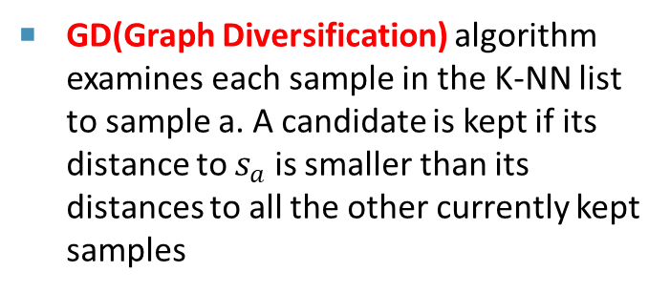
HNSW(Hierarchical Navigable Small World)
Built on the KNN(k-nearest neighbor) graphs but organizes the links between vertices into a hierarchy
The NN search starts from the top layer. The found nearest neighbor from the current layer will be used as the entry point for the NN search on the next layer until the bottom layer.
On the bottom layer, a standard NN-Descent search is adopted for updating a top-k nearest neighbors list.
GD(Graph Diversification) algorithm examines each sample in the K-NN list to sample a. A candidate is kept if its distance to $s_{a}$ is smaller than its distances to all the other currently kept samples
Notes:
Hierarchical navigable small world algorithm is a top performance among the NN search algorithms, different from classic KNN search, this algorithm using a multi-layer graph.
First, data points is inserted to the layer based on an exponentially decaying probability distribution. The layer 0 has the most data points while the layer 2 has e^2 lower numbers.
The search starts from the top to the bottom. And between layers, the previous nearest point will be passed to the next layer as the entry point.
At the bottom layer, a standard NN-Descent search is implemented for the final top-k nearest neighbours list.

Slide 10
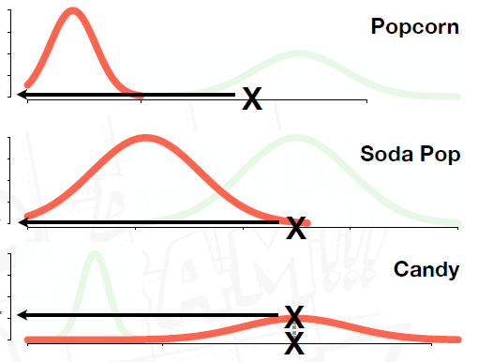
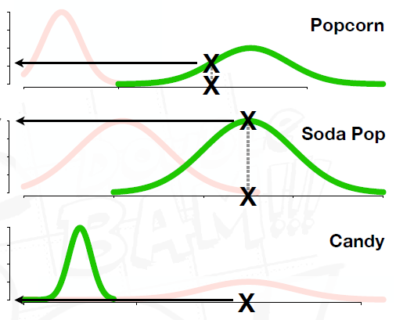
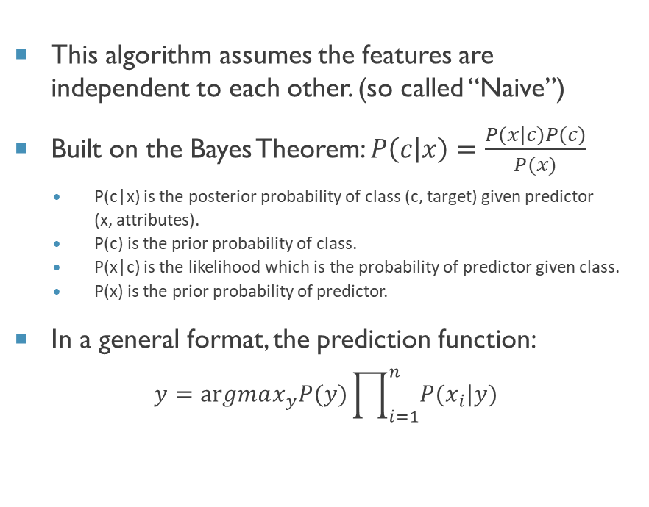
Naïve bayes
Classify someone who eat 20 grams of popcorn, 500ml pop and eat 25 gram of candy each day likes movie Troll 2 or not?
This algorithm assumes the features are independent to each other. (so called “Naive”)
Built on the Bayes Theorem: $P\left(c | x\right)=\frac{P(x|c)P(c)}{P(x)}$
P(c|x) is the posterior probability of class (c, target) given predictor (x, attributes).
P(c) is the prior probability of class.
P(x|c) is the likelihood which is the probability of predictor given class.
P(x) is the prior probability of predictor.
In a general format, the prediction function:
$$y=argmax_{y}P(y)\prod_{i=1}^{n}{P(x_{i}|y)}$$
p( No Love )
x L( popcorn = 20 | No Love )
x L( soda pop = 500 | No Love )
x L( candy = 25 | No Love )
log(p( No Love ))
+ log(L( popcorn = 20 | No Love))
+ log(L( soda pop = 500 | No Love))
+ log(L( candy = 25 | No Love))
log(Not Love Troll 2 Score) = -48
p( Loves Troll 2 )
x L( popcorn = 20 | Loves )
x L( soda pop = 500 | Loves )
x L( candy = 25 | Loves )
log(p(Loves Troll 2 ))
+ log(L( popcorn = 20 | Loves ))
+ log(L( soda pop = 500 | Loves ))
+ log(L( candy = 25 | Loves ))
log(Loves Troll 2 Score) = -124
Does Not Love Troll 2 !
Notes:
This algorithm is based on the Bayes Theorem assuming all the features are independent. So called Naïve.
In this example, to predict if a person loves the movie Troll 2 or not, we calculate his probability of being love or not love movie people.
On the group of love people’s features distributions, we calculated this person’s probability on each feature and get the final total probability.
Similarly, we obtained this person’s total not love probability using the features’ distributions of not love people.
Finally, the highest value of probability gives us the classification result.

Slide 11
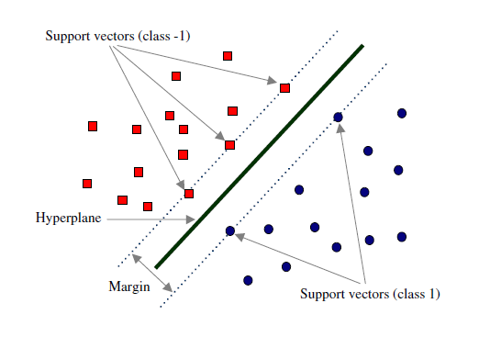
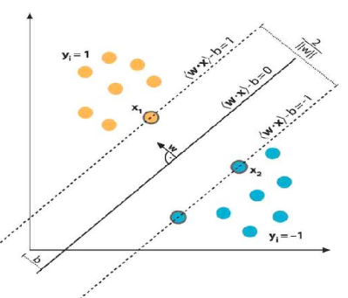
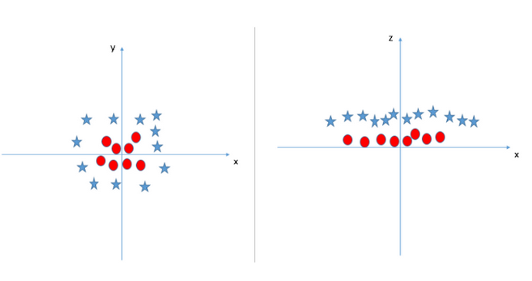
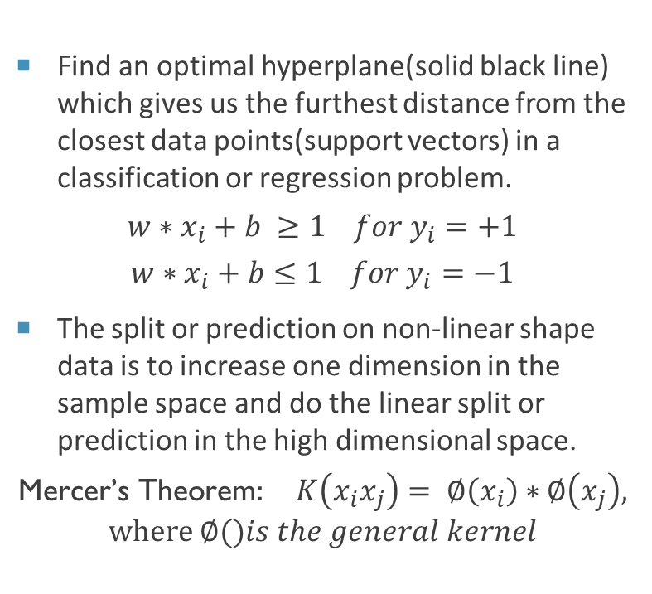
Svm(Support Vector Machine)
Find an optimal hyperplane(solid black line) which gives us the furthest distance from the closest data points(support vectors) in a classification or regression problem.
$$w∗x_{i}+b ≥1 for y_{i}=+1$$
$$w∗x_{i}+b≤1 for y_{i}=−1$$
The split or prediction on non-linear shape data is to increase one dimension in the sample space and do the linear split or prediction in the high dimensional space.
$$\text{Mercer}\text{’}\text{s} \text{Theorem}: K\left(x_{i}x_{j}\right)= ∅\left(x_{i}\right)∗∅\left(x_{j}\right), where ∅()is the general kernel$$
Notes:
Support Vector Machine is about to find an optimal Hyper-Plane among the data points for classification or prediction.
The optimal Hyper-Plane is defined as the one give us the maximum margin.
We solve this optimization problem using primal gradient based optimization method and dual quadratic programming based method. First method is more familiar to us and more popular. We convert a constrained optimization to unconstrained then use the gradient decent to update the parameters of classifier.
And for non-linear data, the theoretical foundation of the solution is Mercer’s Theorem. It is solved same as find the optimal value of w and b.
Now I passed to Mingming for a few other algorithms and the conclusion.

Slide 12

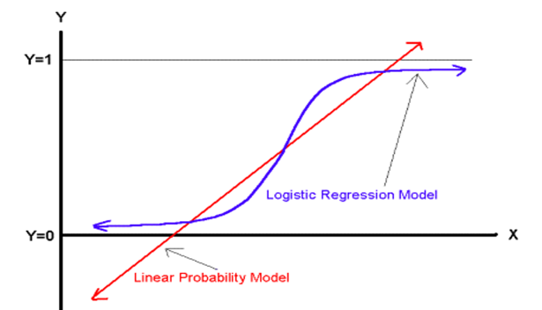


Logistic regression
Notes:
Thank you, Hua.
Because logistic regression is a binary classifier, it’s suitable for this case.
In terms of this algorithm, firstly, utilize the sigmoid function to get a value from 0 to 1.
Then, we put the sigmoid result to log-odds equation to get the probability. ##It’s also well known as hypothesis function.
We can get the result either 1 or 0 based on the probability with the default threshold of 0.5.
##It’s also known as a generalized linear regression mode, is essentially the same as a linear regression model.
##The difference lies in their dependent variables.
Compare with the accuracy, the dataset either with mean or drop is 0.8. The standard deviation is different.
ROC has the same expression as 78%. This model is consistent.

Slide 13
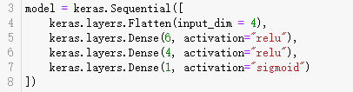
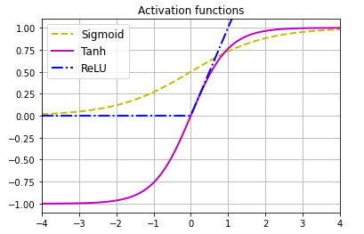
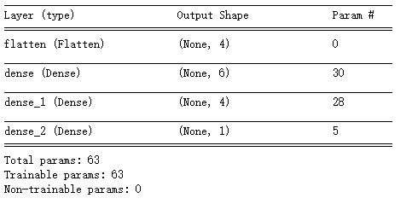
Artificial neural network
Notes:
The last one is the Multiple layer Perceptron as an algorithm usually for binary classifier. It belongs to artificial neural network , enables neurons to learn and processes elements in the training set.
Under this case, we created 2 hidden layers with RELU (Recitfied Linear Unit) activation function. The blue one is it.
The output layer uses sigmoid function due to the binary classifier case.
##The accuracy is also closed around 0.78.
##From the ROC, the dropped dataset is better than the meaned dataset.

Slide 14
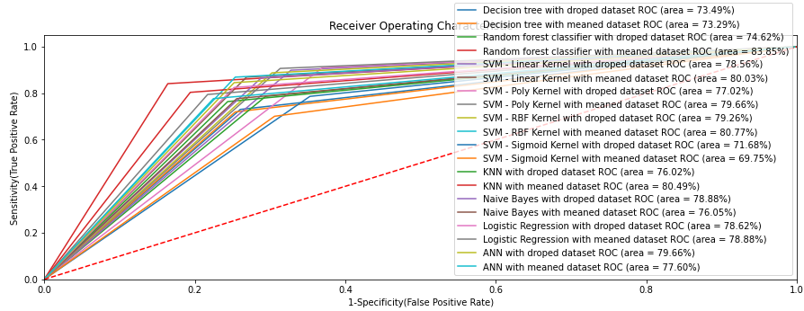
Compare to get the best result – Random forest
Notes:
The last, we plot every ROC under one graph to compare the final result.
The largest area among this graph is the random forest classifier. So, it’s the champion in this match.
That’s our project. Thank you for watching it.
##The reason why we use ROC to evaluate the appropriate machine learning model is that successfully avoid the problem of uneven samples.
##Moreover, ROC labels the probability of true and false classes, which is better than just cross-validate the accuracy results.
#In conclusion, in most scenarios, the dropped dataset is less than the meaned dataset. The reason supposes to be the size of the data.
##Moreover, in machine learning, algorithm which reaches 70% accuracy is a recognized model.
##All of those algorithm are satisfy this standard.

Slide 15

Thank You
someone@example.com

