Slide 1
Data warehouse concepts
Notes:
Tools at hand: DB, SQL, PL/SQL etc. => Information systems

Slide 2
Objectives
Operational vs Analytical systems
Data Warehouse definition
Contrast with traditional Databases
ETL (Extract, Transform and Load) Process
Dimensional Design + Example
Star Schema
Snowflake Schema
Dimensions tables + SCD
Fact Tables
Querying star schemas

Slide 3
Operational vs. Analytical Systems
Supports execution of business processes
Not interested in history, but to ensure daily operations
Focus on individual, atomic transactions and usually one process
Insert, Update, Delete, Select
Supports analysis of business processes
Interested in history, trends, predictions
Focus on the “big picture”, consolidates many processes in a single format
Select
Notes:
Key words : Execution vs. Analysis
Examples
Zoom into Analytical systems: how ? Through Dimensional Design

Slide 4
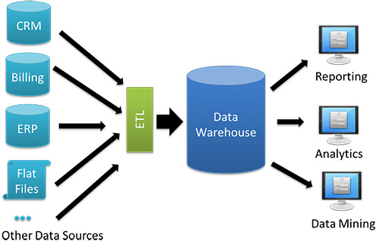
Data Warehouse
Data Warehouse definition:
subject-oriented
integrated
timevarying
non-volatile
collection of data
support management's decision-making process
used for reporting and data analysis
uploaded from the operational systems (such as marketing, sales, etc.)

Slide 5
Contrast with traditional Databases
Traditional databases are designed for transactional workloads
Data warehouses run on top of traditional databases in order to separate long-term analytic processing from rapid transactional processing
Data warehouse is a conceptual approach to solving the problem of running complex operations on the same databases that are used for transactional or other operations that require low time-to-answer rates

Slide 6
Contrast with traditional Databases
 | Traditional Databases OLTP System Online Transaction Processing (Operational System) | OLAP System Online Analytical Processing (Data Warehouse)
Source of data | Operational data; OLTPs are the original source of the data. | Consolidation data; OLAP data comes from the various OLTP Databases
Purpose of data | To control and run fundamental business tasks | To help with planning, problem solving, and decision support
About data | Reveals a snapshot of ongoing business processes | Multi-dimensional views of various kinds of business activities
Queries | Relatively standardized and simple queries Returning relatively few records | Often complex queries involving aggregations
Processing Speed | Typically very fast | Depends on the amount of data involved; batch data refreshes and complex queries may take many hours; query speed can be improved by creating indexes
Space Requirements | Can be relatively small if historical data is archived | Larger due to the existence of aggregation structures and history data; requires more indexes than OLTP
Database Design | Highly normalized with many tables | Typically de-normalized with fewer tables; use of star and/or snowflake schemas

Slide 7
ETL (Extract, Transform and Load) Process
E extracting the data from source systems
T transforming the data:
applying business rules (so-called derivations, e.g., calculating new measures and dimensions),
cleaning (e.g., mapping NULL to 0)
filtering (e.g., selecting only certain columns to load),
splitting a column into multiple columns and vice versa,
joining together data from multiple sources (e.g., lookup, merge),
transposing rows and columns
L loading the data into a data warehouse
Tools:
Mediation Zone, Oracle PL-SQL,
SSIS,
TALEND

Slide 8
Dimensional design
Every modern data warehouse / data mart architecture relies on dimensional design
It makes use of a very simple approach, but enables very powerful analytics :
One process measured in a specific context
Notes:
Think of examples of questions an Analytical System should answer
Generalize and formalize: one business process measured in a specific context

Slide 9
Example

Slide 10
Example

Slide 11
Example
Sales by Region and by Product
 | iPhone | iPad | iPod | Mac | Soft | Total
USA | 5 | 4 | 4 | 1 | 1 | 15
Asia | 1 | 2 | 0.5 | 0.5 | 0.5 | 4.5
Europe | 3 | 1 | 1 | 0.5 | 1 | 6.5
Rest of the world | 1 | 1 | 0.5 | 1 | 0.5 | 4
Total | 10 | 8 | 6 | 3 | 3 | 30

Slide 12
Facts & Dimensions
Measurements = FACTS
Context = DIMENSIONS
Notes:
Think of some examples

Slide 13
Exercise
Create two dimension tables
Create a fact table
Create corresponding Foreign Keys

Slide 14
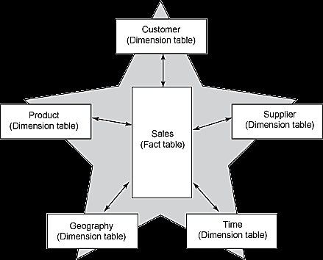
Star Schema
Fact tables - central tables in star schema.
quantitative information, referred to as "facts“
denormalized - faster queries and analysis
Dimension tables
context to fact
store, categorize, and describe facts in ways that enable useful answers to business questions
typically house a small number of records, with each record containing a large number of attributes related to fact data.

Slide 15
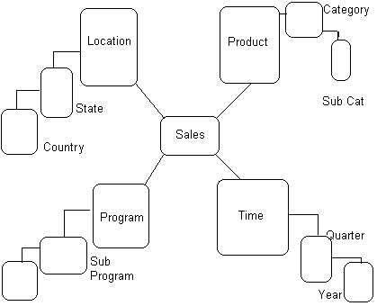
Snowflake Schema
Notes:
Usually should be avoided, by transforming into a Star Schema

Slide 16
Dimension Tables
Natural keys
Surrogate keys - mapped to the combination of dimension attributes that form the natural key
Smaller number of records
Slow changing dimensions (SCD 1, 2, 3)
Rich set of dimension attributes

Slide 17
Slowly Changing Dimensions (SCD)
dimensions change slowly over time
Example of such dimensions could be: customer, account, product
Type 0: retain original
Type 1: overwrite
Type 2: add new row
Type 3: add new attribute
Type 4: add history table
Type 6: hybrid

Slide 18
Fact Tables
Record measurements or metrics for a specific event
Consist of numeric values, and foreign keys to dimensional data
Grain - facts can record events at a very atomic level.
Three types of fact tables:
Transaction fact tables record facts about a specific event (e.g., sales events)
Snapshot fact tables record facts at a given point in time (e.g., account details at month end)
Accumulating snapshot tables record aggregate facts at a given point in time (e.g., total month-to-date sales for a product)

Slide 19
Querying Star Schemas
SELECT f.dim_id1, f.dim_id2, ..,
AGGREGATE_FUNCTION (f.fact_number)
FROM DIM_1 d1, DIM_2 d2, ..,
FACT_TBL f
WHERE f.dim_id1 = d1.dim_id1 and f.dim_id2 = d2.dim_id2 --join
and d1.natural_key = ValX -- filter
and d2.natural_key = ValY -- filter
GROUP BY f.dim_id1, f.dim_id2, .. -- roll up
ORDER BY f.dim_id1, f.dim_id2, … -- sort

Slide 20
Thank you

