Slide 1

EN.525.726 – Applications of Power Electronics Design
Project Milestone 6
Hoang Nguyen
05/05/24

Slide 2
Main Requirements
Topology: Flyback Converter
Vin: 12V
Vout: 5V
Load Current Range: 0-5A
Output Ripple: +/- 0.1V (steady-state), +/- 0.2V during load step from 3A to 5A and 5A to 3A
Efficiency: >75% at full-load
PCB: 2 layers
PCB dimension: < 10 in^2

Slide 3
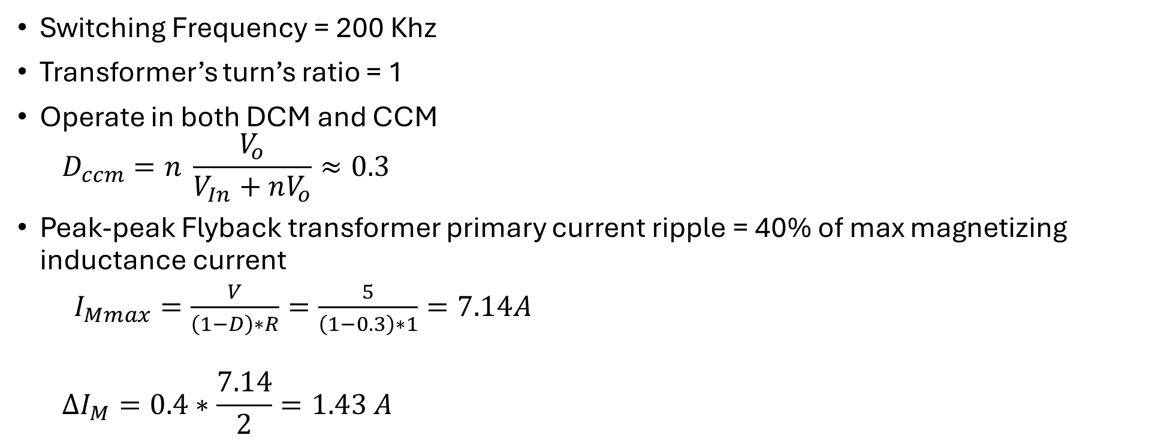
Power Stage Design (1)
Switching Frequency = 200 Khz
Transformer’s turn’s ratio = 1
Operate in both DCM and CCM
  $$D_{ccm}=n \frac{V_{o}}{V_{In}+nV_{o}}≈0.3$$
Peak-peak Flyback transformer primary current ripple = 40% of max magnetizing inductance current
  $I_{Mmax}=\frac{V}{\left(1−D\right)∗R}=\frac{5}{\left(1−0.3\right)∗1}=7.14A$
  $$∆I_{M}=0.4∗\frac{7.14}{2}=1.43 A$$

Slide 4
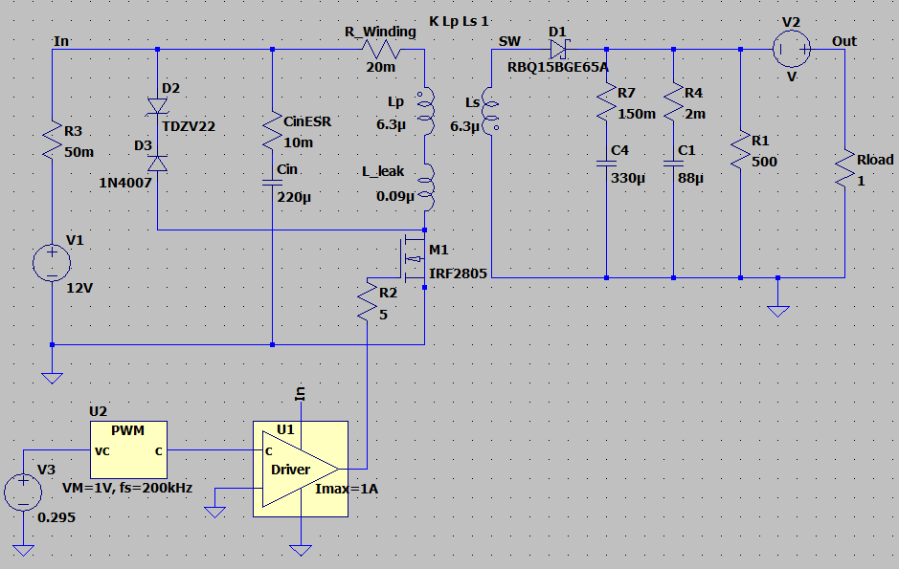
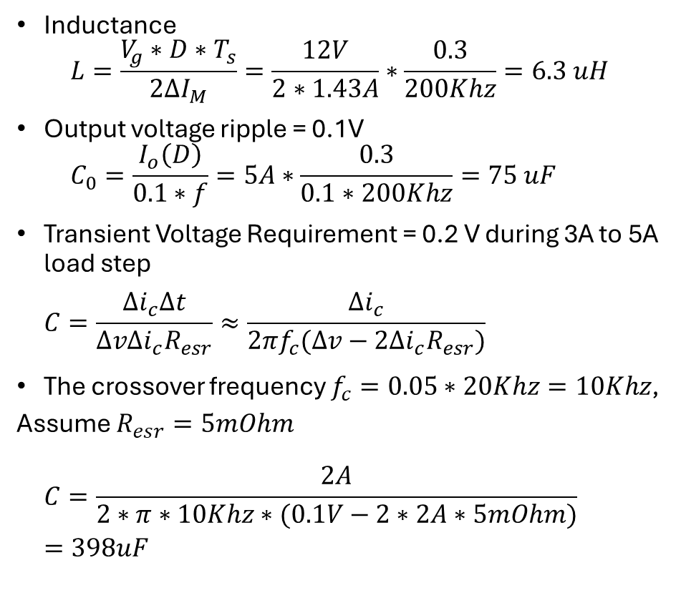
Power Stage Design (2)
Inductance
  $$L=\frac{V_{g}∗D∗T_{s}}{2∆I_{M}}=\frac{12V}{2∗1.43A}∗\frac{0.3}{200Khz}=6.3 uH$$
Output voltage ripple = 0.1V
  $$C_{0}=\frac{I_{o}\left(D\right)}{0.1∗f}=5A∗\frac{0.3}{0.1∗200Khz}=75 uF$$
Transient Voltage Requirement = 0.2 V during 3A to 5A load step
  $$C=\frac{∆i_{c}∆t}{∆v∆i_{c}R_{esr}}≈\frac{∆i_{c}}{2πf_{c}(∆v−2∆i_{c}R_{esr})}$$
The crossover frequency $f_{c}=0.05∗20Khz=10Khz$, Assume $R_{esr}=5mOhm$
  $$C=\frac{2A}{2∗π∗10Khz∗(0.1V−2∗2A∗5mOhm)}=398uF$$

Slide 5
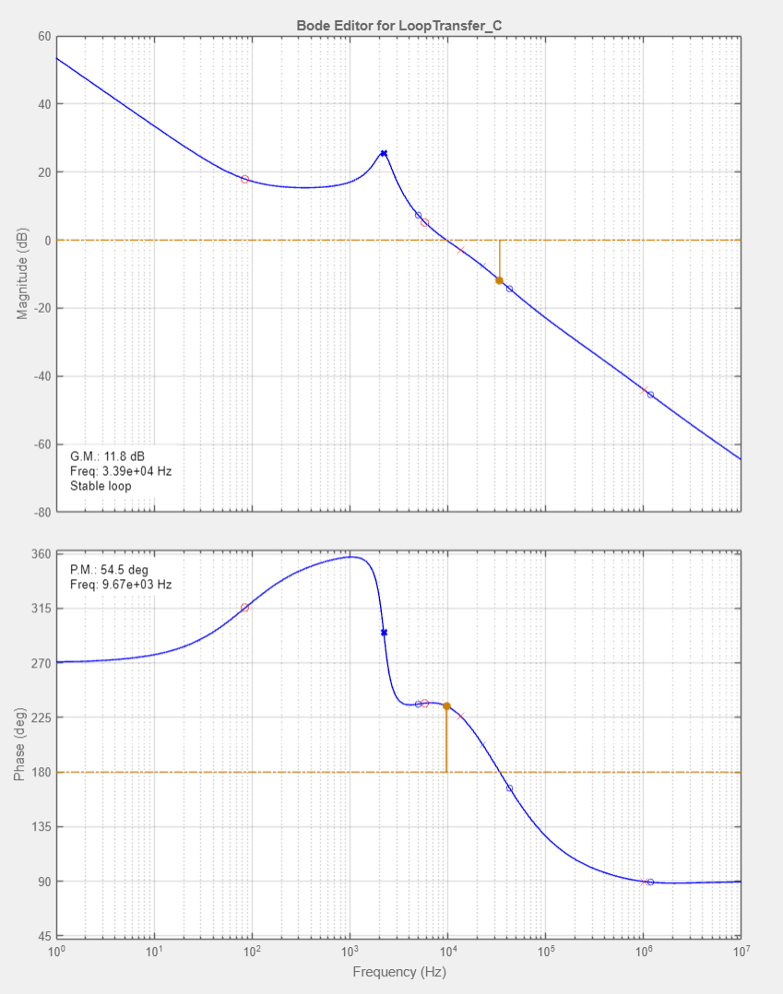
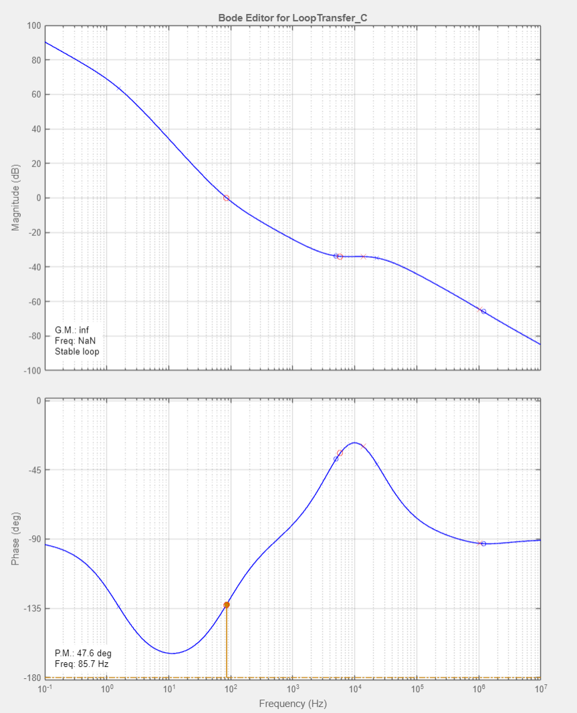
Controller Design (1) – Type III compensator
CCM_full load
DCM_ no load

Slide 6
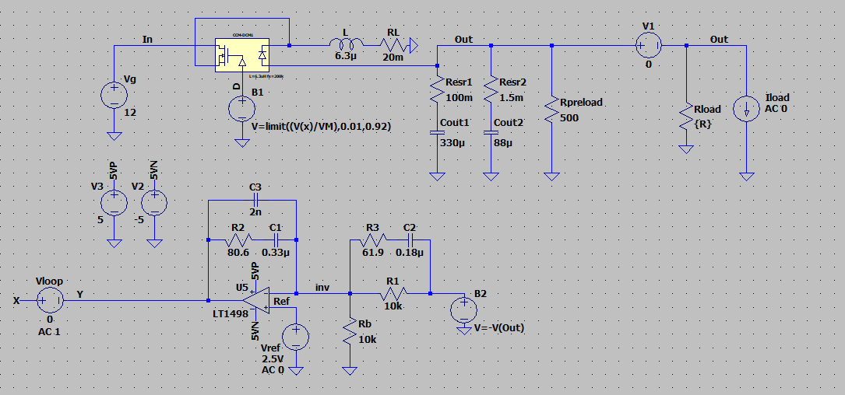
Controller Design (2)

Slide 7
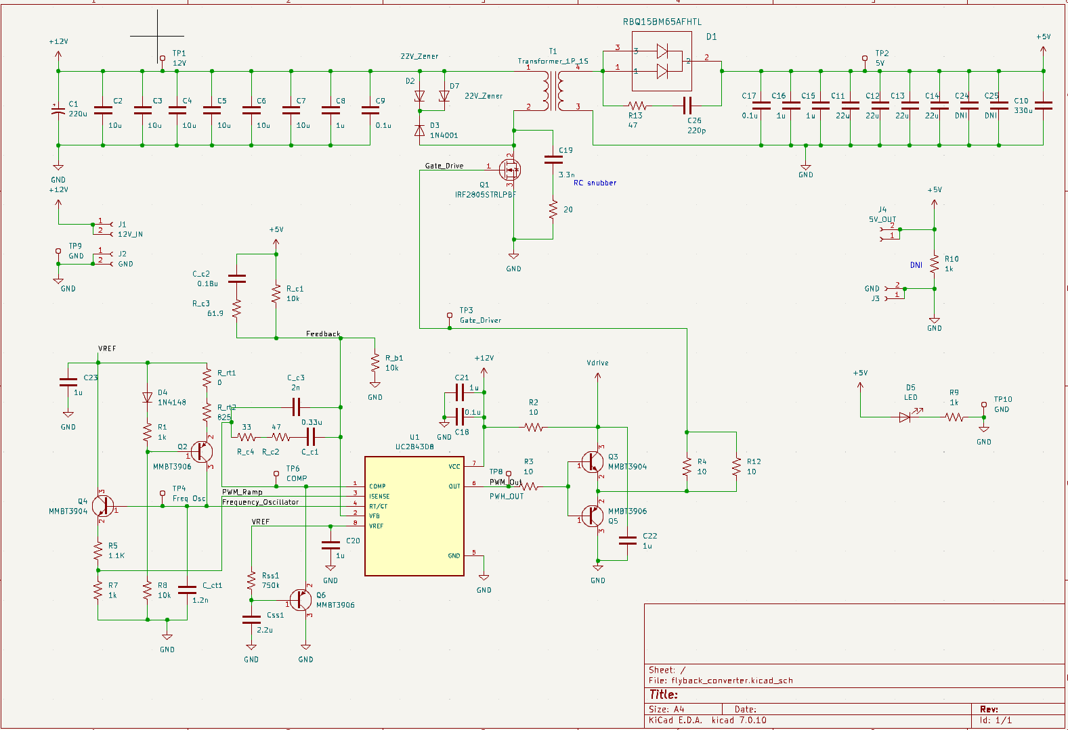
Schematic
Power Stage
Controller

Slide 8
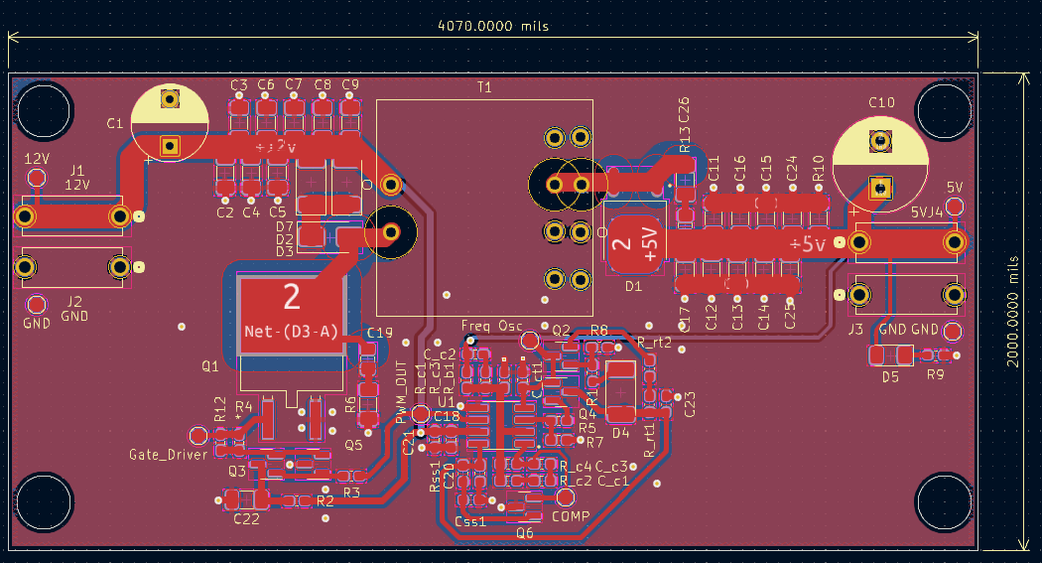
PCB Layout

Slide 9
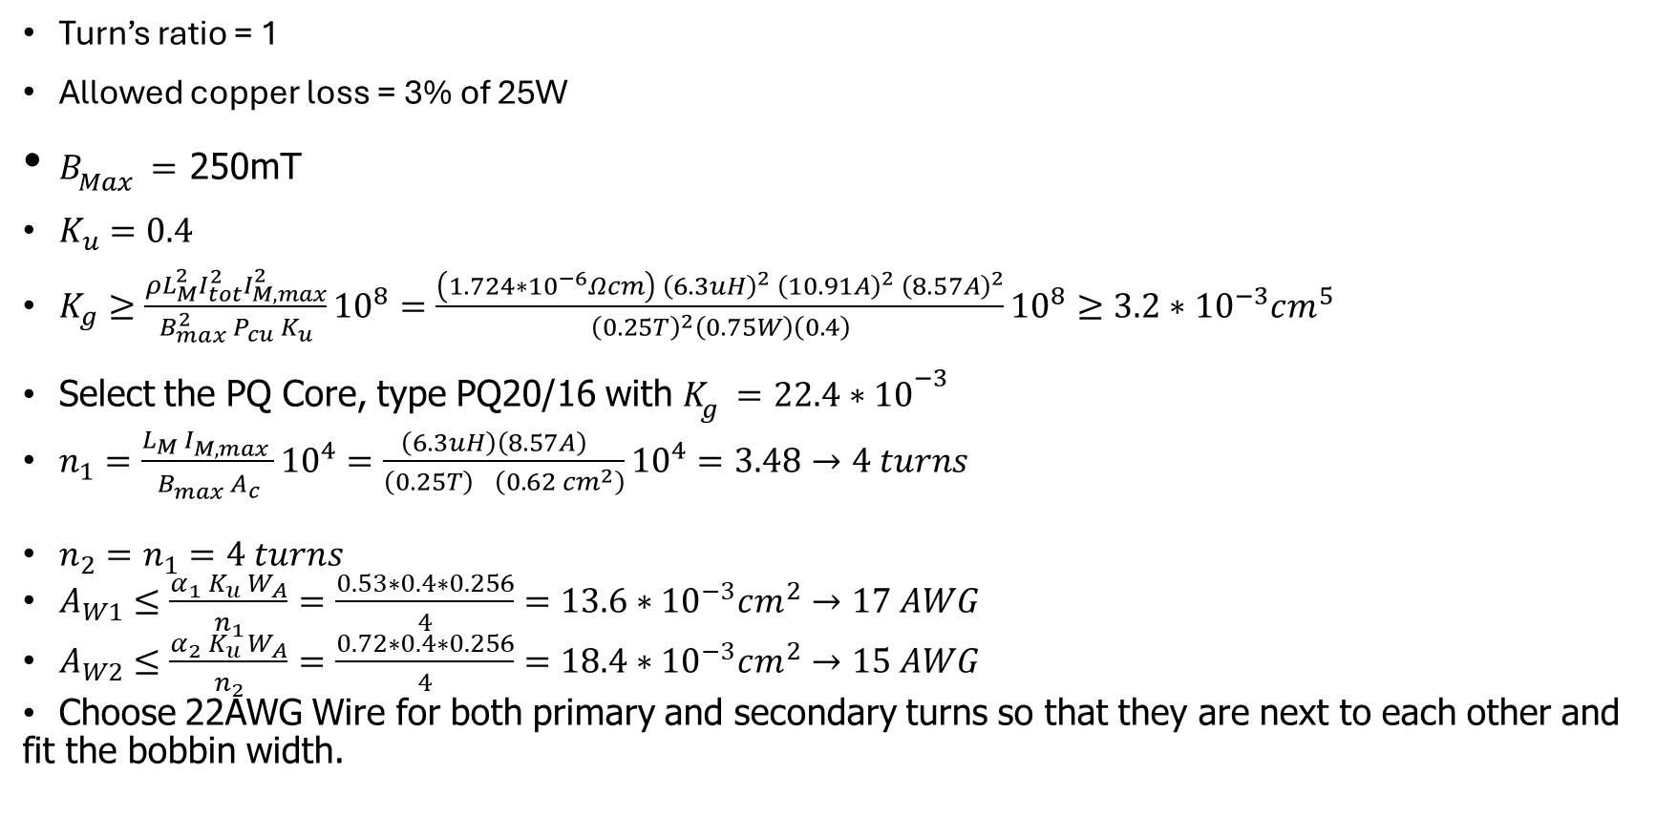
Transformer Design (1)
Turn’s ratio = 1
Allowed copper loss = 3% of 25W
$B_{Max}=$ 250mT
$K_{u}=0.4$
$K_{g}≥\frac{ρL_{M}^{2}I_{tot}^{2}I_{M,max}^{2}}{B_{max}^{2} P_{cu} K_{u}}{10}^{8}=\frac{\left(1.724∗{10}^{−6}Ωcm\right) {\left(6.3uH\right)}^{2} {\left(10.91A\right)}^{2} {\left(8.57A\right)}^{2}}{{\left(0.25T\right)}^{2}\left(0.75W\right)\left(0.4\right)}{10}^{8}≥3.2∗{10}^{−3}cm^{5}$
Select the PQ Core, type PQ20/16 with $K_{g}=22.4{∗10}^{−3}$
$n_{1}=\frac{L_{M} I_{M,max}^{} }{B_{max}^{} A_{c}}{10}^{4}=\frac{\left(6.3uH\right){\left(8.57A\right)}^{}}{{\left(0.25T\right)}^{}\left(0.62 cm^{2}\right)}{10}^{4}=3.48→4 turns$
$n_{2}=n_{1}=4 turns$
$A_{W1}≤\frac{α_{1} K_{u} W_{A}}{n_{1}}=\frac{0.53∗0.4∗0.256}{4}=13.6∗{10}^{−3}cm^{2}→17 AWG$
$A_{W2}≤\frac{α_{2} K_{u} W_{A}}{n_{2}}=\frac{0.72∗0.4∗0.256}{4}=18.4∗{10}^{−3}cm^{2}→15 AWG$
Choose 22AWG Wire for both primary and secondary turns so that they are next to each other and fit the bobbin width.

Slide 10
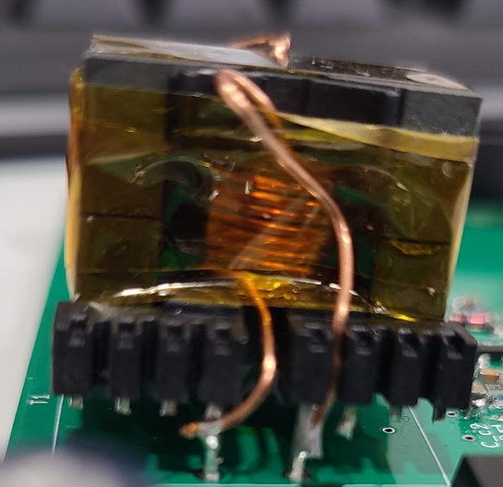
Transformer Design (2)
Primary winding:
  clockwise for 4 turns
  Start from bottom end at the top of bobbin
Secondary winding:
  Start from the other window
  clockwise so that the 1st turn of the secondary copper is next to the 1st turn of the primary copper and so on
  Start from bottom end at the top of bobbin
Add 1 layer of Kapton tape at the center of the core then measure the inductance
Repeat until the measured inductance matched with desired value.

Slide 11
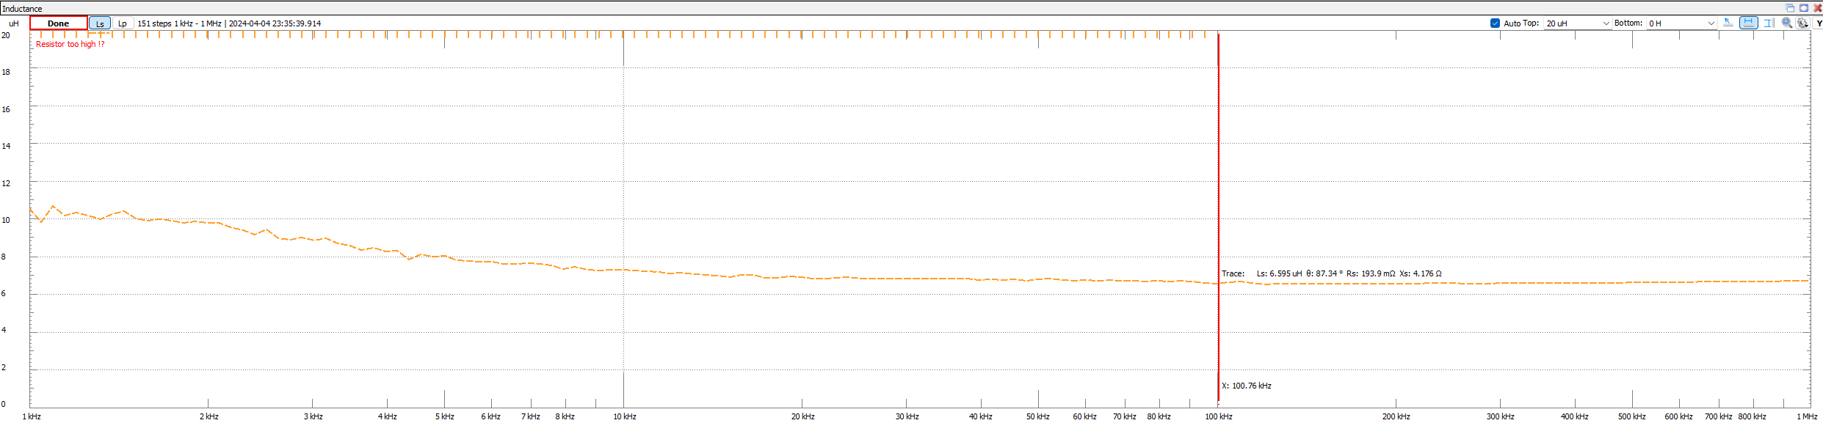
Transformer Design (3)
Measured inductance: 6.6uH
Desired Inductance: 6.3uH

Slide 12
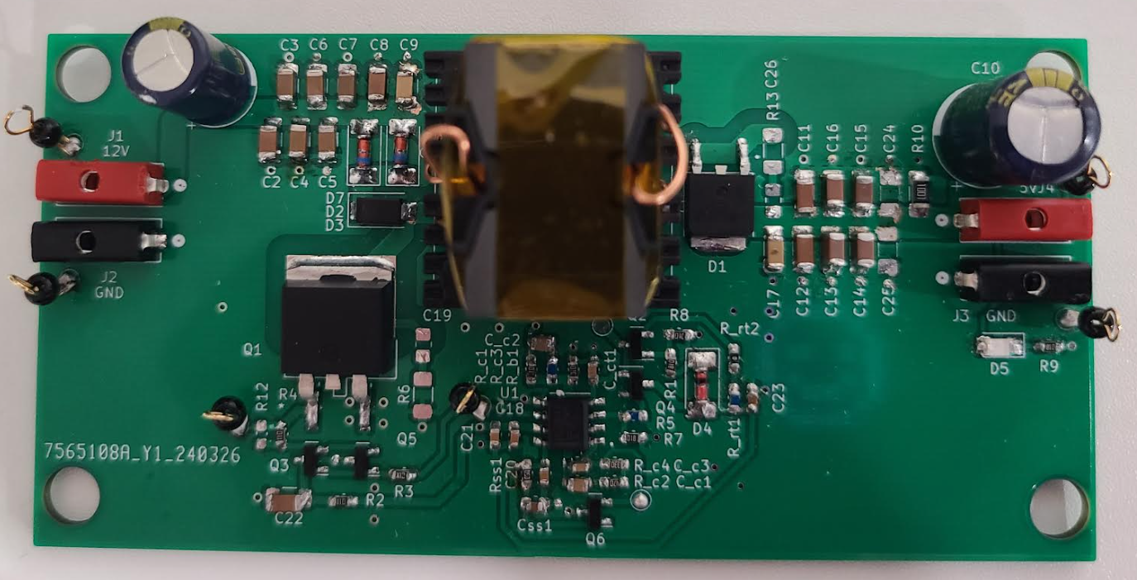
Circuit Board Assembly (top)

Slide 13
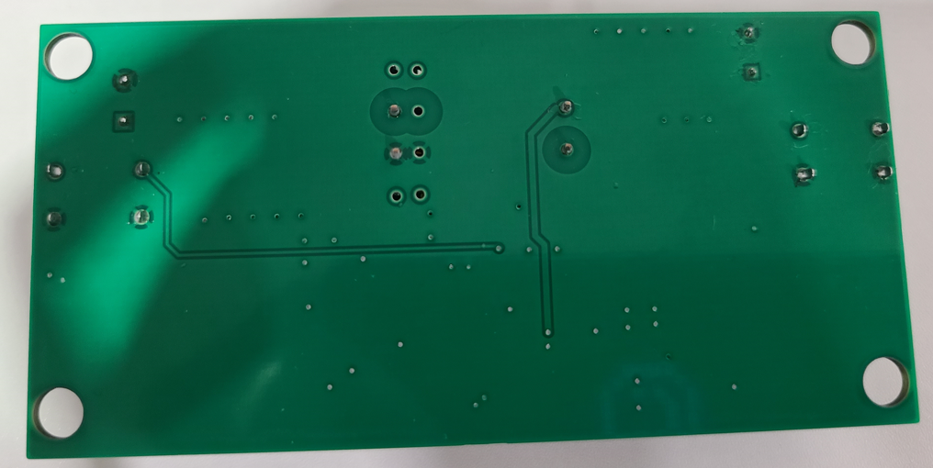
Circuit Board Assembly (bottom)

Slide 14
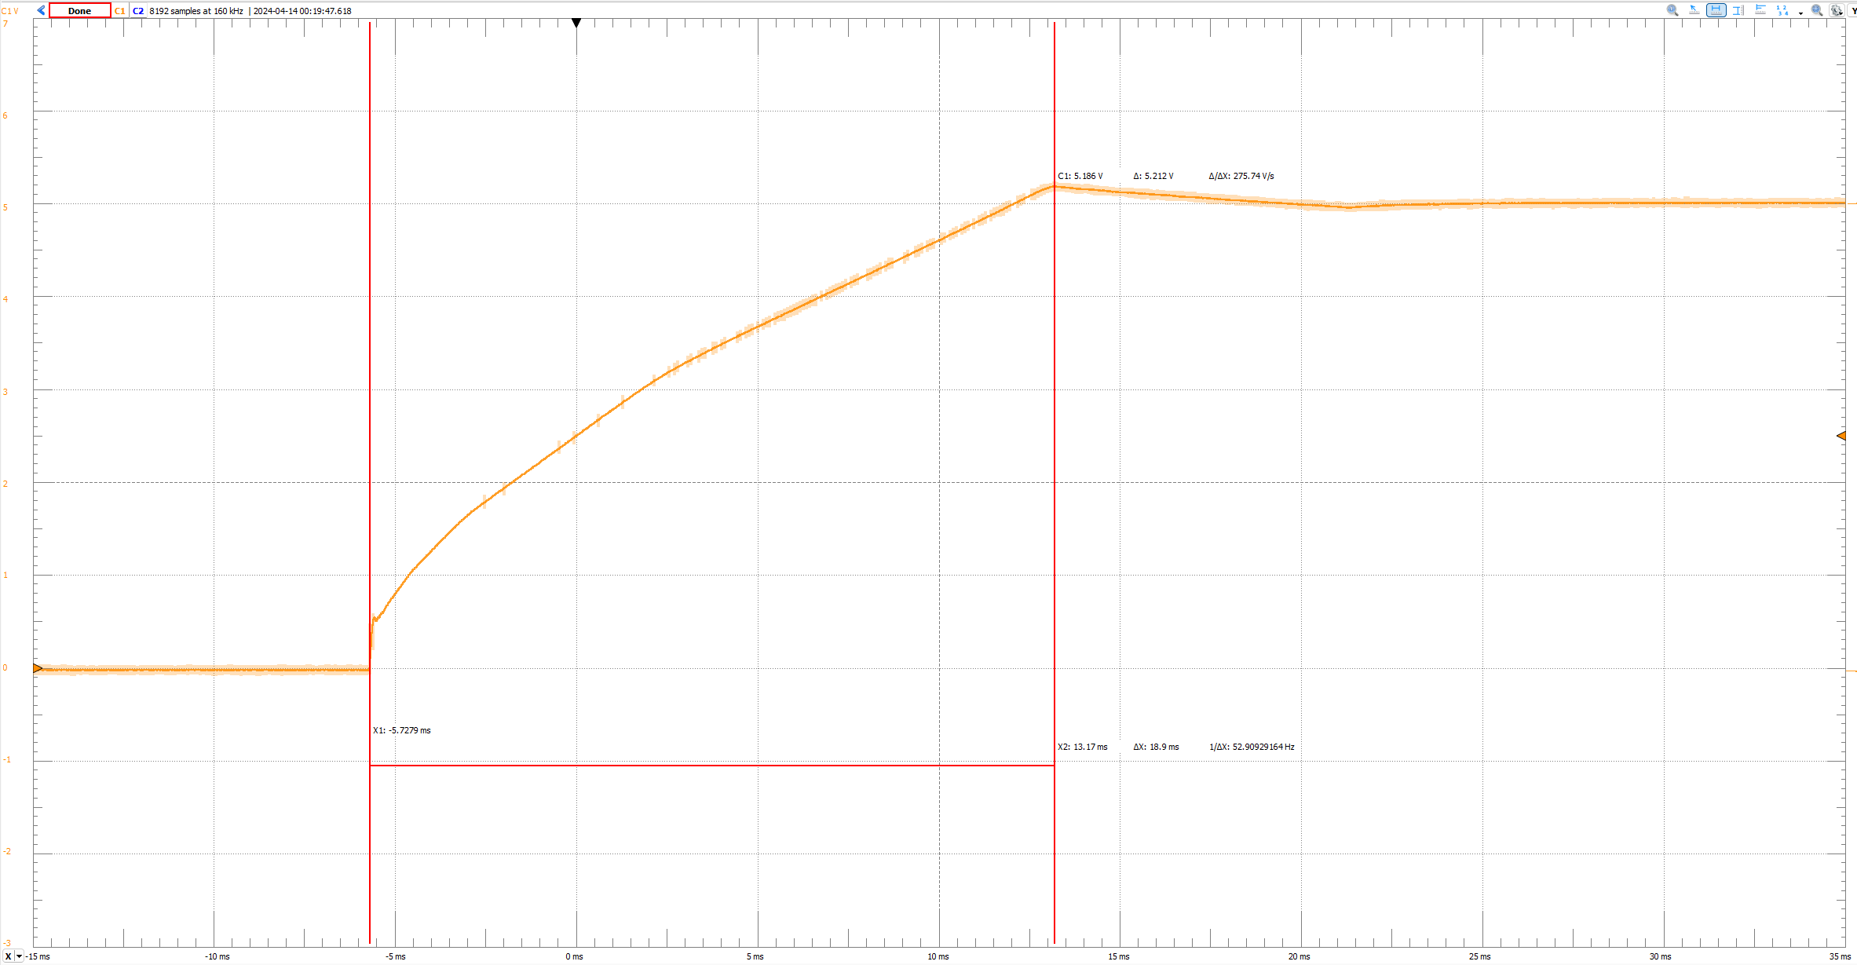
Turn on Waveform – No Load

Slide 15
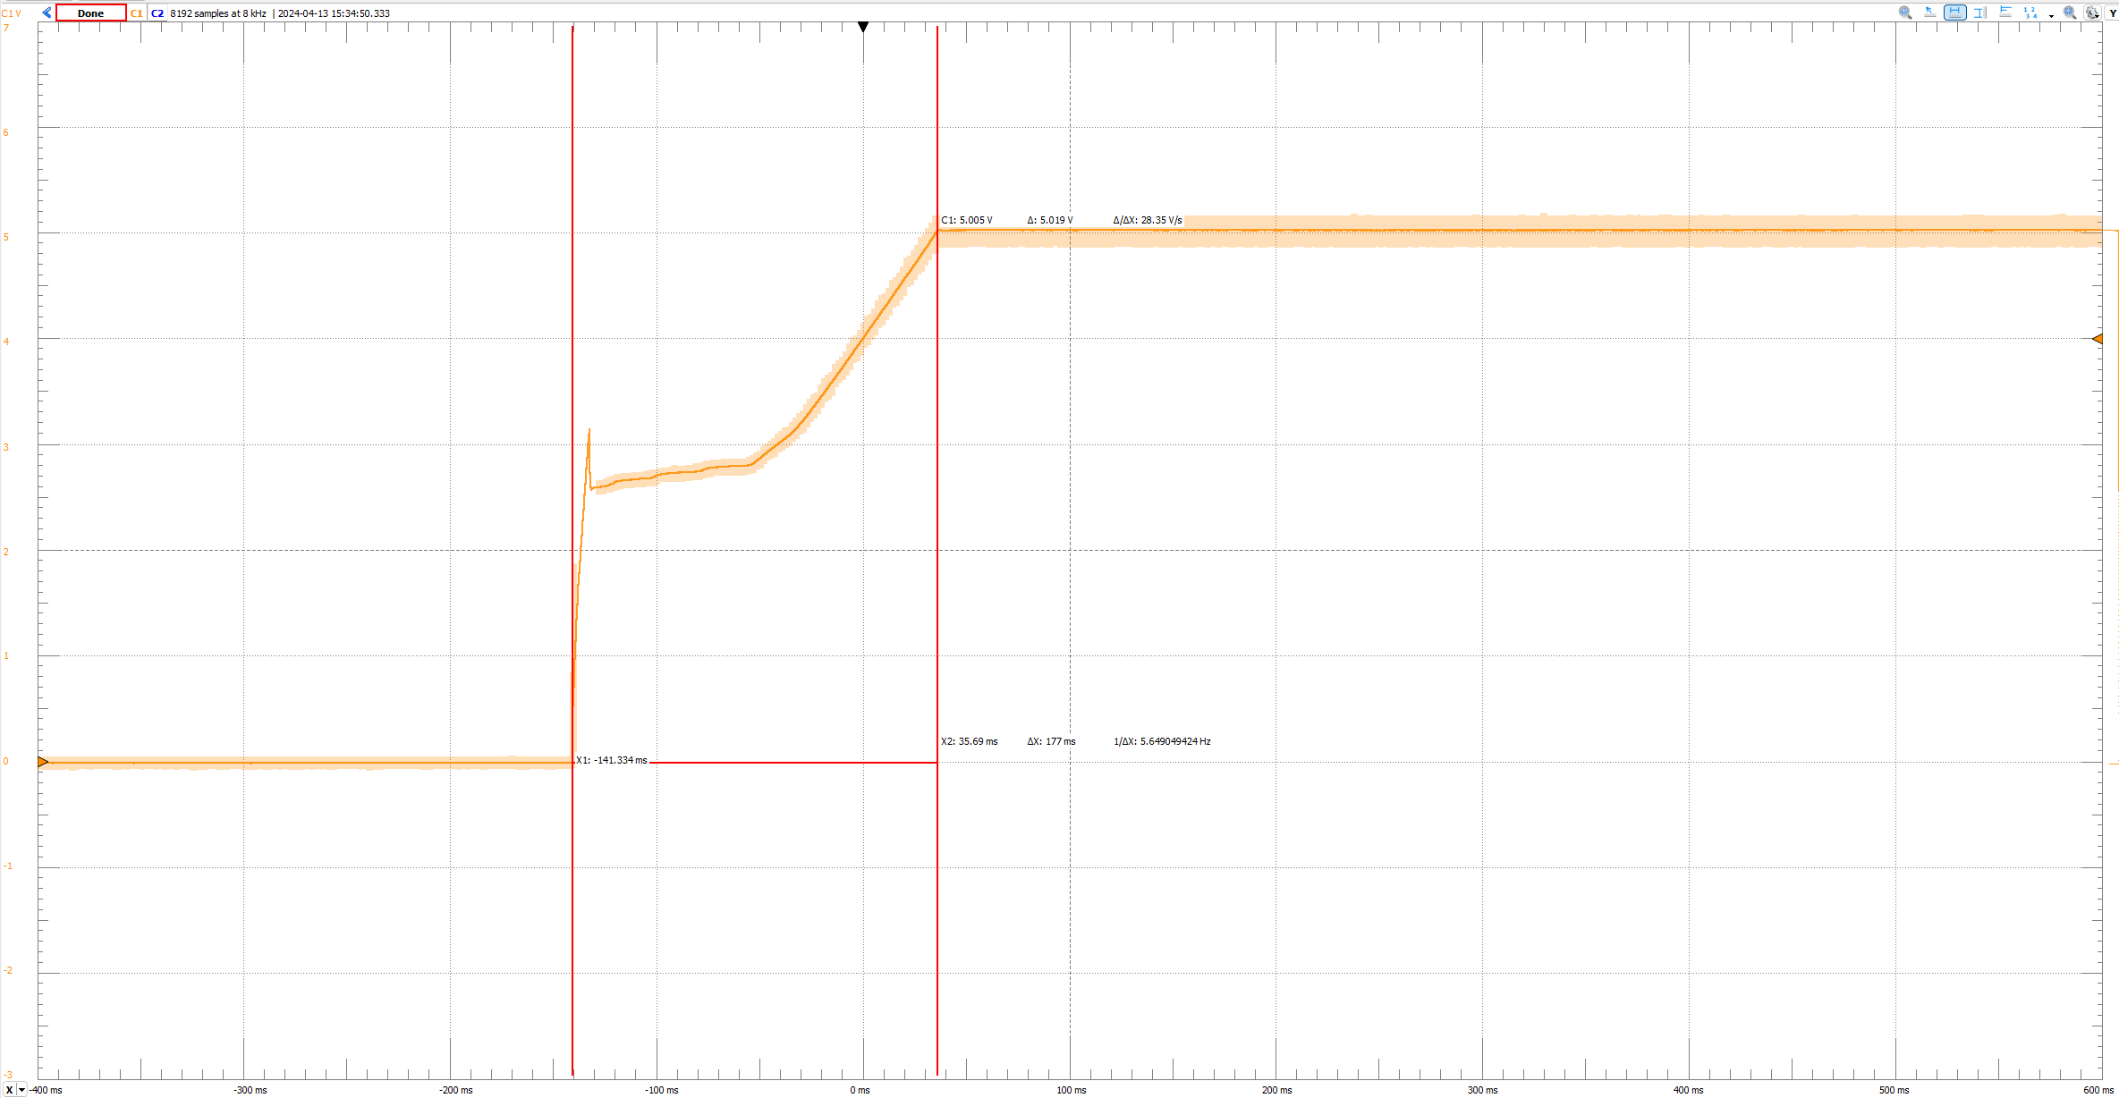
Turn on Waveform – 5A Load

Slide 16
Efficiency vs Load Current

Slide 17
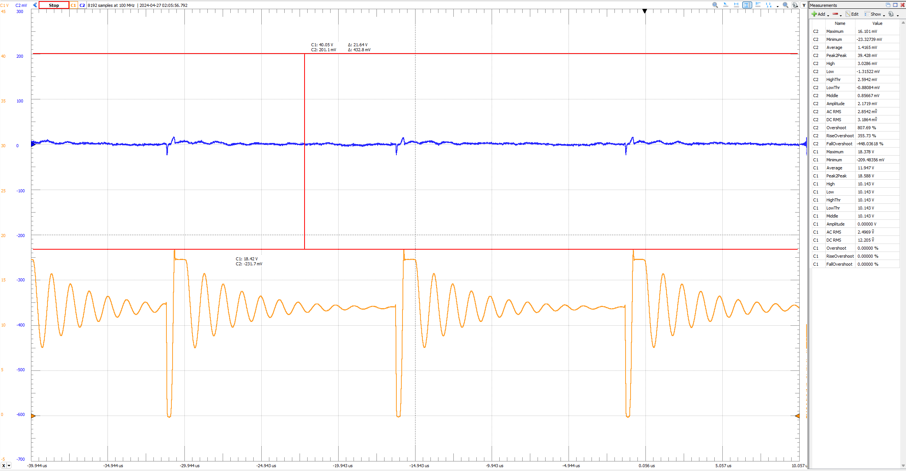
Steady state – No load

Slide 18
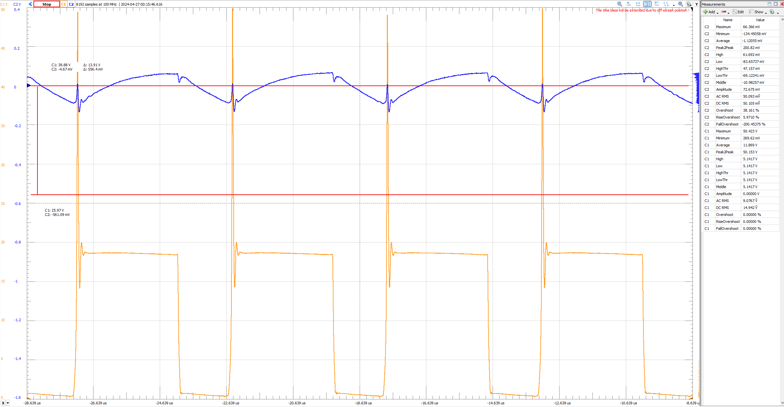
Steady state – 5A load

Slide 19
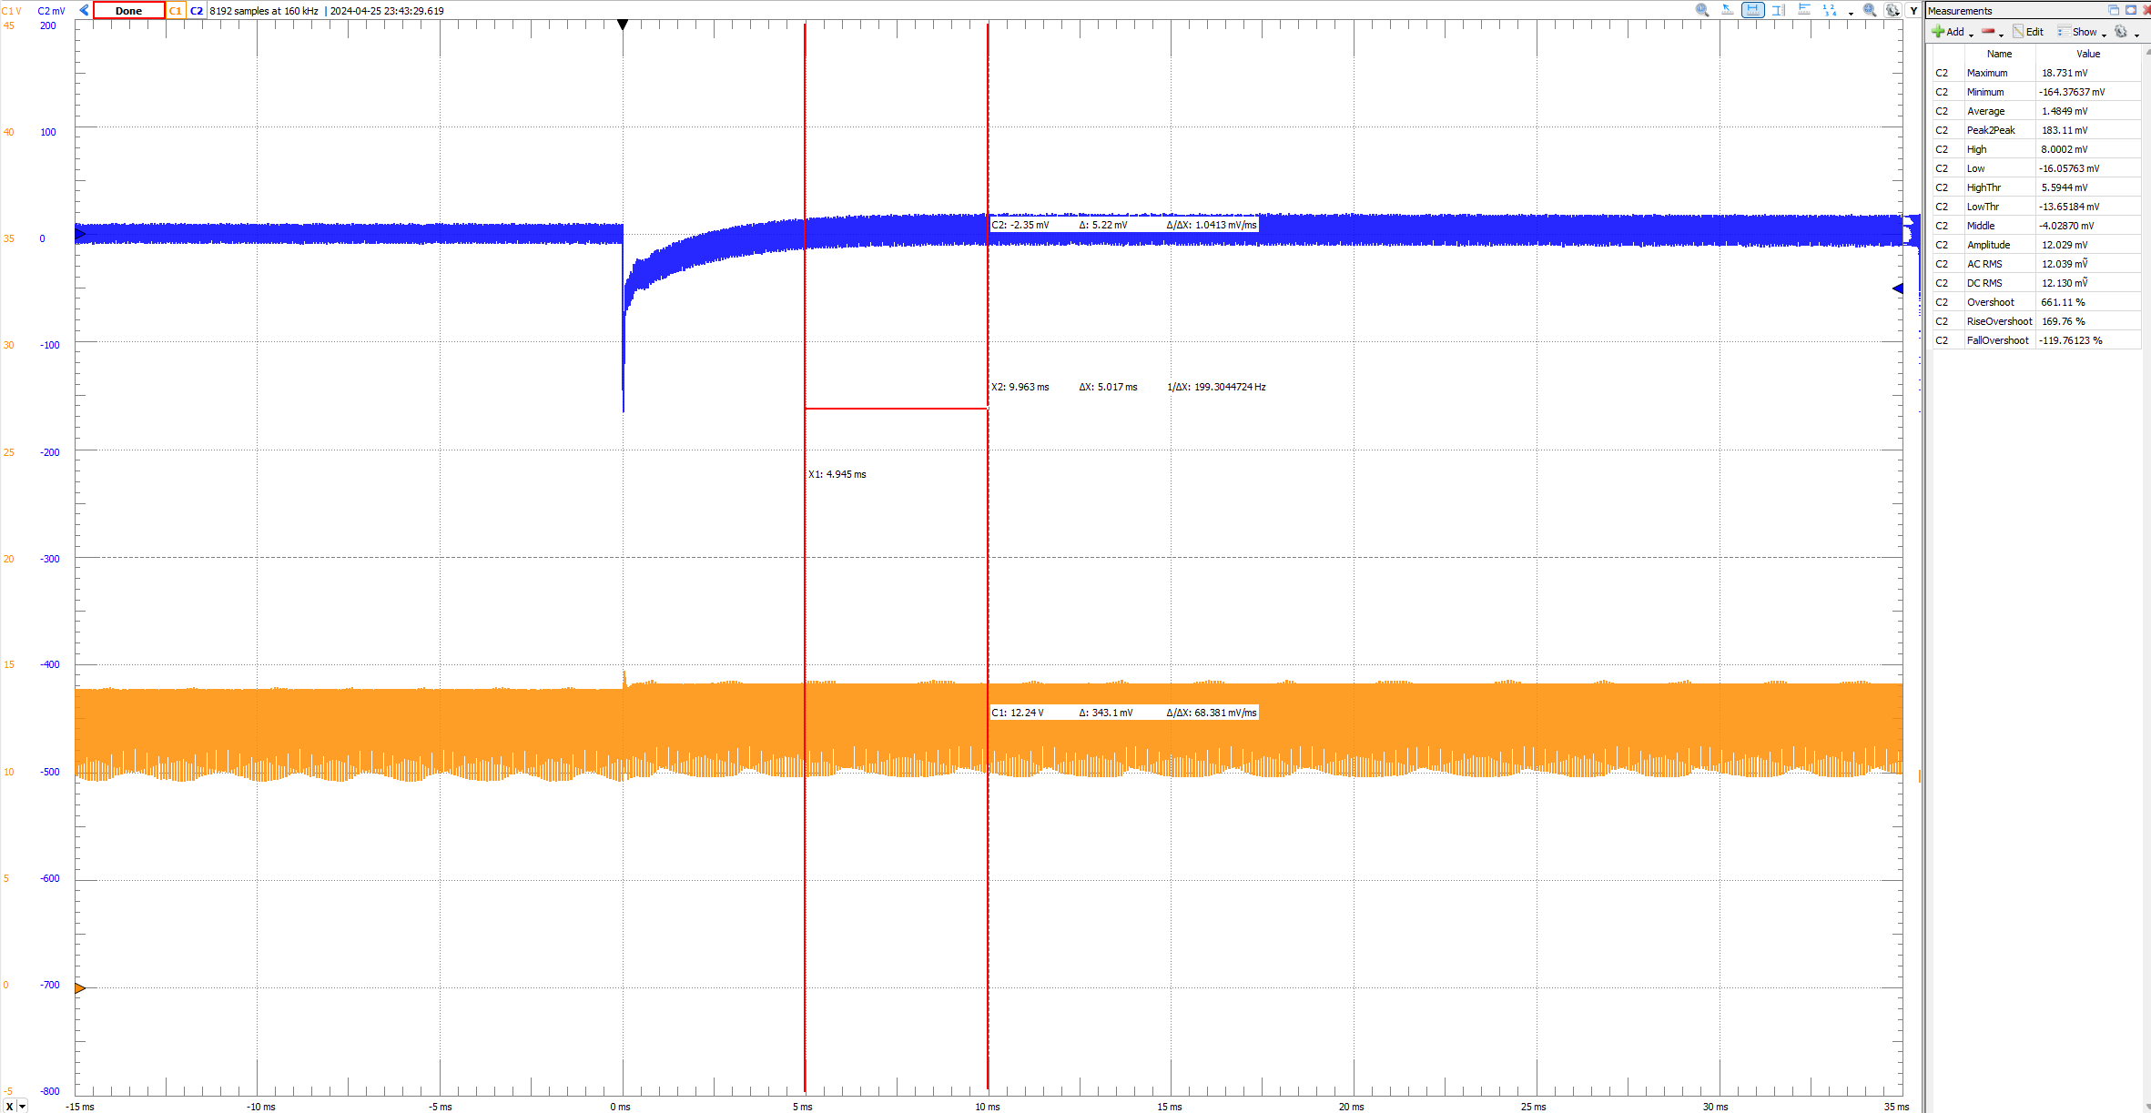
Load Step Response (1)

Slide 20
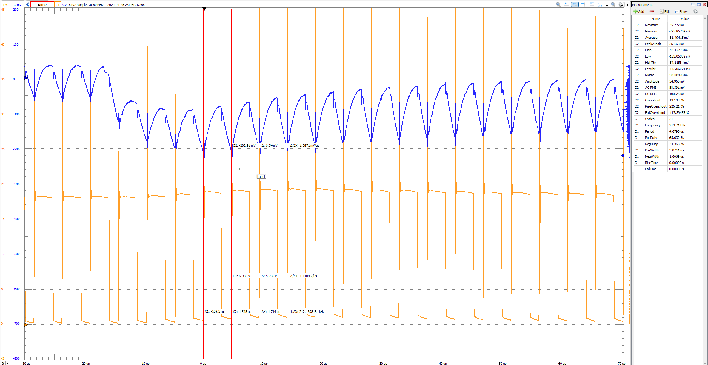
Load Step Response (2)

Slide 21
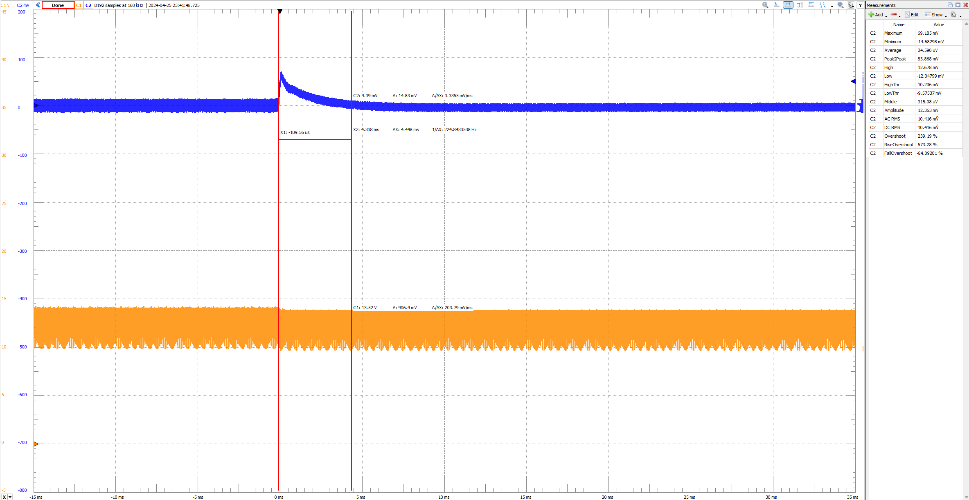
Load Step Response (3)

Slide 22
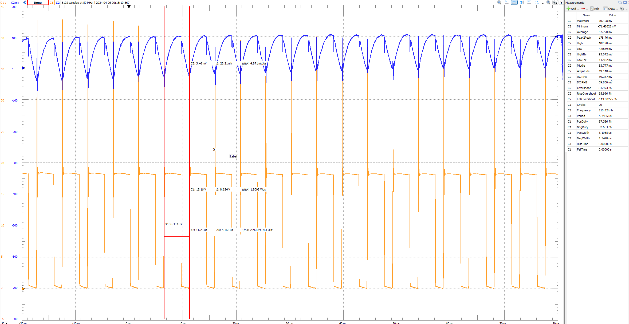
Load Step Response (4)

Slide 23
Learning that will be applied for future designs
Design compensator
Using average model for simulation
Calculate and build a custom transformer/inductor
Kicad

