Slide 1
Walklets
by
Bryan Perozzi, Vivek Kulkarni, Haochen Chen, and Steven Skiena
Presentation
by
Vesea Eduard
https://arxiv.org/pdf/1605.02115

Slide 2
RandomWalks/ What does it miss?
Content keypoints
Introduction to embeddings
Solving the far communities problem through Walklets
Tests on Walklets embeddings

Slide 3
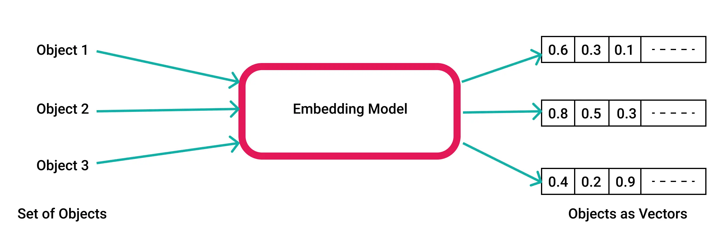
What are Embeddings?

Slide 4
Data type for storing relevant informations and used for different kind of tasks
They are used in AI related fields in ways of:
Simplifying the inputs for a model
(in e.g to work with valid data)
Preserve structural relationships
Reduce dimensionality of features

Slide 5
Types of embeddings…
Depending on the input type(the dataset of origin) we will have:
Depending on the input type(the dataset of origin) we will have:
For networks(represented as graphs)--> embeddings preserve the information about network structure/labels/features of other nodes
For real-world datasets(e.g images) --> embeddings of inputs will preserve their features info use them after for further classification tasks
Graph embeddings: RandomWalk based, Matrix Factorization
(DL)Network arhitectures used for feature embedding: CNN, RNN, Autoencoders

Slide 6
RandomWalk Algorithms
Used for community learning, by preserving the neighbours at different scales(distances) in an embedding
What are the differences? Local vs Multiscale
E.g. of algorithms (All uses at their basis the RW algorithm):
DeepWalk https://arxiv.org/pdf/1403.6652
Walklets https://arxiv.org/pdf/1605.02115
Anonymous Walks https://arxiv.org/pdf/1805.11921

Slide 7
Local community learning: RandomWalks

Slide 8
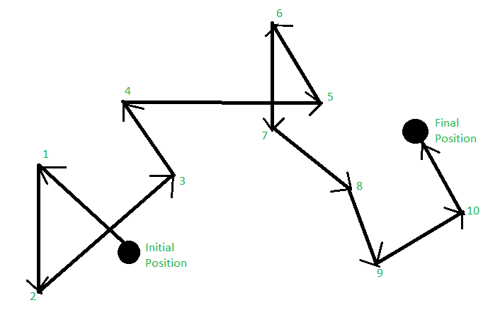
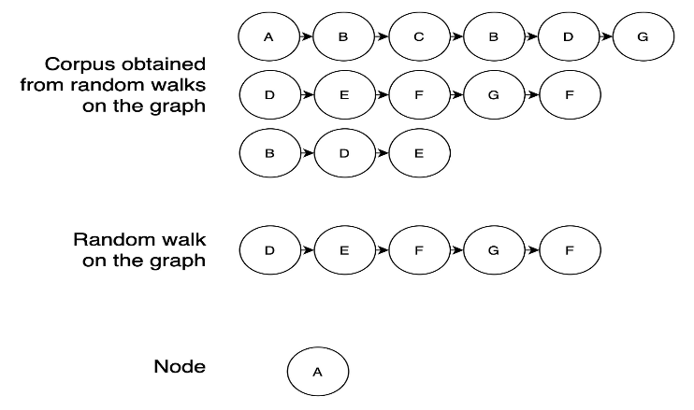
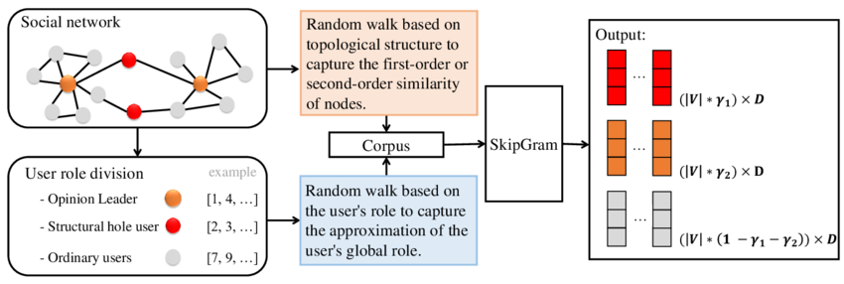
Walk length from a node
Walk numbers from a node
Corpus = “walks”
Embedding Trainer Models:
Word2Vec(CBOW or SkipGram implementation)
Node2Vec

Slide 9
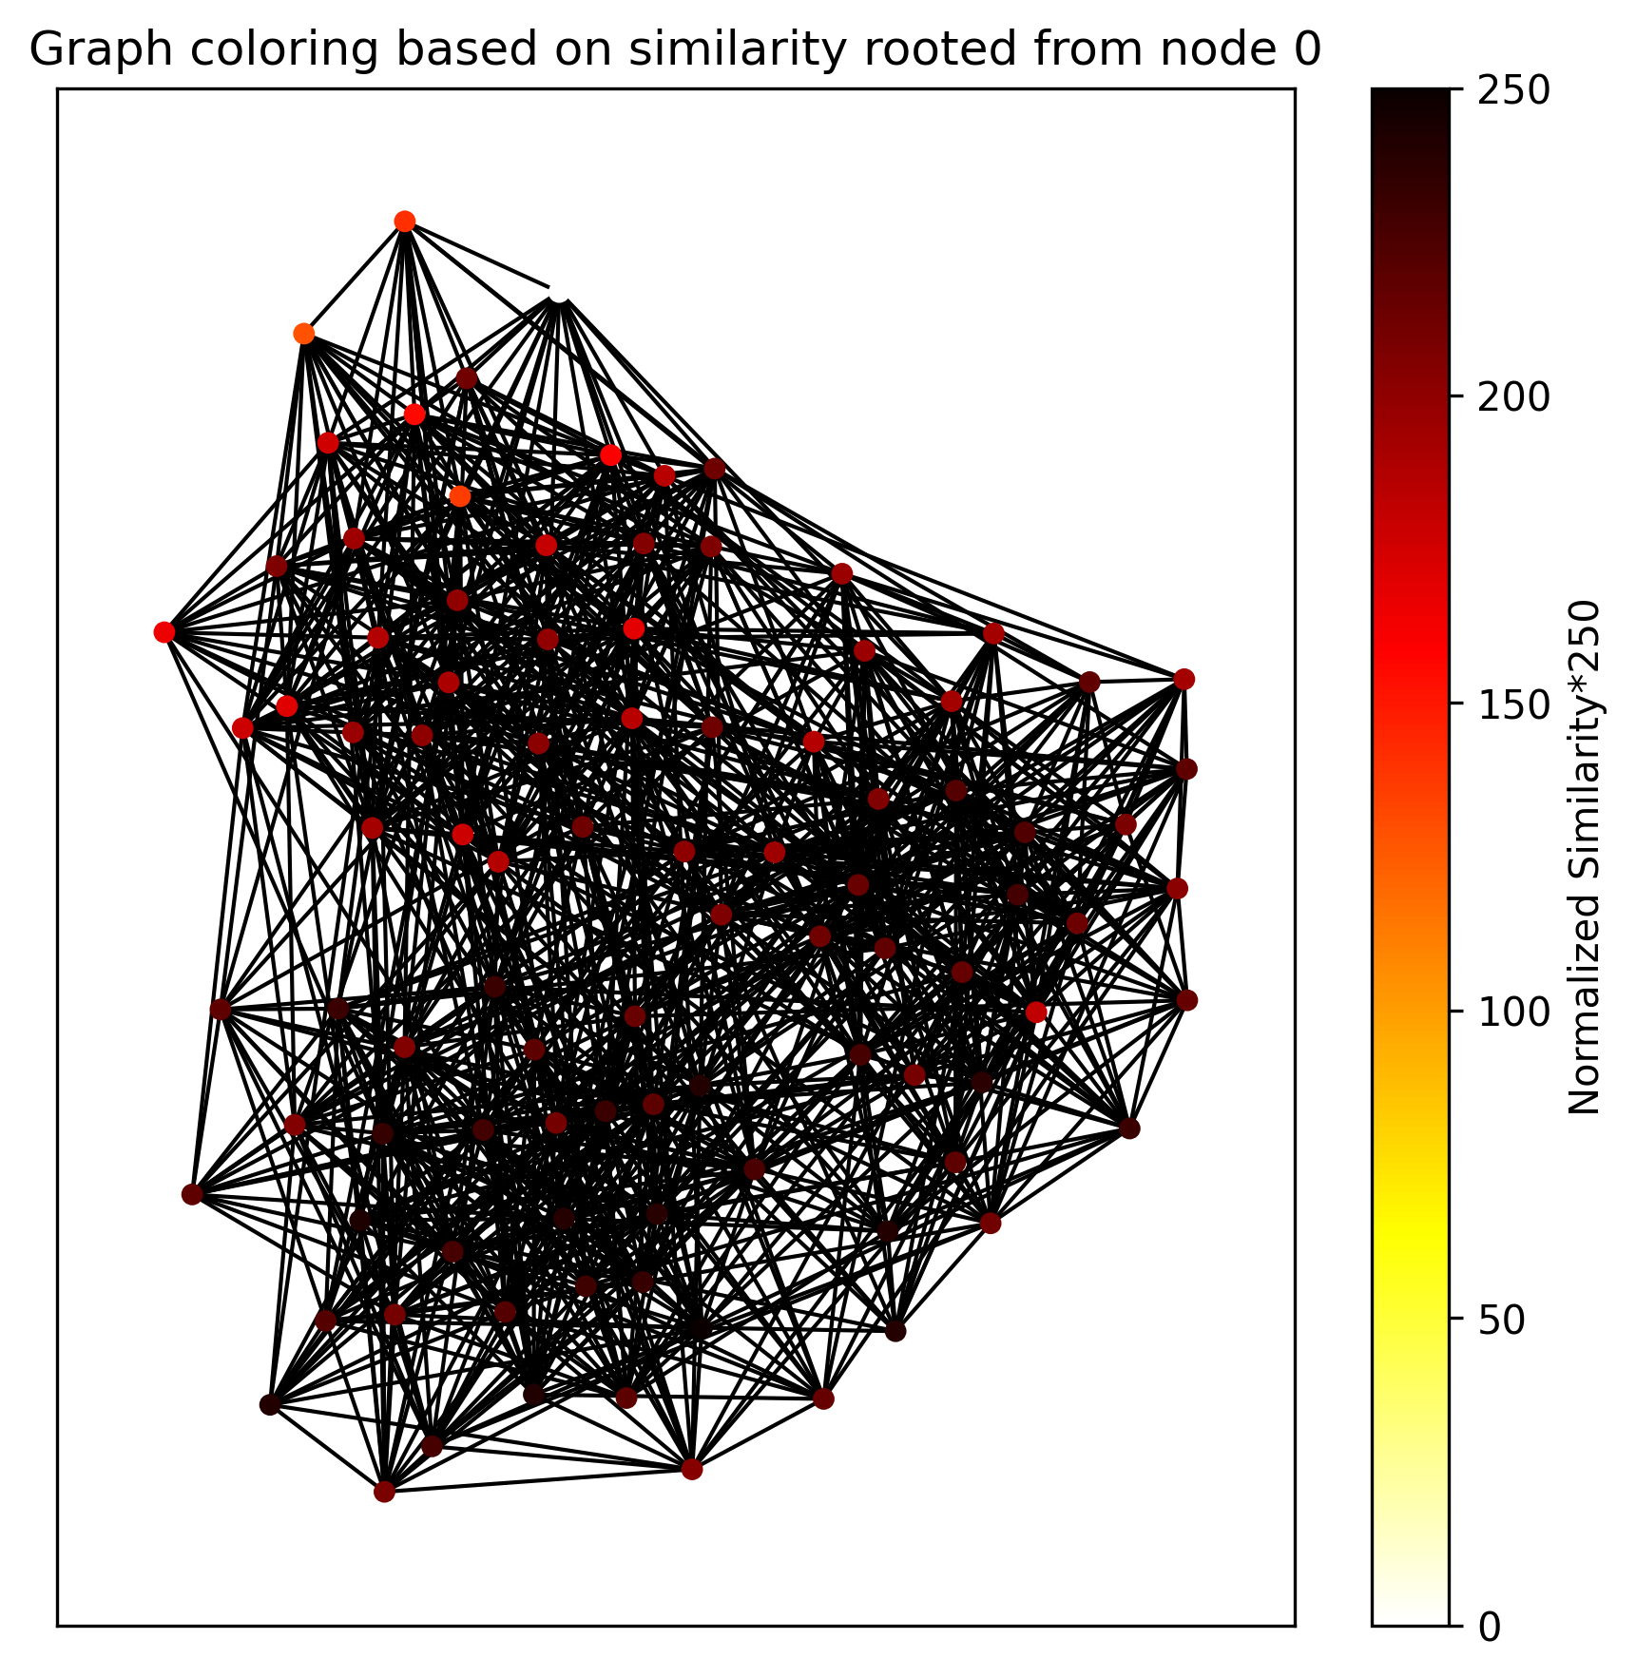

Slide 10
Problems:
Embeddings limited for capturing local communities
Higher similarity on nodes that are in the same or neighbour communities
of source node
Not good for preserving longer relationships,
best for learning small communities
Solution:
Modify the RW corpus at each walk by skipping over a number of nodes
from the original path =>Multiscale Communities Learning
Best for predicting voluminous communities,
reliable on large networks

Slide 11
Multiscale community learning: Walklets

Slide 12

Motivation:
On larger networks, like social ones, we often have the situation where a
two nodes share the same community but they are not close to each other
(not directly linked).
=>we need an algorithm that preserves the information of k distanced
neighbours
Implementation
-choose a scale to learn k
-create the corpus via RW, the modify by ignoring k=scale elements
-obtain the embeddings by training on the new corpus
=>Multiscale Latent Representations
J seeks to maximize the log likelihood
of vi co-occurring with context node vj

Slide 13
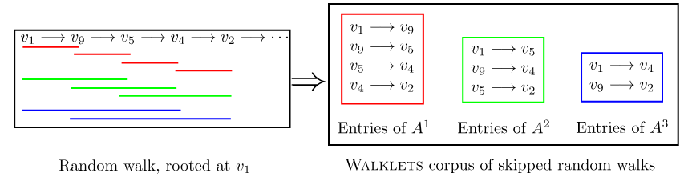



=adjency matrix at scale k
=the number of paths between node of k length
$A^{k}$
$A_{ij}^{k}$
Probabilities

Slide 14
Embeddings testing: Walklets

Slide 15
Test structure
-For testing the efficiency of the embeddings trained
on the corpus generated
via Walklets:
Analyze embeddings of RandomWalks and Walklets on different
scales, made on datasets, through 2 types of tests
Community Learning Capability
=>TSNE reduction/similarity based coloring
2. Label Association Capability
=>use an classifier on the embeddings,
to print the micro-F1 accuracy and avg. train loss

Slide 16
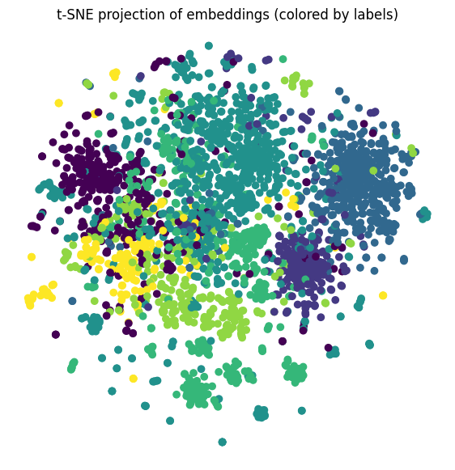
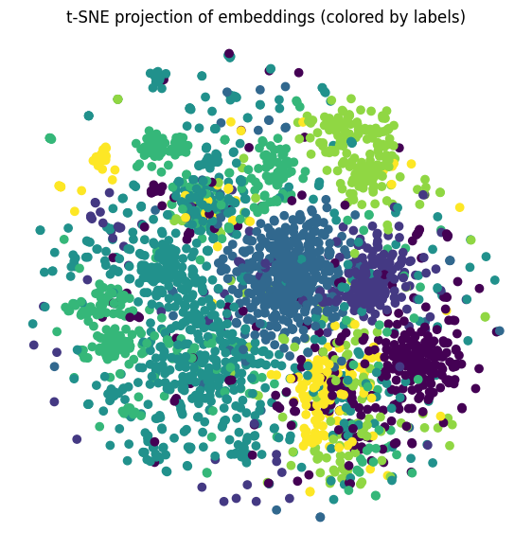
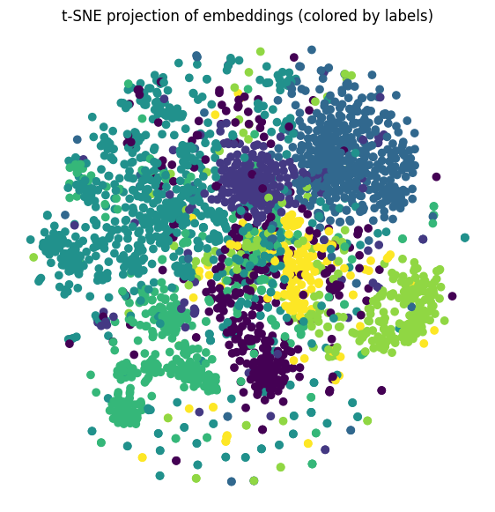
1.CORA
-nodes: research papers -label: r. domain
-edge: citation(bidirectional) between 2 papers
RandomWalk
Walklets k=2
Walklets k=4

Slide 17
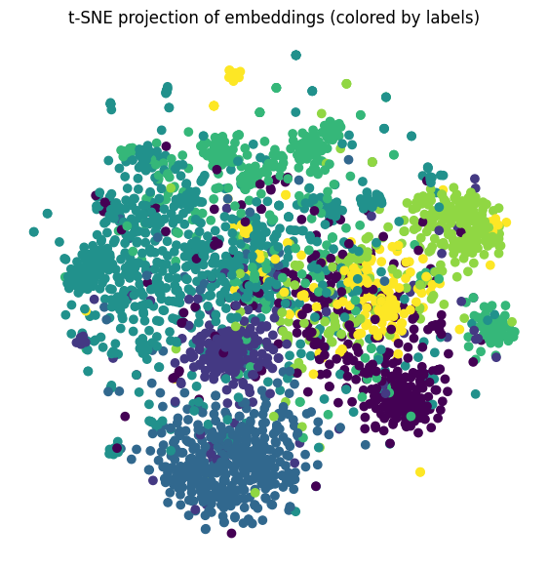
Walklets k=8

Slide 18
*Homophily causes the difference between uF1’s

Slide 19
2.KarateClub
-nodes: members of an Karate club
-label: faction
-edge: two members have socials interactions

Slide 20
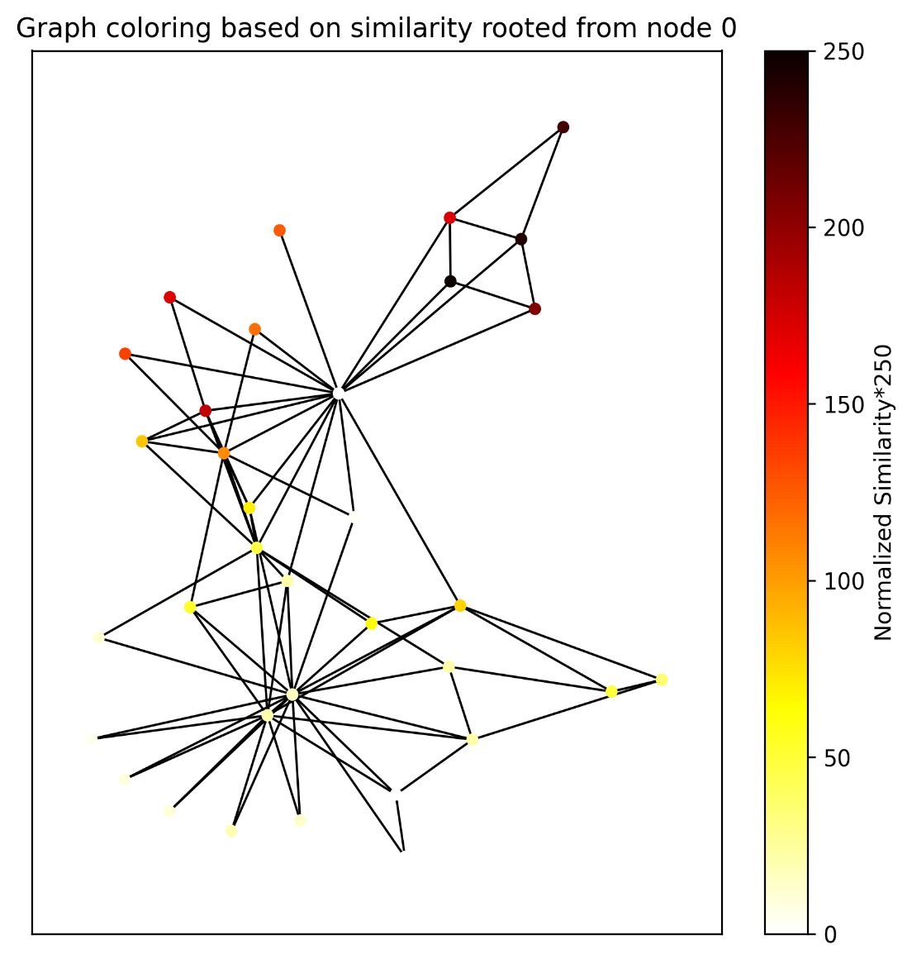
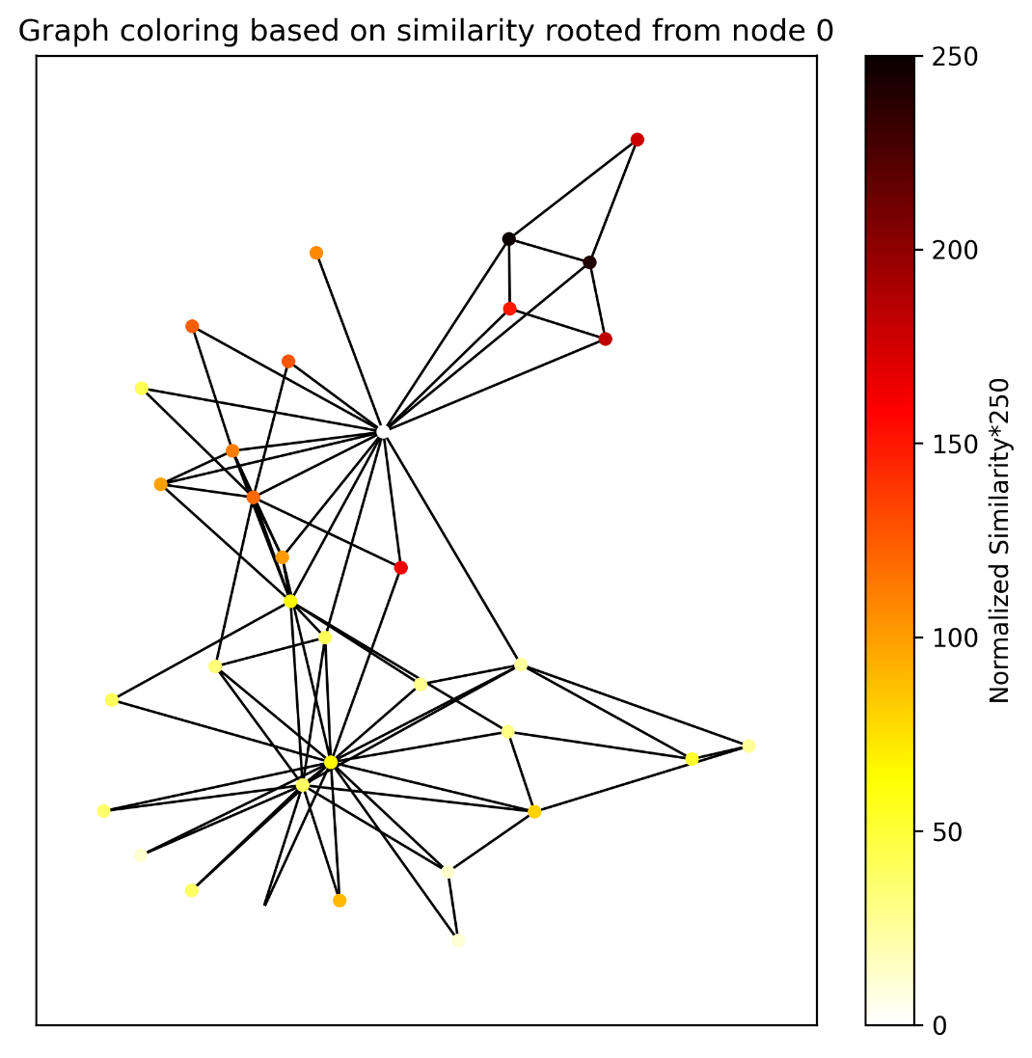
Walklets k=2
RandomWalks

Slide 21
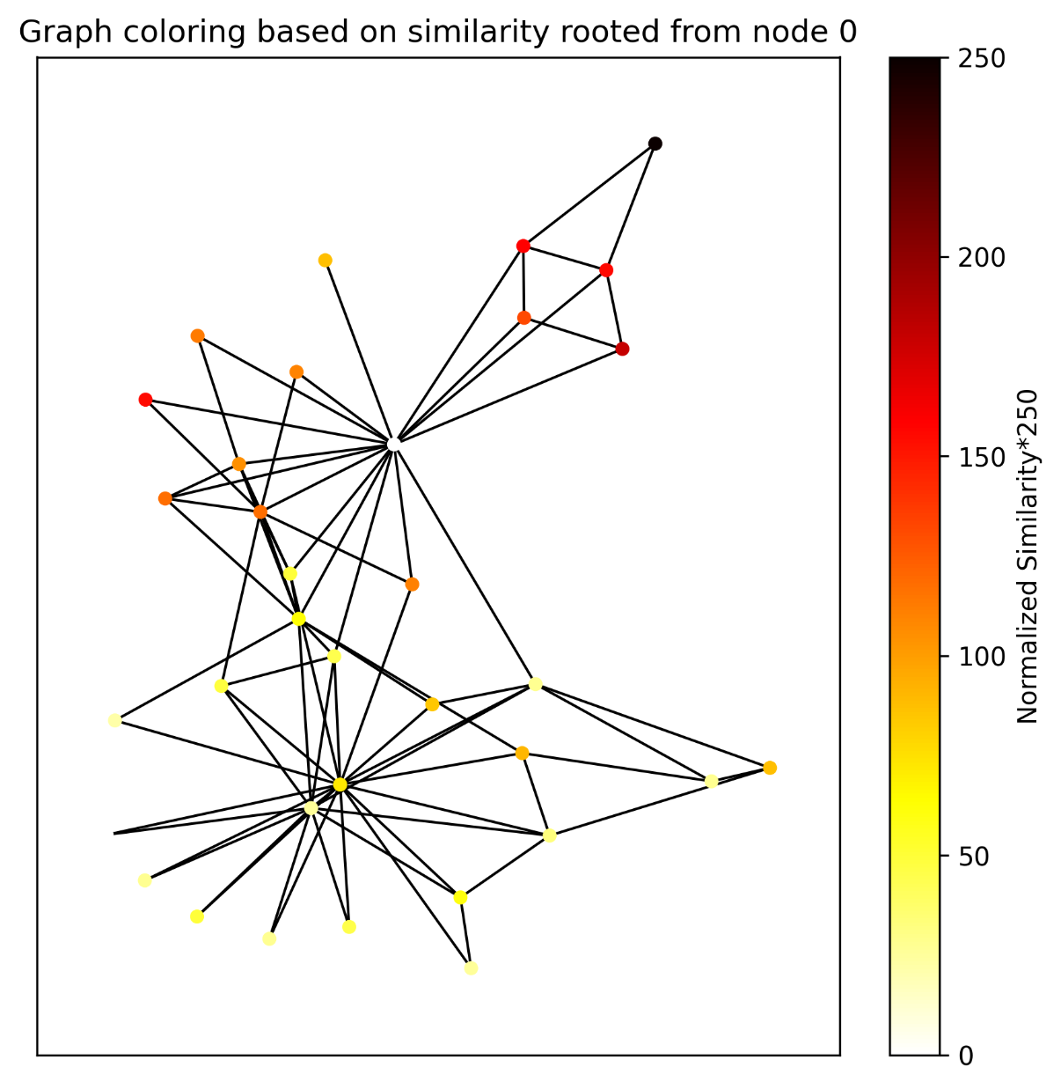
Walklets k=3

Slide 22
*Homophily causes the difference between uF1’s

Slide 23
Thank you!

