Slide 1
Walklets
by
Bryan Perozzi, Vivek Kulkarni, Haochen Chen, and Steven Skiena
Presentation
by
Vesea Eduard
https://arxiv.org/pdf/1605.02115

Slide 2
DeepWalk/ What does it miss?
Content keypoints
Introduction to embeddings
Solving the far communities problem through Walklets
Tests on Walklets embeddings

Slide 3
What are Embeddings?

Slide 4
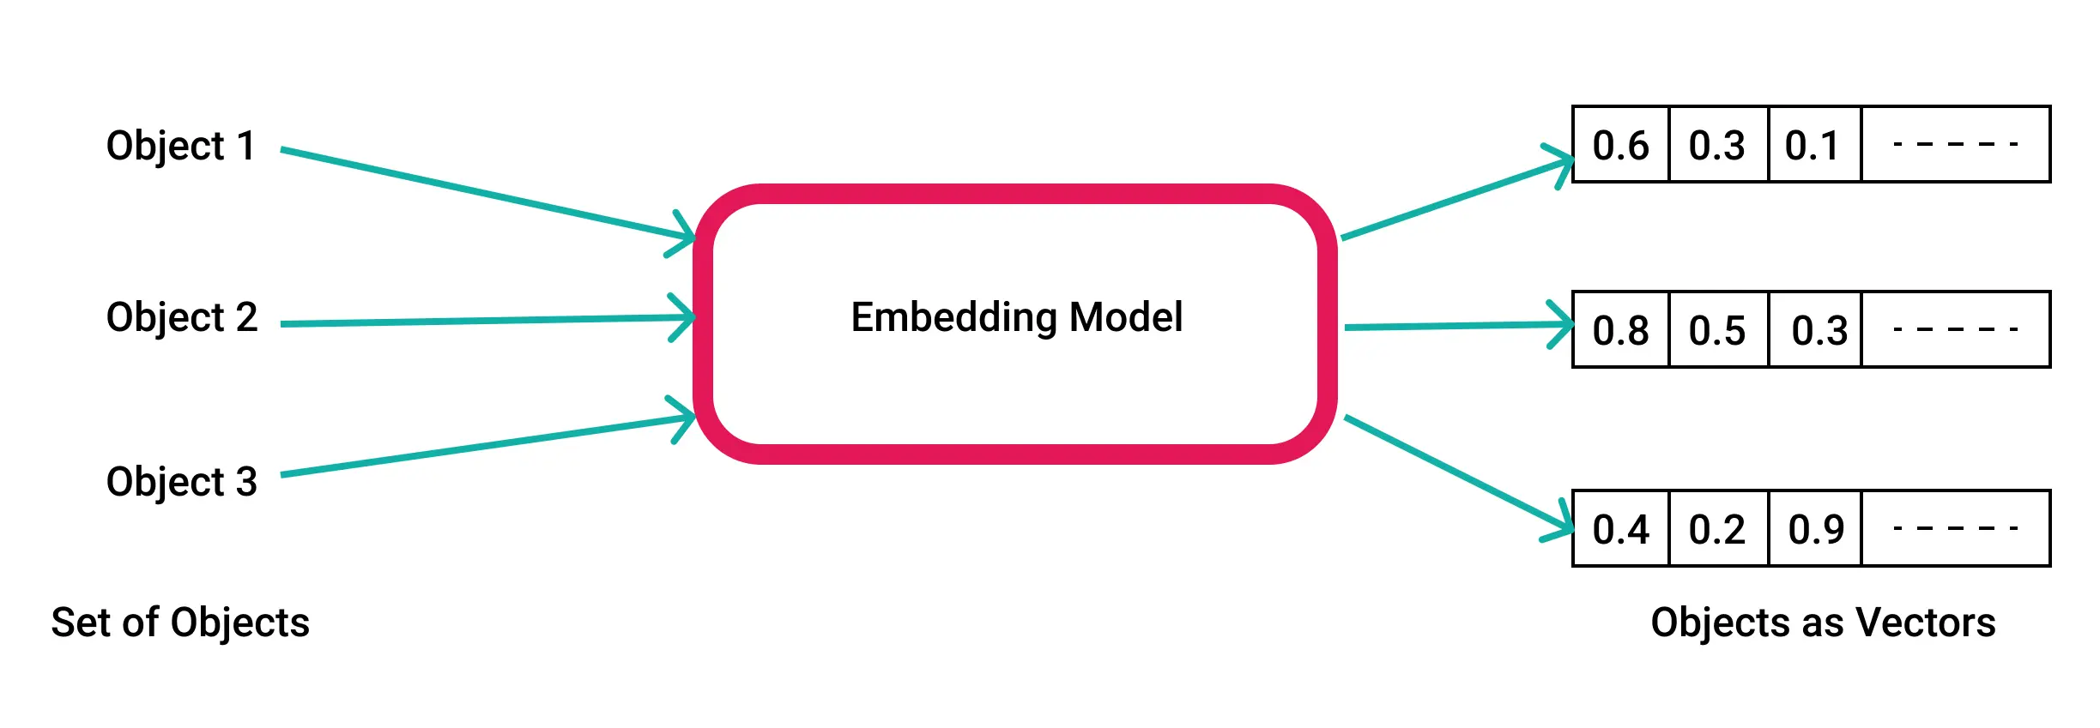
Data type for storing relevant informations and used for different kind of tasks
They are used in AI related fields in ways of:
Simplifying the inputs for a model
(in e.g to work with valid data)
Preserve structural relationships
Reduce dimensionality of features

Slide 5
Some Algorithms…
Depending on the input type(the dataset of origin) we will have:
For networks(represented as graphs)--> embeddings of nodes will preserve the information about network structure in e.g labels or features of other nodes
For real-world datasets(e.g images) --> embeddings of inputs will preserve their features info in e.g for further classification tasks
Algorithms used for networks: RandomWalk based, Matrix Factorization, DeepLearning
Network arhitectures used for feature embedding: CNN, RNN, Autoencoders

