Slide 1
FBNET: Feedback network for point completion
Xuejun Yan, Hongyu Yan et al
Presentation by Stroia Dacian

Slide 2
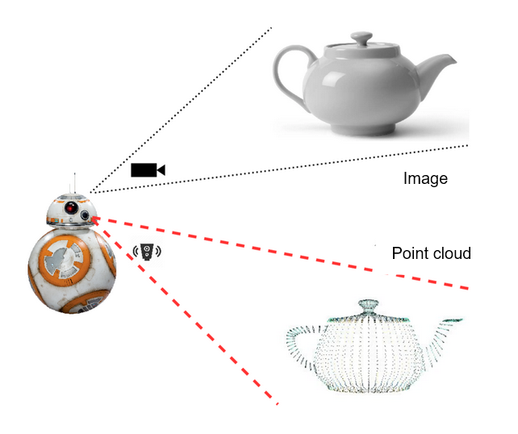
Problem and motivation:
3D sensors - A common way to perceive space, nowadays.
Problem: Due to the instability of sensors, the generated point clouds are sparse, partial and noisy

Slide 3
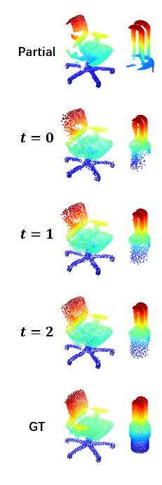
Problem and motivation:
3D sensors - A common way to perceive space nowadays.
Problem: Due to the instability of sensors, the generated point clouds are sparse, partial and noisy
Task: Recover the complete shape from partial observations

Slide 4
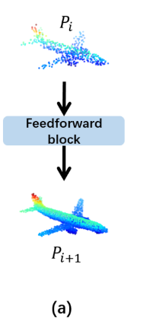
Main Idea - Feedback

Slide 5
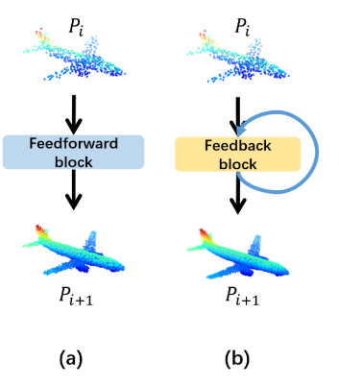
Main Idea - Feedback

Slide 6
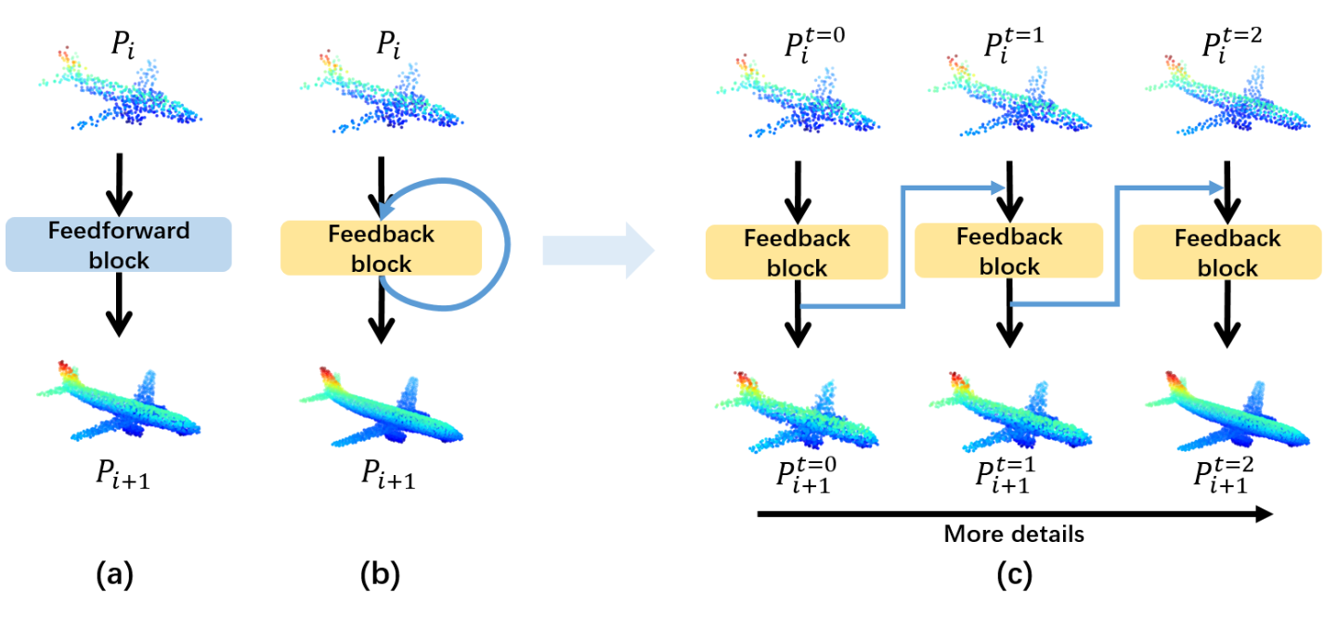
Main Idea - Feedback

Slide 7
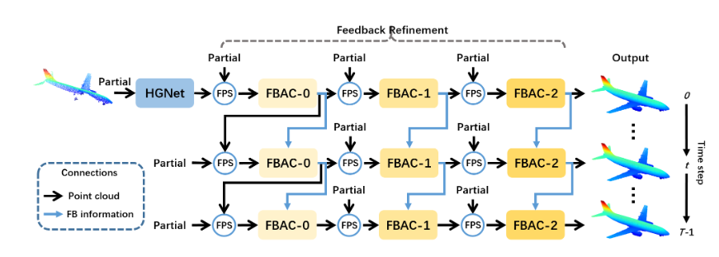
Architecture - High level
Input: We start with a partial point cloud.
We pass the input to a preprocessing network, HGNet, to extract features.
At timestep T, we sequentially preprocess the features using the Feedback blocks: FBAC
At timestep T+1, we pass the output from timestep T, alongside the previous features.

Slide 8
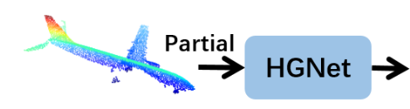
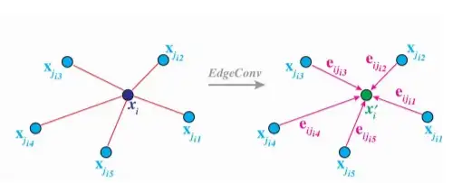
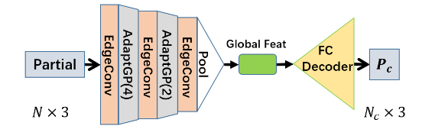
Architecture - HGNet
Encoder-Decoder structure:
EdgeConv for gathering features from neighbours.
AdaptGP = Farthest point sampling to subsample new PC + attention mechanism between new and old PC.
Decode to a coarse point cloud

Slide 9
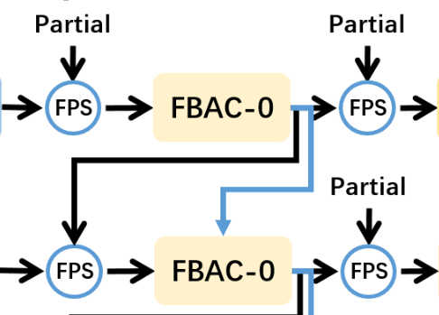
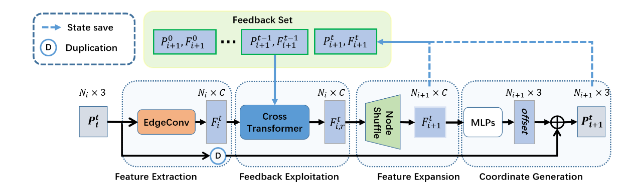
Architecture - FBAC
FBAC = Feedback-Aware Completion Block
Input: Output of the previous block (or HGNet), its output at a previous timestep
Output: Refined (and upsampled) point cloud.

Slide 10
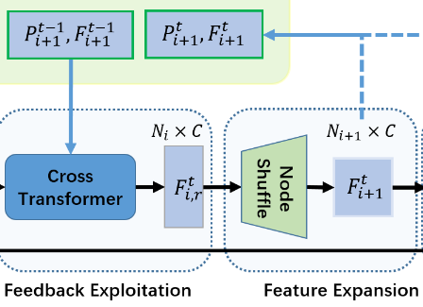
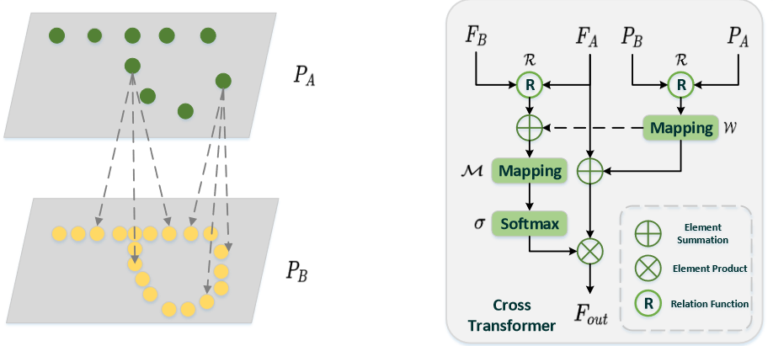
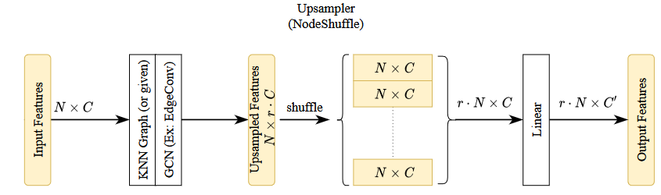
Architecture - FBAC Internals
The FBAC takes 2 point clouds as input: from the previous block and the previous timestep. => We need a layer to take into consideration
Cross transformer - Computes attention weights using the positions and features of the 2 point clouds.
The NodeShuffle is an upsampling module Inspired by PixelShuffle.

Slide 11
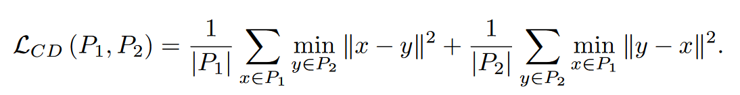
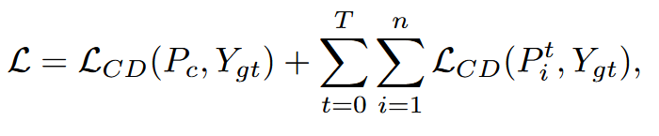
Training
Loss function: Chamfer Distance between point clouds
The total training loss takes into account all timesteps:

Slide 12
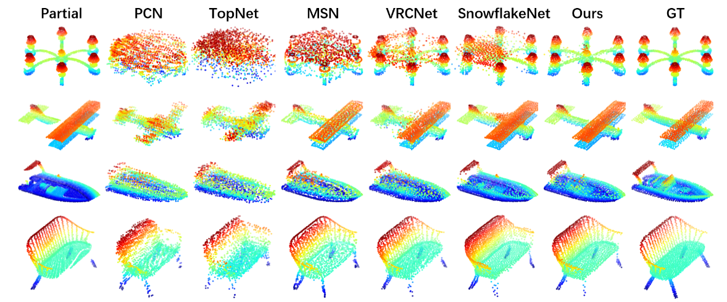
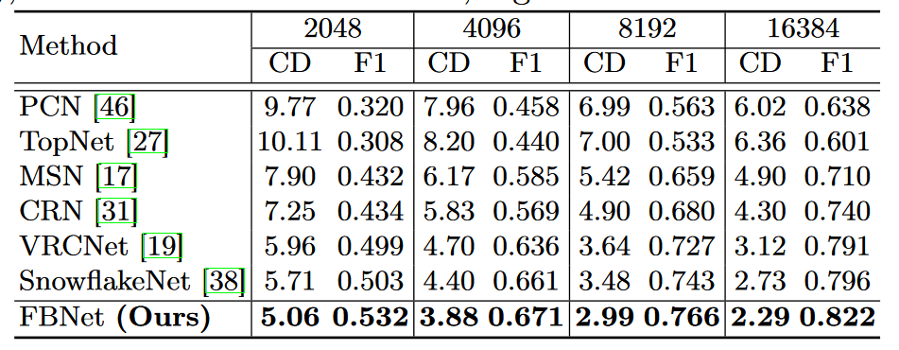
Results - Compared with other works

Slide 13
Demo

Slide 14
Thank you.

