Slide 1
Walklets
by
Bryan Perozzi, Vivek Kulkarni, Haochen Chen, and Steven Skiena
Presentation
by
Vesea Eduard
https://arxiv.org/pdf/1605.02115

Slide 2
RandomWalks/ What does it miss?
Content keypoints
Introduction to embeddings
Solving the far communities problem through Walklets
Tests on Walklets embeddings

Slide 3
What are Embeddings?

Slide 4
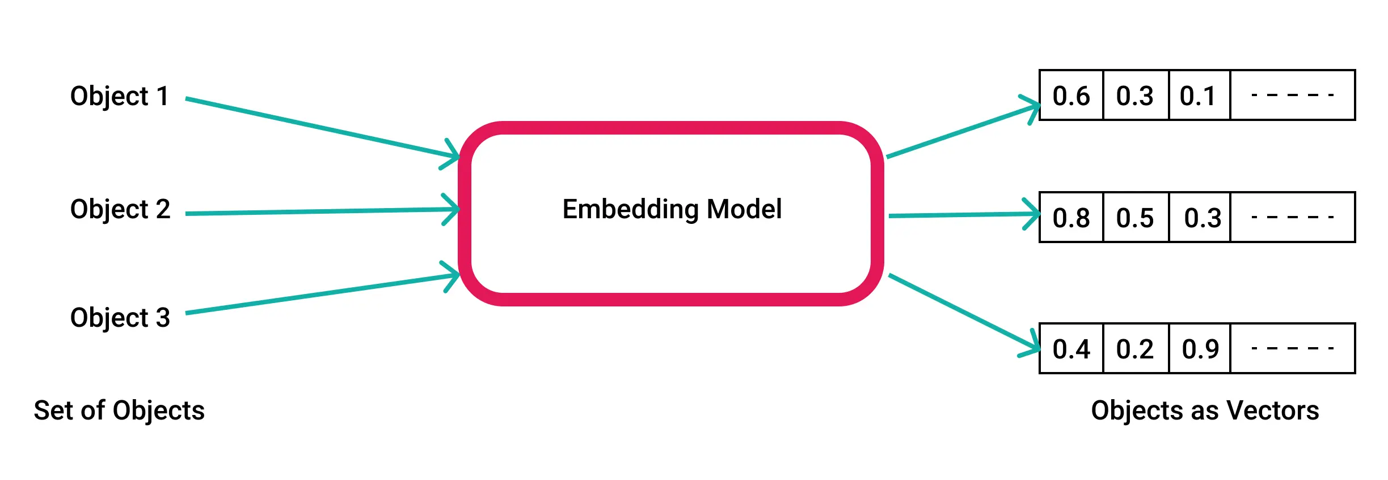
Data type for storing relevant informations and used for different kind of tasks
They are used in AI related fields in ways of:
Simplifying the inputs for a model
(in e.g to work with valid data)
Preserve structural relationships
Reduce dimensionality of features

Slide 5
Types of embeddings…
Depending on the input type(the dataset of origin) we will have:
For networks(represented as graphs)--> embeddings of nodes will preserve the information about network structure or labels or features of other nodes
For real-world datasets(e.g images) --> embeddings of inputs will preserve their features info and use them after for further classification tasks
Algorithms used for networks: RandomWalk based, Matrix Factorization, DeepLearning
Network arhitectures used for feature embedding: CNN, RNN, Autoencoders

Slide 6
RandomWalk Algorithms
Used for community learning, by preserving the neighbours at different scales(distances) in an embedding
What are the differences? Local vs Multiscale
E.g. of algorithms (All uses at their basis the RW algorithm):
DeepWalk https://arxiv.org/pdf/1403.6652
Walklets https://arxiv.org/pdf/1605.02115
Anonymous Walks https://arxiv.org/pdf/1805.11921

Slide 7
Local community learning: RandomWalks

Slide 8
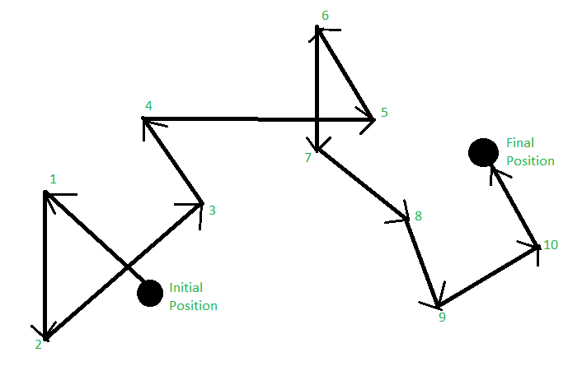
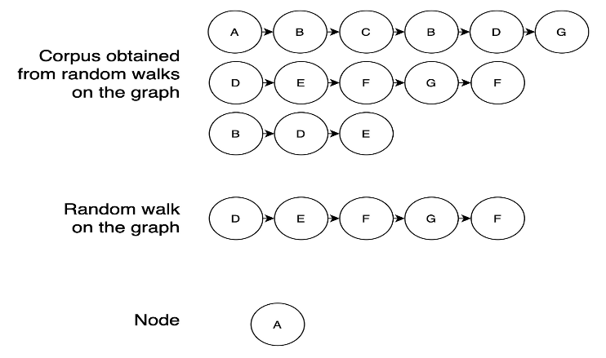
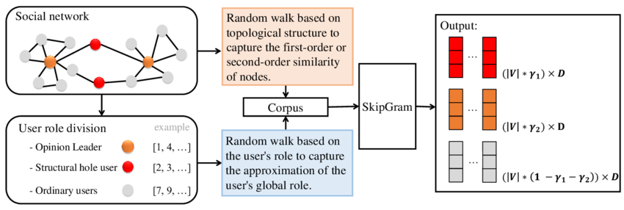
Walk length from a node
Walk numbers from a node
Corpus = “walks”
Embedding Trainer Models:
Word2Vec(CBOW or SkipGram implementation)
Node2Vec

Slide 9
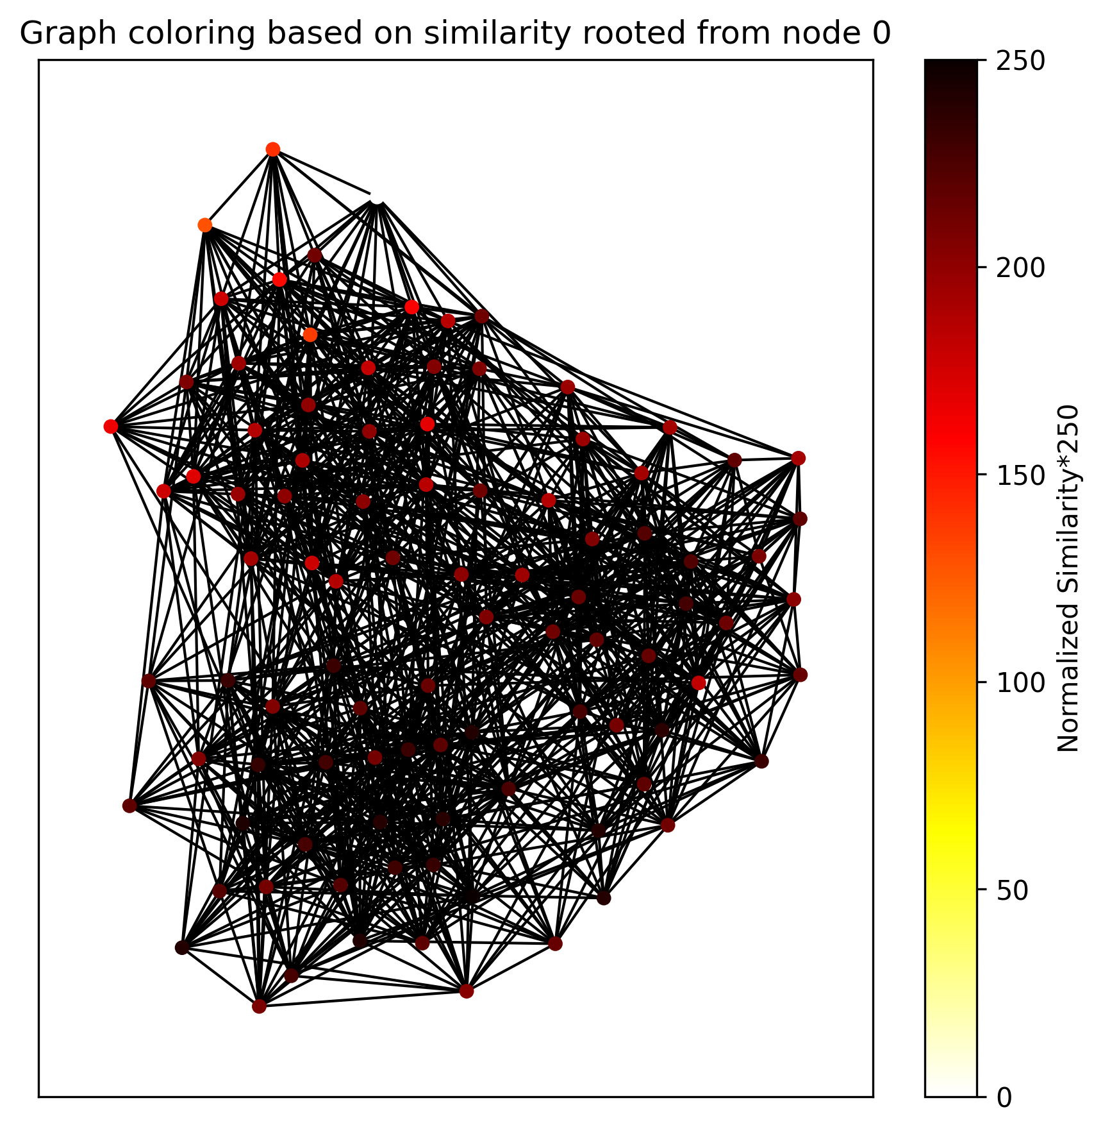

Slide 10
Problems:
Embeddings limited for capturing local communities
Higher similarity on nodes that are in the same or neighbour communities
of source node
Not good for preserving longer relationships, best for small to
medium networks
Solution:
Modify the RW corpus at each walk by skipping over a number of nodes
from the original path ➔ Multiscale Communities Learning
Good for predicting farther communities, reliable on large networks

Slide 11
Multiscale community learning: Walklets

Slide 12

Motivation:
On larger networks, like social ones, we often have the situation where a
two nodes share the same community but they are not close to each other
(not directly linked).
➔we need an algorithm that preserves the information of k distanced
neighbours
Implementation
-choose a scale to learn k
-create the corpus via RW, the modify by ignoring k=scale elements
-obtain the embeddings by training on the new corpus
➔ Multiscale Latent Representations
J seeks to maximize the log likelihood
of vi co-occurring with context node vj

Slide 13
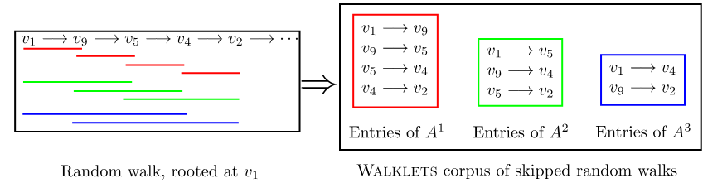



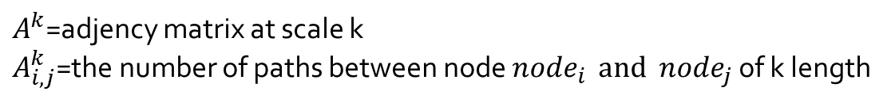
$A^{k}$=adjency matrix at scale k
$A_{i,j}^{k}$=the number of paths between node ${node}_{i } and {node}_{j}$ of k length
Probabilities

Slide 14
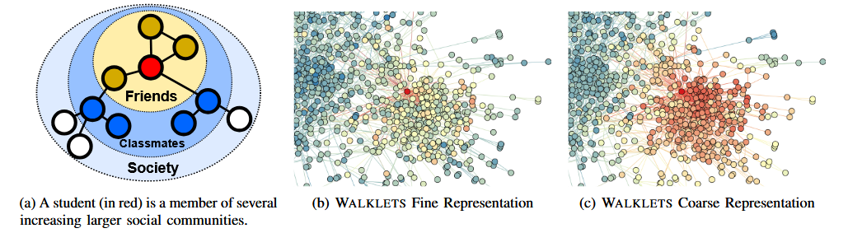
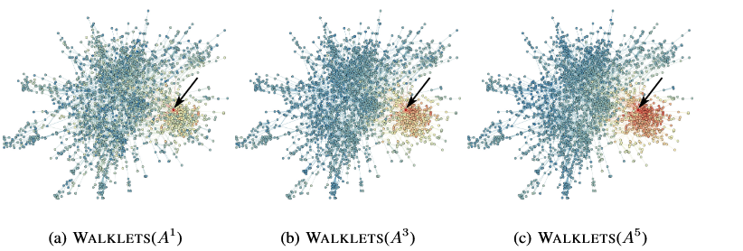

Slide 15
Embeddings testing: Walklets

Slide 16
Test structure
-For testing the efficiency of the embeddings trained on the corpus generated
via Walklets:
Analyze embeddings of RandomWalks and Walklets on different scales
made on datasets, through 2 types of tests
Community Learning Capability
➔TSNE reduction/similarity based coloring
2. Label Association Capability
➔use an classifier on the embeddings,
to print the micro-F1 accuracy and avg. train loss

Slide 17
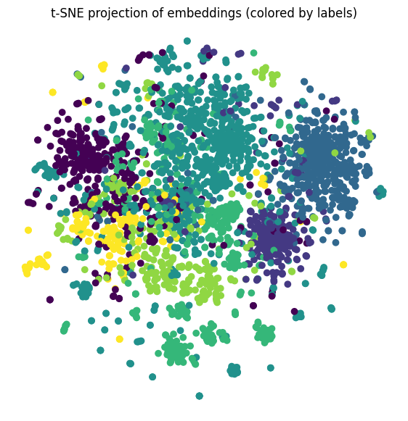
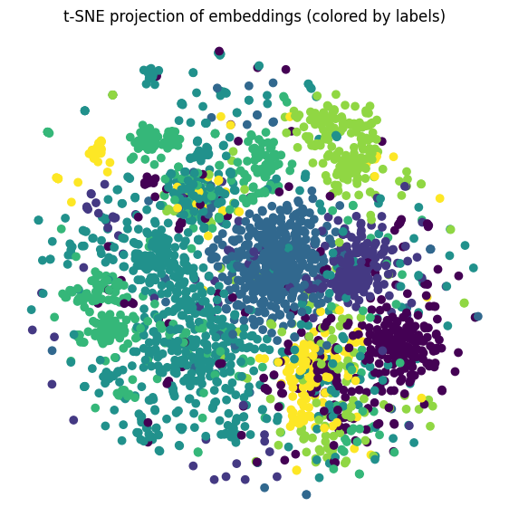
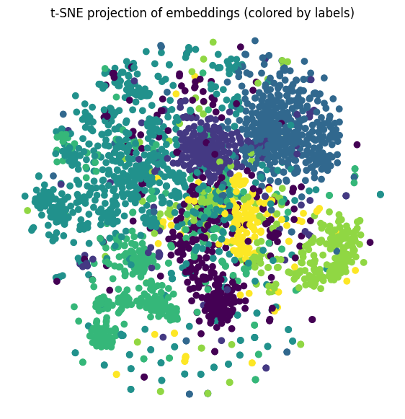
1.CORA
-nodes → research papers -label → r. domain
-edge → citation(bidirectional) between 2 papers
RandomWalk
Walklets k=2
Walklets k=4

Slide 18
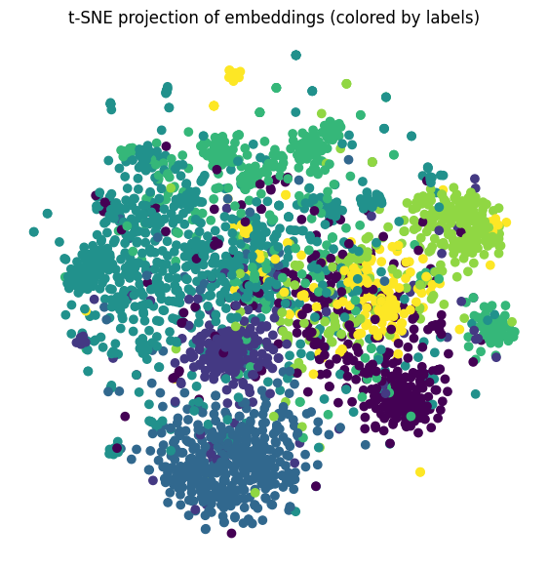
Walklets k=8

Slide 19
*Homophily causes the difference between uF1’s

Slide 20
2.KarateClub
-nodes → members of an Karate club -labels → faction
-edge → two members have socials interactions

Slide 21
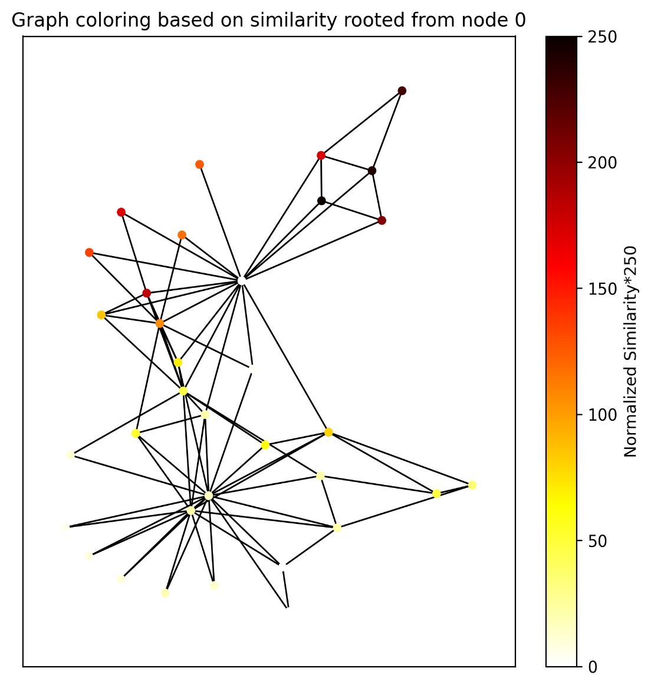
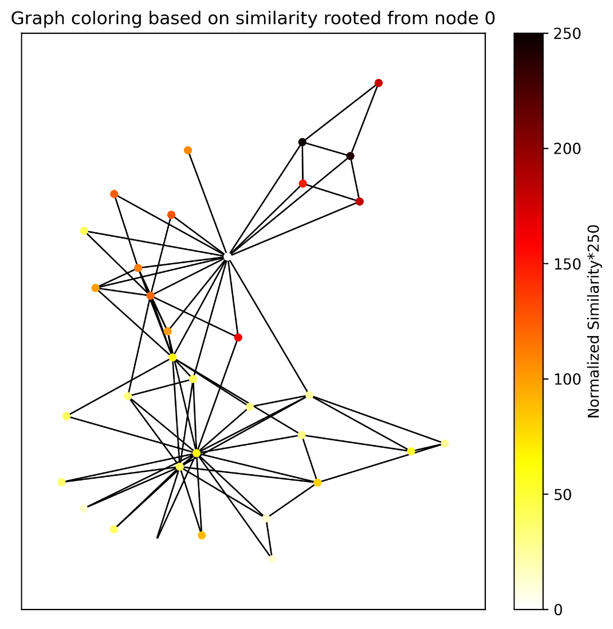
Walklets k=2
RandomWalks

Slide 22
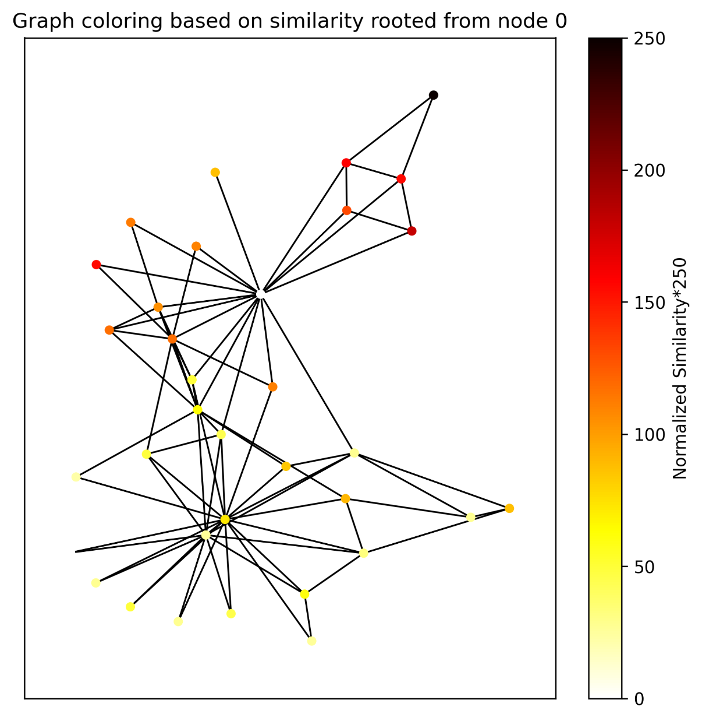
Walklets k=3

Slide 23
*Homophily causes the difference between uF1’s

Slide 24
Thank you!

