Slide 1

XYZ
Corporation
Phishing Identification

Slide 2
Content
Introduction
Methods
Data Cleanup
Grid Search
Scoring
Models
Computational Considerations
Results
Top Models
Who is a target
Why are they a target
Solutions
Conclusions
Notes:
Phishing: the fraudulent practice of sending emails purporting to be from reputable companies in order to induce individuals to reveal personal information, such as passwords and credit card numbers.

Slide 3




Introduction
Phishing
Reactive Costs
Who is a likely target and why?
What actions will decrease the amount of phishing attacks?

Slide 4






Introduction

Slide 5




Introduction
Four Classifications:
Desirable
Less Desirable
Least Desirable

Slide 6
Methods

Slide 7

Data Cleanup
14k rows in length – 11k for training, 3k for testing
No extraneous characters, obvious errors, or crazy outliers
Most columns were categorical and numerical
Two columns were strings
Converted to lowercase
Missing Values

Slide 8
Grid Search
Variety of potential classifiers
Various combinations of parameters
Hold out test set used to compute relative performance
Exhaustive Grid Search
Cross-Validation:
10 fold cross-validation scheme proved too time consuming
5 fold cross-validation allowed for an adequate amount and equated to 20% data hold out for validation

Slide 9
Scoring
1. Minimizing the
Harmonic Mean of Precision and Recall = F1
=
Maximizing precision
=
Maximizing recall
2. Assign Appropriate Weighting
Weighted variant for F1 = f-beta

Slide 10
Models
Tree-Based Classifiers
Decision trees
Random forests
Fit with gini and entropy criterion
Bootstrap and oob both on and off
Various leaf configs
Square root and log maximum features

Slide 11
Models
Ridge Classifier – 6 solvers for a range of alpha between 0 and 1
Logistic Regression – 5 solvers with each of I1, I2, elastic net, or no penalty, an exponential set of C value and an I1 ratio of between 0 and 1
Passive Aggressive Classifier – similar range of C values
Support Vector Machine – compute expensive, so reduced parms
Ada Boost – varied the learning rate between .01 and .5
Stochastic Gradient Descent – similar to logistic regression

Slide 12
Models
3 Exotic Models
LightGBM – 4 boosting methods with depths between 2 and 10 and learning rates between .05 and .1
XGBoost –same depths and learning rates, varying numbers of estimators between 60 and 220
Multilayer Perceptron – 4 activations, 3 common solvers, 3 learning rates, 5 increasing alphas

Slide 13
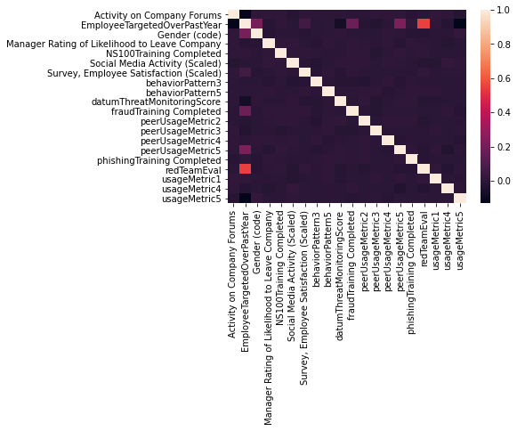

Indicators of Causality
Correlations
Red Team Evaluation
Metric 5
Fraud Training
Gender

Slide 14
Results

Slide 15
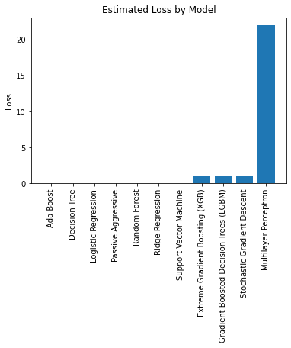
Top Models
AdaBoost
Decision Tree
Logistic Regression
Passive Regressive
Random Forest
Ridge Regression
Support vector Machine
+ 5 *
Cost =

Slide 16
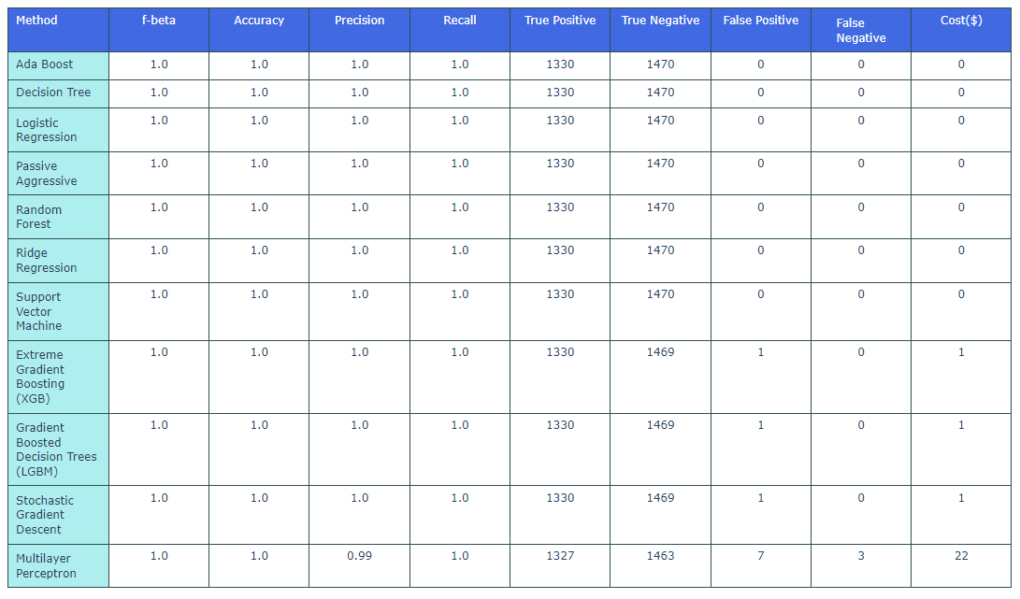
Top Models

Slide 17
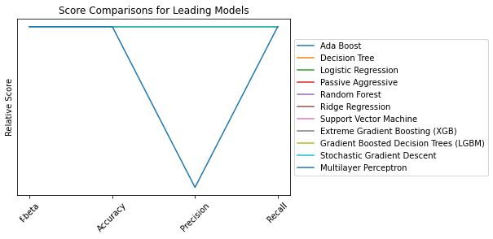
Relative Performance

Slide 18
Conclusions
The best model was Ada Boost.
The Neural Network was poor and not recommended.
Red team evaluation had the strongest correlation to phishing attacks.
REST API is deployed but has a bug – apply holdout dataset when fixed
Recommend deeper look at red team for additional features and analysis

Slide 19
Thank You

