Slide 1

XYZ
Sportswear

Slide 2
Content
Introduction
Current Data
Methods
Classifications
Data Cleanup
Grid Search
Scoring
Results
Global explainability
Biased data
Removing bias
Conclusions
Holdout dataset
Notes:
Phishing: the fraudulent practice of sending emails purporting to be from reputable companies in order to induce individuals to reveal personal information, such as passwords and credit card numbers.

Slide 3

Introduction
Employee Turnover
Reactive Costs
300%
Which employees will likely leave and why?
What actions will decrease the rate of turnover?
Notes:
Reactive Costs Annual Salary of 300%

Slide 4
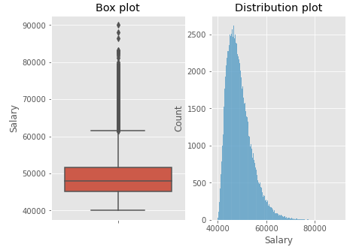
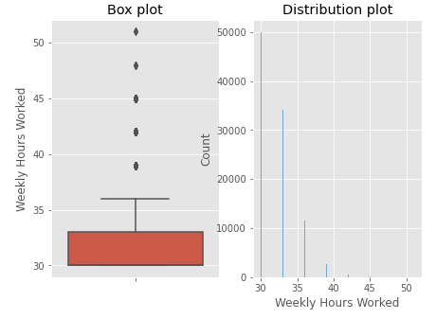
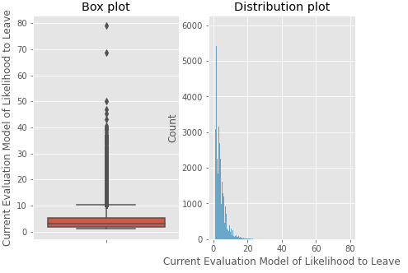
Analysis

Slide 5
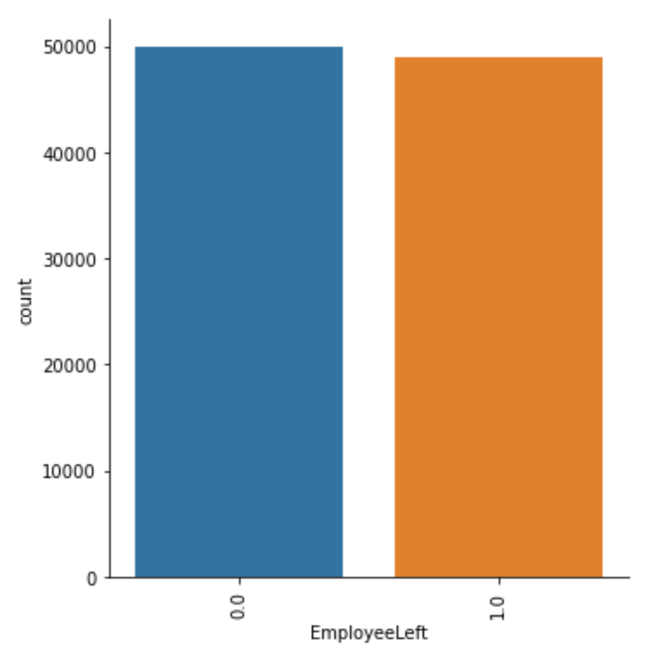
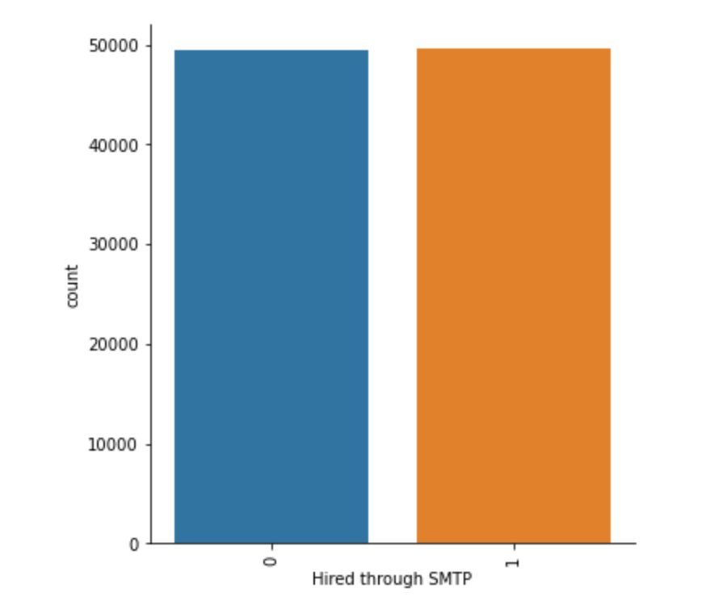
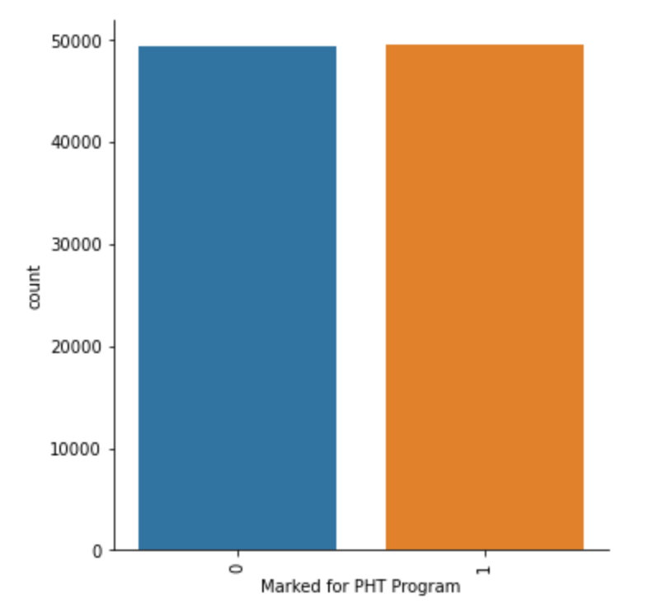
Analysis

Slide 6
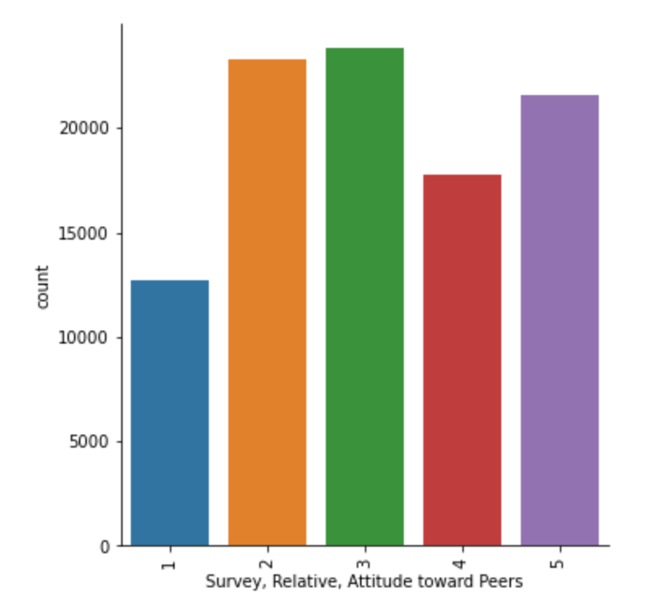
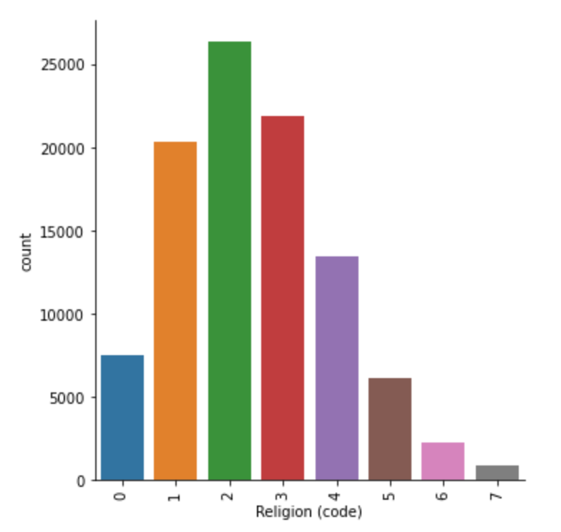
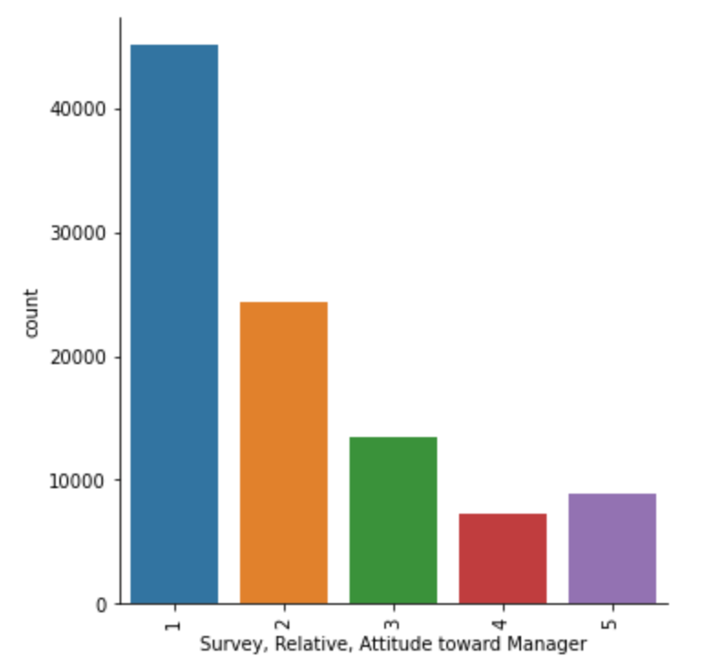
Analysis

Slide 7
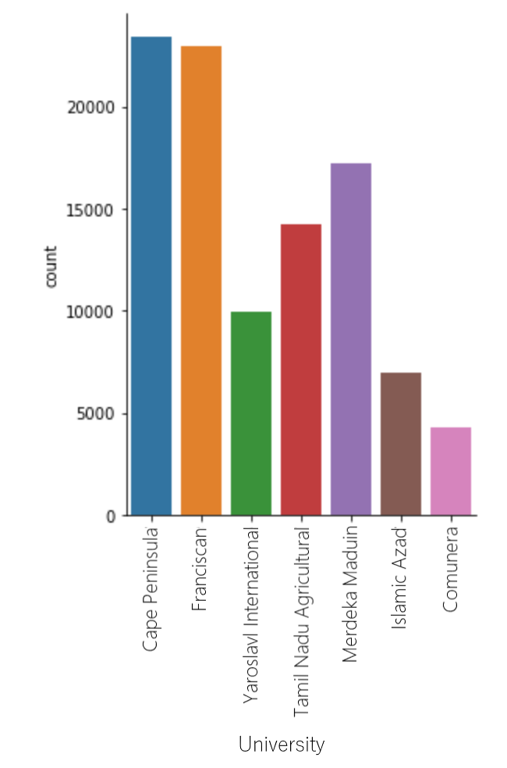
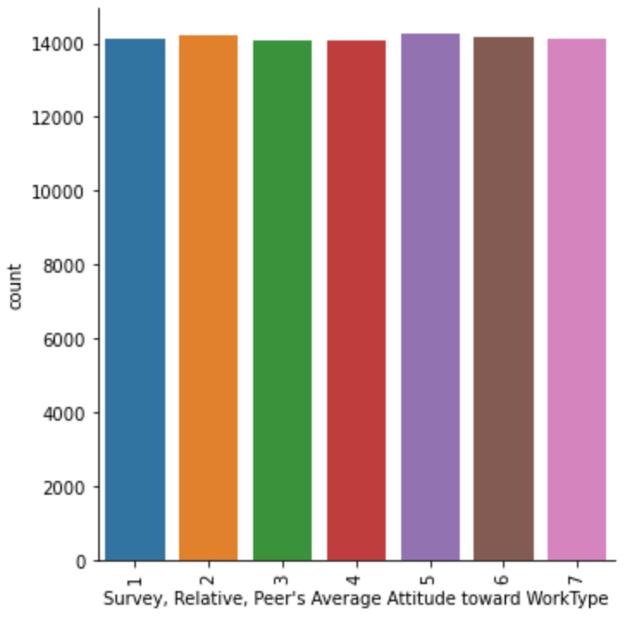
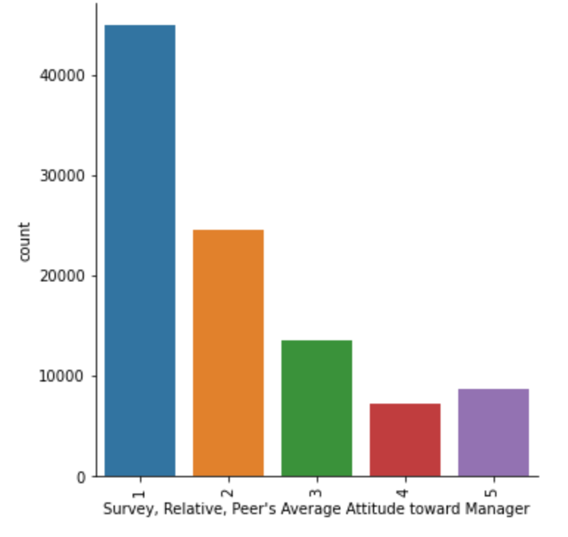
Analysis

Slide 8
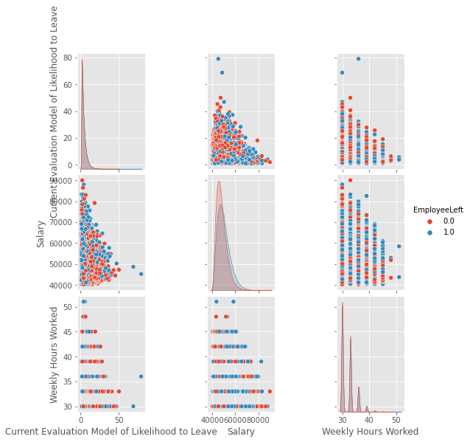
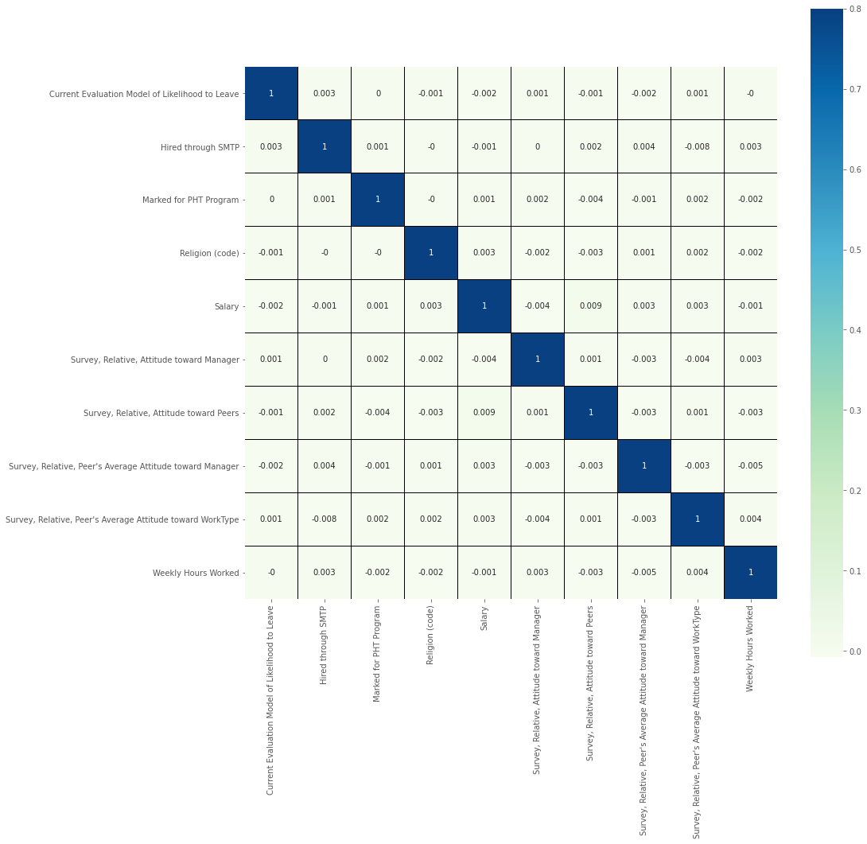
Analysis
Correlations

Slide 9




Classifications
Four Classifications:
TP/TN
False Negatives = FN
False Positives = FP
True Negatives = TN
True Positives = TP
FP
FN
Notes:
TP/TN Correctly predicts no cost
FP Wrong predict no cost
FN wrong predict High cost

Slide 10



Data Cleanup
99k rows in length
No extraneous characters, obvious errors, or crazy outliers
Most columns were categorical
One column was a string
Two continuous
Missing Values

Slide 11
Grid Search
Variety of potential classifiers
Various combinations of parameters
Hold out test set used to compute relative performance
Exhaustive Grid Search
Only one classifier (XGBoost) used initially to save time
Cross-Validation:
10 fold cross-validation scheme proved too time consuming
5 fold cross-validation allowed for an adequate amount and equated to 20% data hold out for validation
Notes:
In the interests of time the first pass only had one classifer

Slide 12
Results

Slide 13
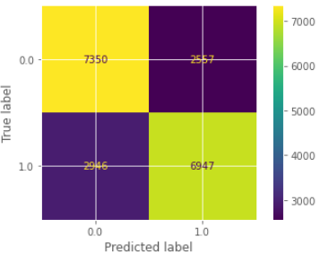
Scoring
False negatives are the most expensive
Optimize to minimize false negatives
Use recall for classifier scoring
Recall Score = 0.7142157484971339

Slide 14
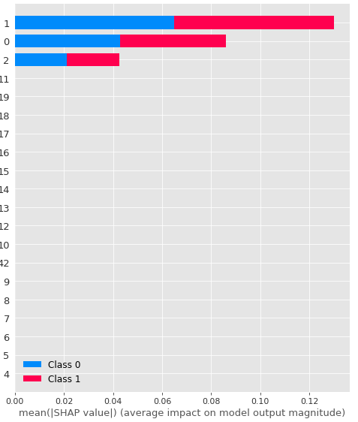
Explainability
Global
Shap summary plot
Top influencing variables
1 = Marked for PHT Program
0 = Hired through SMTP
2 = Religion (code)
Notes:
# Plot global explainability shap.summary_plot(shap_values, encoded_x_test) # From list earlier: # 1 = Marked for PHT Program # 0 = Hired through SMTP # 2 = Religion (code)

Slide 15
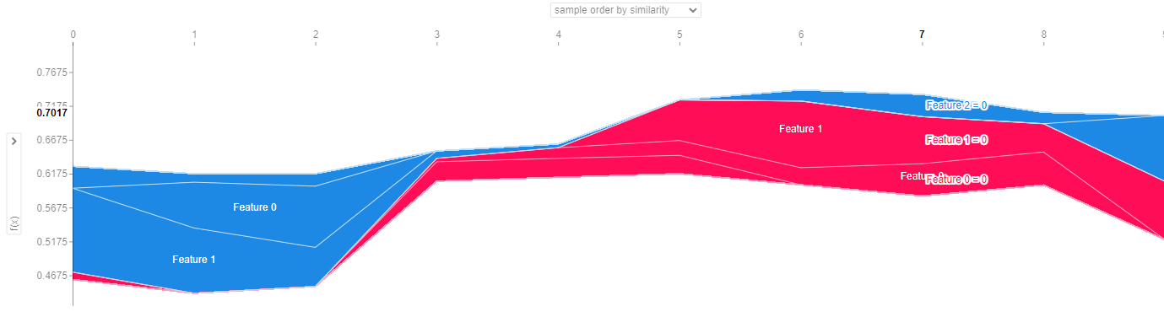
Explainability
Local
Shap force plot
Top influencing variables
1 = Marked for PHT Program
0 = Hired through SMTP
2 = Religion (code)
Notes:
# Plot global explainability shap.summary_plot(shap_values, encoded_x_test) # From list earlier: # 1 = Marked for PHT Program # 0 = Hired through SMTP # 2 = Religion (code)

Slide 16
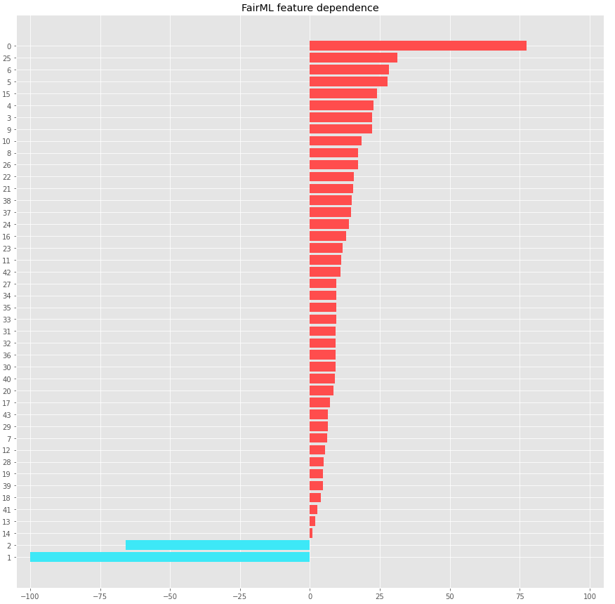
Bias
Fair ML feature dependence
Top influencing variables
1 = Marked for PHT Program
0 = Hired through SMTP
2 = Religion (code)
Religion is a protected group
Remove from data due to excessive influence
Notes:
Religion

Slide 17
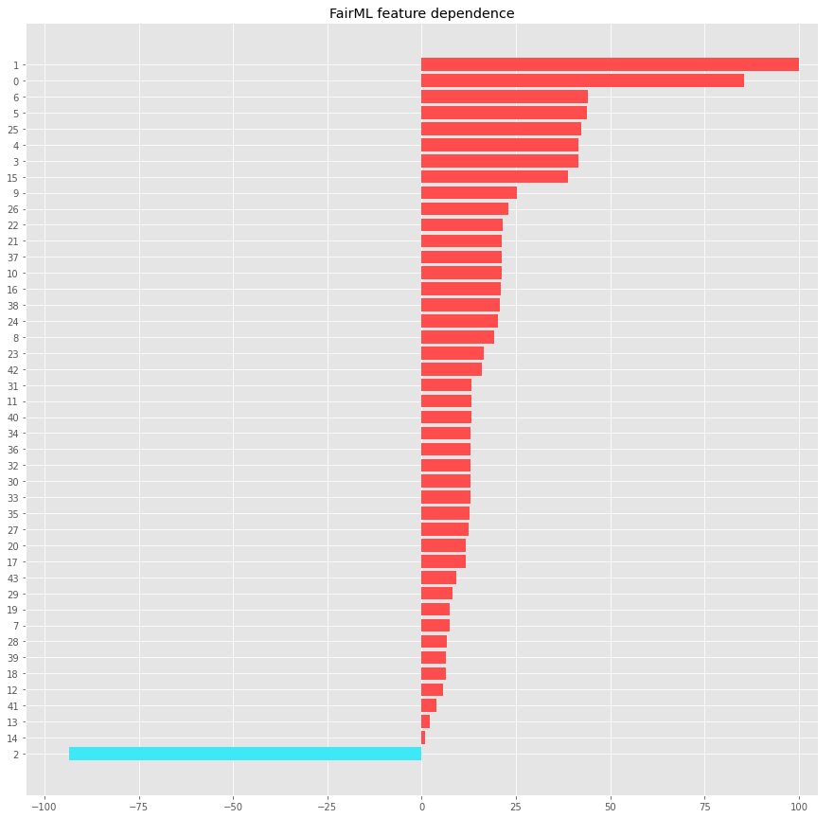
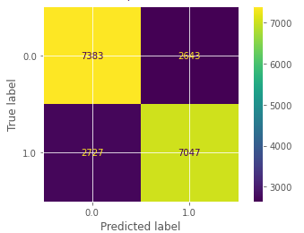
Bias
Removing bias
Remove Religion
Retrain
Recall Score (unbiased): 0.7152769813159423
New top influencing variables
0 = Hired through SMTP
1 = Marked for PHT Program
2 = Survey, Relative, Attitude toward Manager

Slide 18
Conclusions
Religion biased against a protected group
Remove religion in future analyses
Without religion, opinion of manager emerges
Manager relationship training
Employee culture vetting
Standards of management
Examine the PHT program
Why is this so influential?
Is bias also a concern?
Employees hired from SMTP (email)
May not be as invested
May not be vetted as thoroughly
Potential for fraud
Run the full grid search when time allows
Find better model
Tune hyperparameters
Additional bias mitigations
IBM AI Fairness 360
Google What-If tool
Lime

Slide 19
Thank You

