Slide 1
L02: Fine-Tuning a Pretrained Large Language Model

Slide 2
L02 Summary
What is Fine-tuning
Overview of Fine-Tuning Steps
Data Collection
Preprocessing the training data
Fine-tuning the model
Recap L01

Slide 3
Recap: L01 – Running a GPT-2 Model Locally
Running an LLM locally/Google Colab
Loaded GPT-2 + tokenizer from Hugging Face
Encoded input text using the tokenizer
Generated text with model.generate(...)
Tuned parameters: temperature, top_k, top_p, repetition_penalty
Ran experiments + homework

Slide 4
Key things to remember
Tokenization – for encoding/decoding between text and Token IDs
This is a sentence.
Tokens
This | is | a | sentence | .
1212 | 318 | 257 | 6821 | 1012
Token IDs
Parameters: temperature, top_k, top_p
Local GPT-2 (117M) is small, and its results are often generic (ok for learning, not for production)

Slide 5
Why Fine-tuning? Limitations of a Pre-Trained Model
Difficulty in understanding the context
May generate incorrect or misleading information
Hallucinations: nonsensical, detached from reality answers
Not Domain Specific
Lacks specialized knowledge

Slide 6
Fine-tuning
Fine-tuning is the process of continuing training a pretrained model on a new, often smaller dataset, so the model adapts to a specific task or domain.
Fine-tuning means tweaking the model’s parameters to make it better at performing specific tasks
Fine-tuning continues an LLM's training by optimizing its parameters on new data from a target domain or task
How It Works
Start with a model that already knows language (pre-trained model)
Feed it new data/examples
Update only some (or all) model weights to learn task-specific patterns -> specialized LLM

Slide 7
Examples of Tasks
Sentiment analysis
Medical chatbot tuning
Legal or technical document adaptation
Stylistic rewriting (e.g., formal/informal)
…

Slide 8
Training from Scratch vs Fine-Tuning
Training From Scratch | Fine-Tuning
Needs huge data | Can work with a small dataset
Expensive (compute) | Affordable on GPU or even CPU
Long training time | Fast (minutes to hours)
Starts from zero | Starts from “knows English”

Slide 9

Benefits of Fine-tuning
Performance
Reliability
More consistent responses
Increased knowledge
Greater Control
Decreased Hallucinations
A smaller (fine-tuned) model can often outperform larger (more expensive) models on the set of tasks on which it was fine-tuned!

Slide 10
Overview of Fine-Tuning Steps
Set a clear goal/task
Collect the training data
Model and Tokenizer
Training
Saving the Model
Next steps…
Setting up the environment

Slide 11
Step 1: Have a clear task in mind
Before fine-tuning a language model, clearly define what you want it to learn.
Our Task for this lab: Text Generation in Shakespearean Style
Goal: Fine-tune GPT-2 to generate original text that mimics the tone, vocabulary, and structure of Shakespeare's writing.
Why This Task?
Consistent writing style
Ideal for testing the adaptation of the model to the writing style
Easy to evaluate outputs

Slide 12
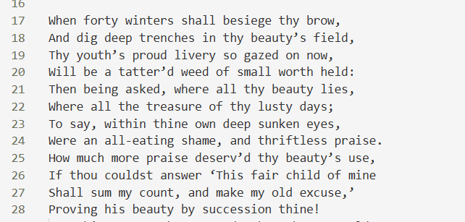
Step 2: Collect the training data
Our Data: Shakespeare Text Samples
Format:
Each line is treated as a text sequence
Stored in a .txt file for simplicity
Considerations:
Remove metadata or stage directions if needed
Keep consistent formatting for better model learning

Slide 13
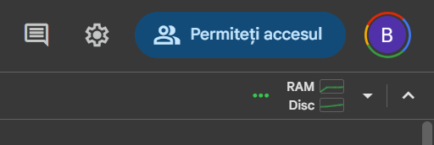
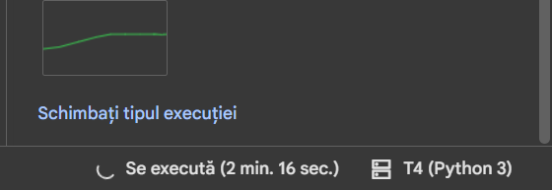
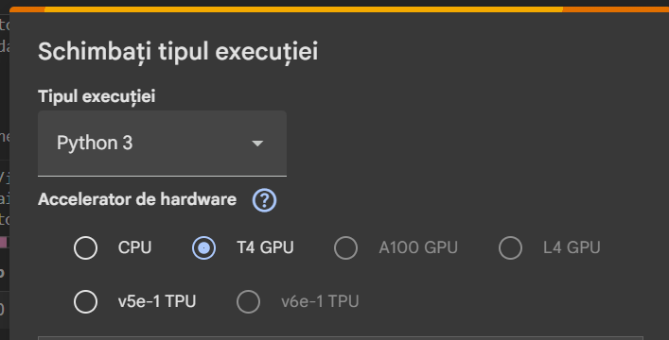
Step 3: Setting up the Environment – Google Colab
https://colab.research.google.com/drive/1PexpKG0BtFHrwmIJCv3FSxRRBGbxAoq5?usp=sharing
Environment: Google Colab notebook
! GPU has free limited use
You can also do it locally but you need to install everything manually, as well as make sure you have a powerful enough GPU
On Google Colab: Runtime : Change runtime type to T4 GPU
Top right corner

Slide 14
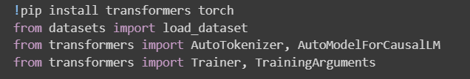
Step 3: Setting up the Environment – Google Colab
Write this:

Slide 15
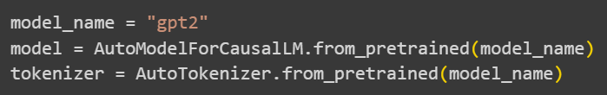
Step 4: Model and Tokenizer
Same as in L01, we will use gpt2 and its assigned tokenizer
Since gpt2 is a generative model, we will focus on the generation task
! For the homework, if you wish to fine-tune a model for classification (e.g. sentiment classification), you need to choose a classification model such as GPT2ForSequenceClassification, BertForSequenceClassification, or DistilBertForSequenceClassification, depending on the task structure you are using.
Don’t forget to use the correct tokenizer

Slide 16
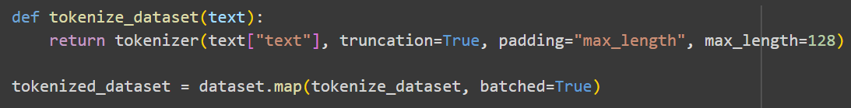
Step 5: Load Dataset and Tokenize it
Remember from L01!
A model won’t understand words, it will only understand numbers (token IDs)
Therefore, the whole dataset needs to be tokenized!

Slide 17
Step 6: Training 3 Ways to Parameter Training
Retrain all parameters (Full):
The most conceptually straightforward means of fine-tuning is to simply update the entire neural network
The only fundamental differences between the full fine-tuning and pre-training are the dataset and the initial state of the parameters
Very computationally expensive
Can cause “catastrophic forgetting”
Transfer Learning
Freeze most of the parameters
Fine-tune the last few layers (head)
Parameter Efficient Fine-tuning (PEFT)
Freeze all parameters
Augmenting a small number of trainable parameters
PEFT methods have often been demonstrated to be more stable than full fine-tuning methods

Slide 18
Step 6: Training
Setting Training Arguments
Use TrainingArguments
Initialize the Trainer
Use Trainer
Start the training
Use trainer.train()

Slide 19
6.1 Training Arguments
Name | Value | Description
output_dir |  | Where to save the trained model (checkpoints + final model)
num_train_epochs | 5 | How many full passes over the dataset — 1 is fast, 3+ learns more Rule of thumb: Start small (1–3 epochs) Increase if loss is still dropping
per_device_train_batch_size | 8 | How many samples per step per GPU If you hit an out-of-memory error, lower this (to 2 or 4)
logging_steps | 20 | Print training info (like loss) every 20 steps
save_steps | 250 | Save a model checkpoint every 250 steps
save_total_limit | 1 | Keep only the latest checkpoint to avoid filling disk space
warmup_steps | 50 | Gradually increases the learning rate from 0 to 5e-5 over 50 steps
learning_rate | 5e-5 | How fast the model learns. Smaller = slower but more stable updates For HW: Try 5e-5, 3e-5, and 1e-5 if unsure, see what happens!
weight_decay | 0.01 | Penalizes large weights to prevent overfitting. Helps generalization

Slide 20
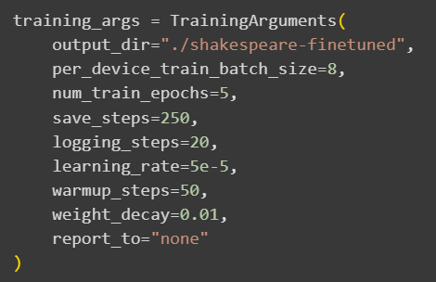
6.1 Training Arguments
Your turn! Write this:

Slide 21
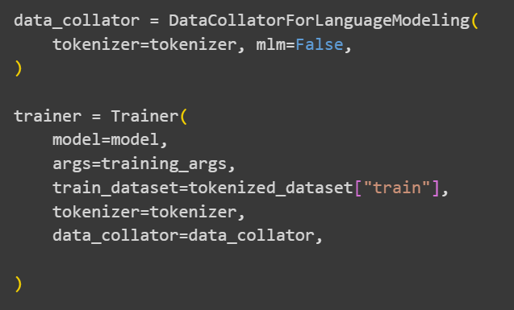
6.2 Initialize the Trainer
In Hugging Face, a data collator is a helper that batches, pads, and formats your data right before it's fed to the model during training.
It handles:
Dynamic Padding;
Formatting the batch into tensors
mlm set to False -> Causal LM
Padding means adding extra tokens to make inputs the same length in a batch, since the data is processed in batches and tensors must have the same shape (same number of tokens)
Sentence | Tokens | After Padding (to length 6)
"Hello world" | [101, 102] | [101, 102, 0, 0, 0, 0]
"How are you today" | [103, 104, 105, 106] | [103, 104, 105, 106, 0, 0]

Slide 22

6.3 Start the training

Slide 23
Results
Today I did not know that thou art, but knew thy worth; and yet my love was never so strong.’ So it is now, ‘Will of thee! why then do I say this: for Love knows no man can make such a lie. For what purpose dost she? Time spent in me lies, till he come again came. And thus shall his story be told. Wherefore hate should ever live on him, though new finder. To-doth life

Slide 24
Homework
Fine-tune a language model on a custom dataset of your choice.
You choose:
The model (e.g., GPT-2, DistilGPT2)
The task (text generation, creative writing, etc.)
The dataset (poetry, jokes, stories, lyrics, dialogue...)
Adjust epochs, batch size, learning rate, etc.
Save your fine-tuned model
Generate outputs
Reflection (5–10 sentences)
What worked well?
Did the model learn the style?
Any interesting, funny, or weird results?
Would you change anything next time?
Write a small report. As usual, send the homework to bianca.ebrasu@gmail.com

