Slide 1
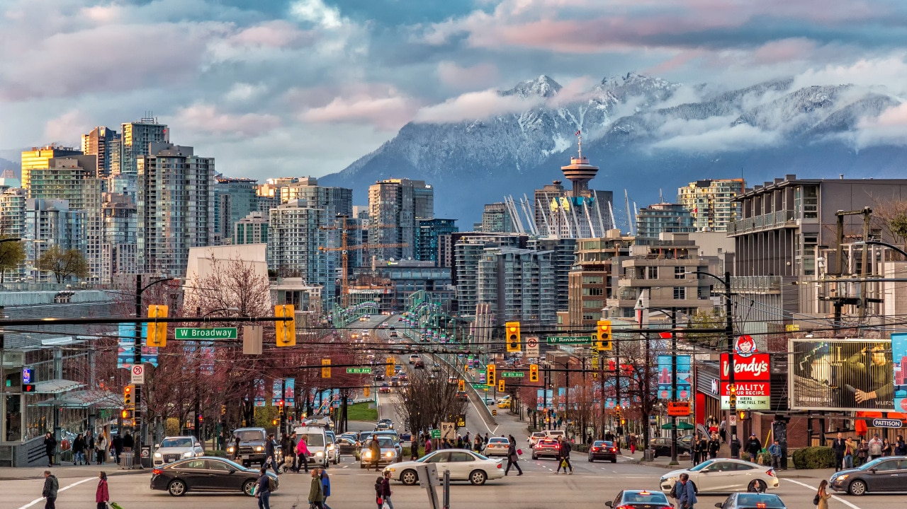




Canadian Housing Market Analysis
Top 45 Cities Across Canada
Edward Agyemang
Northeastern University — Vancouver Campus
April 2026
34,381 Listings
45 Cities
9 Provinces

Slide 2




Data at a Glance
34,381
45
Research Questions
Listings After Cleaning
Cities Covered
1
How do listing prices vary across Canadian provinces?
2
Which cities have the highest and lowest median listing prices?
9
Oct 29 2023
3
Do higher incomes mean proportionally higher home prices?
Provinces Covered
Data Collection Date
4
Which cities are the least and most affordable relative to family income?
National Median Price
National Mean Price
$699K
$879.8K

Slide 3
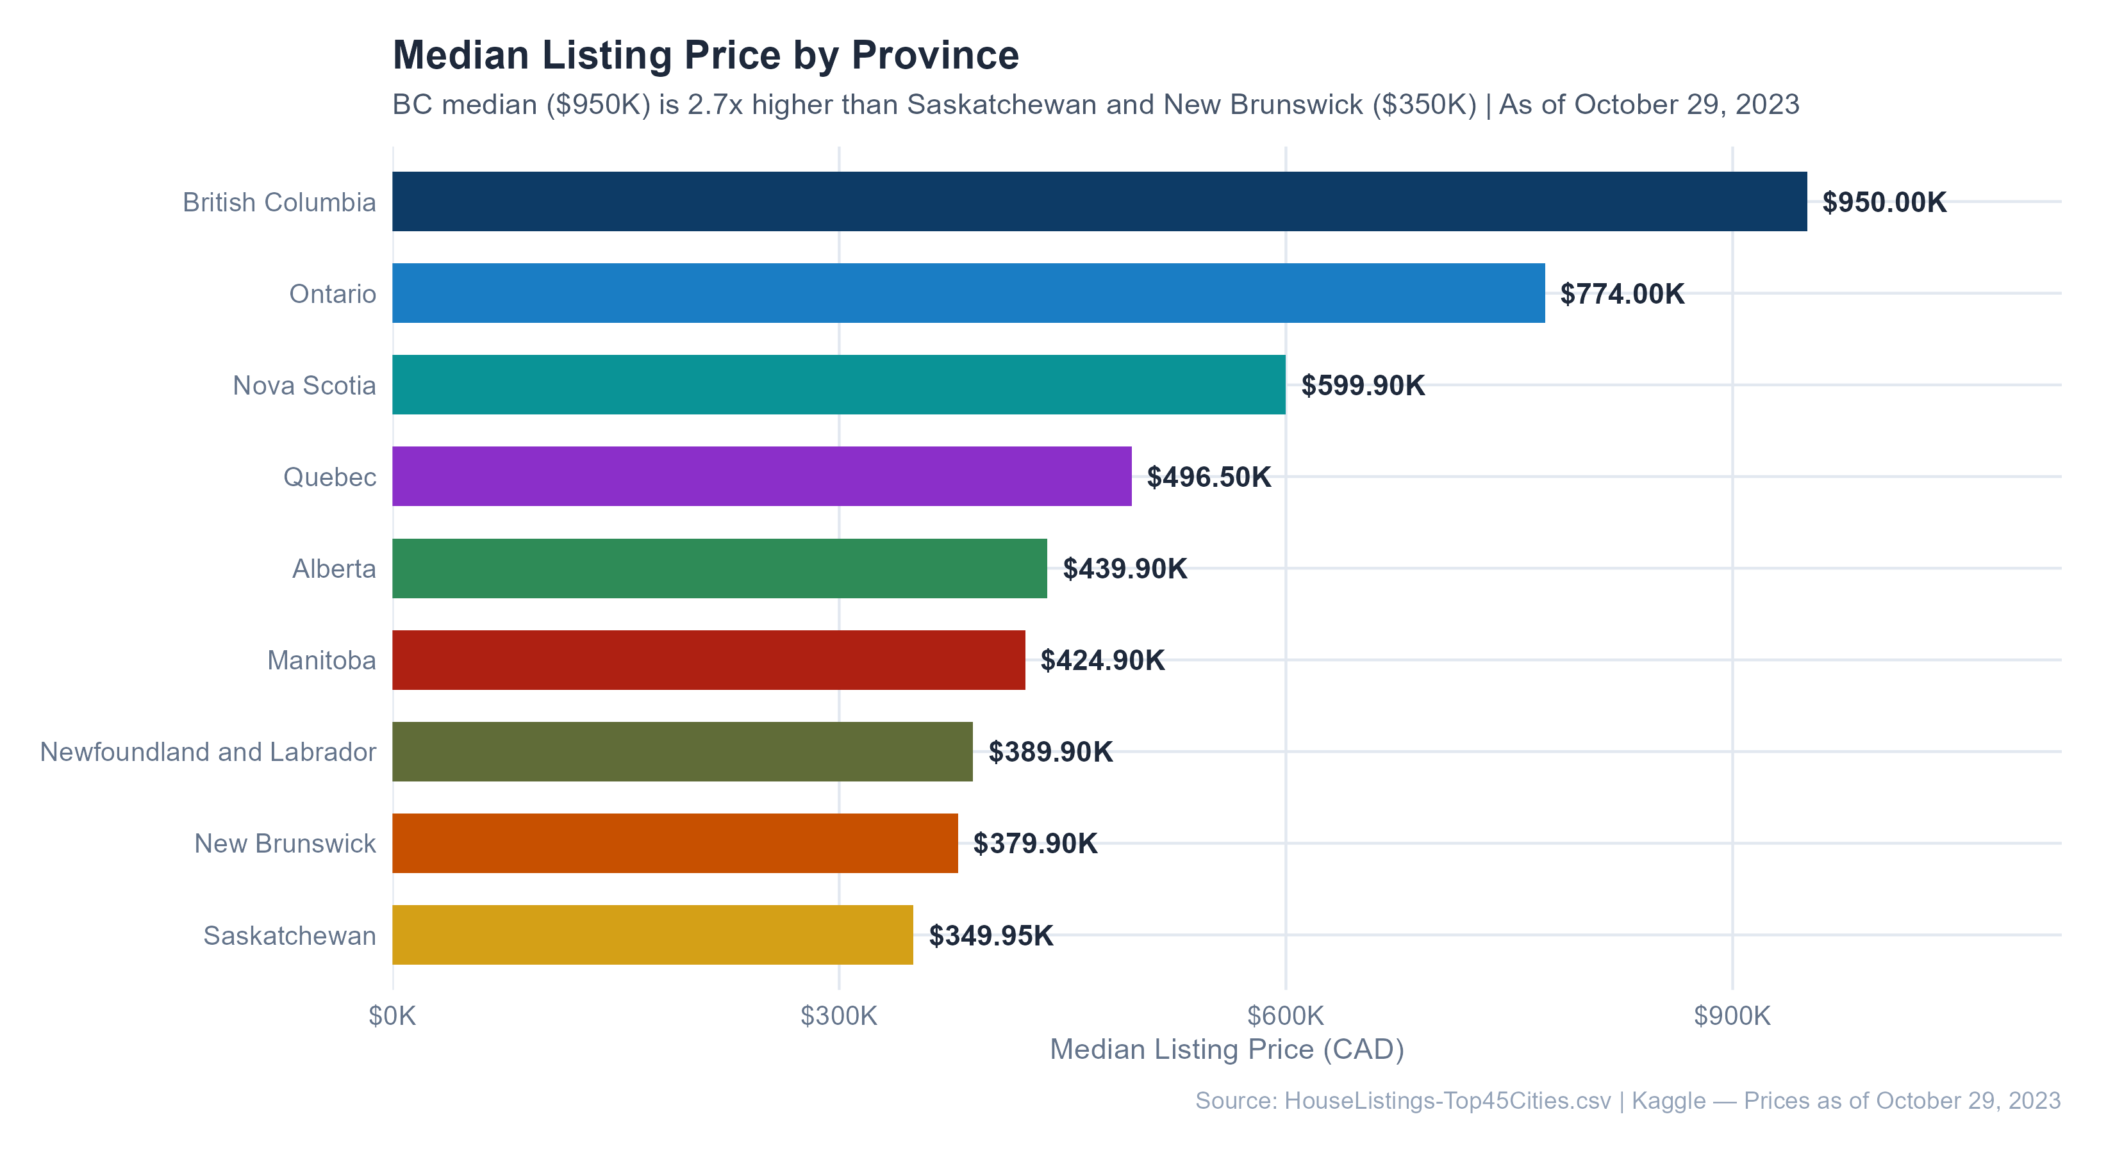


Canada Has 9 Different Housing Markets
Key Gap
$950K
BC:
$350K
Sask:
2.7x
Price Difference
Main Takeaway
Location determines affordability more than any other factor

Slide 4

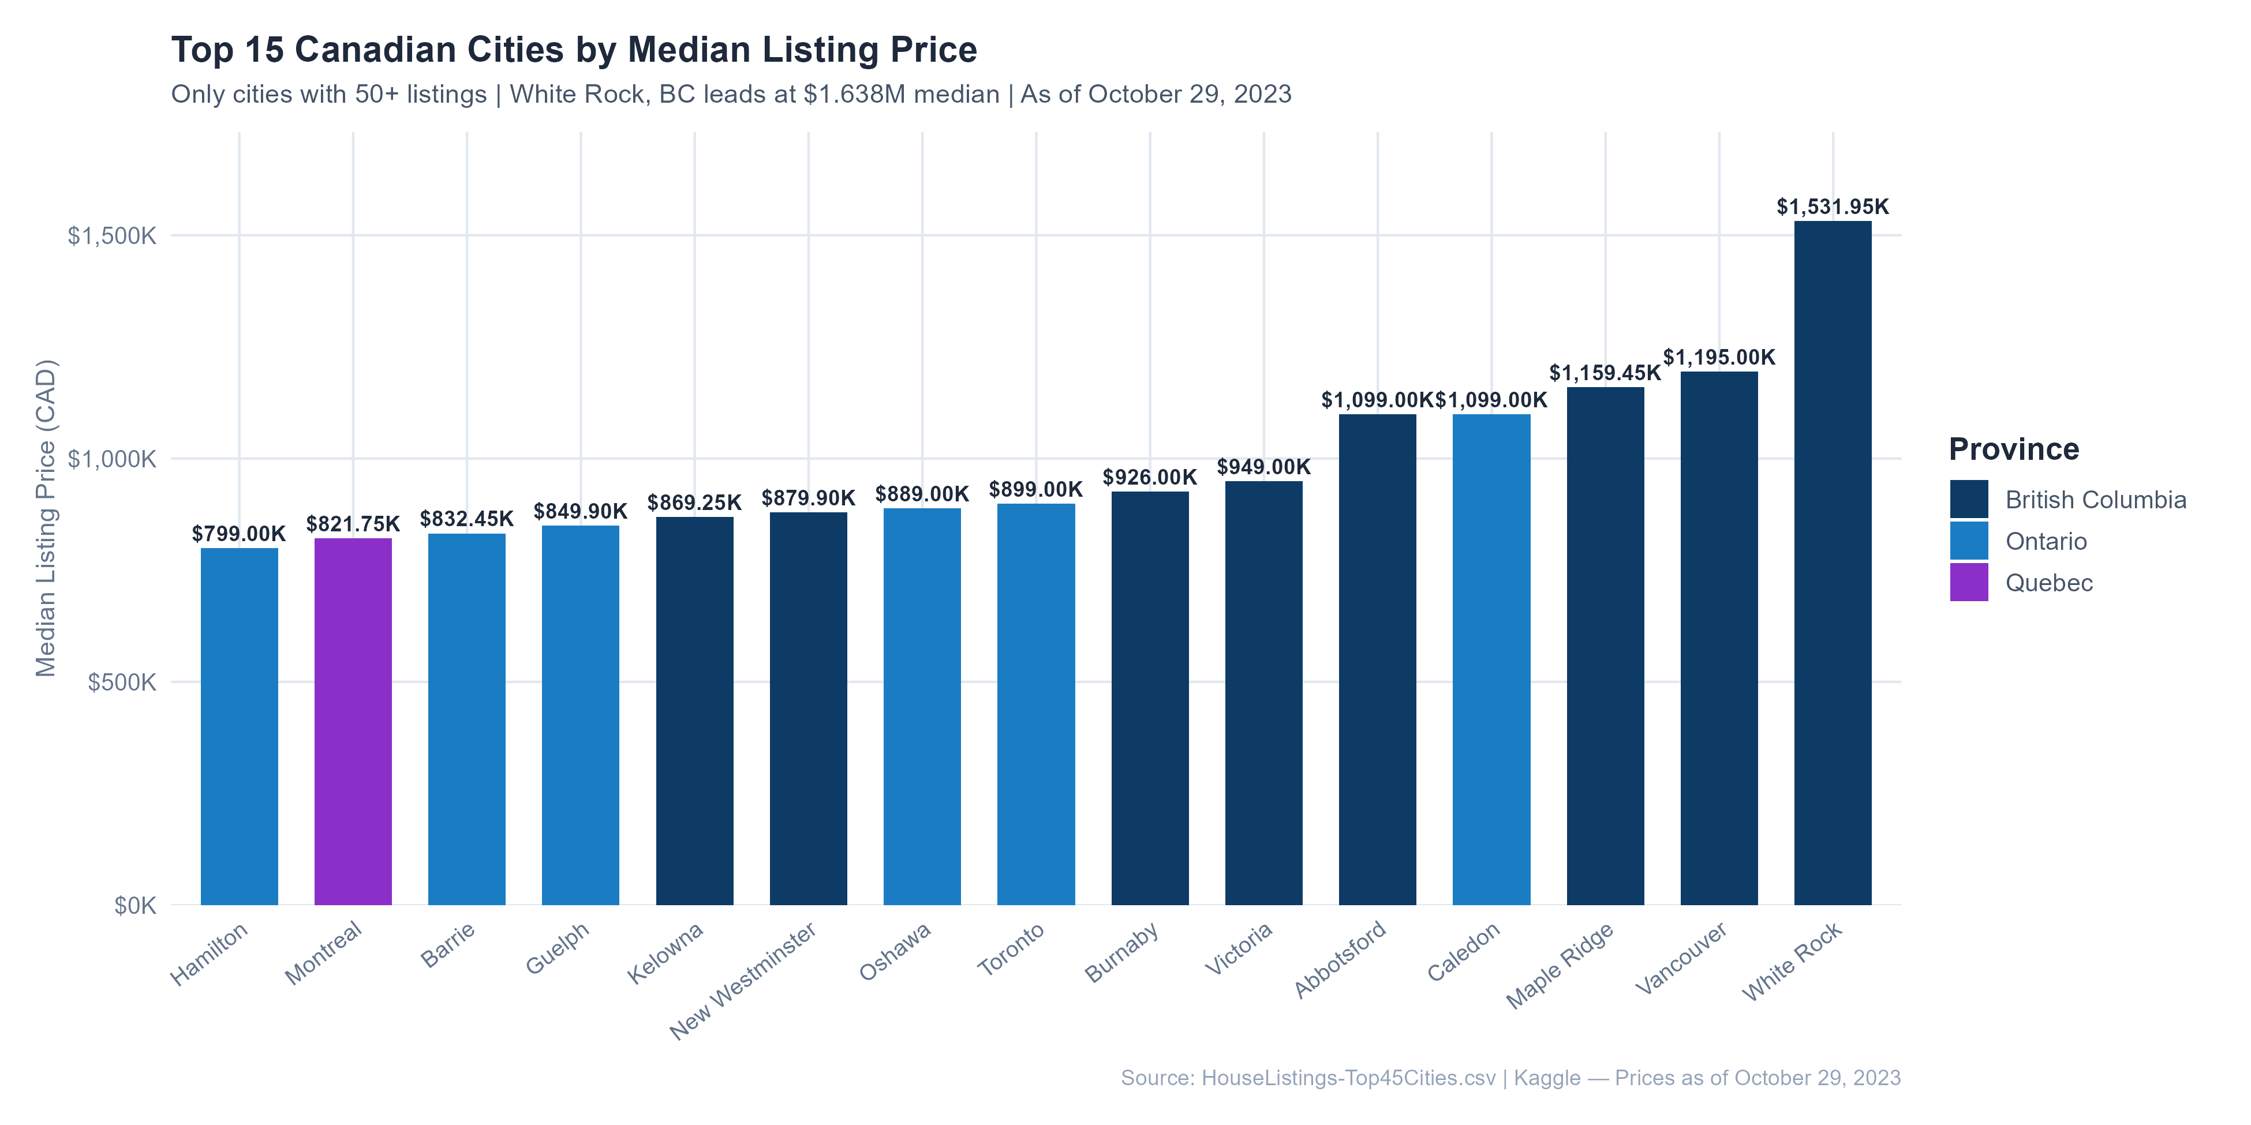


BC Dominates the Top Tier
Most Expensive City
$1.53M
White Rock:
BC Dominance
6 out of 6
Top most expensive cities are all in British Columbia
Toronto Ranking
8th
Rank:
at $899K

Slide 5
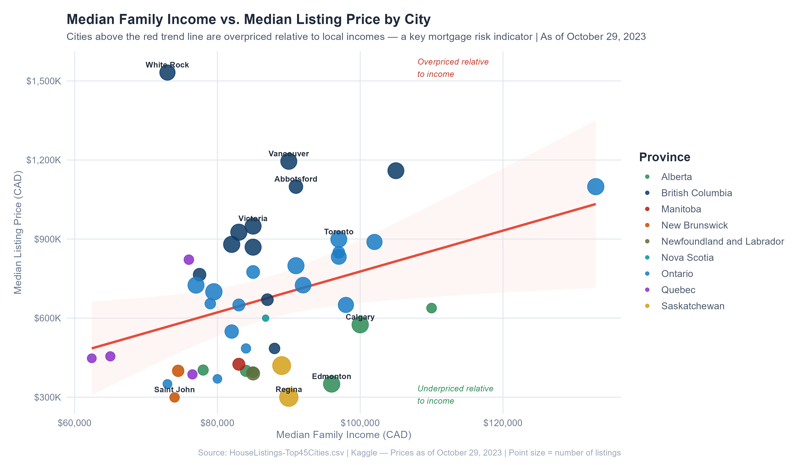




Income vs Price: The Mortgage Risk Map
Above Line = Overpriced
Higher mortgage default risk
Below Line = Underpriced
Lower mortgage default risk
Severely Overpriced
White Rock, Vancouver, Abbotsford
Underpriced Relative to Income
Regina, Edmonton

Slide 6

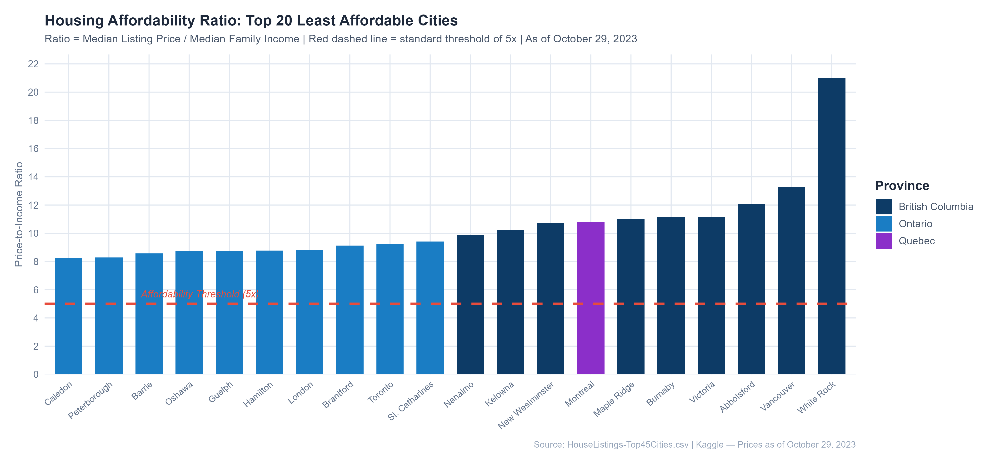

The Affordability Crisis
Least Affordable
21x
White Rock:
Critically Unaffordable
Global Threshold
5x
Internationally recognized:
Housing is considered affordable below 5x
Montreal
Toronto
10.8x
9.3x

Slide 7
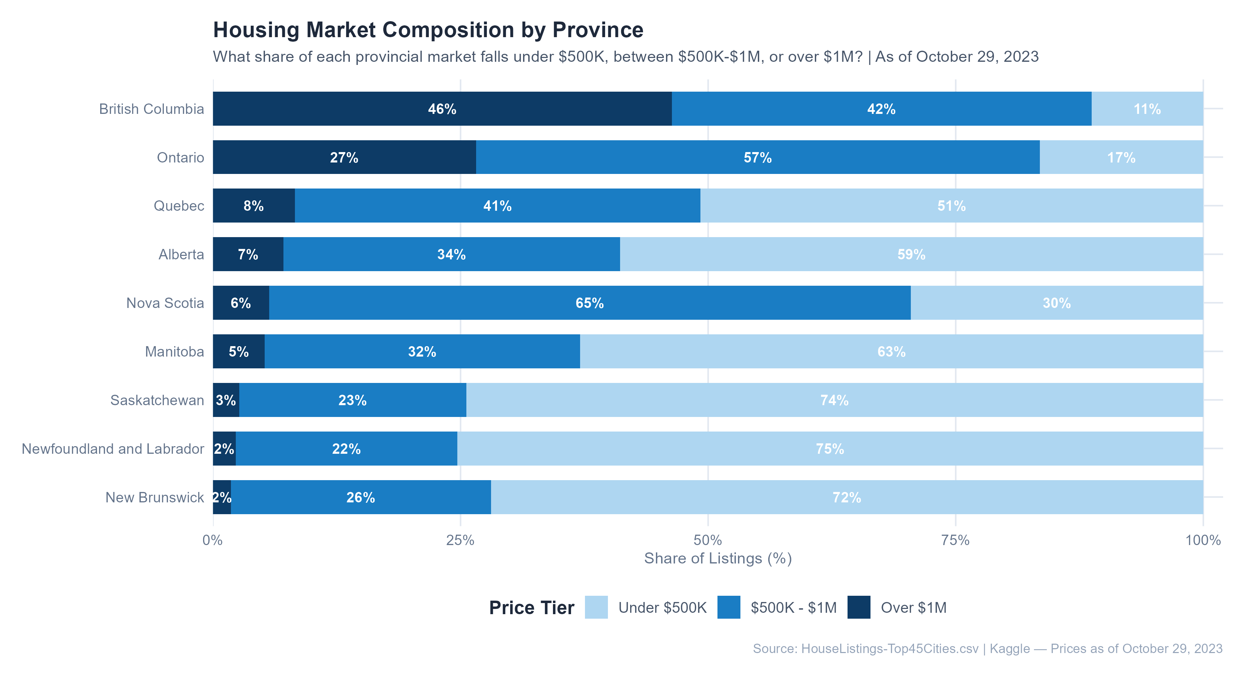



Market Structure by Province
British Columbia
46%
over $1M
Only 11% under $500K
Ontario
Balanced market 27% over $1M · 57% $500K-$1M · 17% under $500K
Affordable Markets
Saskatchewan, Newfoundland, NB 74-75% under $500K
Alberta
59% under $500K Despite oil wealth

Slide 8

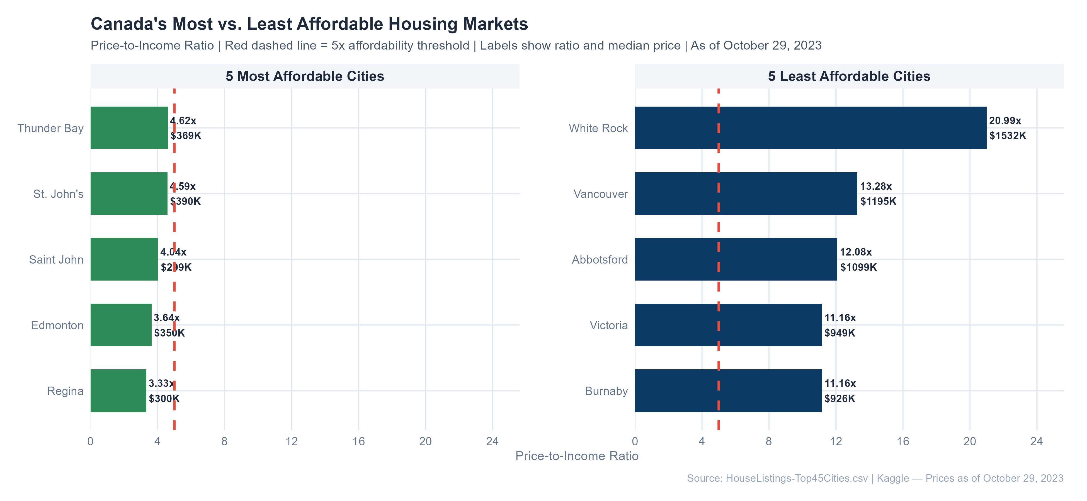

The 6x Gap Between Best and Worst
Most Affordable
3.33x
3.64x
4.04x
Regina
Edmonton
Saint John
Prairie & Atlantic cities
Least Affordable
21x
13.3x
12.1x
White Rock
Vancouver
Abbotsford
All 5 least affordable cities are in BC
The Gap
6x
More than
Between Canada's least and most affordable markets

Slide 9
Key Takeaways
1
2.7x
Higher
2
6/6
BC ($950K) vs Saskatchewan ($350K)
All most expensive cities are in BC
Location determines affordability more than any other factor
Structural supply crisis that individual buyers cannot solve alone
3
Above Line
4
46%
BC cities far above income-price regression line
of BC listings are priced over $1M
Decoupled from earnings — elevated mortgage default risk
Out of reach for families on average incomes
White Rock: 21x
vs
Regina: 3.33x
5
6x gap between Canada's least and most affordable markets — larger than almost any other developed country

Slide 10

Thank You
Canada's housing market varies dramatically by province and city. Location is the single biggest factor in housing affordability, with a 6x gap between the most and least affordable markets.
British Columbia faces the most severe affordability crisis, with home prices decoupled from local incomes.
Edward Agyemang | Northeastern University — Vancouver Campus | April 2026

