Slide 1
FOOD INSECURITY
24%
of Canadians food-insecure
(2024 — record high)
& POVERTY IN CANADA
+43%
A Structural Analysis of Unemployment, Income Inequality,
Housing Affordability, and Food Insecurity Across Canadian Provinces and Cities
rise in food insecurity
since 2018
78%
Edward Agyemang
MPS Data Analytics | Northeastern University, Vancouver | May 2026
food-insecure households
are ABOVE the poverty line
Data: Statistics Canada 2021 Census • Canadian Income Survey 2018–2024 • Uppal (2023)
Notes:
Welcome. This presentation explores how structural factors — income inequality, housing costs, unemployment, and social marginalization — interact to drive food insecurity across Canada. The headline finding is already counterintuitive: 78% of food-insecure Canadians live above the poverty line. This challenges standard narratives and is the central analytical thread of the entire study.

Slide 2
CONTEXT
The Scale of the Crisis
Between 2018 and 2024, food insecurity in Canada rose nearly 43% — faster than any other comparable nation. Yet hunger in Canada is not primarily a story of unemployment or poverty. It is a story of structural conditions: unaffordable housing, precarious employment, income inequality, and systemic marginalization.
10M
2.5M
52%
40.6%
36.8%
Canadians food-insecure
(2024)
Children in food-insecure
households (2024)
Female lone-parent families
food-insecure (2022)
Food insecurity rate
among Black Canadians
Food insecurity rate
among Indigenous peoples
Field Perspective: Vancouver's Downtown Eastside
As a Building Operator across 13 properties in Canada's most studied urban poverty zone (2023–2025), I witnessed daily how structural conditions — not individual choices — determine whether people can access food, housing, and dignity. This analysis puts data behind that lived reality.
Notes:
These five statistics establish why this analysis matters. The DTES callout box grounds the quantitative work in direct lived experience — a differentiator that makes this project distinctive on both a job application and a PhD application.

Slide 3
RESEARCH DESIGN
Four Research Questions
RQ1
The Income-Insecurity Paradox
Does higher median income protect against food insecurity, or do housing costs and inequality neutralize that advantage?
RQ2
The Quebec Exception
What structural factors explain Quebec's persistent food security advantage — and did it hold through the COVID shock?
RQ3
Unemployment vs Food Insecurity: A Broken Relationship?
Has unemployment lost its predictive power over hunger, given that 78% of food-insecure households are employed?
RQ4
Building a Provincial Vulnerability Index
Which structural combination of indicators best predicts provincial food insecurity risk?
Notes:
Each research question is designed to challenge conventional wisdom. RQ1 tests whether income is protective. RQ2 isolates social policy as a structural buffer. RQ3 directly challenges the standard unemployment-hunger link. RQ4 synthesizes all indicators into a composite risk score.

Slide 4
DATA SOURCES
Three Statistics Canada Datasets
DATASET 01
DATASET 02
DATASET 03
Census Profile — Provinces
Census Profile — Cities (CMAs)
Canadian Income Survey
98-401-X2021001
98-401-X2021002
Table 13-10-0835-01
Income, unemployment, LIM-AT, Gini,
housing burden — 10 provinces + Canada
Same indicators across 41 Census
Metropolitan Areas (cities)
Food insecurity rates 2018–2024
by province, severity and demographics
Analytical Methods
Exploratory Data Analysis (EDA)
Pearson Correlation Analysis
7-Year Longitudinal Trend Analysis
Min-Max Normalized Vulnerability Index
City-Level Structural Comparison
Demographic Equity Analysis
Notes:
All three datasets are from Statistics Canada — open licence, peer-reviewed data collection standards. The 2021 Census provides the structural snapshot; the CIS provides the food insecurity outcome variable over 7 years. Note that 'Canada' appears in the province dataset as a national benchmark row — retained deliberately for RQ2 comparisons, excluded from all correlation and vulnerability index calculations which use provinces only.

Slide 5
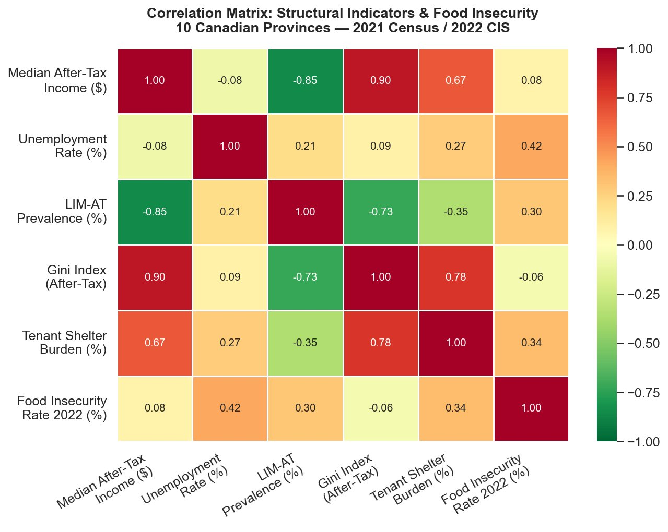
EXPLORATORY ANALYSIS
Structural Indicator Relationships
KEY CORRELATIONS
r = −0.85
Income ↔ LIM-AT
Higher income provinces have far fewer people in low income — strong negative link
r = +0.90
Income ↔ Gini
Higher income provinces also have greater inequality — income and inequality co-move
r = +0.78
Gini ↔ Shelter
More unequal provinces also have heavier housing cost burdens on tenants
r = +0.34
Shelter ↔ Food Insec.
Housing burden has the strongest structural link to food insecurity
r = +0.42
Unemployment ↔ Food
Unemployment correlates positively but is not statistically significant (p=0.23)
Notes:
The heatmap reveals the structural architecture of poverty in Canada before a single analysis chart is drawn. The most surprising finding: Gini index is essentially uncorrelated with food insecurity (r = -0.06). This challenges the assumption that inequality drives hunger at the provincial level — other structural factors appear to matter more within the range of Canadian provincial inequality.

Slide 6
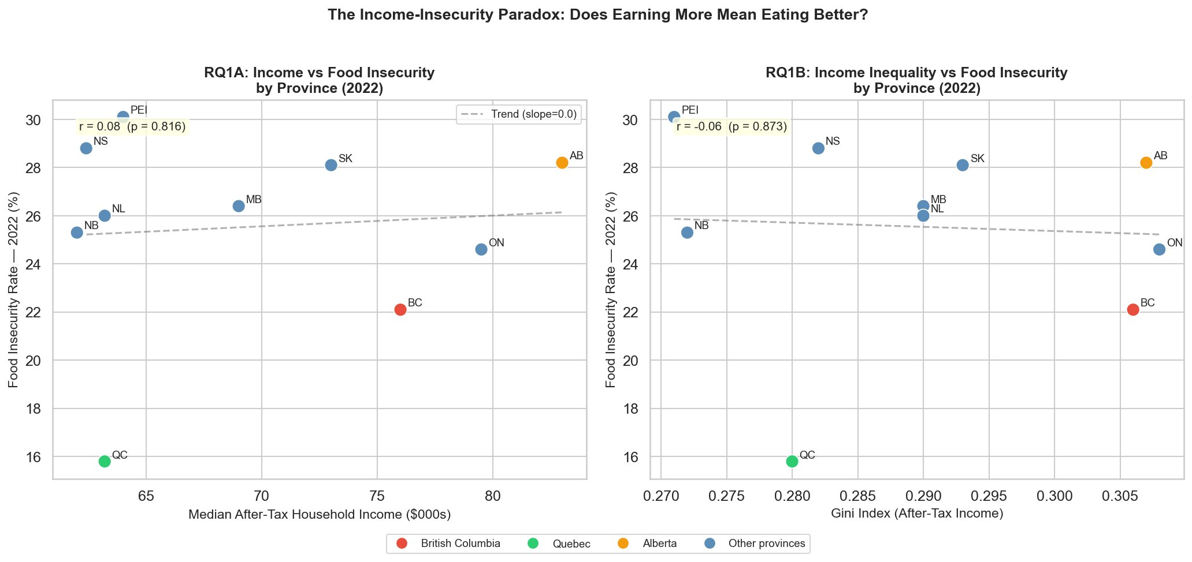
RQ1 — INCOME PARADOX
Does Earning More Mean Eating Better?
r = 0.08 (p = 0.82) — income is essentially uncorrelated with food insecurity at the provincial level.
Notes:
RQ1 Answer: No — earning more does not systematically protect against food insecurity at the provincial level. Alberta earns the most ($83K median) but has 28.2% food insecurity. Quebec earns among the least ($63.2K) but has only 15.8% — lowest in Canada. BC earns $76K with 22.1% food insecurity, well below the regression line. The income-insecurity relationship is essentially flat (r=0.08, p=0.82). The Gini chart (RQ1B) shows inequality is similarly uncorrelated. This establishes the core paradox: structural factors beyond income explain provincial food insecurity differences.

Slide 7
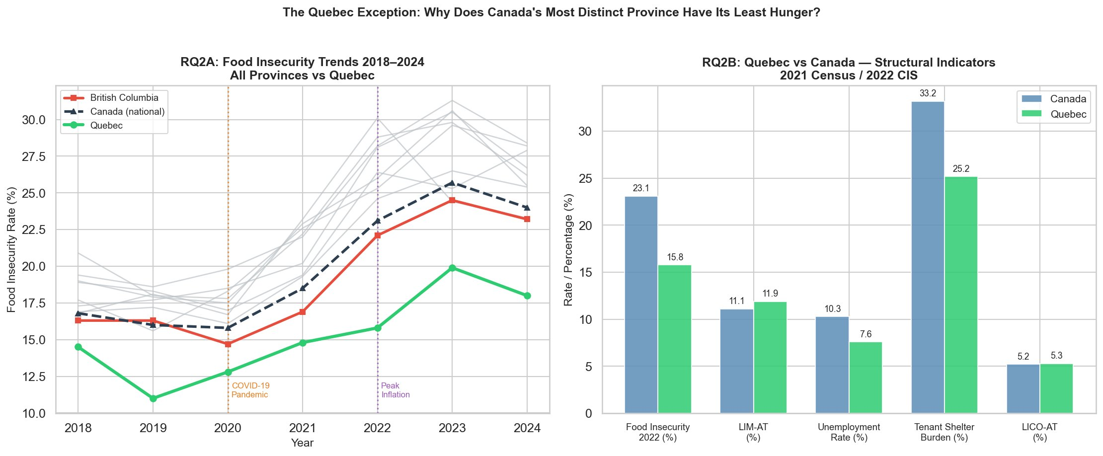
RQ2 — QUEBEC EXCEPTION
Why Does Canada's Most Distinct Province Have Its Least Hunger?
Quebec was the ONLY province where food insecurity did not increase between 2019 and 2022 — a natural experiment in social policy resilience.
Notes:
RQ2 Answer: Quebec's advantage is structural, not accidental. Despite having the 3rd lowest median income ($63.2K), Quebec has 15.8% food insecurity vs 23.1% nationally. The bar chart shows the key differentiators: tenant shelter burden (25.2% vs 33.2% nationally) and unemployment (7.6% vs 10.3%) are substantially lower. Social programs — $10/day childcare, stronger rent controls, broader social assistance — buffer food insecurity. The COVID comparison is striking: Quebec's line barely moved 2019-2022 while all other provinces surged. This is strong evidence that social policy architecture, not income level, determines food security outcomes.

Slide 8
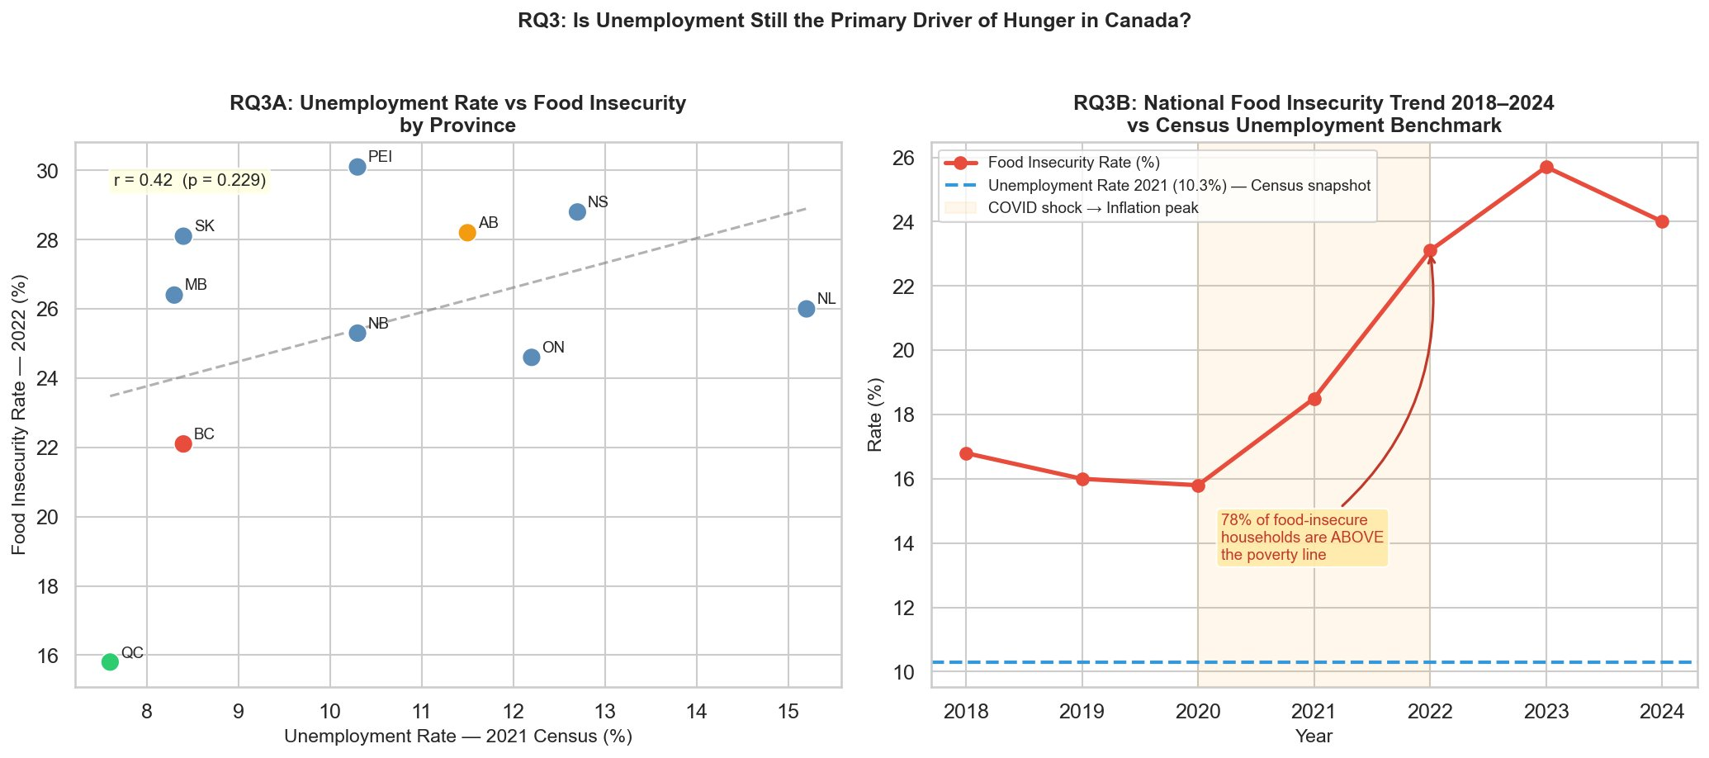
RQ3 — UNEMPLOYMENT
Is Unemployment Still the Primary Driver of Hunger?
Food insecurity rose from 16% to 25.7% (2018–2023) while the Census unemployment benchmark remained at 10.3%. The relationship has decoupled.
Notes:
RQ3 Answer: No — unemployment is no longer the primary driver of hunger in Canada. The scatter plot shows r = 0.42 (p = 0.23) — positive but statistically insignificant with only 10 provinces. The right panel tells the more powerful story: food insecurity climbed from 16% to 25.7% between 2018 and 2023 while the unemployment benchmark stayed near 10%. These two lines have completely decoupled. The 78% annotation is the key analytical finding: most hungry Canadians are employed and above the poverty line. Housing inflation, wage stagnation, and precarious employment — not joblessness — are driving the hunger surge.

Slide 9
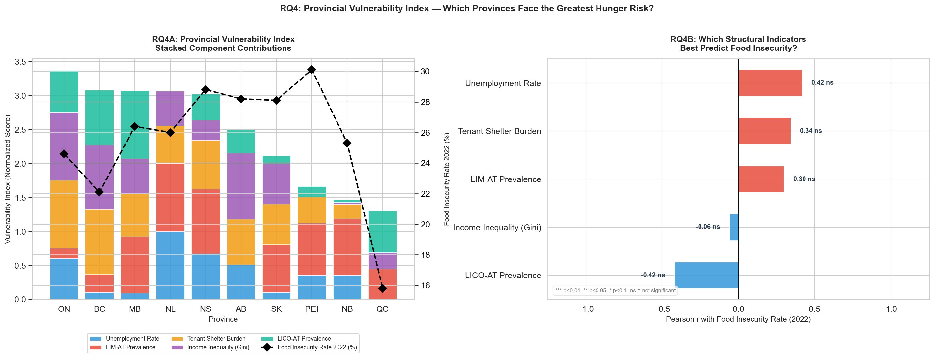
RQ4 — VULNERABILITY INDEX
Which Provinces Face the Greatest Structural Hunger Risk?
Index constructed from 5 min-max normalized indicators. Food insecurity is the outcome variable — excluded from the index itself.
Notes:
RQ4 Answer: Ontario and BC rank highest on the composite vulnerability index despite having middle-range food insecurity — their structural exposure (housing burden, inequality, LIM-AT) is high even if outcomes are partially buffered. Quebec ranks lowest on both the index and food insecurity — consistent with RQ2 findings. The right panel shows that none of the five indicators are statistically significant predictors individually — this confirms that food insecurity is a multi-dimensional structural problem, not reducible to any single variable. Unemployment (r=0.42) and shelter burden (r=0.34) have the highest positive associations; LICO-AT is counterintuitively negative (r=-0.42).

Slide 10
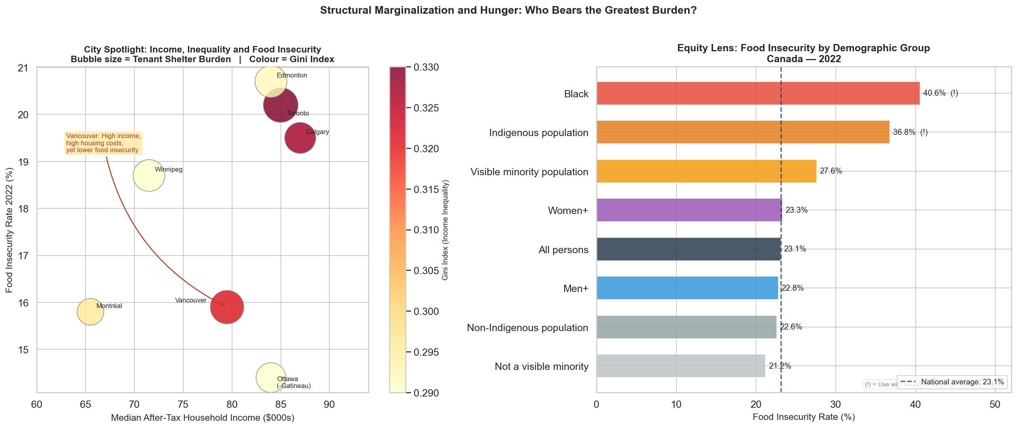
CITY SPOTLIGHT & EQUITY
Structural Marginalization and Hunger: Who Bears the Greatest Burden?
City data: Uppal (2023), Statistics Canada Catalogue 75-006-X. • (!) = Stats Can reliability flag C — use with caution.
Notes:
The city bubble chart confirms the Vancouver paradox at the city level: Vancouver has the largest bubble (highest shelter burden, 38.5%) and highest Gini among BC CMAs, yet food insecurity (15.9%) is lower than Toronto (20.2%) or Edmonton (20.7%). After controlling for income and race in the regression (Uppal 2023), Vancouver's predicted probability of food insecurity is 0.16 vs Toronto's 0.19 — the difference holds even accounting for demographics. The equity panel shows the racialized burden: Black Canadians (40.6%) and Indigenous peoples (36.8%) face nearly double the national rate of 23.1% — a direct connection to the DTES field experience.

Slide 11
KEY FINDINGS
What the Data Reveals
01
Income Does Not Protect Against Hunger
02
Social Policy Architecture Is the Key Differentiator
At the provincial level, median household income is essentially uncorrelated with food insecurity (r = 0.08, p = 0.82). Alberta earns the most and still faces 28.2% food insecurity.
Quebec's food security advantage persists across all income levels and survived the COVID shock intact. Tenant shelter burden 25% vs 33% nationally is the single biggest structural gap.
03
Unemployment Has Decoupled From Hunger
04
Structural Marginalization Compounds Risk
Food insecurity rose 43% from 2018–2023 while unemployment remained stable. 78% of food-insecure households are employed and above the poverty line.
Black Canadians (40.6%) and Indigenous peoples (36.8%) face nearly double the national food insecurity rate — inequities that persist above the poverty line and across income quintiles.
Notes:
These four findings directly answer the four research questions and together construct a coherent argument: food insecurity in Canada is structural — driven by housing costs, social program coverage, and systemic racial inequity — not by individual income levels or employment status alone.

Slide 12
IMPLICATIONS
Why This Analysis Matters
For Financial Sector Roles
For PhD Research Applications
Composite vulnerability index methodology directly parallels credit risk scoring and financial inclusion assessment
Multi-dataset integration (census + survey panel) mirrors financial analyst workflows with large administrative datasets
Structural indicator analysis — income, housing burden, inequality — is foundational to community reinvestment and lending risk models
7-year longitudinal trend analysis demonstrates time-series thinking required for economic forecasting roles
Directly operationalizes structural and social determinants of health framework — the theoretical basis for PhD work in health informatics
Demonstrates comfort with administrative health databases, multi-source data integration, and ecologically-structured analysis
Quebec natural experiment illustrates causal thinking and policy evaluation — foundational skills for causal ML research
Equity analysis of racialized food insecurity connects to research interests in housing instability and health inequity in marginalized populations
Notes:
This slide explicitly bridges the analytical work to its two audiences. For a Canadian bank data analyst interview: emphasize vulnerability index scoring methodology and multi-dataset integration. For PhD committees at Ottawa Telfer, CWRU, SFU, or Arizona Eller: emphasize structural determinants framing and the causal logic of the Quebec natural experiment.

Slide 13
HUNGER IN CANADA IS
A STRUCTURAL PROBLEM.
It requires structural solutions — adequate housing, portable benefits, and targeted income supports for marginalized communities. Data can make that case. This project is one contribution to that argument.
Edward Agyemang
github.com/EdwardAgyemang | edward.agyemang@northeastern.edu
REFERENCES
Statistics Canada. (2022). Census Profile, 2021 Census of Population [Tables 98-401-X2021001 & 98-401-X2021002].
Statistics Canada. (2025). Food insecurity by selected demographic characteristics [Table 13-10-0835-01]. https://doi.org/10.25318/1310083501-eng
Uppal, S. (2023). Food insecurity among Canadian families. Statistics Canada, Cat. no. 75-006-X. https://www150.statcan.gc.ca/n1/pub/75-006-x/2023001/article/00013-eng.htm
Food Banks Canada. (2025). HungerCount 2025. | Food Banks Canada. (2025). Poverty Vulnerability Map Research Notes.
Notes:
Closing message: this is not just a data project. It is an argument that hunger in Canada is addressable — if policymakers look at the structural levers that Quebec has already demonstrated work. Thank the audience and invite questions.

