Slide 1
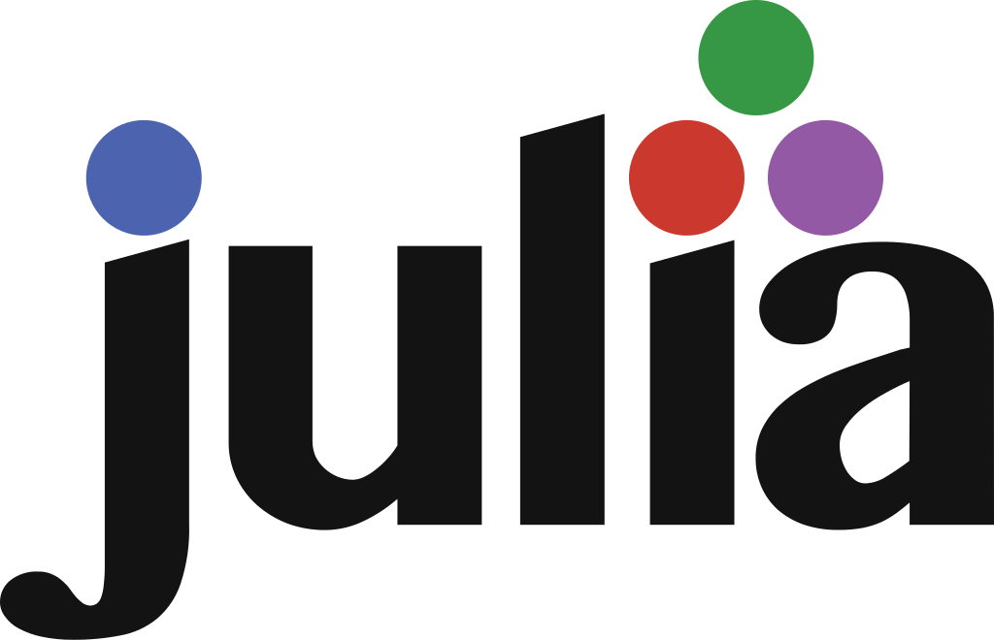
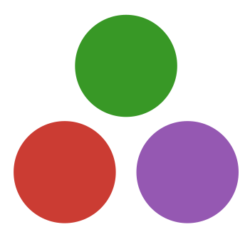

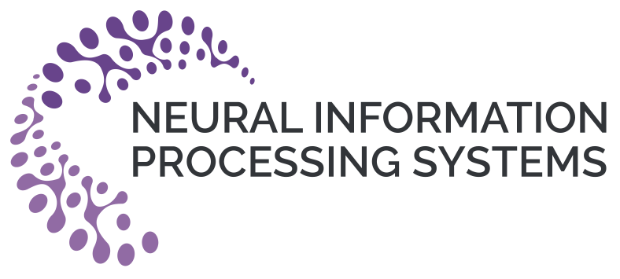

The State of for Scientific Machine Learning
Edward Berman* and Jacob Ginesin*
We characterize Julia’s main limitations as...
We characterize Julia’s main limitations as...
Lack of Software Engineering Features
Complex Debugging Messages
Poor Interoperability
...This manifests in Low Industry Adoption
Call to action: A new constitution of language goals for Julia to enable broader adoption of the language for scientific machine learning

