Slide 1

PRINCETON FACEBOOK
RAJA GOEL
MING LU
MICHAEL YAROSHEFSKY

Slide 2
Motivation
Old Princeton Facebook was discontinued
Students wondered where it went
We wanted to recreate a student directory for the Princeton community to take it’s place

Slide 3
Use cases
Students use it to find other students they know limited information about
“He’s a 2012 MAE from California”
Students use it to find information about friends
Birthdays
Campus address
Roommates

Slide 4
Main Features
Improved searching ability
Know limited information about someone and be able to narrow down results
Consolidated key info about current undergraduates
Based on data provided by the University
PROFILE VIEWS!!

Slide 5
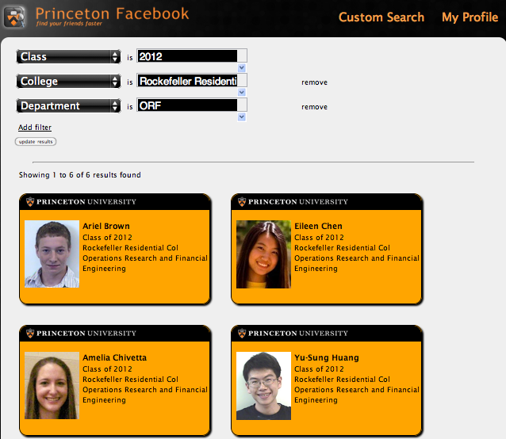

Slide 6
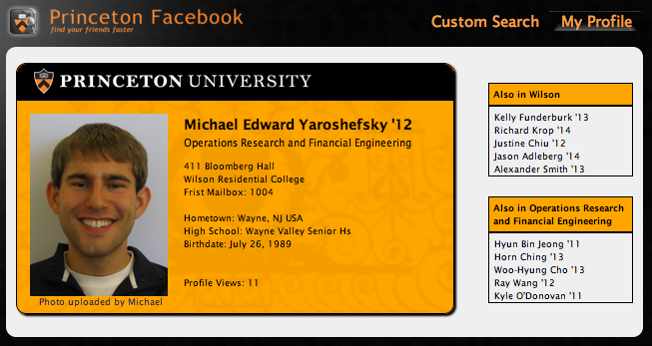

Slide 7
Further Improvements
Eating clubs
Varsity sports
Scrape GoPrincetonTigers.com for rosters
Student organizations/club sports
Add course schedule (from ICE)
Add summer location
Useful for finding potential roommates
Geotag hometowns and dorms

