Slide 1


Slide 2
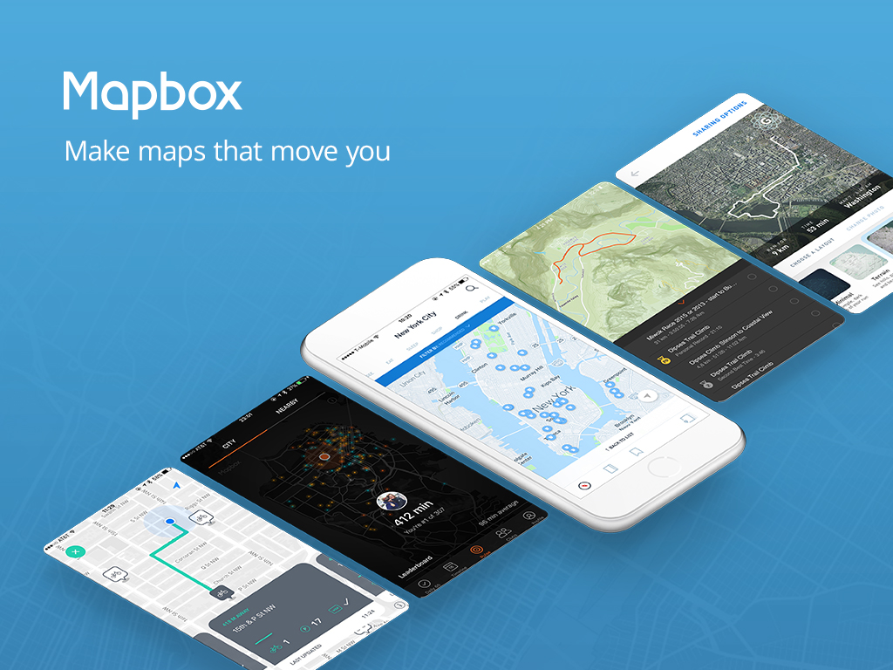

Slide 3



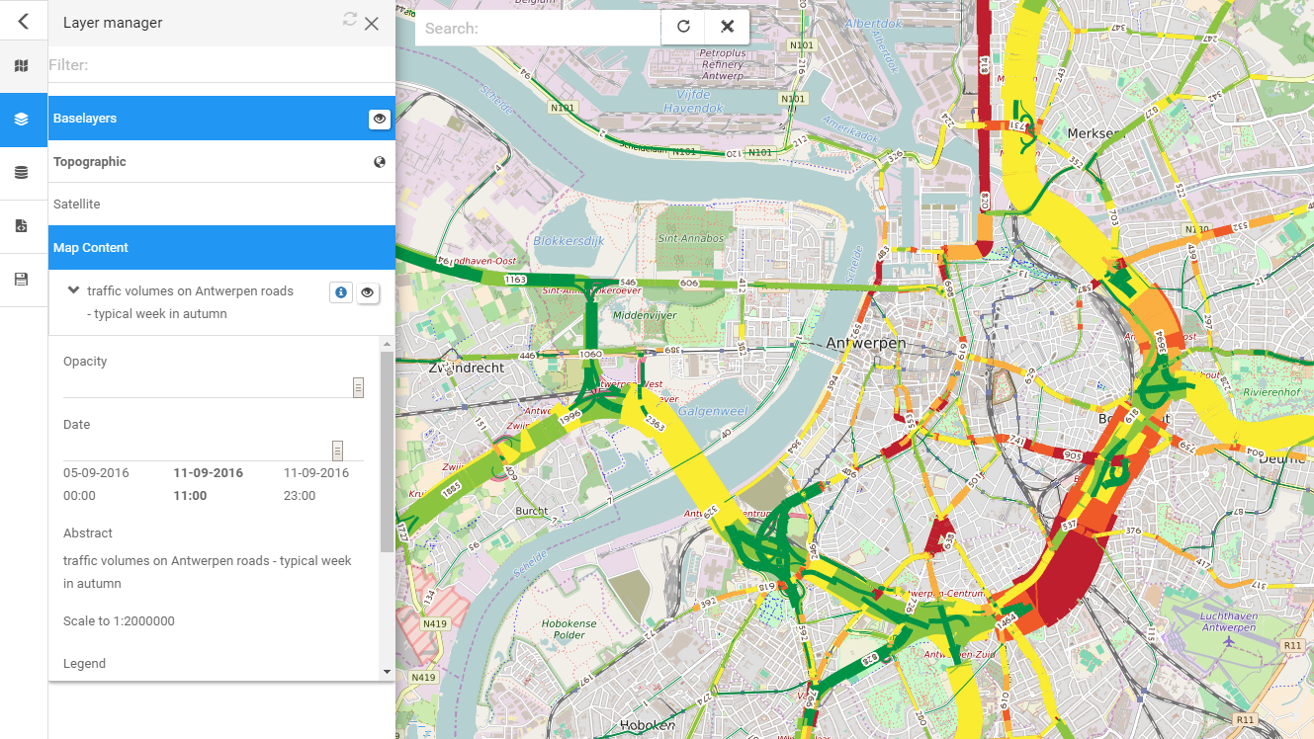
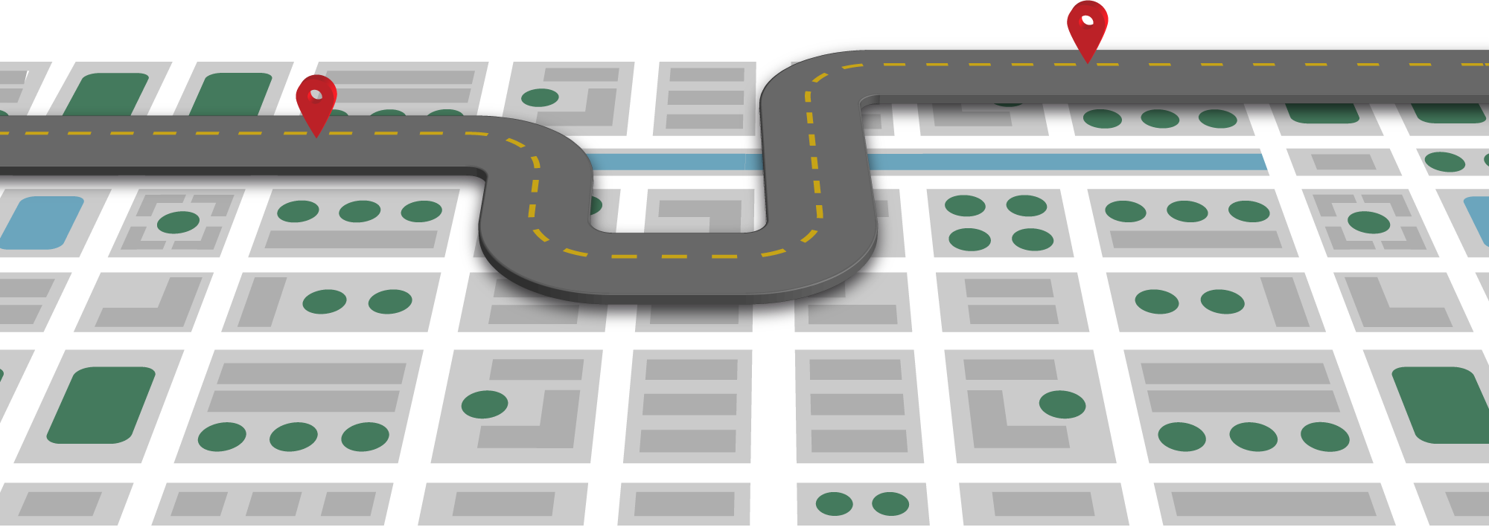
Open Transport Map
= INSPIRE compatible and routable OPENSTREETMAP
Available as a map and a geo-layer
Suitable for routing
Accessible via GUI and API
Time related Traffic Volumes
Covering the whole of the EU

Slide 4

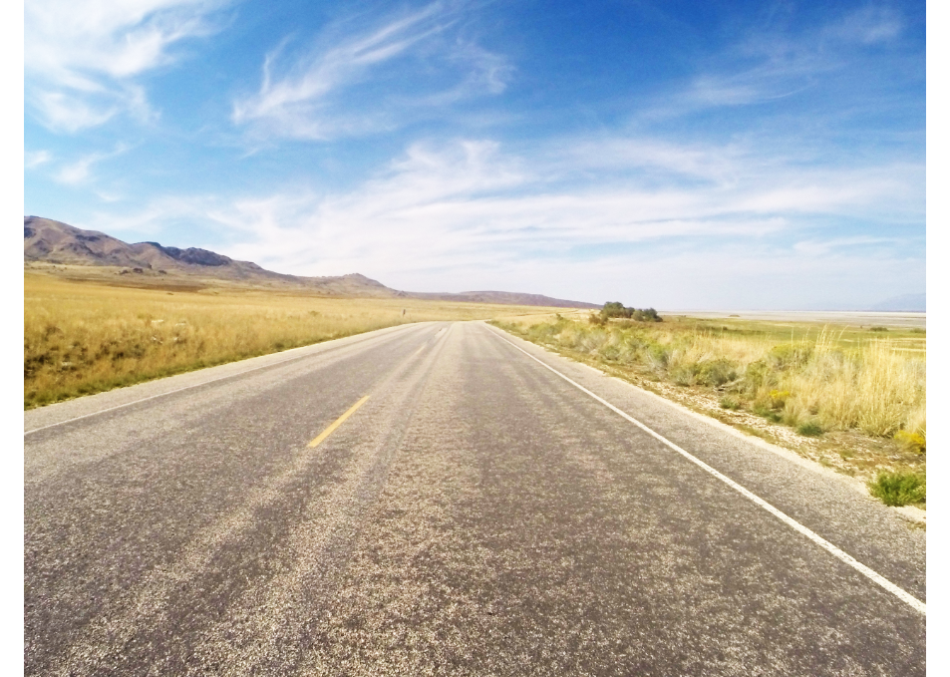
Get the free iOS or Android mobile app
Record images as you drive
Intelligent detection and capture of speed signs
Recognition of sign posts and lanes coming soon!
Learn more on Sunday at 10:00 in Room QC

Slide 5


Slide 6


Slide 7
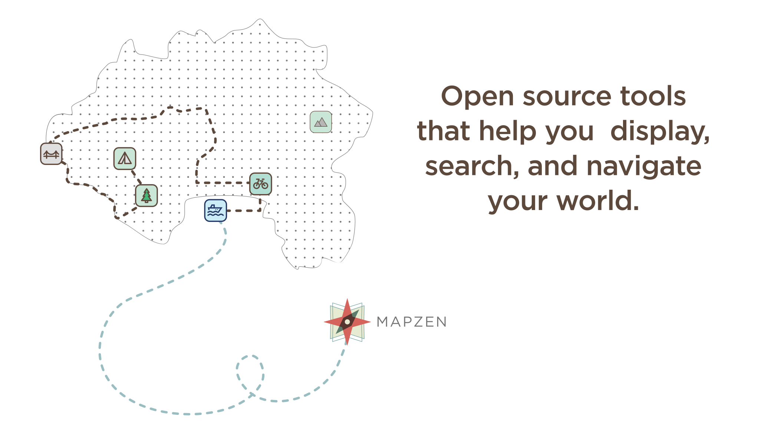

Slide 8


Slide 9


Slide 10


