Slide 1
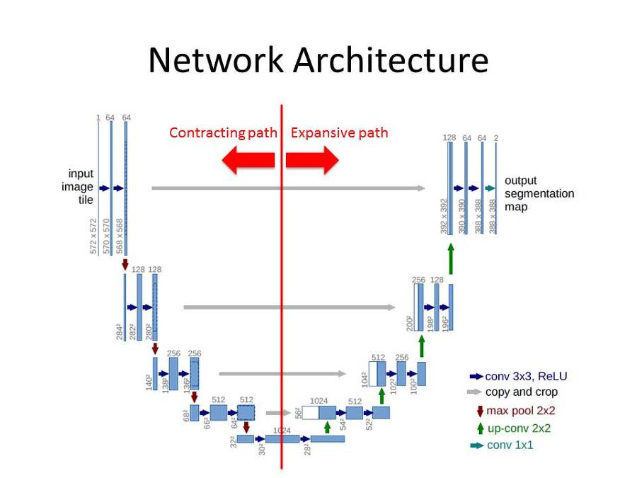
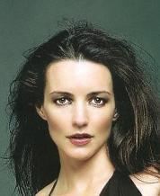
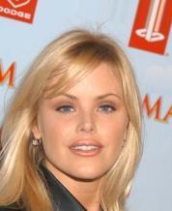
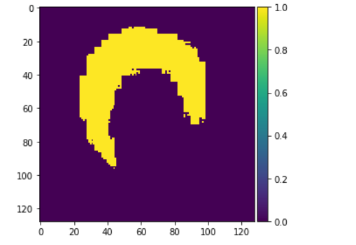
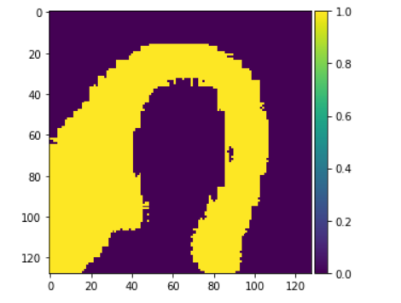
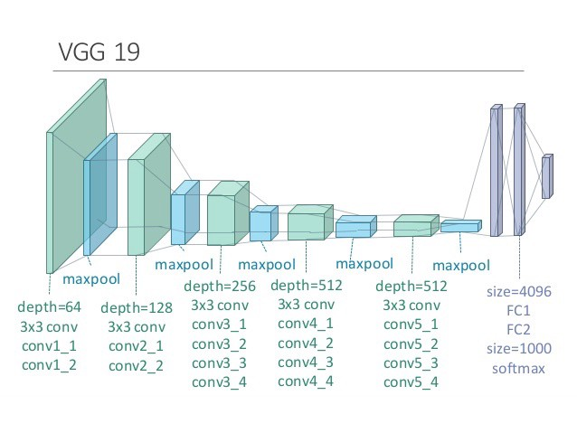
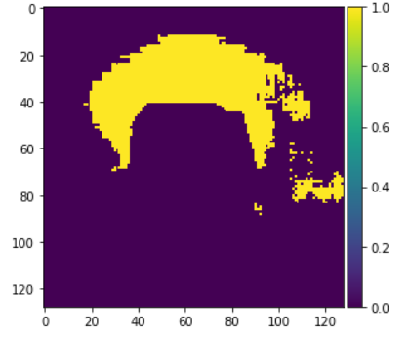
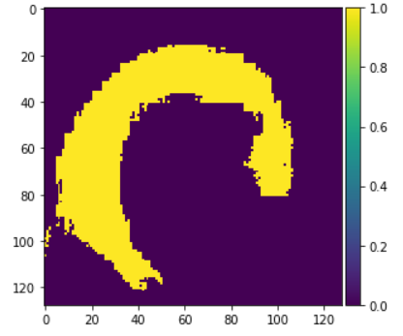
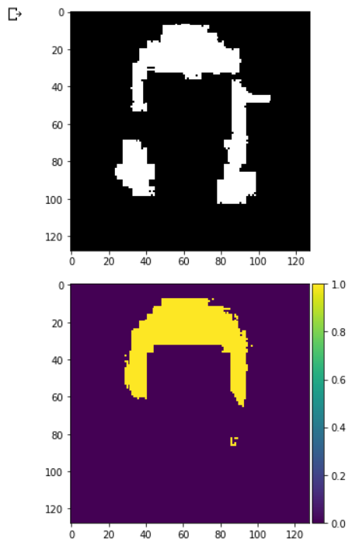
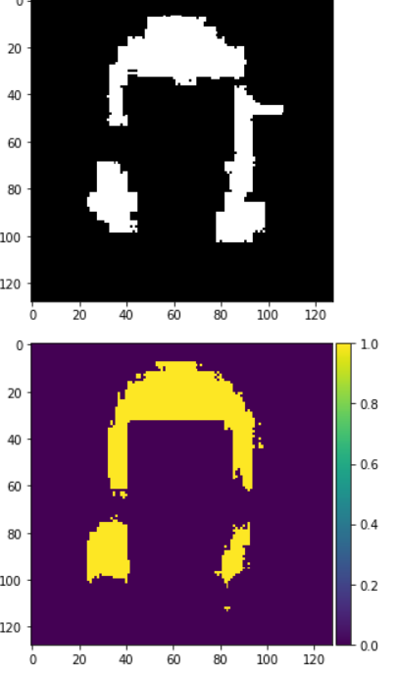
Hair Segmentation with Transfer Learning
Edward Guaman
CS 4990.01 Dr. Hao Ji
ABSTRACT
METHOD
RESULTS
Conclusions
The goal of this project is to build on top of the previous hair segmentation model and improve it. Specifically either through the use of both skin and hair masks or through the use of transfer learning. The model for this project makes use of the transfer learning approach and was then tested on both the previous testing data as well as on some images from the well known dataset CelebA.
The model that was used was a functional model so that I could make use of two models one for feature extraction and one for upscaling. The pretrained model that I chose to use was the VGG19 model. The VGG model without the top would return an image of size (4, 4, 512) thus I used five transposed convolution layers with decreasing number of filters and finished off with a sigmoid function to return an image of shape (128, 128, 1).
Below are two images from the CelebA dataset and below them are the outputs of the model with transfer learning and below them are the outputs using the old model. The model has definitively improved as is evident in the right set of pictures where previously the model only displayed the hair closest to the head whereas the new model shows the hair reaching all the way to the bottom of the frame. The set of pictures on the left shows that the model is far from perfect however it is still a substantial improvement seeing as the previous model had disconnected hair. Below the set of photos is another set however these are simply the outputs of the old and new models on the previously provided test data.
To conclude the use of transfer learning with the pretrained VGG19 model had clear improvements on the performance of the hair segmentation autoencoder. Nevertheless it is still far from idea seeing as there are many possible avenues for improvement. Aside from the simple increase of training data some other ways of improving the model would include adding noise and other such augmentations to the training data. There is also the possibility that making use of another pretrained model may improve the results. Similarly fine tuning of the model both the pretrained and the top could potentially improve the model.
Link to Code
Link To Colab Notebook

