Slide 1
Sumo Game (With Mathematics)
By Graham Joonsar

Slide 2
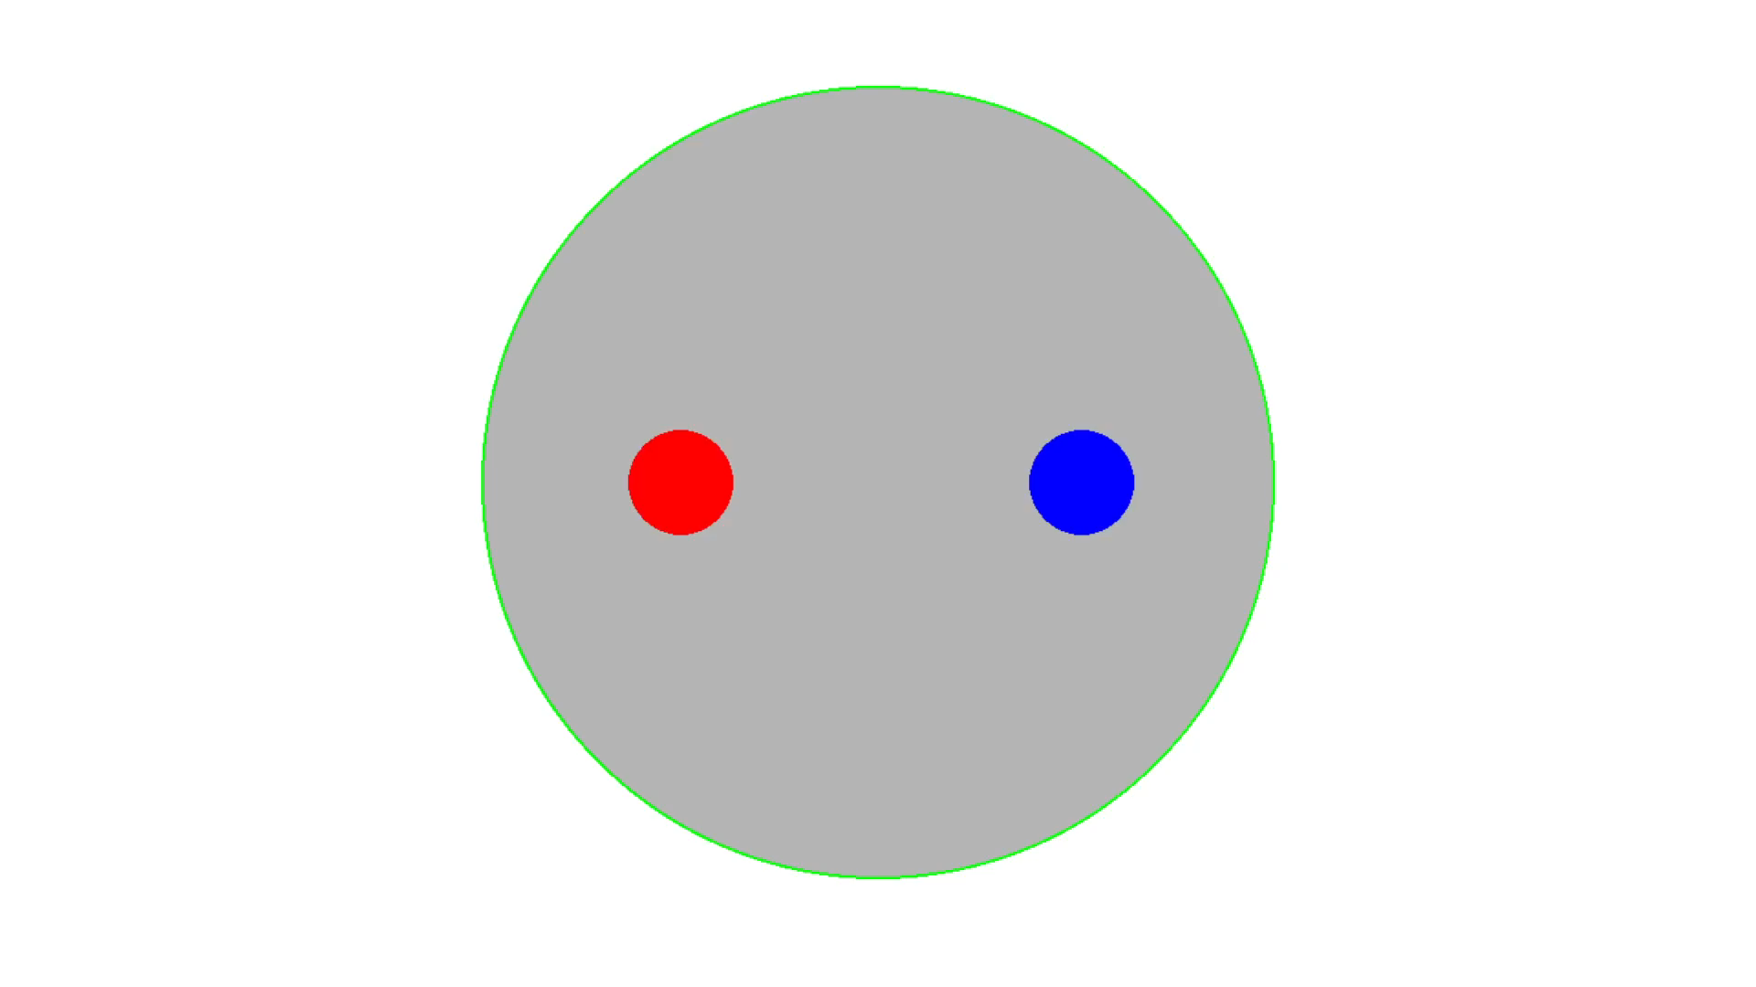
Gameplay

Slide 3
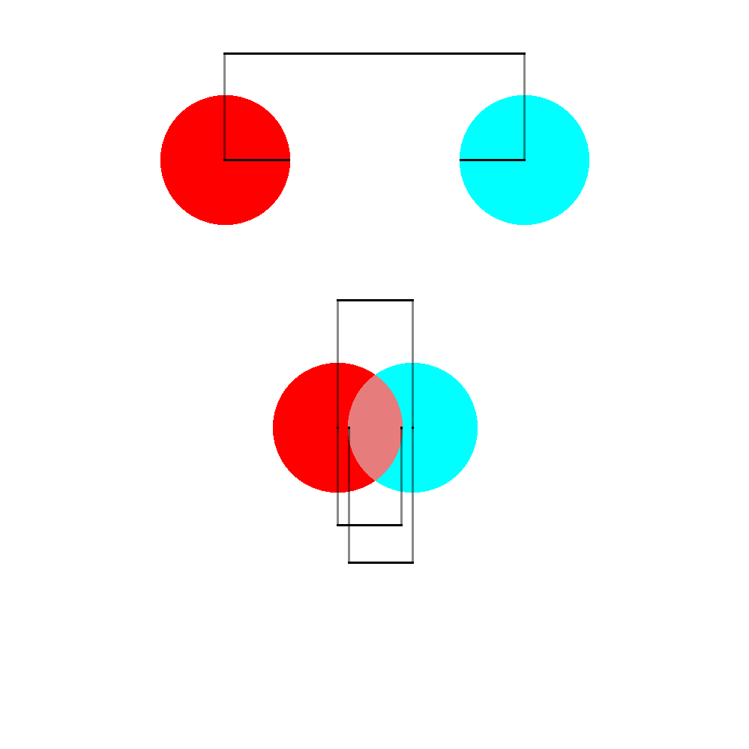
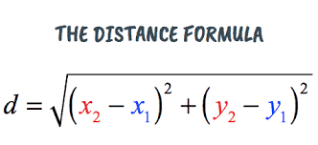
Detecting when the players collide

Slide 4
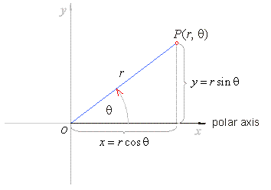

Bouncing away from each other
Θ = atan($(y_{2}$- $y_{1})$/$(x_{2}$- $x_{1})$)
X Velocity = cos(Θ) * N
Y Velocity = sin(Θ) * N

Slide 5
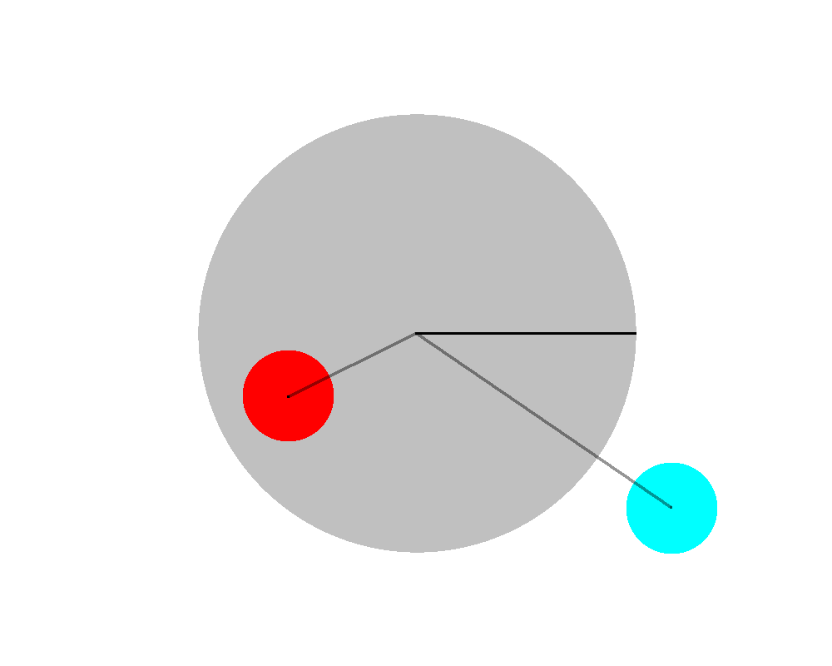
Detecting leaving the Sumo ring
The first to leave loses.

