Slide 1
Spring boot
May 5, 2017
Limited Access

Slide 2
Spring boot Features
Create stand-alone Spring applications
Embed Tomcat, Jetty or Undertow directly (no need to deploy WAR files)
Provide opinionated 'starter' POMs to simplify your Maven configuration
Automatically configure Spring whenever possible
Provide production-ready features such as metrics, health checks and externalized configuration
Absolutely no code generation and no requirement for XML configuration
Bootable, Minimal, Ops-Ready

Slide 3
Agenda
Quick overview of goals and high level features
Getting started demo
Application configuration with Spring Boot

Slide 4
Starter POMs
Standard maven POMs
Define dependencies that we recommend
Parent optional
…
<parent>
<groupId>org.springframework.boot</groupId>
<artifactId>spring-boot-starter-parent</artifactId> <version>1.5.2.RELEASE</version>
</parent>
<dependency>
<groupId>org.springframework.boot</groupId>
<artifactId>spring-boot-starter-web</artifactId>
</dependency
<dependency>
<groupId>org.springframework.boot</groupId>
<artifactId>spring-boot-starter-actuator</artifactId>
</dependency
<dependency>
<groupId>org.springframework.boot</groupId>
<artifactId>spring-boot-starter-test</artifactId>
<scope>test</scope>
</dependency>

Slide 5
SpringApplication
@EnableAutoConfiguraion

Slide 6
Packaging For production
Maven plugin (using spring-boot-starter-parent):
<plugin> <groupId>org.springframework.boot</groupId> <artifactId>spring-boot-maven-plugin</artifactId> </plugin>
mvn package
Java –jar yourapp.jar

Slide 7
Spring Boot Modules
Spring Boot
Main library supporting the other parts of Spring Boot
Spring Boot Autoconfigure
Single @EnableAutoConfiguration annotation creates a whole Spring context
Spring Boot Starters
A set of convenient dependency descriptors that you can include in your application.
Spring Boot CLI
Compiles and runs Groovy source as a Spring application
Spring Boot Actuator
Common non-functional features that make an app instantly deployable and supportable in production
Spring Boot Tools
For building and executing self-contained JAR and WAR archives

Slide 8
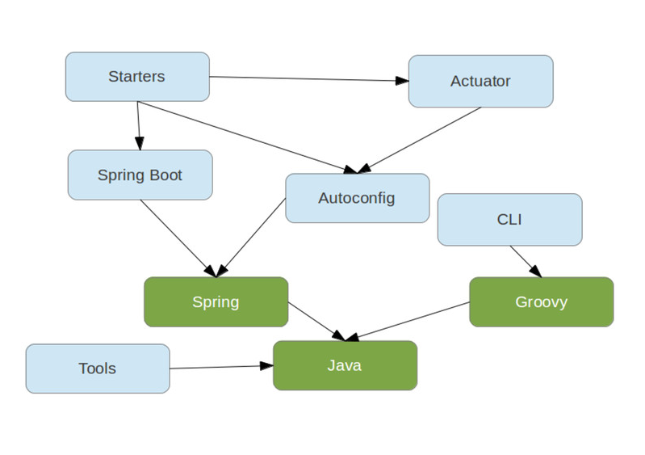
Spring Boot Module Relations

Slide 9
Links
Start: http://start.spring.io/
Official website: https://projects.spring.io/spring-boot/ http://spring.io/blog
Official docs: https://docs.spring.io/spring-boot/docs/current/reference/htmlsingle/
Sliding: https://speakerdeck.com/dsyer/spring-boot-introduction

Slide 10
Q&A?

