Slide 1
ARPEGGIO: A sarcastic twist on RPGs
Edward Hu, David Yang, Oliver Dong
Period 6

Slide 2
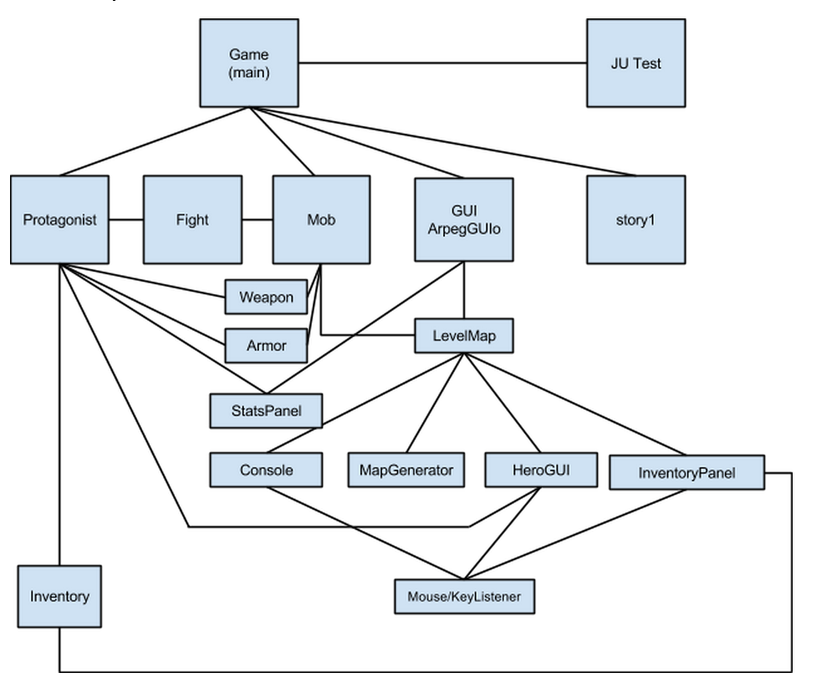
Classes

Slide 3
Game.class & Story1.class
Game.class
Has the main()
Stores and loads master weapon and armor lists
Story1.class
Introduces player to fighting mechanics
Has a plotline

Slide 4
Protagonist.class
Stores all of the player’s fields
HP, current weapon, current armor, etc.
Holds an Inventory object to allow for player selection of gear
Holds experience and a Lvlup method to increment player statistics as battles are won

Slide 5
Armor.class & Weapon.class
Stores statistics of weapon objects and armor objects
Holds a String name and an int stat
Stat is a 6-digit number that dictates weapon damage, accuracy, element,
Has many calculation methods
Allows damage/block calculation to be done from the weapon/armor object, instead of in FinalFighter

Slide 6
FinalFighter.class
Core class behind entire fighting mechanic
Elemental checks and effects
Accuracy and Damage + Damage mitigation interpretation
Critical hits
At end of fight: grants experience and calls LvlUp

Slide 7
Map Generation Classes
MapGenerator
Makes a randomly generated map
Features trees, road, and lake
Road uses recursion to ensure an unbroken path
LevelMap
Uses MapGenerator to create visual map interface
Also responsible for defining level bosses

Slide 8
GUI Classes
ArpegGUIo.class
Mainframe for the GUI
Takes all of the various panels and represents them in a layout understandable to the user.
Creates various JPanels like Console, LevelMap, and InventoryPanel.
Uses BorderLayout to position different JPanels.
Loads in the monster arrays for random monster encounters.

Slide 9
GUI Classes
Console.class
Text area and buttons for user to fight monsters.
Takes in button input and feeds it to the FinalFighter engine.
Displays FinalFighter engine output.
HeroGUI.class
Decides the Hero image avatar.
Uses ActionListener to decide directional movement of Hero.
Decides which side hero will move and changes avatar to directional avatar.
InventoryPanel.class
Uses JComboBoxes to modify masterProtagonist's inventory.
Uses arrayLists of weapons and armor and converts the name into text for JComboBoxes
Listens for user input

Slide 10
Mob.class
Object of the various non-boss monsters in the game
Holds their HP, weapons, etc.
Every level, 5 mobs are loaded and then randomly selected for a battle per tile movement
Drops experience to advance the protagonist

Slide 11
Structural Design
Data structures:
HashMap
Queue
2D-arrays + recursion

Slide 12
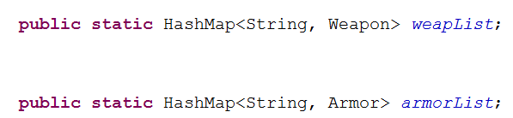
HashMap
Master Weapon and Armor lists
<String, Weapon> and <String, Armor>
Allows specific Weapon and Armor objects to be called via just a String (typically a name)

Slide 13
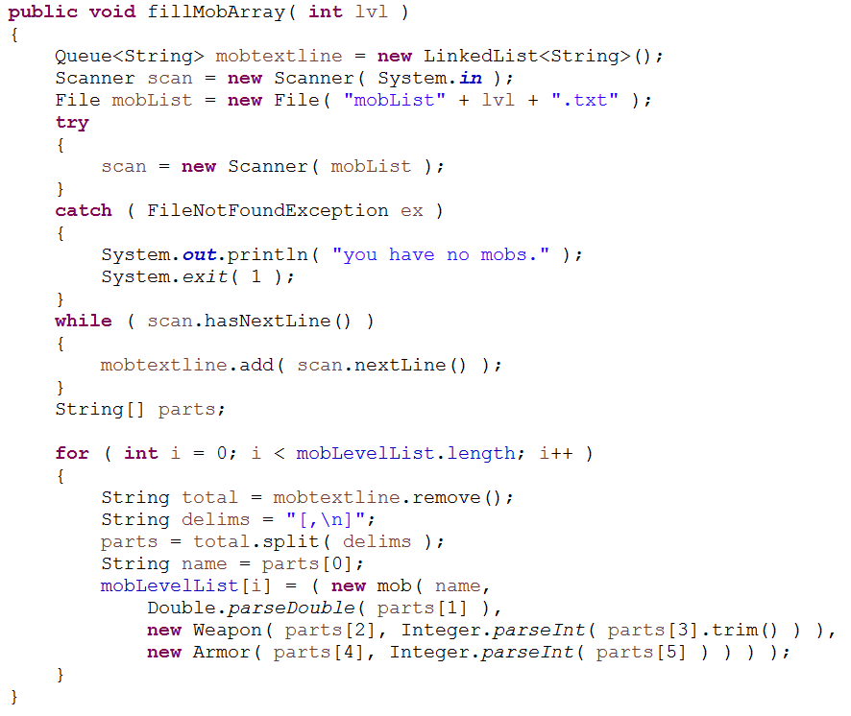
Queue
Used to load random events into arrays
LinkedList<String>
Resulting enemy HP, Weapon, Armor parsed from queue

Slide 14
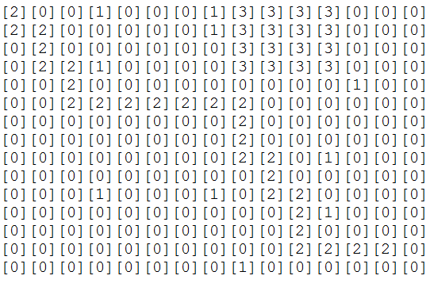
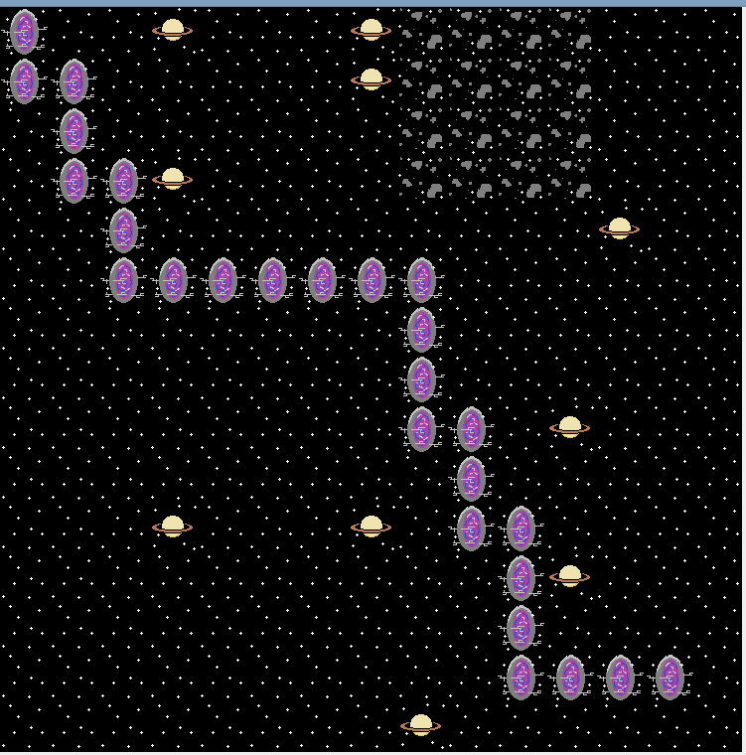
2D-Array + Recursion
GUI Map representation

Slide 15
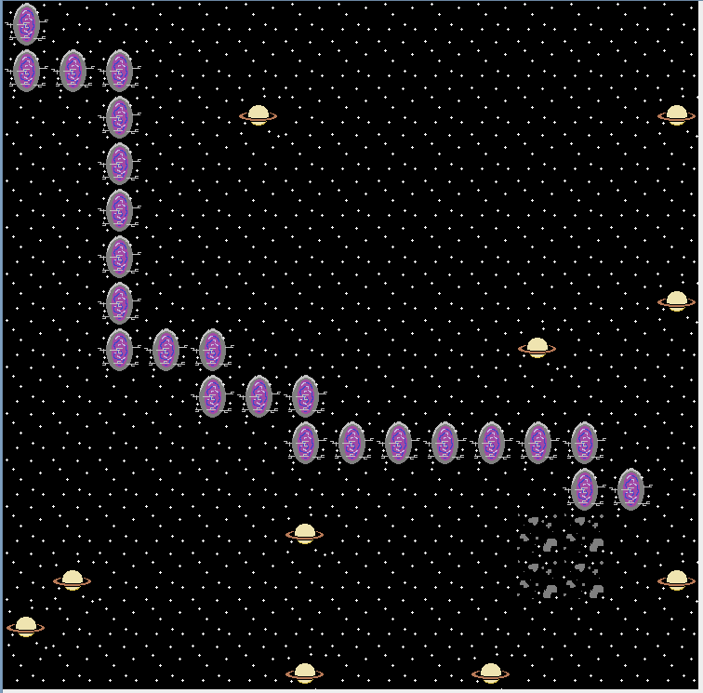
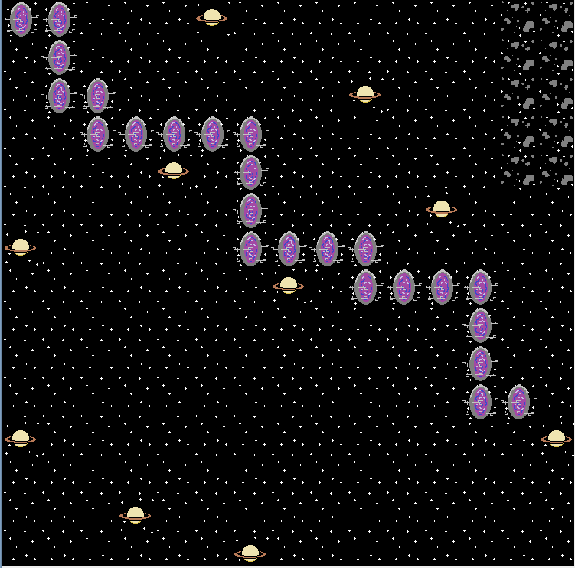
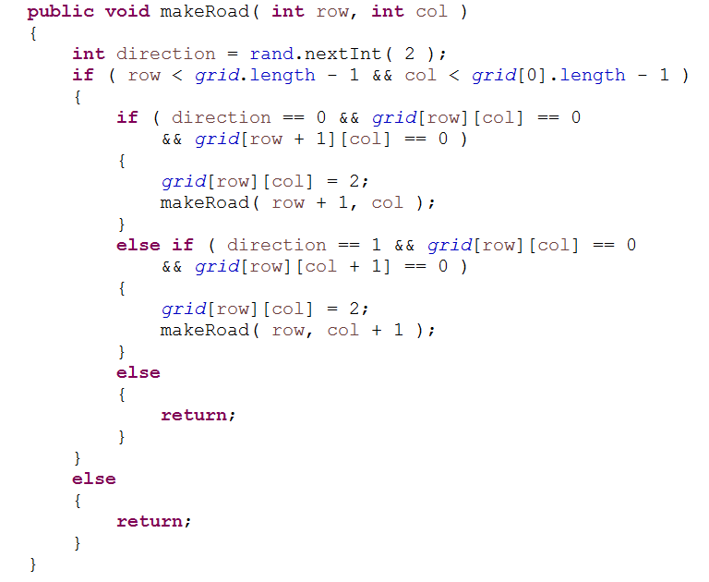
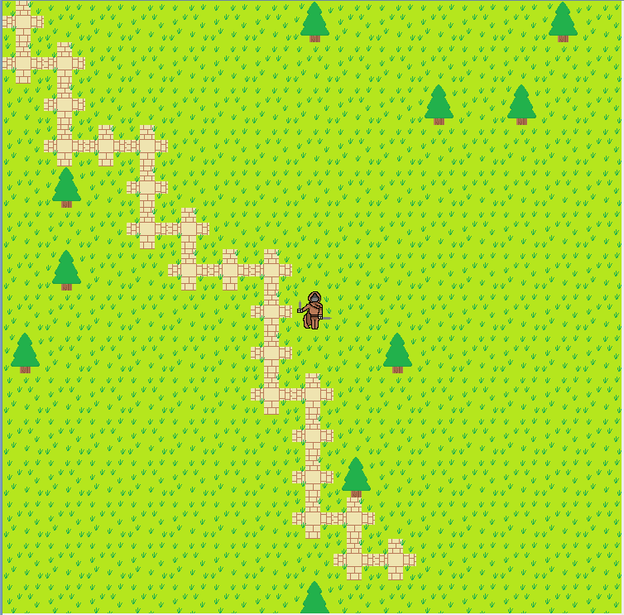
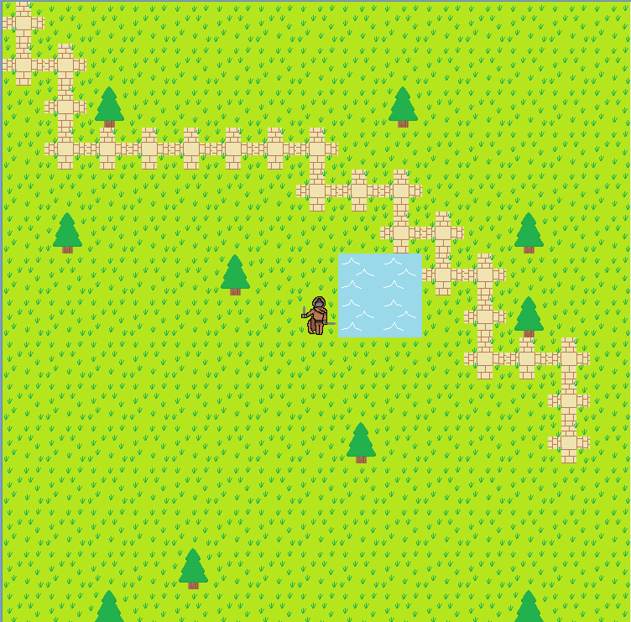
2D-Array + Recursion
GUI “road” generation

Slide 16

DEMO TIME!

