Slide 1
AI Impact Analysis Based on 200K AI/ML News
Topic → Industry mapping · Entity extraction · Sentiment model (trained) · Over-time insights
ADSP 32018 IP01 Next-Gen NLP: Transformers, LLMs and AgenticAI in Practice
WINTER 2026 - Final Project
Deliverable: business-facing insights answering 3 questions
Which industries & companies are most likely to be impacted by AI in the future?
How will they be impacted (positive/negative/unclear) and by what means / technologies?
What factors are associated with successful vs unsuccessful AI adoption?
Name: Zihao Huang (zihaoh3)
Date: 03/10/2026 (MM/DD/YYYY)
Instructor: Ignas Grabauskas
1/22
Notes:
[Sources] - All results shown in this deck are generated from the course-provided ~200K news corpus and the submitted notebooks (01–06). [/Sources]

Slide 2
Method overview & rubric alignment
Pipeline
01
Data audit
02
Clean & filter
03
Topic detection
04
Entity extraction
05
Train sentiment
06
Inference & insights
Clean/filter design
Article clean-up
Topic detection
Org + Tech entities
Model training (required)
Sentiment + viz + answers
How components connect (why this is business-facing)
Filtering focuses analysis on evidence-rich AI impact paragraphs (reduces web-crawl noise).
Define AI trigger patterns and extract evidence-rich paragraphs
Score each document using high-signal and supporting AI terms
Topics are mapped into an industry taxonomy → scalable “who is impacted” view.
Fit BERTopic on the prepared corpus
Map BERTopic topics to an industry taxonomy
The mapping is based on semantic similarity between topic embeddings and manually crafted industry anchor texts.
Entities (companies + technologies) provide drill-down and the “by what means” lens.
Leverage distilbert-NER to extract Organization Entities
Extract technology entities by Rule-Based Phrase Matching
A custom-trained sentiment model enables consistent labeling at scale (millions of contexts).
Construct sentence-based context windows around organization mentions
Create weak labels with an LLM (GPT 5-nano)
Fine-Tune roberta-base with Class-Weighted Loss
Aggregations over (industry × company × technology × time) produce the final insights.
Inference the whole corpus and produce plots
2/22
Notes:
[Sources] - Rubric items and constraints come from instruction.md. [/Sources]

Slide 3
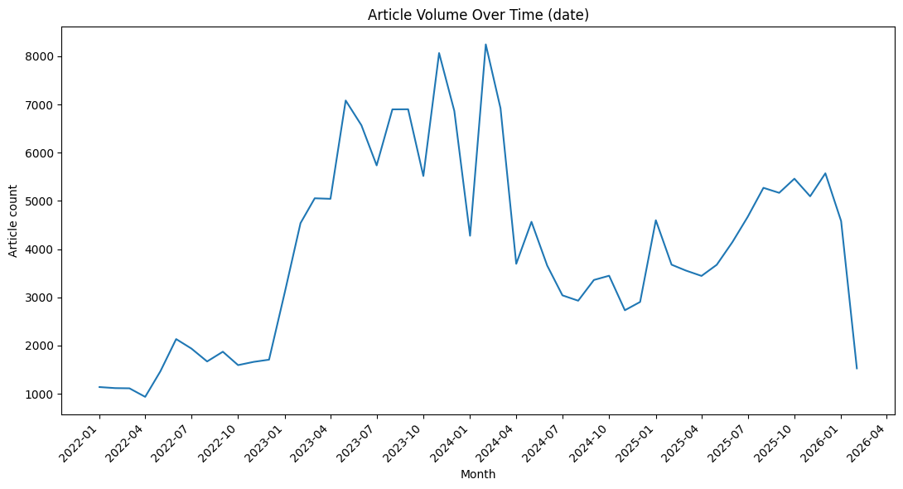
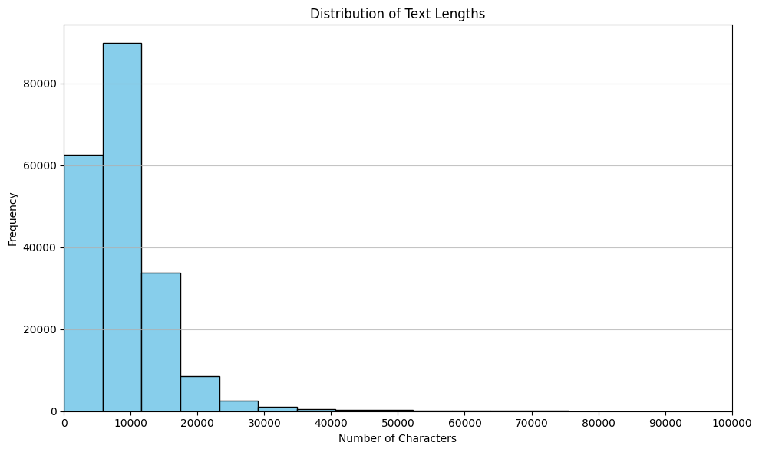
Data overview (raw corpus)
01 Data audit
Articles (raw)
Date range
Schema
199,989
2022-01 → 2026-02
url · date · language · title · text
Figure: Monthly article volume (raw)
Figure: Text length distribution (raw)
3/22
Notes:
[Sources] - Row count and date range are measured in 01_data_audit.ipynb. [/Sources]

Slide 4
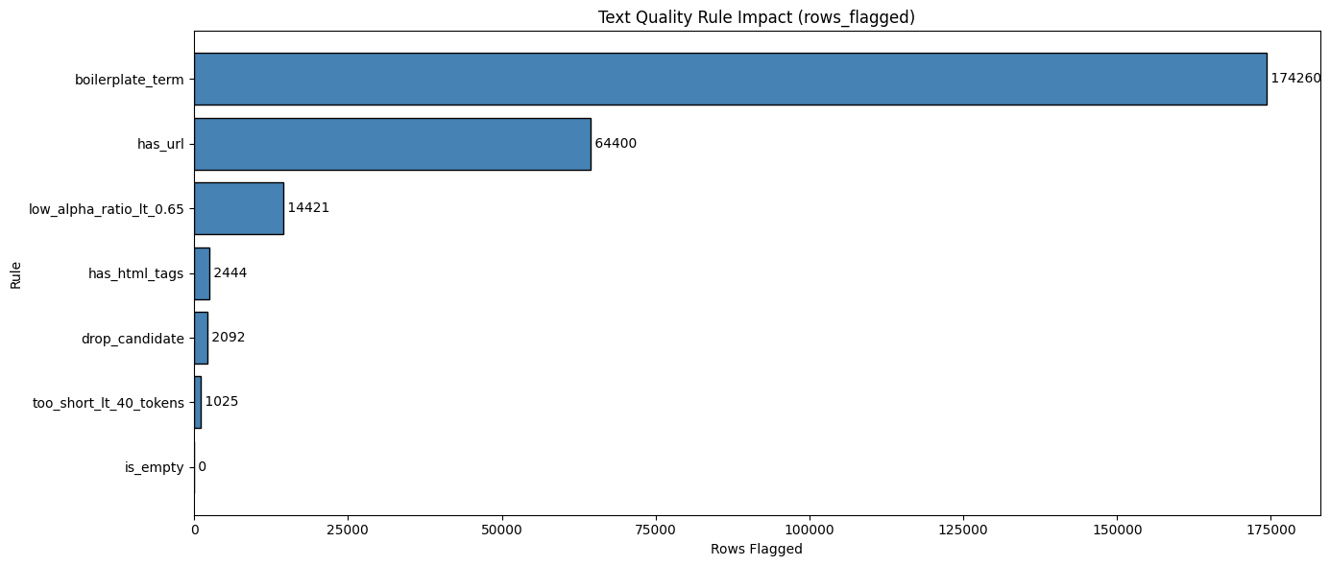
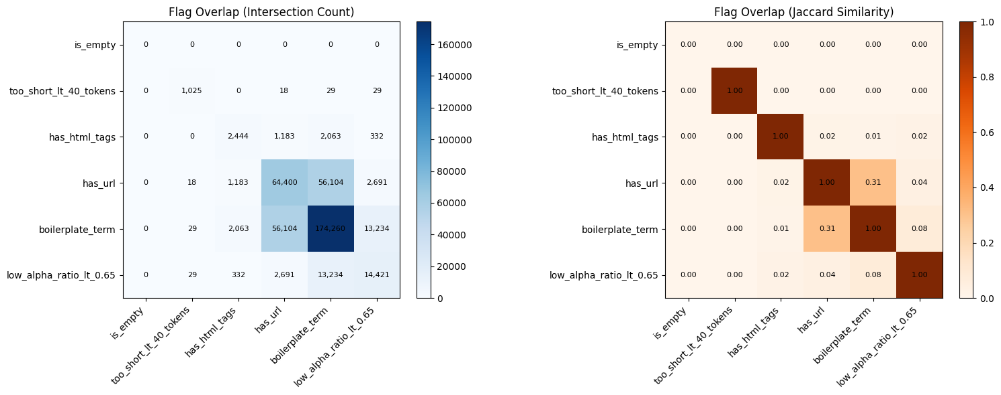
Web-crawl noise: why filtering is necessary
01 Data audit
Heuristic flags on raw article text
Observed artifacts (examples)
Boilerplate (privacy policy, subscribe banners, navigation menus)
Copy/paste link lists and “related stories” blocks
HTML / markup remnants and low alphabetic ratio noise
Extremely short or non-informative pages (image galleries, stubs)
Data-driven filter impact (from audit)
• Drop boilerplate-heavy pages: ~2,063 rows (≈1.03%)
• Deduplicate normalized text: ~511 rows (≈0.26%)
• Drop short/low-info rows: ~29 rows (≈0.01%)
→ Audit suggests targeted rules can remove noise without shrinking corpus drastically
4/22
Notes:
[Sources] - Heuristic flags and estimated filter impacts are computed in 01_data_audit.ipynb. [/Sources]

Slide 5
Article clean-up & filtering (what changed)
02 Clean/filter
Goal: produce a reusable, high-signal AI impact corpus for downstream modeling
Extract
AI evidence paragraphs
Light
text clean
Rule-based
noise filter
AI relevance
scoring
Dedup +
export
Key dataset reductions (transparent counts)
AI-relevant (screen)
Candidate after quality filters
Duplicates removed
Final clean corpus
194,575 (97.29%)
189,943
15,117
174,826
Why this matters?
Downstream modeling (topics/entities/sentiment) is done on the cleaned, evidence-rich text — not raw webpage artifacts.
Filtering is rule-driven and auditable (counts reported), rather than “black-box” removal.
The clean corpus is exported as a reusable artifact for reproducibility.
How did I filter the corpus?
Extract AI evidence paragraphs
split each article into paragraphs and kept only paragraphs containing explicit AI/ML trigger terms such as AI, machine learning, LLM, generative AI, ChatGPT, and OpenAI.
This reduced webpage clutter and turned each article into a more focused, AI-centered text unit.
Apply light text cleaning
lightly normalized titles and extracted text by removing HTML tags, URLs, repeated separators, and extra whitespace.
created cleaned text fields and basic diagnostics such as character count, token count, and alphabetic-character ratio.
Apply staged filtering and deduplicate
5/22
Notes:
[Sources] - Counts come from 02_clean_filter.ipynb. [/Sources]

Slide 6
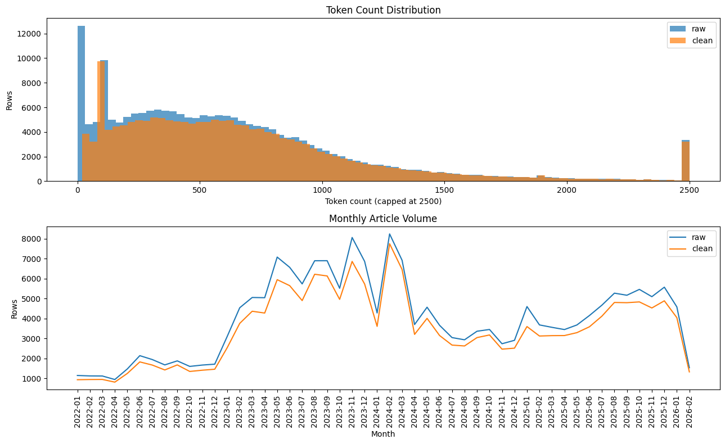
Clean corpus sanity check
02 Clean/filter
Token-length and time trends: cleaned corpus preserves global structure while reducing noise
6/22
Notes:
[Sources] - Raw vs clean token distribution and monthly volume overlay are produced in 02_clean_filter.ipynb. [/Sources]

Slide 7
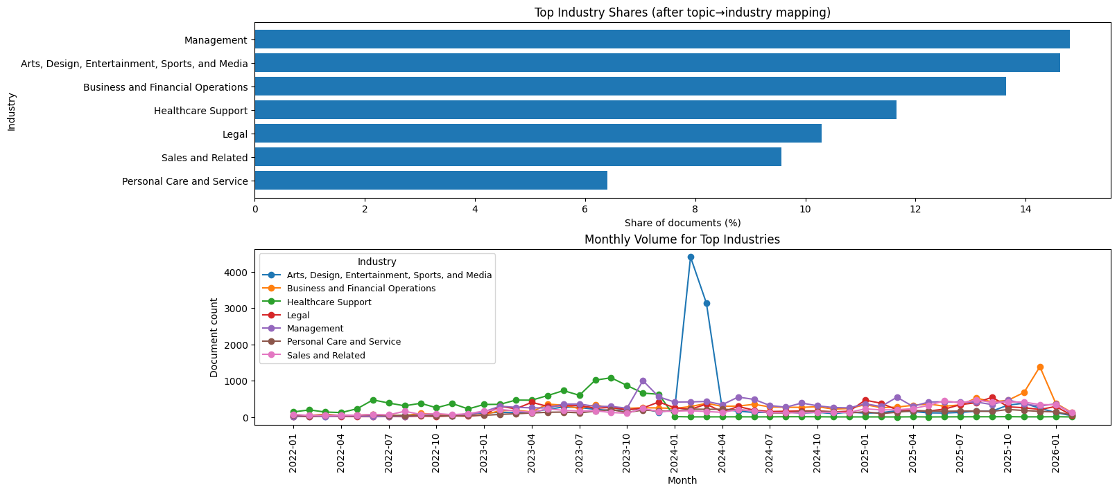
Topic detection → Industry taxonomy
03 Topic detection
Approach: BERTopic on cleaned corpus, then map topic clusters to business-friendly industries
Modeling steps
Example output: industry shares + monthly volume
Prepare modeling text from evidence-rich paragraphs
Embed documents (sentence embeddings)
Cluster embeddings (HDBSCAN) + topic representation (c-TF-IDF)
Assign topic_id per document (incl. -1 outliers)
Map topic→industry taxonomy for interpretation and aggregation
Outputs used downstream
Document-level topic assignments
Industry-level prevalence (% share) and monthly volume
Industry tags joined with entity + sentiment results
7/22
Notes:
[Sources] - Topic modeling and industry mapping are implemented in 03_topic_modeling.ipynb. [/Sources]

Slide 8
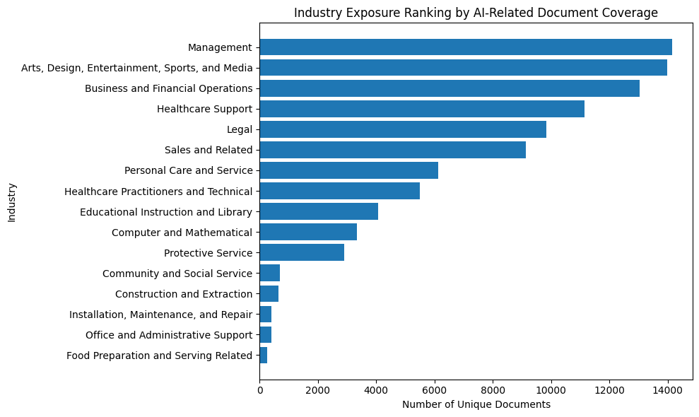
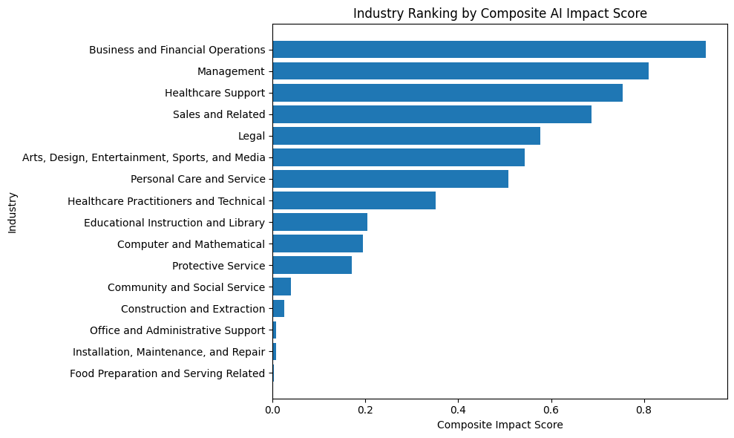
Q1: Which industries are most likely to be impacted?
Industry exposure
Proxy used here: “AI impact exposure” = volume of AI-related coverage mapped to each industry
The heaviest AI-impact coverage concentrates in Management, Arts/Media, Business & Financial Operations, Healthcare Support, Legal, and Sales, suggesting that AI discussion is not limited to “tech-native” domains but is spreading into a broad set of knowledge and service occupations.
These industries appear most frequently in the cleaned news corpus, meaning they are the places where firms, workers, and workflows are already being actively discussed in relation to AI adoption.
By mapping BERTopic clusters into a business-friendly industry taxonomy, the project converts fragmented article-level discussions into an interpretable industry impact map, making it easier to compare where AI attention is most concentrated.
Left: unique-document exposure · Right: composite impact (volume-weighted)
8/22
Notes:
[Sources] - Industry exposure and composite impact scores are computed in 06_sentiment_inference.ipynb. [/Sources]

Slide 9
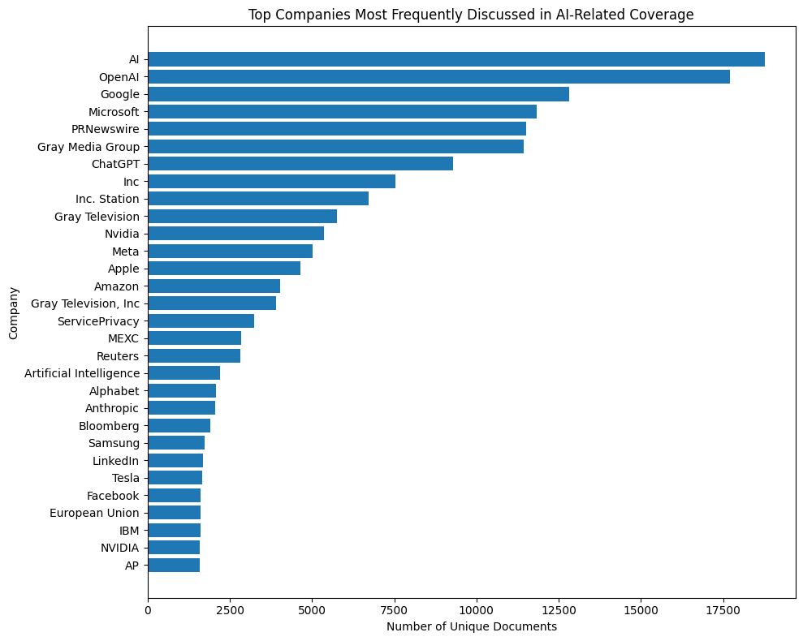
Entity extraction (companies + technologies)
04 Entity extraction
Two-track extraction: pretrained NER for organizations + rule-based phrase matching for technologies
Extraction & normalization
Example output: top companies in AI-related coverage
Org NER: detect organization mentions (e.g., OpenAI, Microsoft, Nvidia)
Leveraged distilbert-NER to extract ORG entities
Tech phrases: curated lexicon + phrase matcher (e.g., process automation, AI copilots)
Standardize variants and join back to document metadata (date, topic/industry)
Aggregate by industry/company/technology/time for insights
Why entities are critical
Topics explain “industry-level narrative”.
Entities provide the drill-down: “which companies” + “by what means”.
Entity-centered contexts become the unit for sentiment training + inference.
9/22
Notes:
[Sources] - Entity extraction workflow and aggregations are implemented in 04_entity_extraction.ipynb and used in 06_sentiment_inference.ipynb. [/Sources]

Slide 10
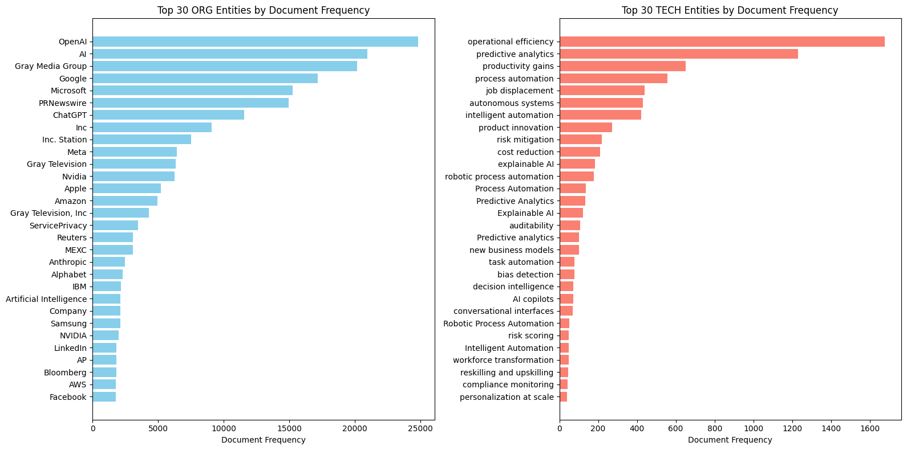
Entity-level view: who is most discussed?
Companies
Top companies/organizations in AI impact coverage (unique documents)
Interpretation notes
Counts reflect how often entities appear in AI impact contexts, not company size.
Some “entities” are publishers or generic terms (e.g., PRNewswire) → limitation to improve with stronger canonicalization.
We use entity-level sentiment (next slides) to distinguish “hyped” vs “criticized” coverage.
Used later for:
Company-level sentiment profiles
Industry × company hotspots
Over-time sentiment trends
10/22
Notes:
[Sources] - Company frequency chart is produced in 06_sentiment_inference.ipynb. [/Sources]

Slide 11
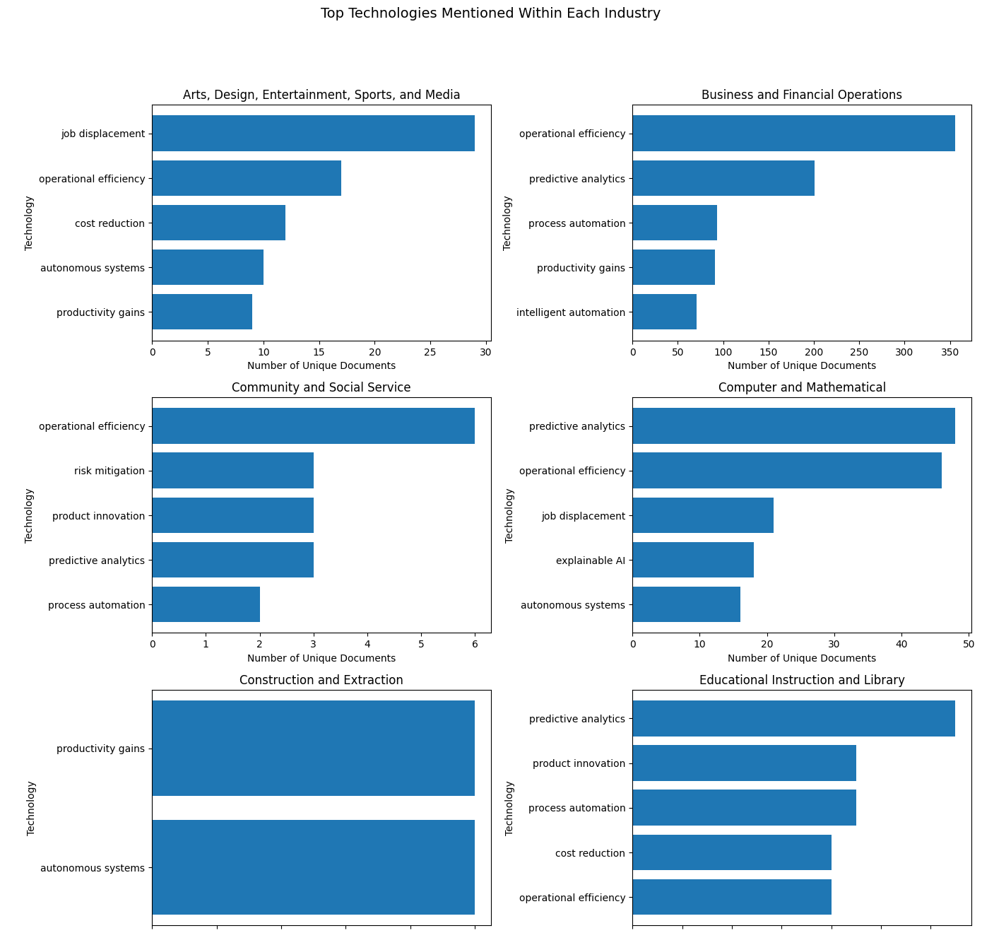
“By what means?” Technology themes
Technologies
Most common AI “means” themes in the corpus
Arts, Design, Entertainment, Sports, and Media
Job displacement dominates, suggesting stronger concern about creative labor substitution.
AI is also framed around efficiency and cost reduction, but the labor-risk narrative is most visible.
Business and Financial Operations
AI is mainly discussed as a tool for operational efficiency and predictive analytics.
The sector shows a strong automation and productivity narrative.
Community and Social Service
AI is framed more around operational support and risk mitigation than worker replacement.
Mentions of product innovation suggest a service-improvement angle.
Computer and Mathematical
Predictive analytics and operational efficiency lead, reflecting data-heavy AI use cases.
Job displacement and explainable AI show that labor and governance concerns are also important.
Construction and Extraction
The dominant themes are productivity gains and autonomous systems.
AI impact here appears tied to physical operations and site automation.
Educational Instruction and Library
Predictive analytics leads, suggesting interest in data-driven educational support.
AI is also associated with innovation, process automation, and cost reduction.
Technology mix varies by industry (examples)
11/22
Notes:
[Sources] - Technology extraction and aggregations are implemented in 04_entity_extraction.ipynb and visualized in 06_sentiment_inference.ipynb. [/Sources]

Slide 12
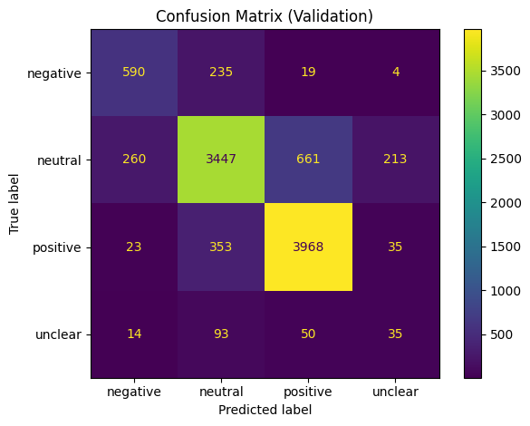
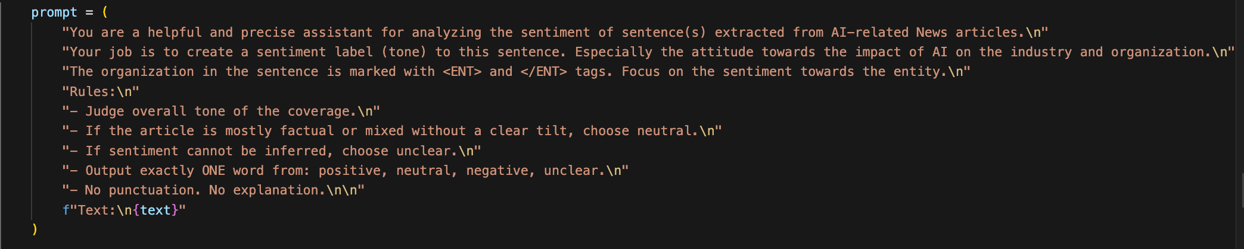
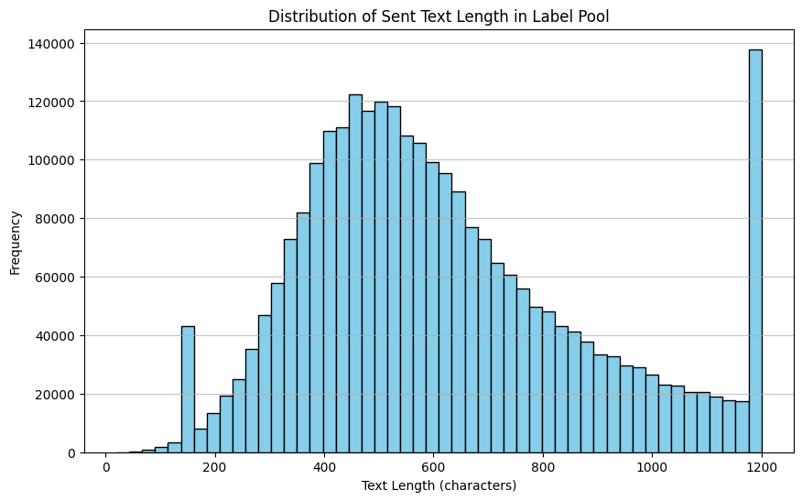
Custom sentiment model
05 Sentiment training
Restriction: sentiment model is self-trained (fine-tuned)
Weak supervision pipeline
Confusion matrix (validation)
Build entity-centered context windows around organization mentions
Generate weak labels with an LLM (positive / neutral / negative / unclear)
Used GPT 5-nano, prompt:
Fine-tune roberta-base on the weakly labeled dataset
Validate on held-out set and inspect confusion matrix
Context length distribution (label pool)
Validation metrics (10k examples)
Accuracy: 0.804
Per-class F1:
• positive: 0.874
• neutral: 0.792
• negative: 0.680
• unclear: 0.146
Note: “unclear” is rare and hardest to learn.
12/22
Notes:
[Sources] - Training pipeline, evaluation report, and confusion matrix are from 05_sentiment_model_train.ipynb. [/Sources]

Slide 13
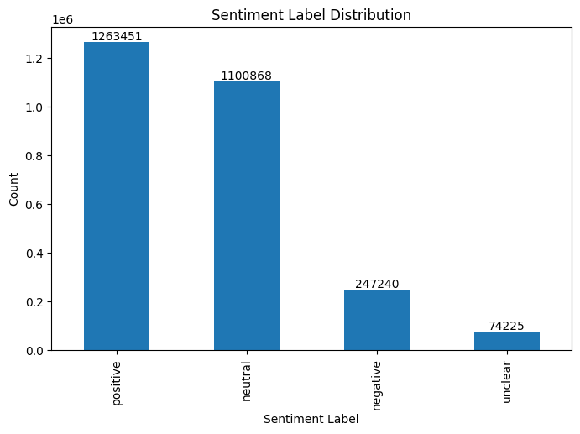
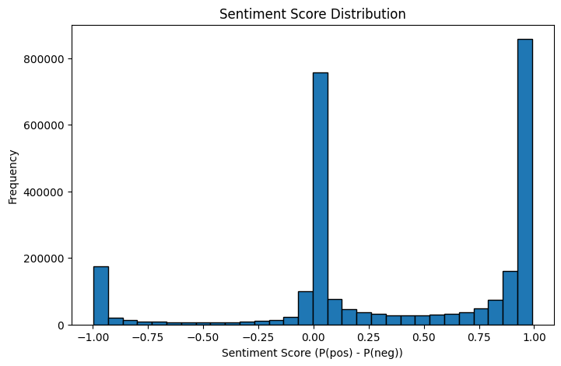
Sentiment inference at scale
06 Inference
Apply the fine-tuned model to all entity-centered contexts, then aggregate by industry/company/tech/time
Total contexts labeled
Label set
Score
2,685,784
positive · neutral · negative · unclear
P(pos) − P(neg) ∈ [-1, 1]
Label distribution (counts)
Score distribution
13/22
Notes:
[Sources] - Inference and aggregation are performed in 06_sentiment_inference.ipynb. [/Sources]

Slide 14
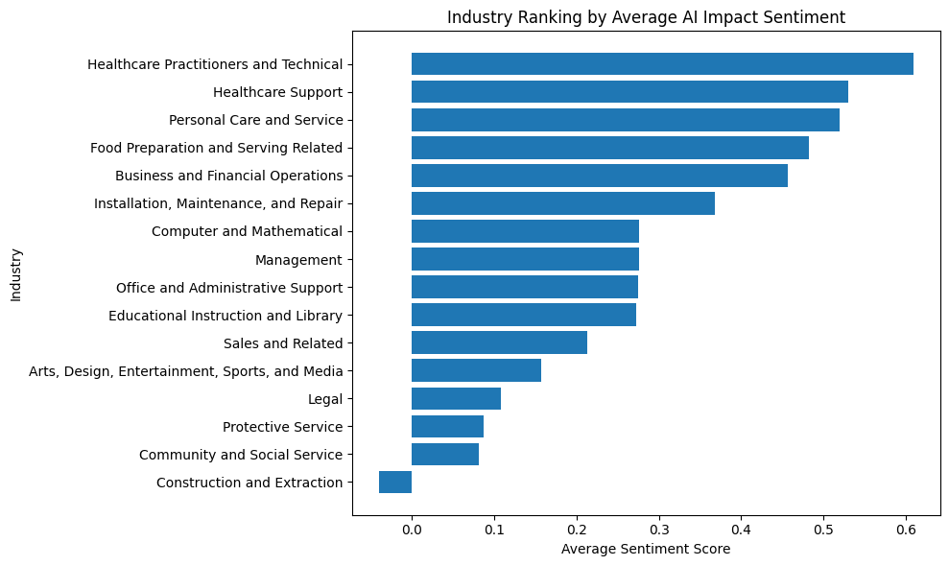
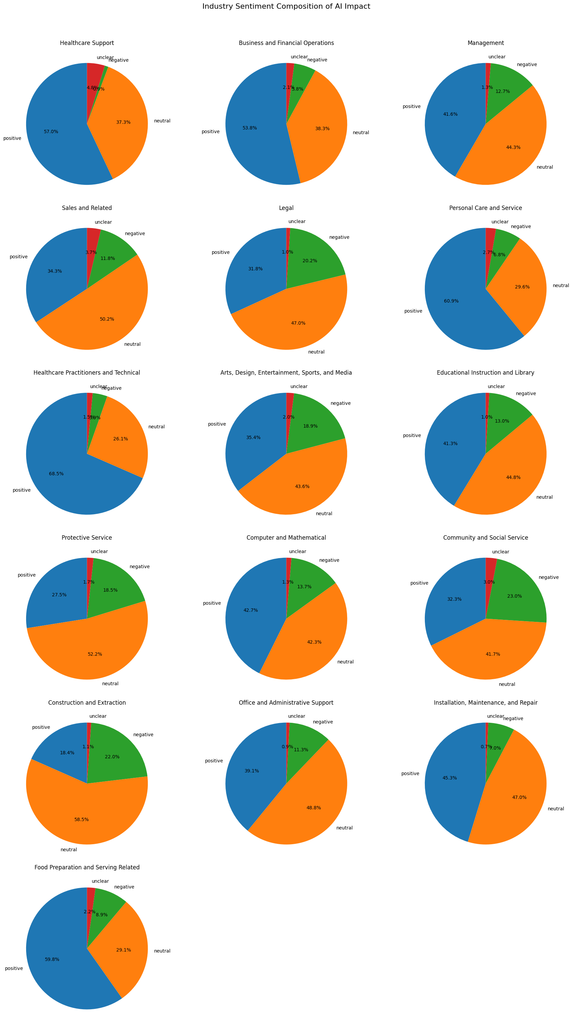
Q2 (topic/industry-level): positive vs negative impact
Industry sentiment
Average sentiment score by industry (higher = more positive framing)
Sentiment composition (selected industries)
14/22
Notes:
[Sources] - Industry sentiment scores and composition plots are computed from entity-context sentiment predictions in 06_sentiment_inference.ipynb. [/Sources]

Slide 15
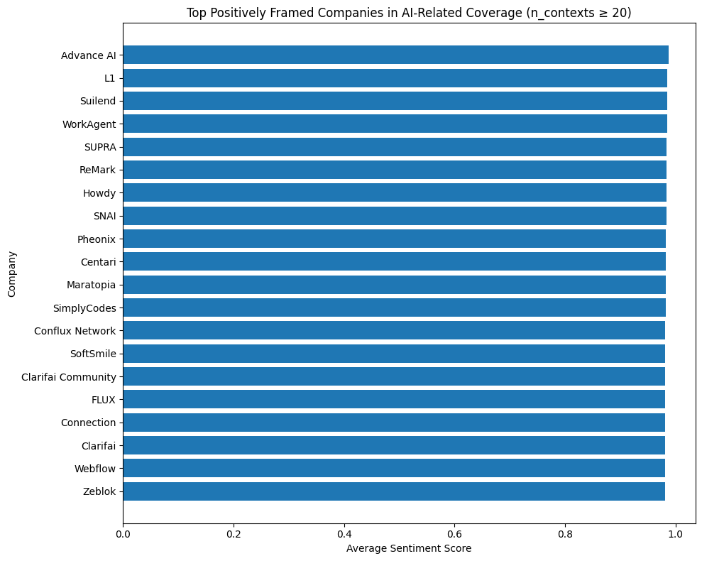
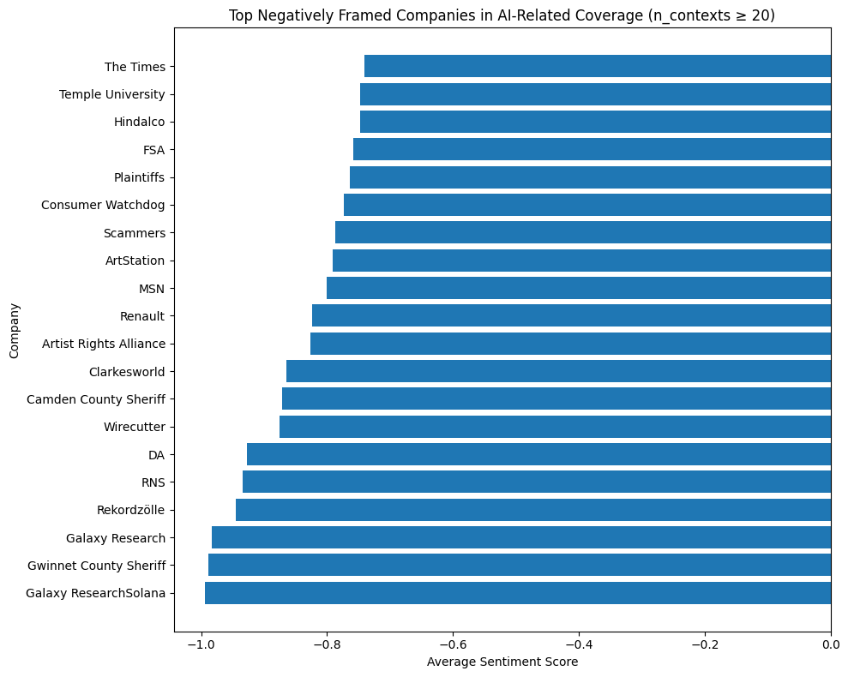
Entity-level sentiment: companies
Entity sentiment
Company sentiment is computed by averaging sentiment scores across entity-centered contexts (min contexts ≥ 20)
Most positively framed (examples)
Most negatively framed (examples)
Caveat: entity canonicalization is imperfect (some names are publishers/generic nouns).
15/22
Notes:
[Sources] - Company sentiment rankings are produced in 06_sentiment_inference.ipynb. [/Sources]

Slide 16
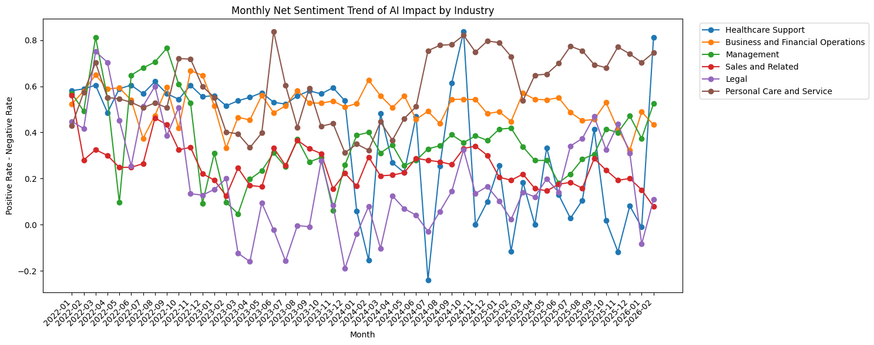
Visualization over time: net sentiment trend
Over-time
Net sentiment = positive rate − negative rate (by month, by industry)
Interpretation: compare trend direction (momentum) vs baseline level; spikes often align with major product/regulation news cycles.
16/22
Notes:
[Sources] - Over-time trend plot is computed in 06_sentiment_inference.ipynb. [/Sources]

Slide 17
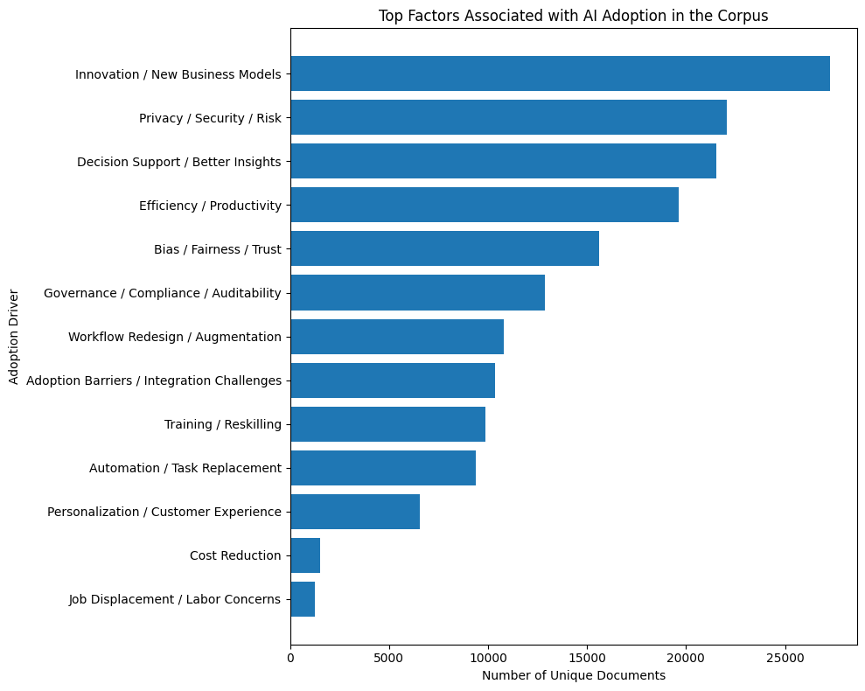
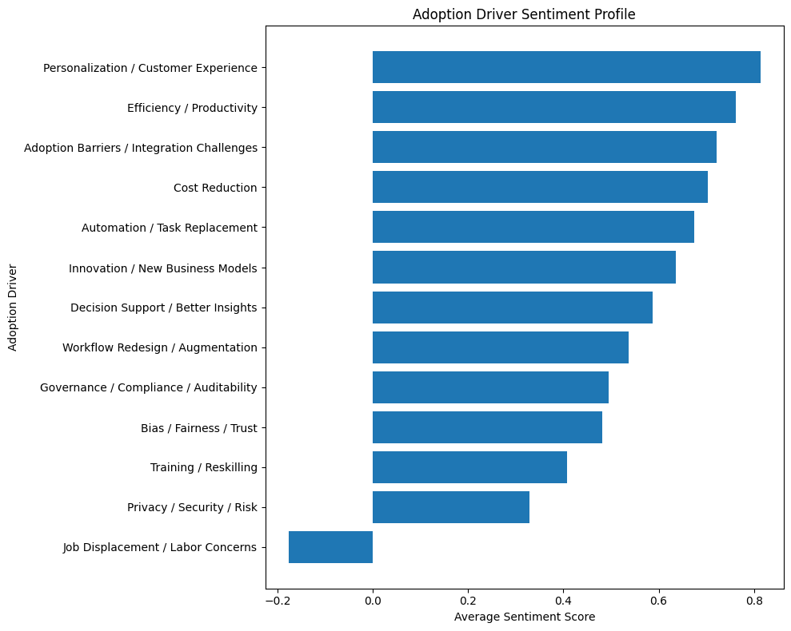
Q3: What drives successful vs unsuccessful adoption?
Adoption drivers
We treat “adoption driver” as a technology/means theme associated with adoption contexts and analyze volume + sentiment
Key pattern
High-volume drivers are mostly positive (innovation, productivity, decision support). Risk-heavy drivers (privacy/security, fairness, governance) reduce sentiment; “job displacement” is the only strongly negative driver.
17/22
Notes:
[Sources] - Adoption drivers (frequency + sentiment) are computed in 06_sentiment_inference.ipynb. [/Sources]

Slide 18
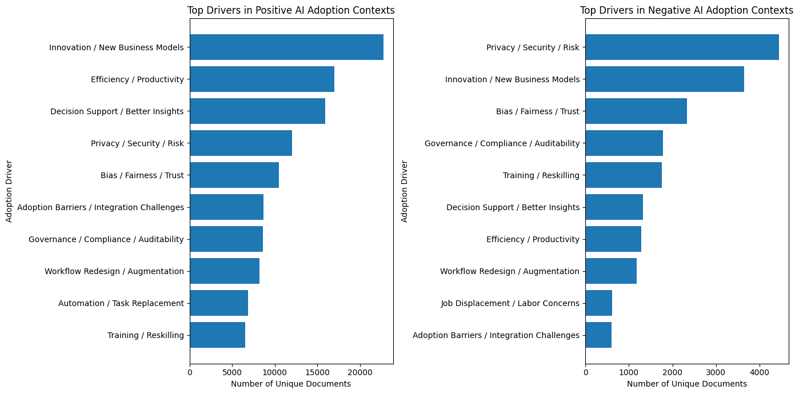
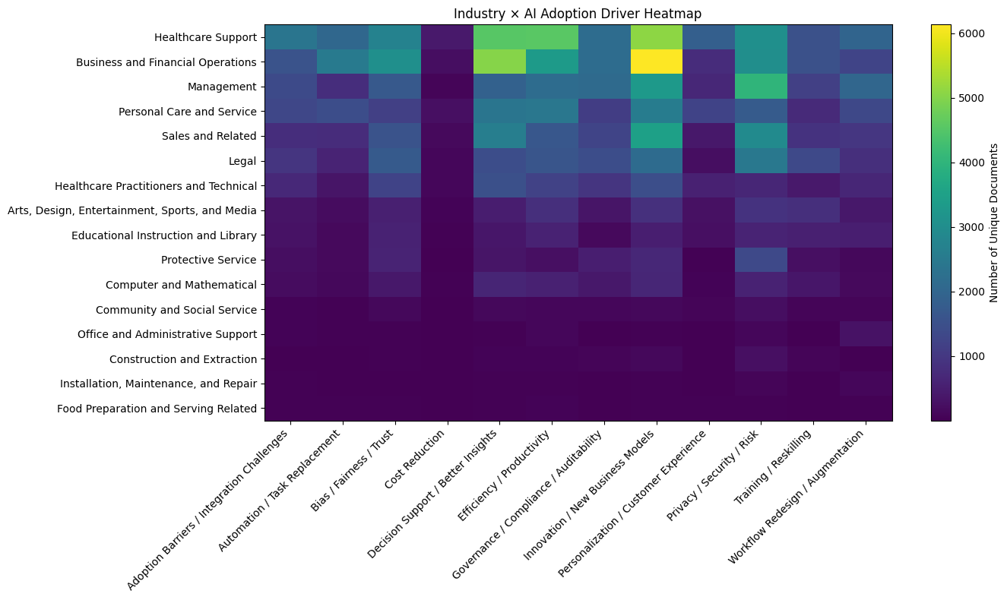
Adoption drivers: what differs in negative contexts?
Drivers × Industry
Compare drivers in positive vs negative adoption contexts; then view industry × driver co-occurrence
18/22
Notes:
[Sources] - Driver splits and industry×driver heatmap are produced in 06_sentiment_inference.ipynb. [/Sources]

Slide 19

Wrap-up: Q1. Which industries are most likely to be impacted by AI?
Most exposed industries
• Management, Arts/Media, Business & Financial Operations, Healthcare Support, Legal, and Sales have the highest exposure.
• These are the sectors most frequently discussed in AI-impact news, especially in information-heavy and service-oriented work.
• Topic→industry mapping turns article-level topics into an interpretable industry impact map.
• High exposure highlights where workflow redesign, labor implications, and competitive pressure are most visible.
19/22
Notes:
[Sources] - Driver splits and industry×driver heatmap are produced in 06_sentiment_inference.ipynb. [/Sources]

Slide 20

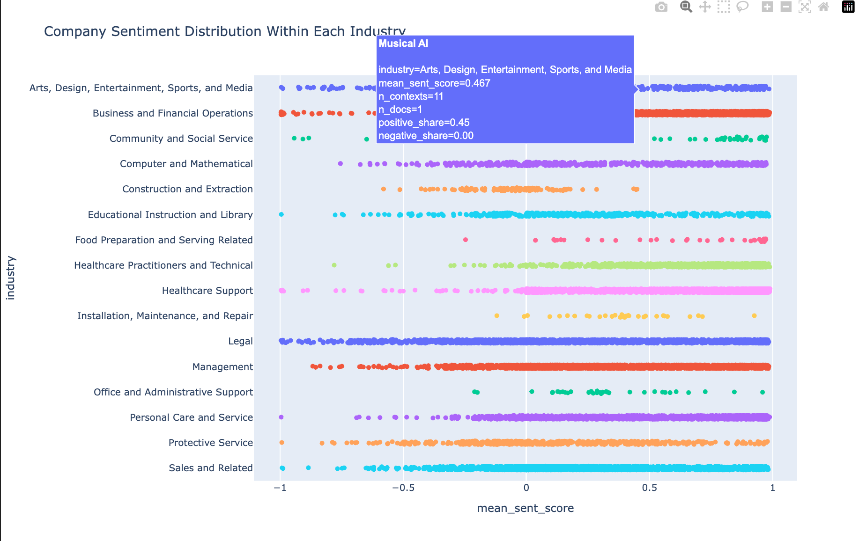
Wrap-up: Q2. AI's impact on those industries and companies mostly positive or negative?
Most exposed industries
AI’s impact on those industries and companies: mostly positive or negative?
Answer: mostly mixed, with a slight positive tilt in some industries - but clearly not uniformly positive.
Industry-level sentiment is mixed rather than one-directional. The monthly net sentiment lines stay above zero for several industries much of the time, but the levels vary a lot across sectors and months.
Some industries are consistently more positive.
Business & Financial Operations and Personal Care & Service show relatively high and stable net sentiment, suggesting AI is often framed there in terms of efficiency, service improvement, or business value.
Others are more volatile or closer to neutral.
Healthcare Support, Management, Sales, and especially Legal fluctuate much more, indicating that AI coverage in these sectors includes both optimism and concern.
Company-level sentiment is highly dispersed within each industry. The company scatterplot shows organizations spread across the full range from negative to positive, which means firms in the same industry are not experiencing AI in the same way.
This suggests execution matters as much as industry. Industry gives the overall context, but company-level outcomes depend on how AI is adopted, governed, and integrated into workflows.
So the overall conclusion is: AI impact is neither mostly positive nor mostly negative. It is mixed, with positive narratives around productivity and innovation, but also negative or uncertain narratives around displacement, risk, and implementation challenges.
20/22
Notes:
[Sources] - Driver splits and industry×driver heatmap are produced in 06_sentiment_inference.ipynb. [/Sources]

Slide 21
Wrap-up: Q3. By what means and technologies is AI creating impact?
Mechanisms of AI impact
Most exposed industries
• The most common mechanisms are predictive analytics, operational efficiency, automation, productivity gains, and autonomous systems.
• The dominant mechanism depends on the industry: job displacement is salient in Arts/Media, while efficiency and analytics dominate Business, Education, and Healthcare-related fields.
• AI is changing work through both task automation and process redesign—not through a single universal pathway.
• Successful adoption is more likely when AI is tied to clear use cases, operational fit, and measurable value.
21/22
Notes:
[Sources] - Driver splits and industry×driver heatmap are produced in 06_sentiment_inference.ipynb. [/Sources]

Slide 22
Wrap-up: answers + limitations
Conclusion
Final answers
Q1 · Who is impacted?
Q3 · What helps/hurts adoption?
High-exposure industries: Management, Arts/Media, Business & Finance, Healthcare Support, Legal, Sales.
Most discussed entities include major AI/platform players (OpenAI, Google, Microsoft, Nvidia), plus industry-specific actors.
Success narrative: innovation/new business models, productivity, decision support, better customer experience.
Failure narrative: privacy/security, bias/fairness/trust, governance/compliance, integration barriers.
Q2 · How and by what means?
Industry sentiment is mostly positive/neutral; negative share is higher in Legal and job-displacement contexts.
Top means: operational efficiency, predictive analytics, process automation, productivity gains, AI copilots.
Limitations & next steps
Entity canonicalization: merge publisher/generic terms; strengthen org linking (aliases, KB).
Topic outliers (-1): refine clustering hyperparameters and/or increase representation quality.
Weak labels: spot-check a human-labeled subset for calibration; improve “unclear” class via targeted sampling.
Causal interpretation: news sentiment is perception, not ground truth impact (use as leading indicator).
22/22
Notes:
[Sources] - Limitations are based on observed artifacts in entity extraction and sentiment evaluation in notebooks 04–06. [/Sources]

