Slide 1
KEP
Khanh Phan
Edward Lam
Peter Weisdepp

Slide 2
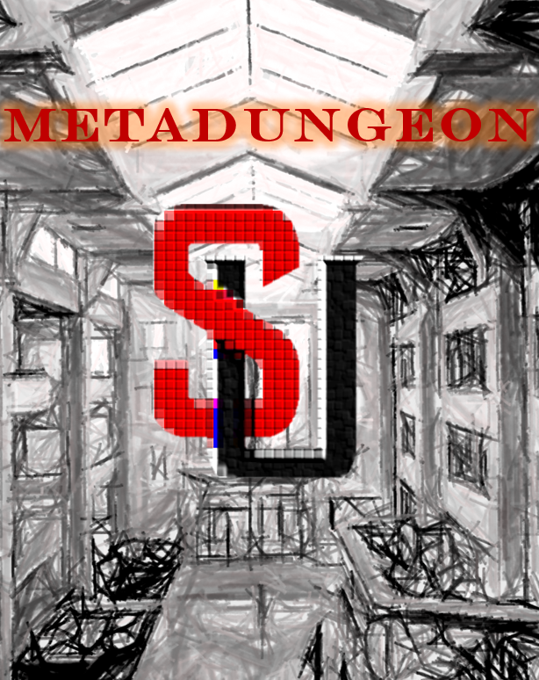
The situation
Characters consist of CPSC 5250 students
Monsters represent assignments and personal issues that get in the way of studying
Disease
Github outages
Hard drive crash
Mike is the end of round boss

Slide 3
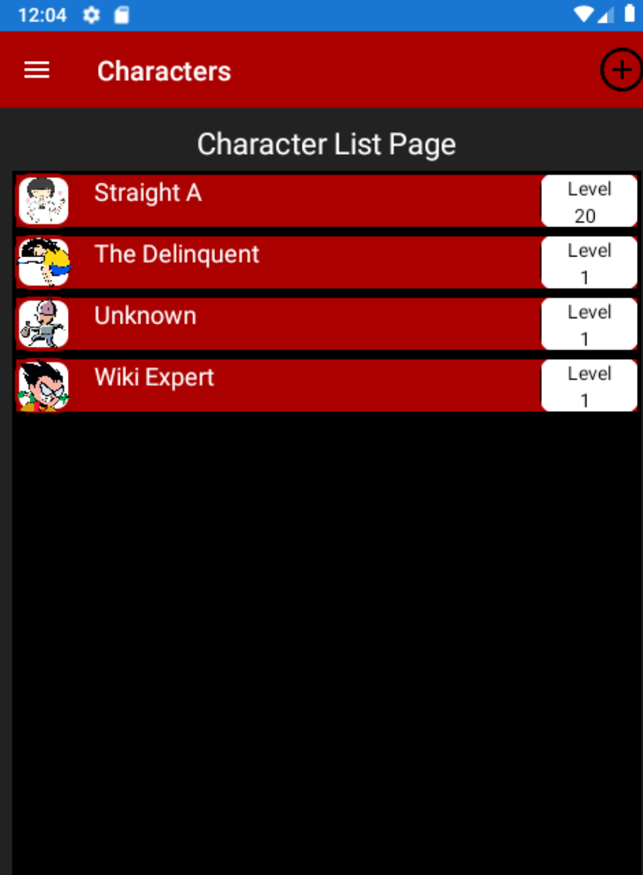
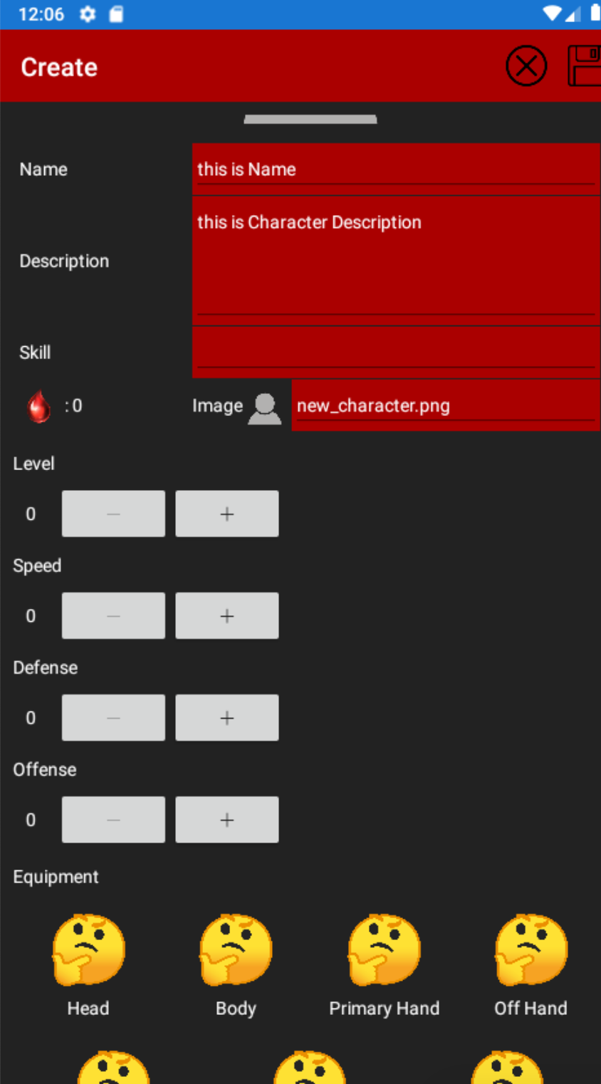
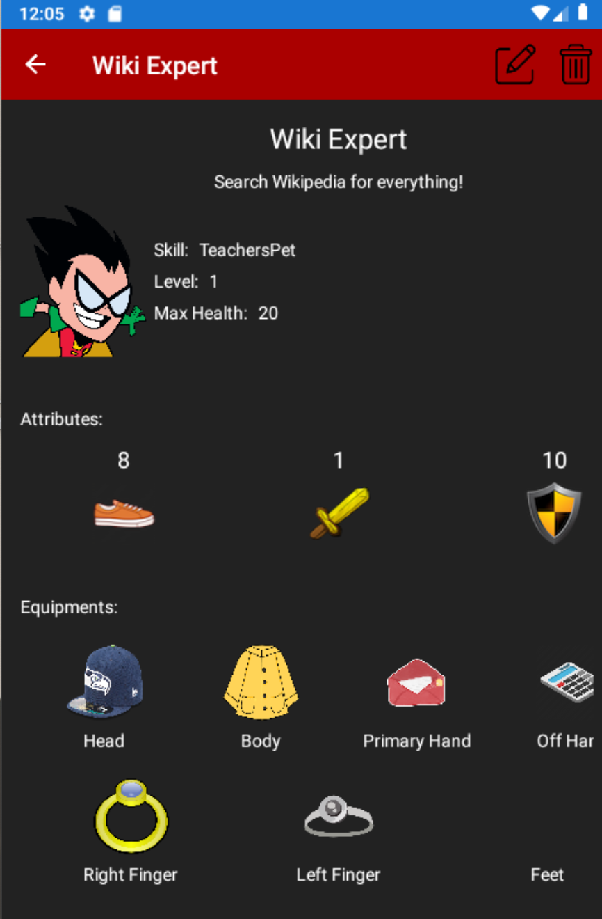
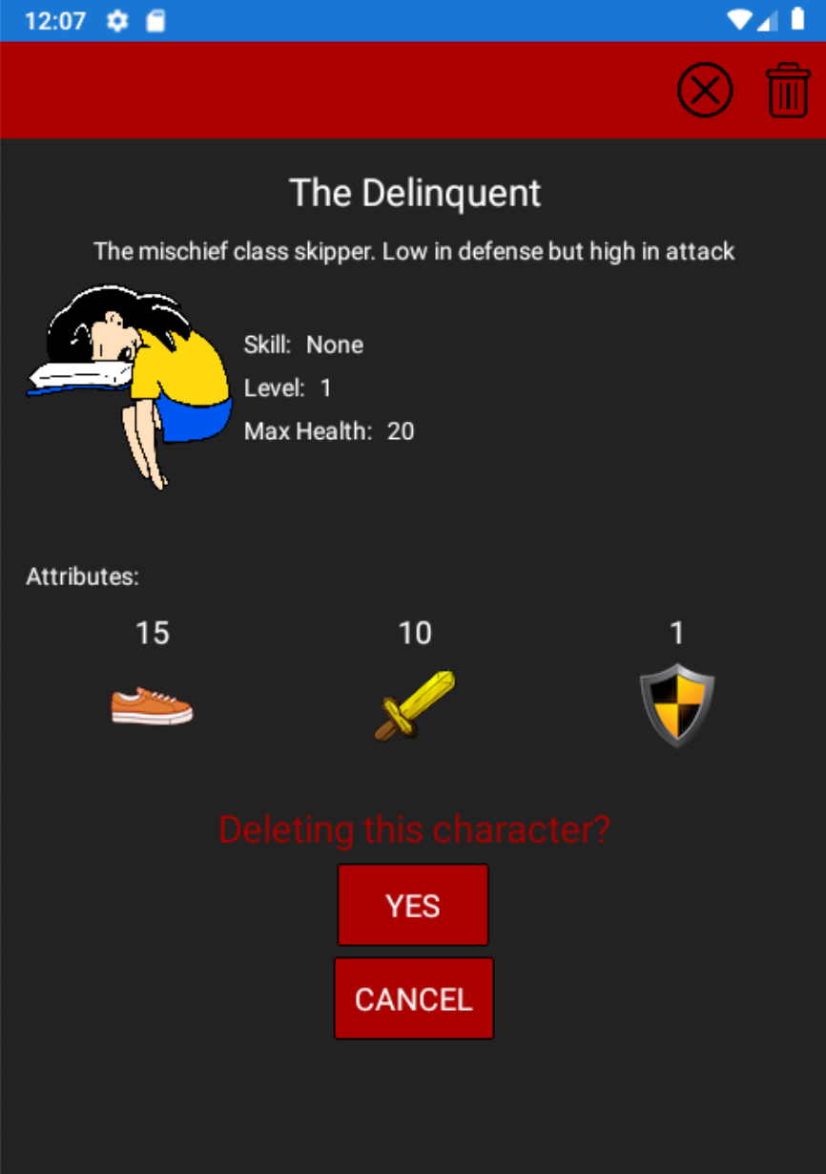
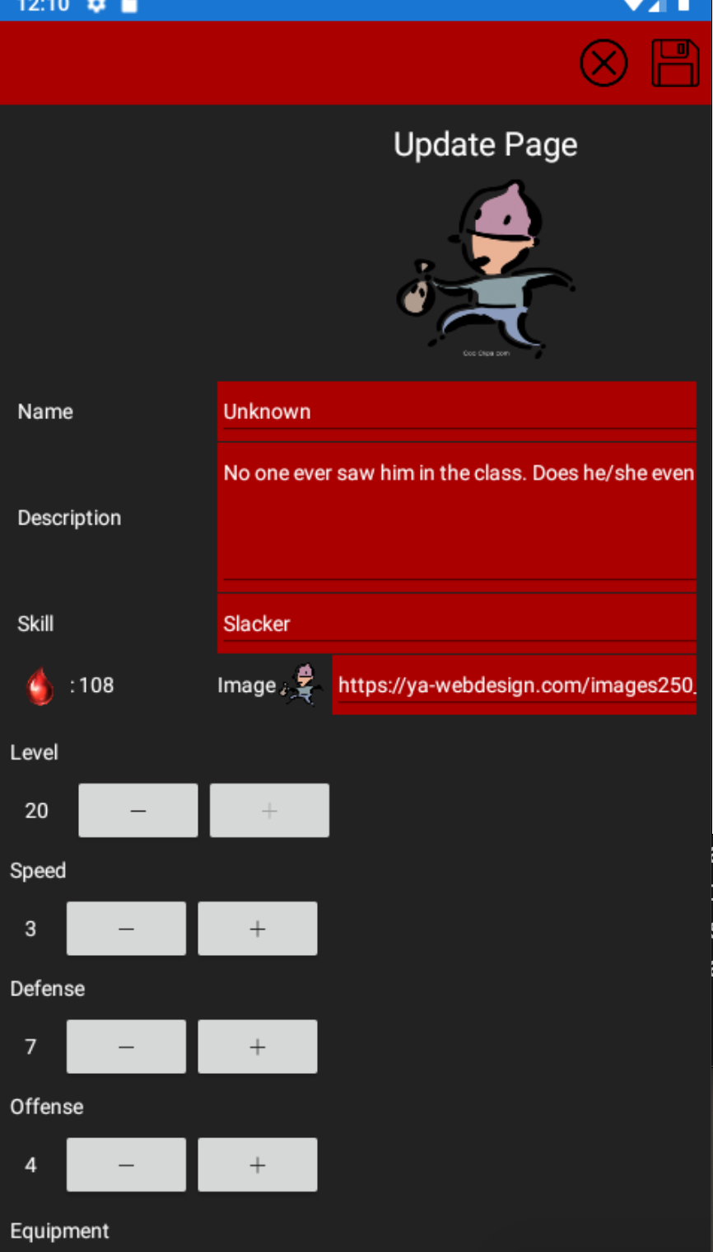
Character (Edward?)
Include: Area, Team owner, Class design, Screen shots

Slide 4
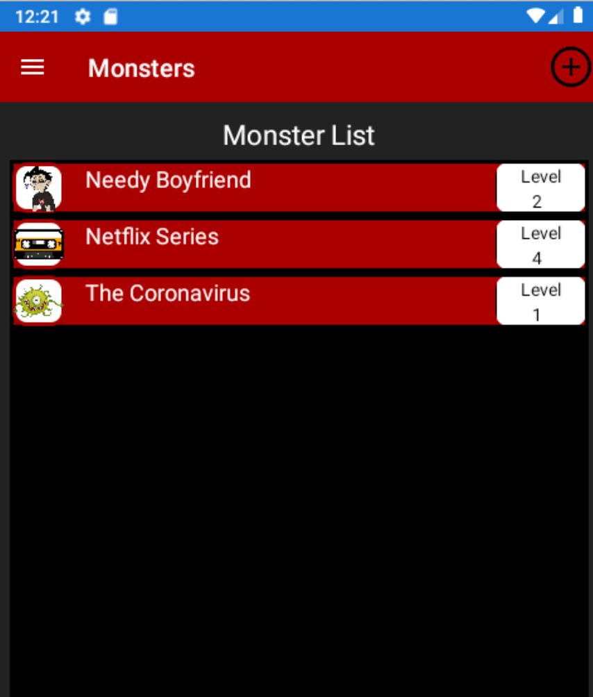
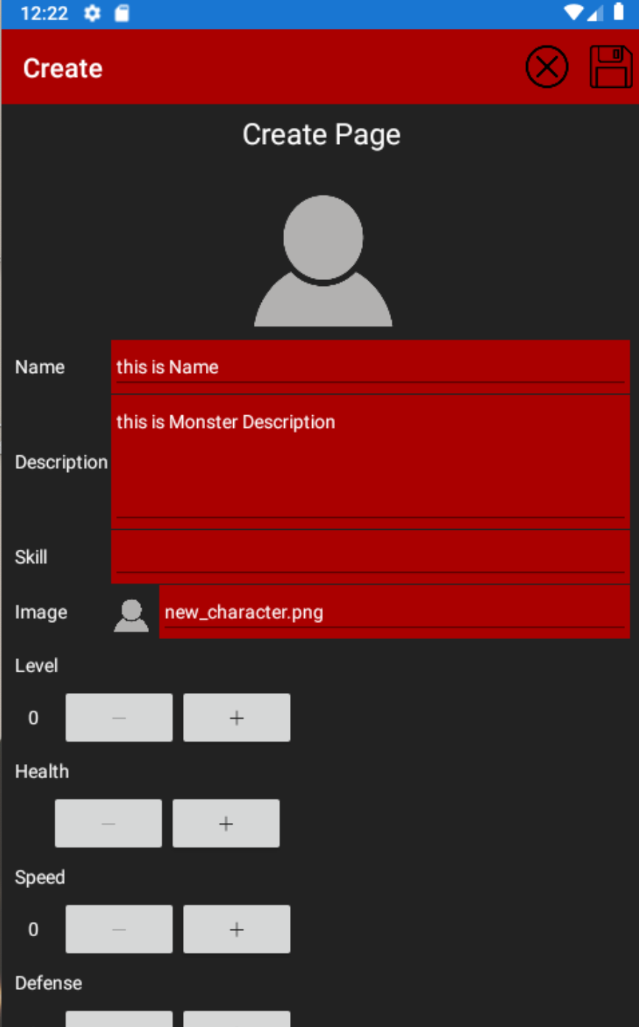
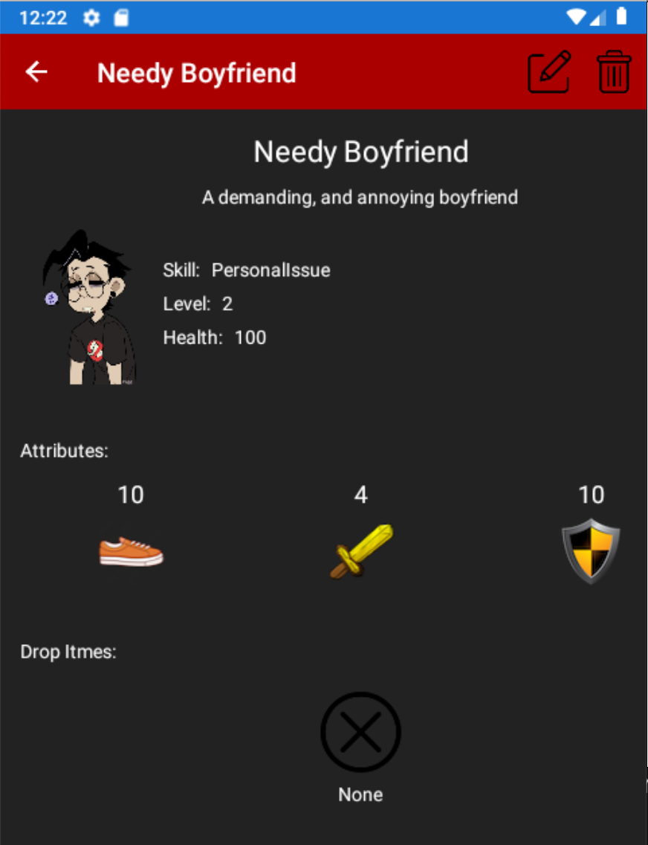
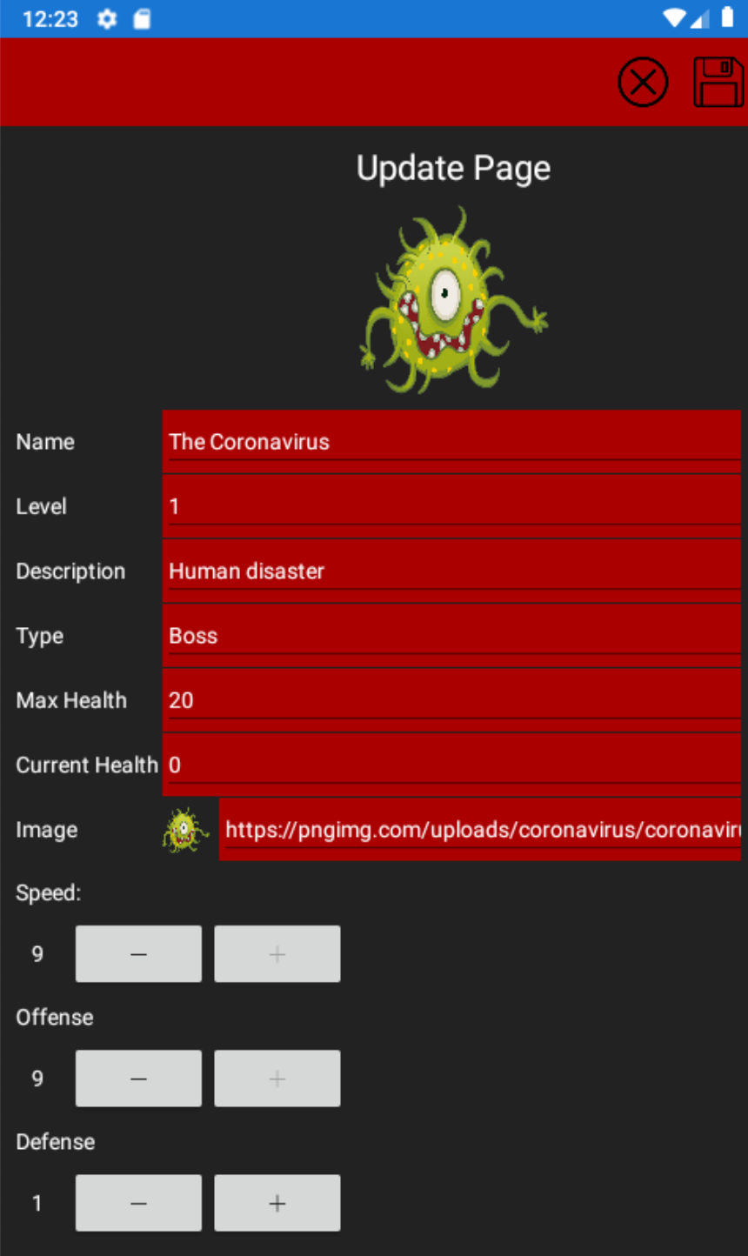
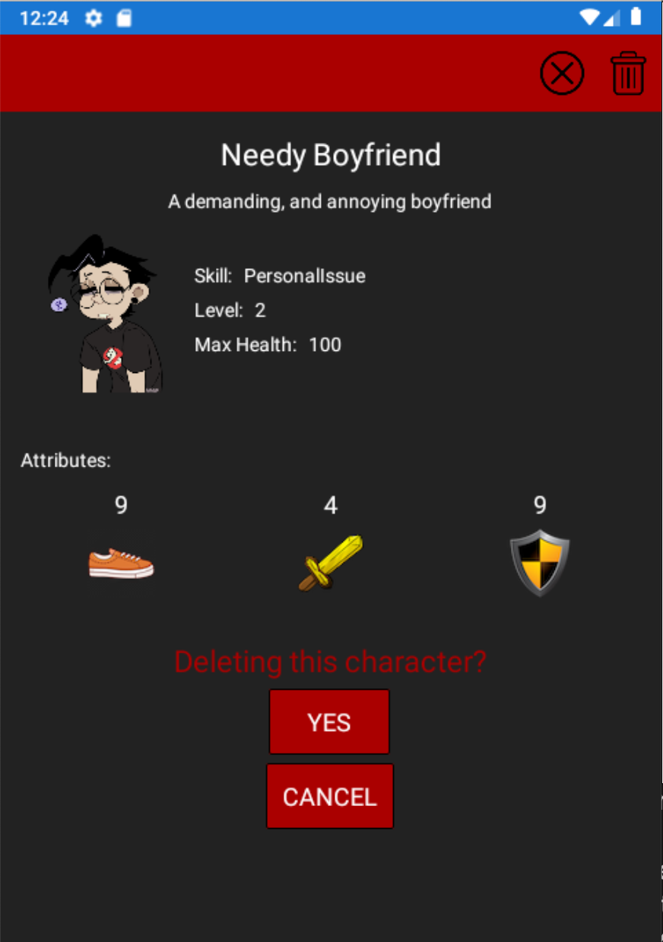
Monster (Edward?)
Include: Area, Team owner, Class design, Screen shots

Slide 5
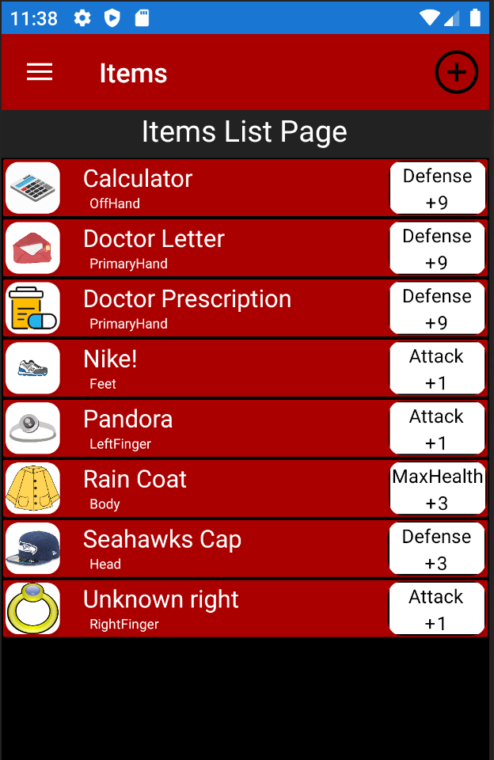
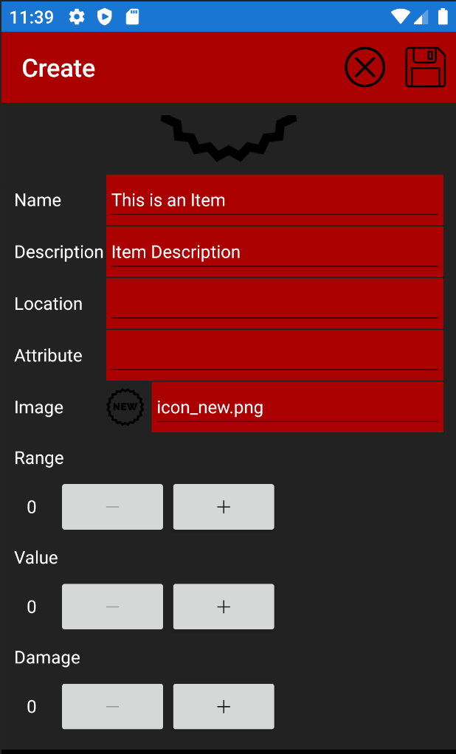
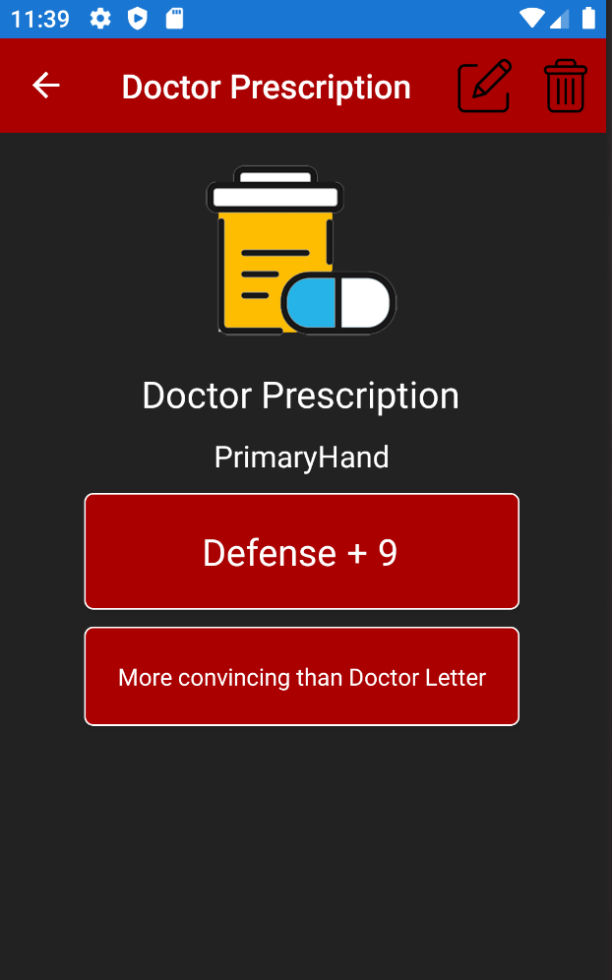
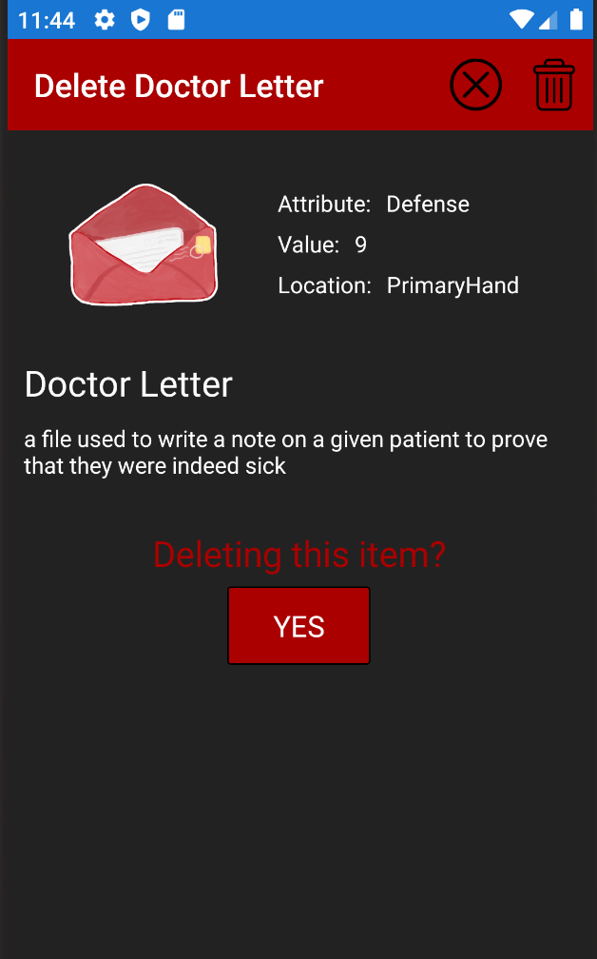
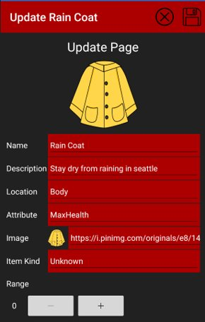
Item(Khanh?)
Include: Area, Team owner, Class design, Screen shots

Slide 6
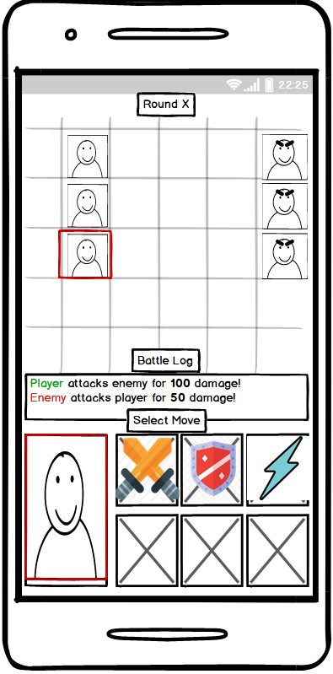
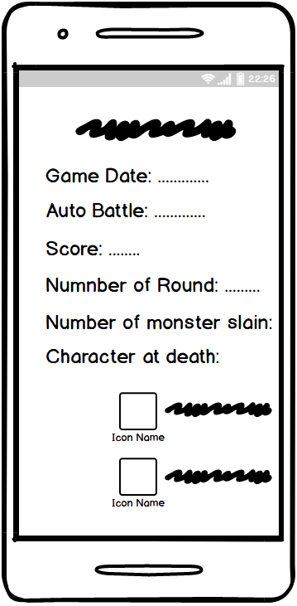
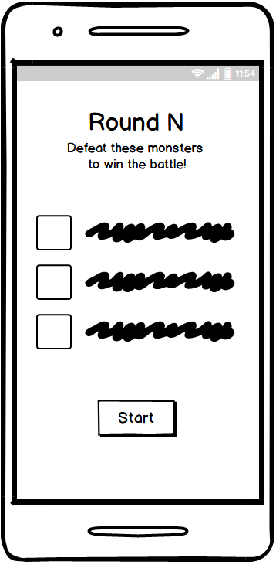
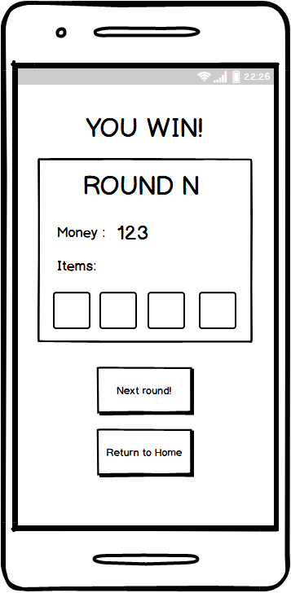
Battle UX
Include: Area, Team owner, Class design, Screen shots

Slide 7
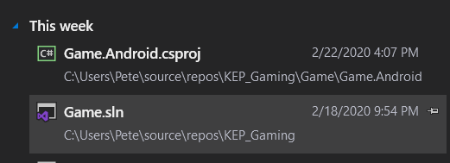
Lessons Learned
What would we do differently next time:
Don’t bother with VS for Mac. Setup a virtual machine with Windows and save ourselves a headache.
What is the thing you want to teach to others:
Xamarin Hot Reload is a great tool, but it doesn’t work unless you open the Android.csproj file specifically:

