Slide 1
Closed-loop Control
Lab3

Slide 2

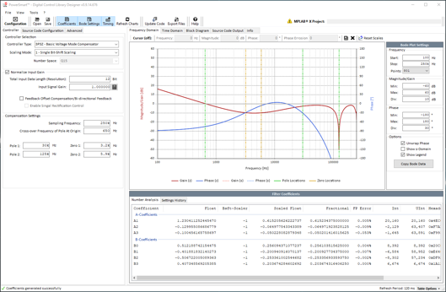

Lab #3: Closed-loop Control
Step3. Closed-Loop Control
PWM4H & 4L
(RC14 & RD6)
Init DC = 0%
619R+ 20R
C12
2200 pF
V_{FB}
(AN22)
1k
Timer2
OS Scheduler
0.5Hz LED Toggle
LED1 (RE6)

Slide 3
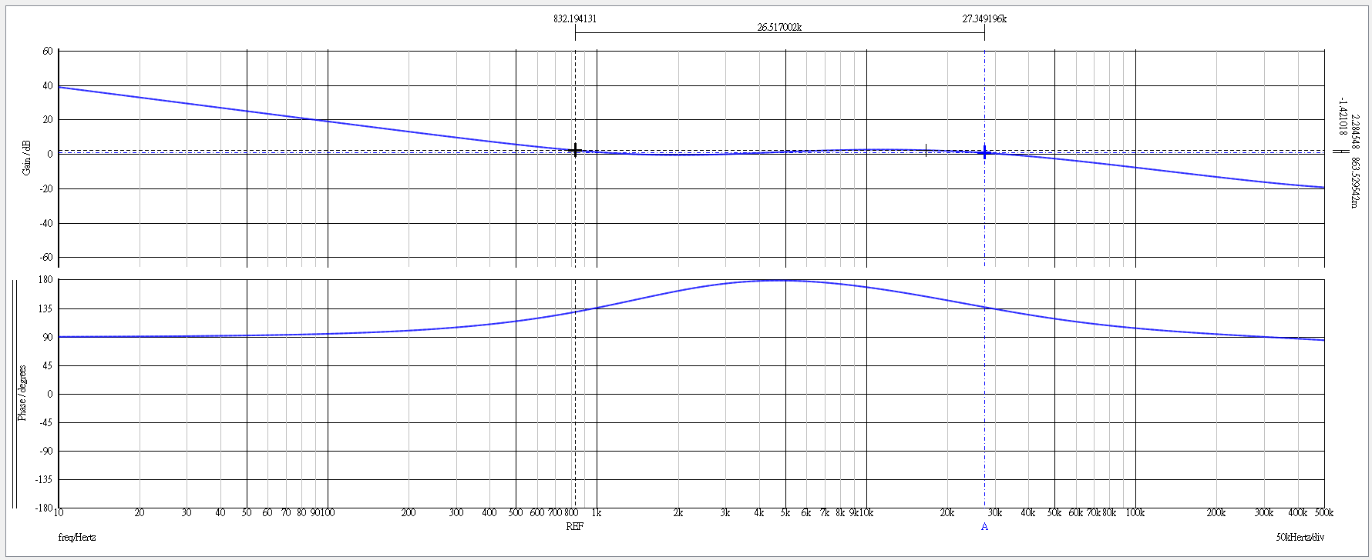
Digital Compensator Design
Type-3 Analog Compensator (Pole-Zero Cancellation By 3P2Z)
Ｘ
O
Ｘ
Ｘ
833 Hz
O
6 kHz
27.5 kHz
125 kHz
1.86 kHz

Slide 4
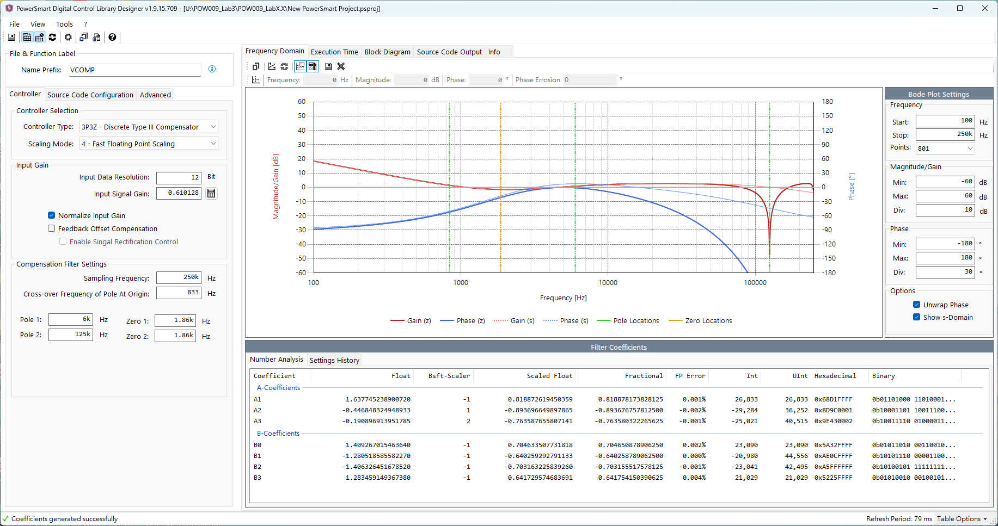

Slide 5
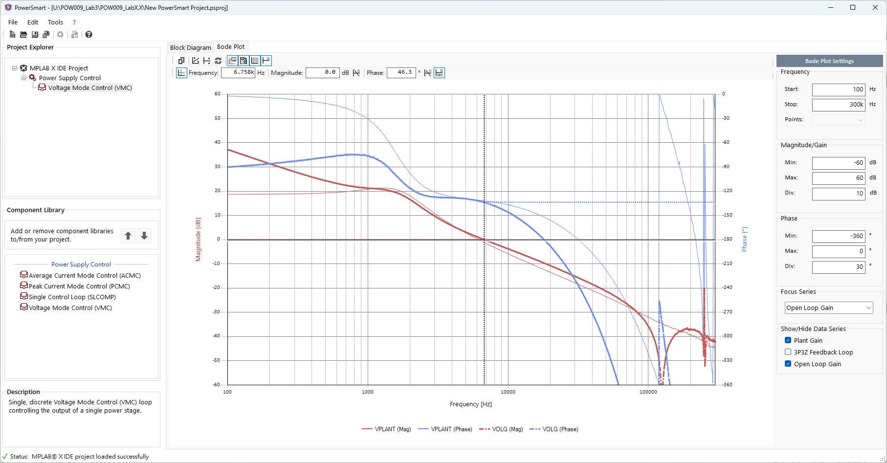

Slide 6
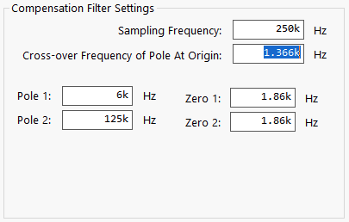
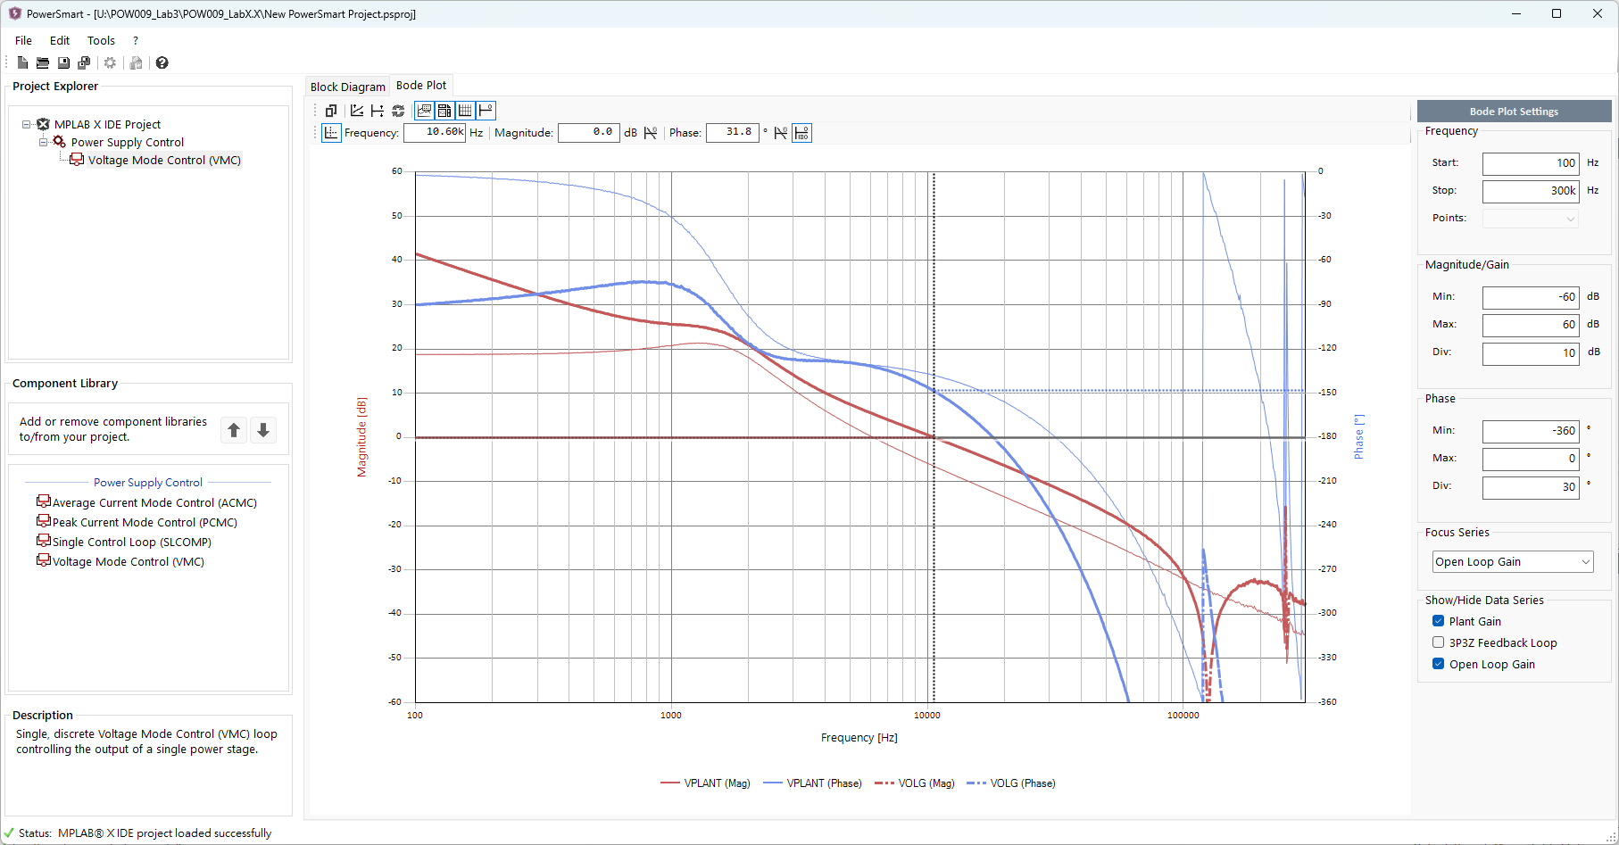

Slide 7
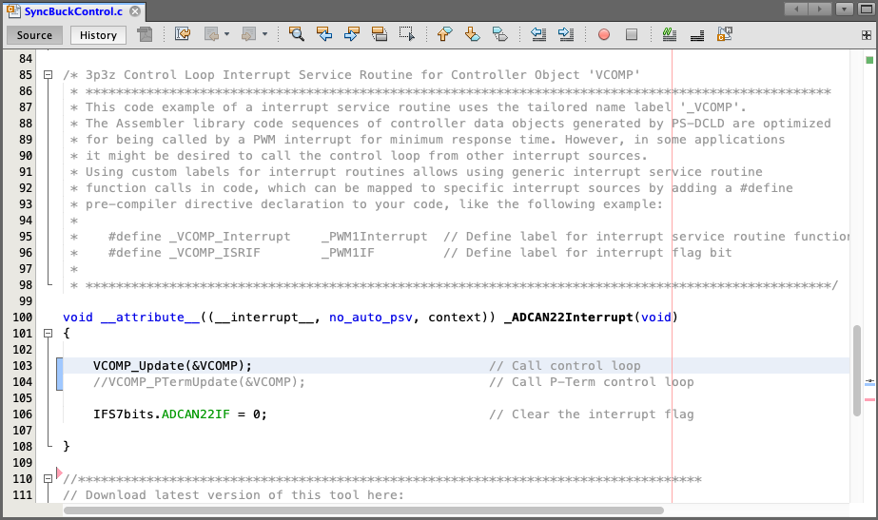
Lab #3: Closed-loop Control
Switch to closed-loop control in AN22 ISR

Slide 8

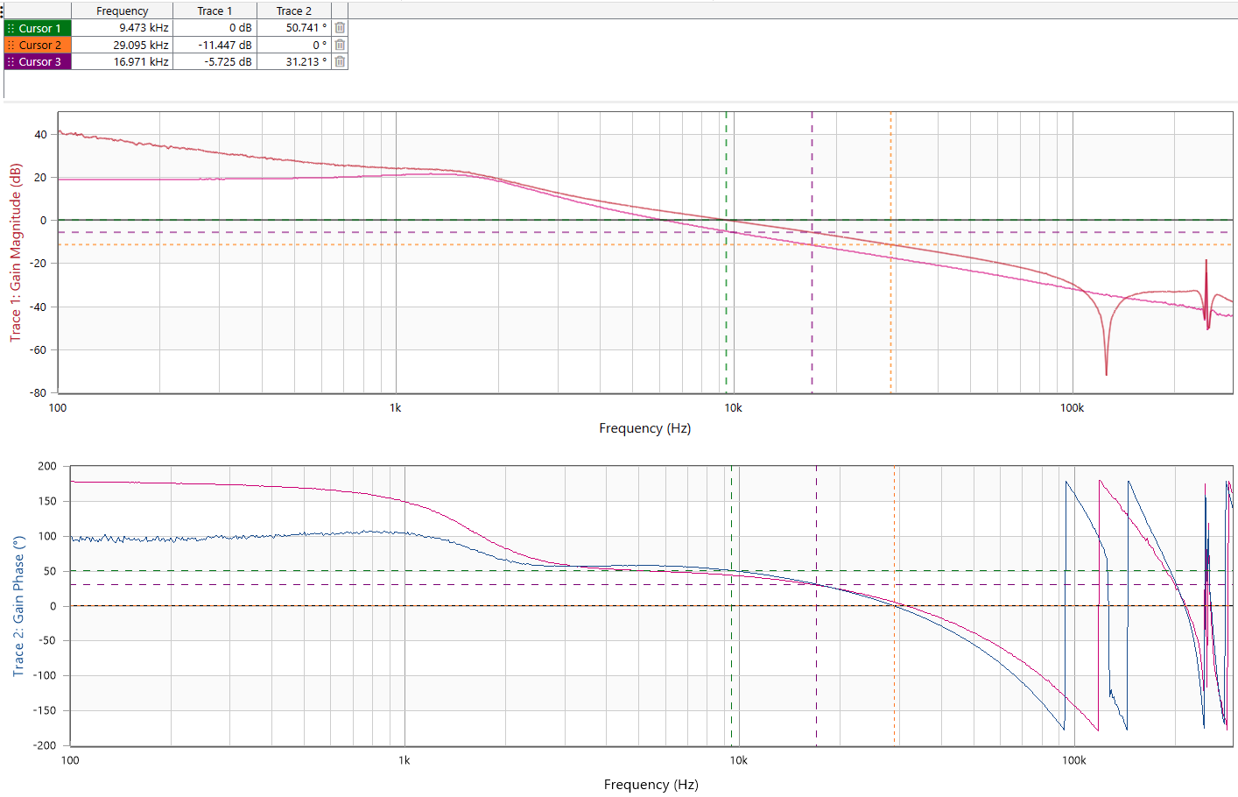

Lab #3: Closed-loop Control
Bode Plot Measurement
OL TF
Example code
Plant

Slide 9

Now, You have known that …
Step2. Plant Modeling
Simulation
OR
Measurement
Using
P-term Control
Step3. Closed-Loop Control
Step1. MCC Codebase

Slide 10
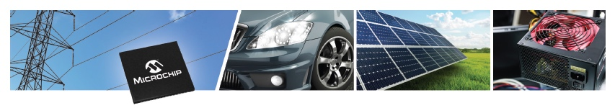

May The Power Be With You
Thanks !
POWER

