Slide 1

50.500 Analysis of Algorithm: Project Proposal – Pitch/Note Detection
Audio Research Group, PhD Student – Kin Wah Edward Lin
Supervised by Dr. Simon Lui

Slide 2

Background
In ISTD Seminar,
A singing synthesizer for re-targeting expressive singing style, particularly from Japanese popular or anime singer
Style Extractor
Recognition Algorithm
Synthesis Engine
Style = {High-Level Features}

Slide 3





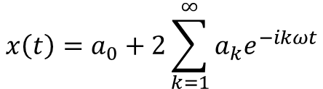
Observation
Given a song, the extractor should be able to extract the style.
Study Audio Signals from the Bottom-up Approach [Nick Collins, Introduction to Computer Music, 2010]
Low-level Features
Periodicity
F0 (fundamental frequency), $ω$
$$T=\frac{2π}{ω}$$
$x\left(t+T\right)=x\left(t\right),∀t$
$$x\left(t\right)=a_{0}+2\sum_{k=1}^{∞}{a_{k}e^{−ikωt}}$$

Slide 4
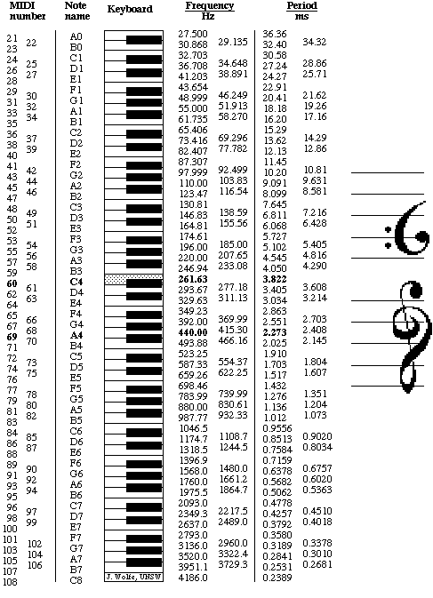
Pitch/Note Detection
High-level Features – Pitch (Monophonic – single singer, Polyphonic – two singers)
Auto-correlation
Pattern-matching
Cross product of Cepstrum & DFT [G. Peeters, ICASSP, 2006]
Plan
Implement those 3 methods with Matlab
Compare their accuracy
With MIDI file as benchmark
Compare their running time

Slide 5
Q & A Session
50.500 Analysis of Algorithm: Project Proposal – Pitch Detection Audio Research Group
PhD Student – Kin Wah Edward Lin

