Slide 1

50.500 Analysis of Algorithm: Project Result – Pitch Detection
Audio Research Group, PhD Student – Kin Wah Edward Lin
Supervised by Dr. Simon Lui

Slide 2
Background
Original Proposal,
Compare the Accuracy & Running Time of 3 different Pitch Detection Algorithms
Now, aim for 14th International Conference on New Interfaces for Musical Expression
Implement and Study
”Element wise Product of FFT and Cepstrum”
In iPhone App (Singer’s Pitch Tuning)
FFT and Cepstrum
Trade-Off Study between Frequency and Time Resolution
Experiment Setting
Result and Conclusion
Notes:
3 different pitch detection algorithms
Auto-correlation
Pattern-matching
Element-wise Product of DFT and Cepstrum ( =DFT(log(DFT) )

Slide 3
FFT and Cepstrum
iPhone has Accelerate Framework (vDSP.h) to perform audio analysis
vDSP_fft_zrip();
Fast Fourier Transform (FFT) – Cooley-Tukey FFT Algorithm O(N log₂ N)
where 0<k<N-1, N is the number of samples points in 1 frame
Cepstrum – O(N log₂ N)
where Arg(FFT[k]) is the angle of the complex number of FFT[k]
$$FFT\left[k\right]=\sum_{n=0}^{N−1}{x[n]e^{−iωnk}}=\sum_{m=0}^{N/2−1}{x[2m]e^{−i2ωnk}}+e^{−i2ωk}\sum_{m=0}^{N/2−1}{x[2m+1]e^{−i2ωnk}}$$
$$cep\left[k\right]=FFT\left[\log\left[FFT\left[k\right]\right]\right]=FFT\left[\log\left|FFT\left[k\right]\right|+iArg(FFT\left[k\right])\right]$$
Notes:
Why O(N Log₂ N)?
1) E_k = DFT of even-indexed part
O_k = DFT of odd-indexed part
2) Preiodicity of the DFT
Hence, the results of intermediate computations can be re-used!

Slide 4
Trade Off Study
Due to the limitation of human hearing (~20k Hz), and Sampling Theorem,
Fix the sample rate, S = 44,100Hz
For example, N = 1024 sample points in one frame, bin = 20th or bin = 21st
But,
$$\underset{bin}{arg max}\left\{AMP[bin]=FFT\left[bin\right]×cep\left[bin\right]\right\} , Pitch\left[bin\right]=\frac{S}{2N}×bin$$
$$Pitch\left[20\right]=\frac{44100}{2×1024}×20≈430.66 , Pitch\left[21\right]=\frac{44100}{2×1024}×21≈452.20$$
MIDI Number | Note Name | Frequency
67 | G4 | 392.00
68 | G#4 | 415.30
69 | A4 | 440.00
70 | A#4 | 466.16
71 | B4 | 493.88
Notes:
Bin: frequency bin
To Find FFT bin, simply bin = S/N, but in IOS, each sample contain 1 real and 1 imaginary part, it seems it need 2 expected sample time to take 1 sample!
Sampling Theorem

Slide 5
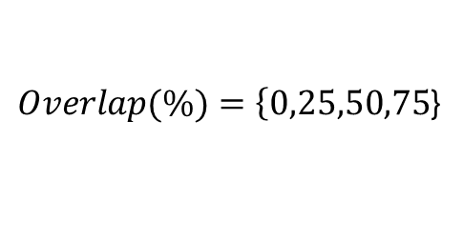
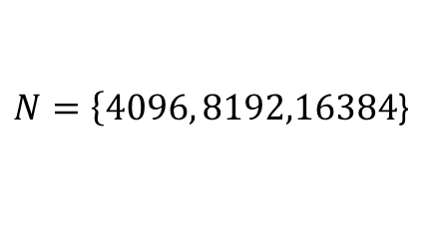
Experiment Setting
With Fixed Sample Rate S, we can only adjust
1) Number of Sample Points in a frame,
2) The percentages of frame overlapping,
Test Case is generated with Vocaloid
29 Notes, Range from A4~F2, each note plays 2 seconds, total 58 seconds
Average Running Time for each pitch detection and Accuracy on detecting the Correct Note
$N=\left\{4096, 8192,16384\right.$}
$Overlap(\%)=\left\{0,25,50,75\right.$}
MIDI Number | Note Name | Frequency | Bin N=1024 N=2048 N=4096
60 | C4 | [261.63 – 277.18) | NiL | 25 | 49,50,51
45 | A2 | [110.00 – 116.54) | NiL | NiL | 21
57 | A3 | [220.00 – 233.08) | NiL | 21 | 41,42,43
69 | A4 | [440.00 – 466.16) | 21 | 41,42 | 82,83,84,85,86
Notes:
We would like to capture all possible pitch that an average human being is able to hear, fix the sampling rate
The choice of number of sample points
Higher Pitch is more easier to detect, when N is larger
Overlap Mechanism is to tackle the possibility of pitch changes within a frame
Correct Note: Due to nature of vocal voice, if vocaloid sing at C4, but if we detect it as C5, we still consider it as correct!

Slide 6
Result and Conclusion
N | Period (ms) | Overlap (%) | Running time(ms) | Correct Note(%)
4096 | 185.76 | 0 | 0.670 | 26.34
4096 | 185.76 | 25 | 0.676 | 25.10
4096 | 185.76 | 50 | 0.673 | 27.37
4096 | 185.76 | 75 | 0.689 | 25.88
8192 | 371.52 | 0 | 1.340 | 27.66
8192 | 371.52 | 25 | 0.521 | 35.48
8192 | 371.52 | 50 | 0.514 | 33.51
8192 | 371.52 | 75 | 0.896 | 28.42
16384 | 743.04 | 0 | 1.340 | 11.11
16384 | 743.04 | 25 | 1.346 | 38.71
16384 | 743.04 | 50 | 1.343 | 32.26
16384 | 743.04 | 75 | 1.348 | 27.42
Notes:
First Preliminary Result
Honestly, I know it is not impressive as the accuracy is very low. As it may due to the testing environment, which has many background noise, such as AirCon. Lacking the Note Alignment mechanism.

Slide 7
Q & A Session
50.500 Analysis of Algorithm: Result Presentation – Pitch Detection Audio Research Group
PhD Student – Kin Wah Edward Lin
Source Code: https://github.com/EdwardLin2013/PitchTuning
Reference:
[1] G. Peeters. Music Pitch Representation by Periodicity Measures Based on
Combined Temporal and Spectral Representations. IEEE International Conference
on Acoustics, Speech and Signal Processing, 2006.
Notes:
Attack, Sustain, Decay and Release

