Slide 1
Project 1
Hadoop mapreduce and hive by Edward reed

Slide 2
Question 1
Which English Wikipedia article got the most traffic on October 20th?
The dataset that was used to answer this question was received using the linux command wget https://dumps.wikimedia.org/other/pageviews/2020/2020-10/pageviews-20201020-{00..23}0000.gz
The dataset is seperated by spaces and is sectioned off into four parts:
The domain_code which is the domain name of where the search occurred
The page_title which is the title of the page
Count_views which is how many views the page recieved
The total_response_size which is the caused by requests for the page
Another thing to note about this dataset is that each file only accounts for a single hour, so there are twenty-four files needed to make up the entire day.
In order to properly use all of the files at the same time, all 24 files were put into their own folder that would all be accesed at the same time with a single hive query.

Slide 3
Question 1 cont.
I first created a database called Project1_db and made a table inside a database called Pageviews using the following schema
CREATE TABLE PAGEVIEWS(CODE STRING, TITLE STRING, VIEWS BIGINT, RESPONSE BIGINT) ROW FORMAT DELIMETED FIELDS TERMINATED BY ‘ ‘;
The fields are terminated by ‘ ‘ because the dataset is separated by white spaces
Then I loaded the data from the folders with the 24 files of pageview data with the Hive query
LOAD DATA LOCAL INPATH ‘/home/rej99/pageviews’ INTO TABLE PAGEVIEWS;
The path in the quotes is the path to the directory with the pageview files
Then I ran a SELECT query that returned the sum of views that had the domain code ‘en’ or ‘en.m’ since those are the two domain codes for English and also group the sums by the title. Then I ordered the query by the views in descending order so the pages with the highest views would be on top
SELECT TITLE, SUM(VIEWS) AS TOTAL_VIEWS FROM PAGEVIEWS
WHERE CODE=‘en’ OR CODE=‘en.m’
GROUP BY TITLE ORDER BY TOTAL_VIEWS DESC;

Slide 4
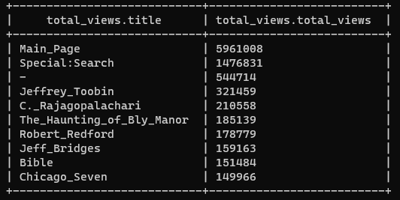
Question 1 cont.
The query results show that, other than Jeffrey Toobin was the most viewed page with 321,459 views on October 20th.

Slide 5
Question 2
What English Wikipedia article has the largest fraction of its readers follow an internal link to another Wikipedia article?
The datasets used for this question is the one used in the previous question, and another dataset that contains information about clicks to and from a page and is retrieved using this linux command: wget https://meta.wikimedia.org/wiki/Research:Wikipedia_clickstream
The dataset is seperated by tabs and divided into four parts
The initial page
The page that the link went to
The type of link, either link(internal), external, or other
The number of clicks on the page
A table called Clickstream was created using a similar convention as the one used in question 1, however the the fields are terminated by tabs (\t): FIELDS DELIMITED BY ‘\t’

Slide 6
Question 2 cont.
Since the data for clicks is all contained in one file, a path to a file rather than a directory is loaded into the database
LOAD DATA LOCAL INPATH ‘/home/rej99/clickstream-enwiki-2020-09.tsv’ INTO TABLE CLICKSTREAM;
Then in a similar manner to the select query used in the first question, a sum is computed grouped on the title field with a where clause the type is internal
However, instead of just outputting the result, a table was created using the query
CREATE TABLE TOTAL_CLICKSTREAM ROW FORMAT DELIMITED FIELDS TERMINATED BY ‘\t’ AS
SELECT TITLE, SUM(NUMBER) AS TOTAL_CLICKS FROM CLICKSTREAM
WHERE UPPER(TYPE)=‘internal’;
Another table called TOTAL_VIEWS is created in a similar fashion using the query that was ran in the first question.

Slide 7
Question 2 cont.
Then using the two tables that were just created, a select query is ran using the two tables linked by an inner join on the title field of both tables that will divide the total clicks by the total number of views.
SELECT TOTAL_VIEWS.TITLE, TOTAL_VIEWS.VIEWS, TOTAL_CLICKSTREAM.TOTAL_CLICKS, ROUND(TOTAL_CLICKSTREAM.TOTAL_CLICKS / TOTAL_VIEWS.VIEWS * 100, 2) AS PERCENTAGE_CLICKED FROM TOTAL_VIEWS
INNER JOIN TOTAL_CLICKSTREAM ON TOTAL_CLICKSTREAM.PREV = TOTAL_VIEWS.TITLE
WHERE TOTAL_VIEWS.VIEWS > 1000000;
ORDER BY PERCENTAGE_CLICKED
LIMIT 10;

Slide 8
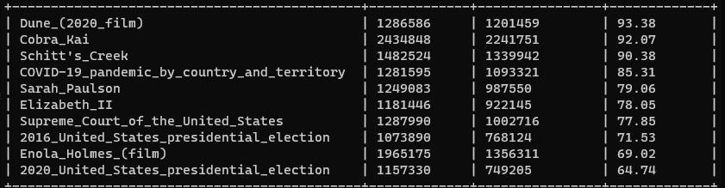
Question 2 cont.
As you can see from the picture below, Dune has the highest amount of people clicking on an internal link with 93.38%

Slide 9
Question 3
What series of Wikipedia articles, starting with Hotel California, keeps the largest fraction of its readers clicking on internal links?
This questions is answered using the same query from question 2 but adding a where like clause for the title where it is the first page of the clickstream.
For example since it starts on Hotel California, the where clause is WHERE TOTAL_VIEWS.TITLE LIKE ‘Hotel California’;
Then following the first item selected the path is the following:
Hotel California
Hotel California (Eagles Album)
The Long Run
Eagles Live
Eagles Greatest Hits, Vol. 2

Slide 10
Question 4
Find an example of an English Wikipedia article that is relatively more popular in the UK, US, and Australia?
To find the answer to this question the dataset with number of pageviews per page was broken up into three sections of six hours.
England having 18-00, Australia having 04-10, and the US having 12-18
A table was made for each country’s pages.
A SELECT query was ran on all of them keeping the title and the total views for each title grouped by the title of the page which was then ordered by the total views in descending order.
SELECT TITLE, SUM(VIEWS) AS TOTAL_US_VIEWS FROM US_VIEWS
GROUP BY TITLE
ORDER BY TOTAL_US_VIEWS;
LIMIT 50;

Slide 11
Question 4 cont.
The three tables had there top 50 most viewed pages lined up against each other where I found the highest viewed page that was not in the other two datasets
in Australia it was the Peter_Cech
in the UK it was The_Murder_of_Kim_Wall
and in America it was The_Trial_of_the_Chicago_Seven.
Also the latest season of Dancing With the Stars (US Version) was searched in the UK and Australia but not in the US.

Slide 12
Question 5
Analyze how many users will see the average vandalized Wikipedia page before the offending edit is reversed?
The dataset needed for this question is received with the linux command wget https://dumps.wikimedia.org/other/mediawiki_history/2020-09/enwiki/2020-09.enwiki.2020-09.tsv.bz2
The main assumption made is that every revision is the result of vandalism.
The dataset is added to a table called revisions.
From the created dataset a sub-table is created that will contain the title of the web page and the seconds_to_identity_revert field where the seconds to revert is greater than 0.
Then that subset is joined with the subset made from the pageview table on the title field to create another subset
Then finally, you take the average of seconds to revert multiplied that by pageviews which is then divided by 86400 (converts seconds into days).
The query returned approximately 461 hits per vandalized page

Slide 13
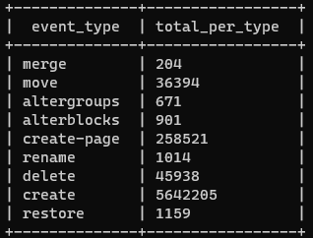
Question 6
Run an analysis you find interesting on the Wikipedia datasets we’re using.
I decided to see how the different types of events on Wikipedia were distributed
Ex. create, delete, update, revision
SELECT EVENT_TYPE, COUNT(EVENT_TYPE) FROM REVISIONS
GROUP BY EVENT_TYPE;

Slide 14
Github Link
https://github.com/EdwardReed1/project1

