Slide 1



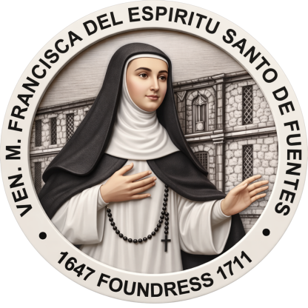
NDSSM
NOTRE DAME-SIENA SCHOOL OF MARBEL, INC.
A PAASCU Accredited School Since 1992
“A Woman of Great Faith,
Resolute Hope and Steadfast Love;
A Woman for our Times”

Slide 2
NDSSM
NOTRE DAME-SIENA SCHOOL OF MARBEL, INC.
A PAASCU Accredited School Since 1992
Welcome…
This is the group …
“A Woman of Great Faith,
Resolute Hope and Steadfast Love;
A Woman for our Times”

Slide 3
NDSSM
NOTRE DAME-SIENA SCHOOL OF MARBEL, INC.
A PAASCU Accredited School Since 1992
“A Woman of Great Faith,
Resolute Hope and Steadfast Love;
A Woman for our Times”
Welcome…
Compare and Contrast

Slide 4
NDSSM
NOTRE DAME-SIENA SCHOOL OF MARBEL, INC.
A PAASCU Accredited School Since 1992
“A Woman of Great Faith,
Resolute Hope and Steadfast Love;
A Woman for our Times”
Welcome…
Compare and Contrast
It is a type of expository text where it focuses on two or more topics that are related to each other, and discuses about the advantages and disadvantages of the two or more topics.

Slide 5
NDSSM
NOTRE DAME-SIENA SCHOOL OF MARBEL, INC.
A PAASCU Accredited School Since 1992
“A Woman of Great Faith,
Resolute Hope and Steadfast Love;
A Woman for our Times”
It is a type of expository text where it focuses on two or more topics that are related to each other, and discuses about the advantages and disadvantages of the two or more topics.
Welcome…
Compare and Contrast
Examples are…

Slide 6
Examples are…
NDSSM
NOTRE DAME-SIENA SCHOOL OF MARBEL, INC.
A PAASCU Accredited School Since 1992
“A Woman of Great Faith,
Resolute Hope and Steadfast Love;
A Woman for our Times”

Slide 7
Examples are…
NDSSM
NOTRE DAME-SIENA SCHOOL OF MARBEL, INC.
A PAASCU Accredited School Since 1992
“A Woman of Great Faith,
Resolute Hope and Steadfast Love;
A Woman for our Times”
Writing an essay about the disadvantages and advantages of Nature Living and Pax Silica.

Slide 8
Examples are…
NDSSM
NOTRE DAME-SIENA SCHOOL OF MARBEL, INC.
A PAASCU Accredited School Since 1992
“A Woman of Great Faith,
Resolute Hope and Steadfast Love;
A Woman for our Times”
The good and bad side of Friendships and Relationships

Slide 9
NDSSM
NOTRE DAME-SIENA SCHOOL OF MARBEL, INC.
A PAASCU Accredited School Since 1992
“A Woman of Great Faith,
Resolute Hope and Steadfast Love;
A Woman for our Times”
How to write it?

Slide 10
Follow the procedures
NDSSM
NOTRE DAME-SIENA SCHOOL OF MARBEL, INC.
A PAASCU Accredited School Since 1992
“A Woman of Great Faith,
Resolute Hope and Steadfast Love;
A Woman for our Times”
Step 1: Choose your topics. Decide what you want to compare. For example, Nature Living and Pax Silica.
Step 2: Find pros and cons. This will help to identify similarities and differences between the different topics.
Step 3: Plan and write. Structure your points so that they are clear. Either bullet point or paragraph. Write your comparison.

Slide 11

NDSSM
NOTRE DAME-SIENA SCHOOL OF MARBEL, INC.
A PAASCU Accredited School Since 1992
“A Woman of Great Faith,
Resolute Hope and Steadfast Love;
A Woman for our Times”
Thank you for listening!

