Slide 1
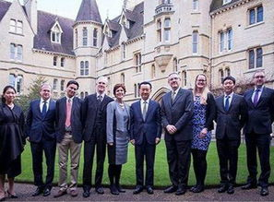
Oxford alumnis
Author:Edward

Slide 2
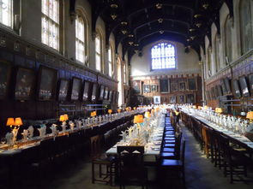
FROM 1167 TO NOW
Oxford has produced at least 12 kings from 8 countries, 6 British kings, 47 Nobel Laureate, 53 presidents and prime ministers from 19 countries, including 25 British Prime Ministers (13 of them from the Christian Church), 12 saints, 86 bishops and 18 cardinal.

Slide 3
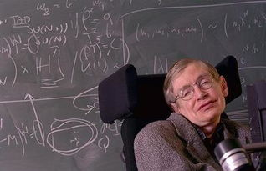
Stephen William Hawking

Slide 4

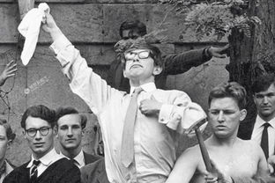
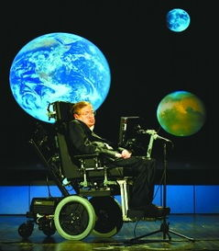
one of the greatest theoretical physicistsand the greatest scientists of the contemporary era after Einstein, is one of the greatest figures in the history of mankind, and is known as the "king of the universe". His representative works include , a brief history of time, the universe in the shell, and the great design.
was born in Oxford, England, a physicist of the Department of Applied Mathematics and theoretical physics, University of Cambridge, a famous physicist, cosmologist, and mathematician. Hocking, who graduated from University of Oxford and University of Cambridge, was professor of mathematics from 1979 to 2009, and later Honorary Professor Lucas Mathematics (Newton once served as the greatest professorship in human history).

Slide 5
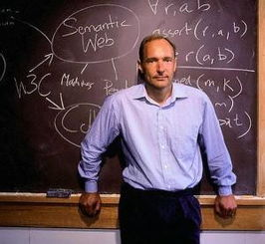
Tim Berners-Lee

Slide 6
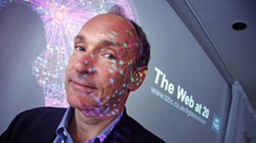

In 1973, he graduated from high school and went to the Queen's College of University of Oxford to further his studies.Finally, he received a bachelor's degree in physics with a first-degree honor.
As early as the major in physics at the University of Oxford, Tim continued to think about whether a "point" could be found, like a human brain, capable of transmitting and acting autonomously through the nerve. Through hard work, he successfully compiled the first efficient local access browser "Enquire" and applied it to data sharing and browsing, and achieved success.

Slide 7
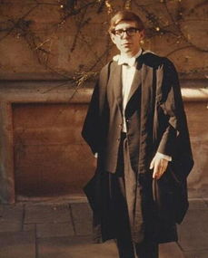
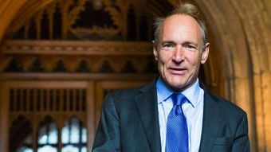
Thanks for listening!

