Slide 1

COVID-19 CONTACT TRACING MODEL (Confidential)
BY: Shunqi Zheng
Jason Fernandez
Nov-2020

Slide 2
The problem
COVID-19 Declared as a Pandemic in March 2020 took the whole world into an emergency state. The efforts of some countries to fight this lethal virus have had several results. Analysis has been demonstrated that one effective method to face the virus is having control of People infected and their relationship with others. This process was named: Contact Tracing.

Slide 3
The solution.
So far, Contact tracing procedures have been putting under pressure the memory of people COVID-19 positive, and their relatives. We think the best opportunity to fight the virus is given people an automatic tool that could be used by everybody. An Application that could work as a radar system and that application could build automatically a Contact List of people. Hence, If a person could result in Covid-19 Positive his contact List could be acquired easily.
This presentation gives confidential details of the solution and a simulation System built to address the objectives of the Advanced Database Course.

Slide 4



Technical details
The Database was built in Oracle 19c where we found all the resources to finish this project.
Oracle Cloud Infrastructure
Oracle Database Modeler
Oracle APEX

Slide 5
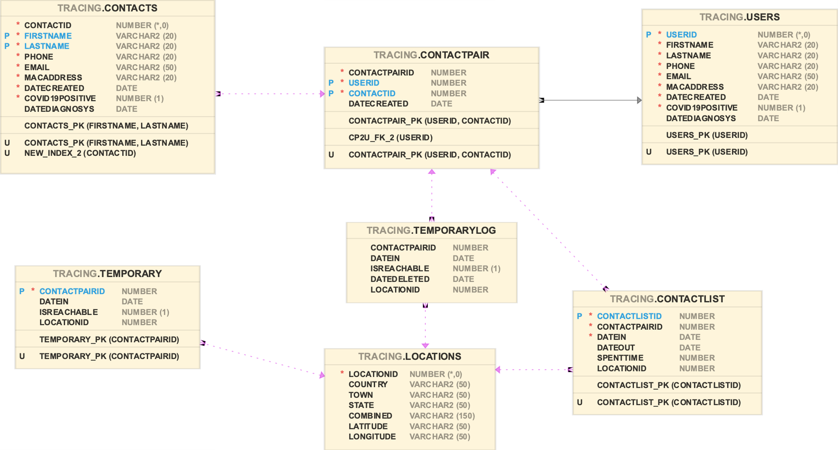
Entity-relationship Diagram

Slide 6
Two main Actors
Users: Owner of the list, person who has the application installed and running.
Contacts: People who get close of the user at public spaces or any place.
The system: It will track all the people who will spend some time close to the user, mainly Two possible states a contact could have in the system. In radar or Out of radar. For a contact Out of radar, the system could identify how much time a Contact spent close to the User. In the database, Both Actors have the attribute Covid-19 Positive.

Slide 7
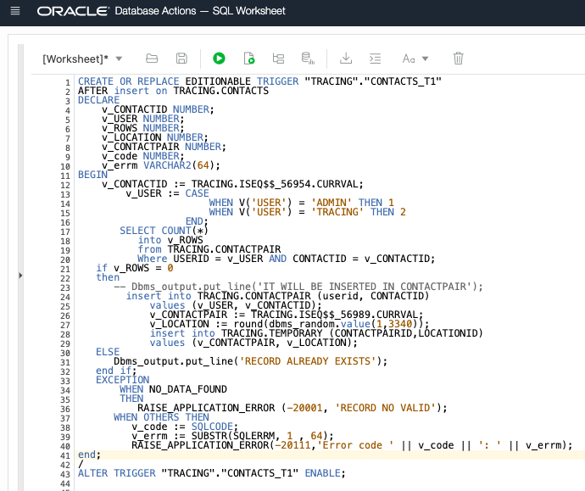
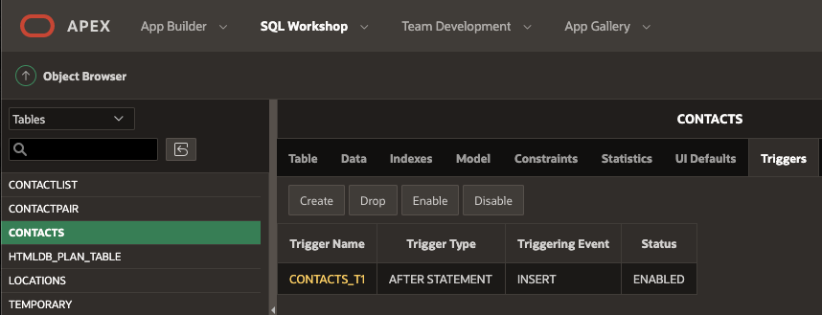
First Trigger
CONTACT_T1
This Trigger inserts a new Contact in the contacts table, Insert a new relationship User-Contact, and finally; inserts a record in the radar System Temporary table; some validations are made by the Interface of the simulator.

Slide 8
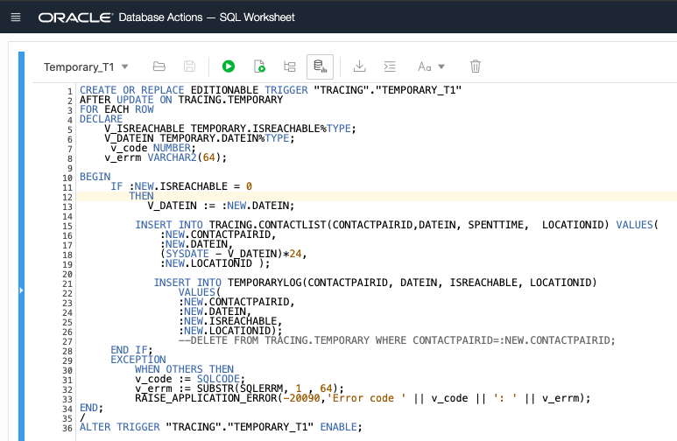
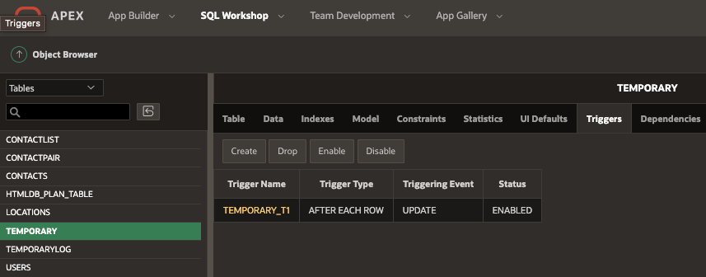
SECOND TRIGGER
TEMPORARY_T1
Triggered when a persons get out of the radar, It moves the record in Temporary table to ContactList table specifying for how long the Contact was close of the User. Also, this trigger insert the record in TemporaryLog, this is an Entity Built to handle the log of the record deleted from Temporary Table. After this trigger A procedure will delete the record of Temporary table.

Slide 9
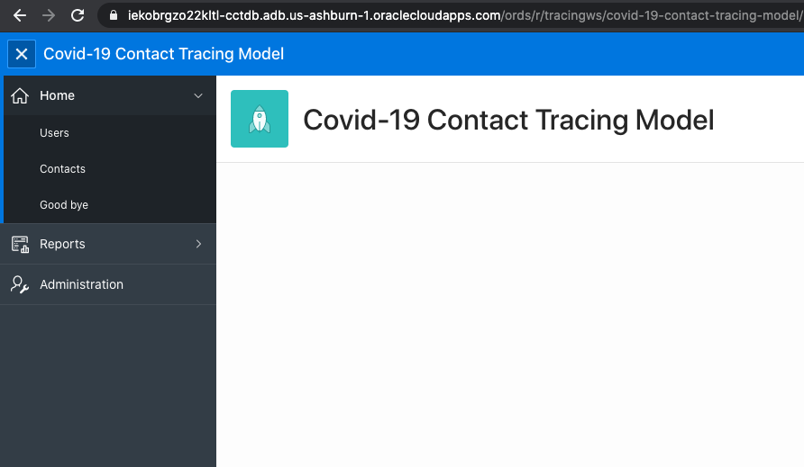
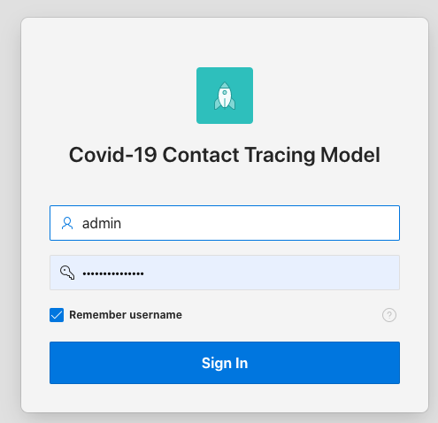
SIMULATOR
User Access Administrated
by the Oracle Database

Slide 10
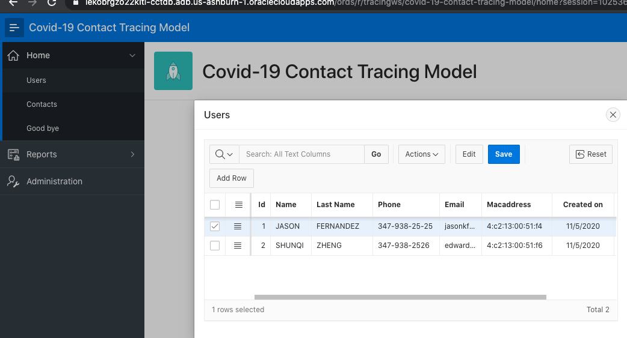
Master users

Slide 11
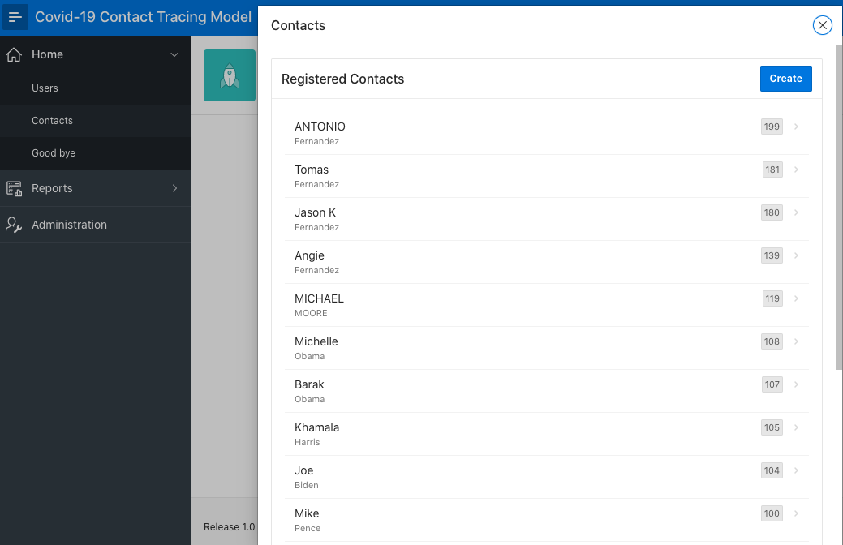
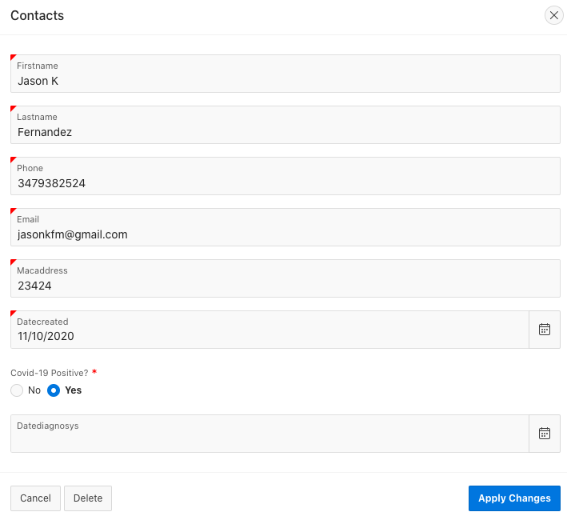
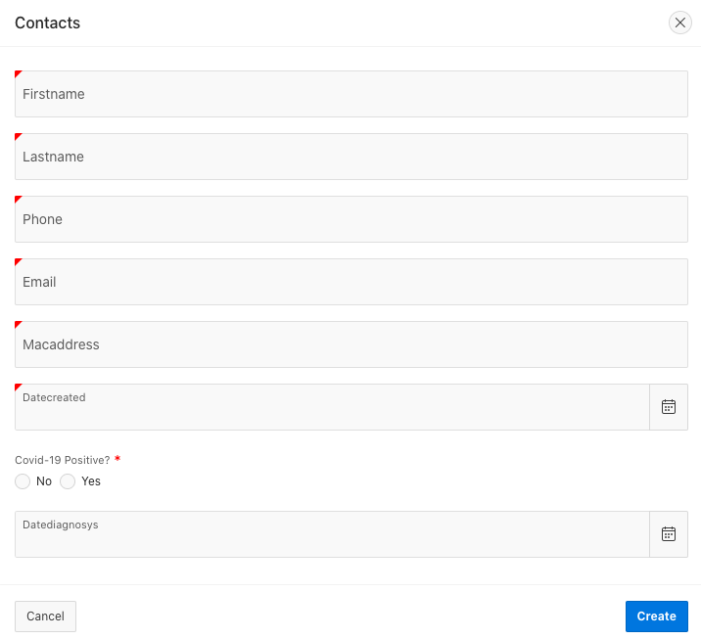
Contacts (contact Simulation Approach)
Registered Contact List
Modification of a Contact
Creation of a Contact

Slide 12
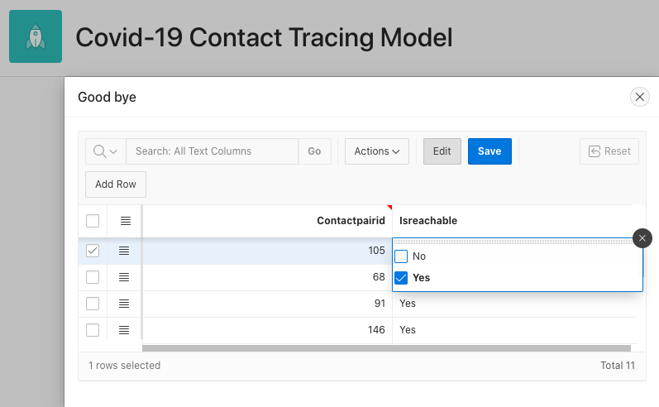
Simulation – Contact disappear off the radar

Slide 13
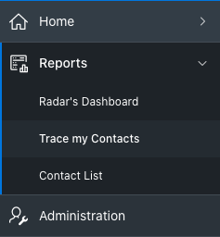
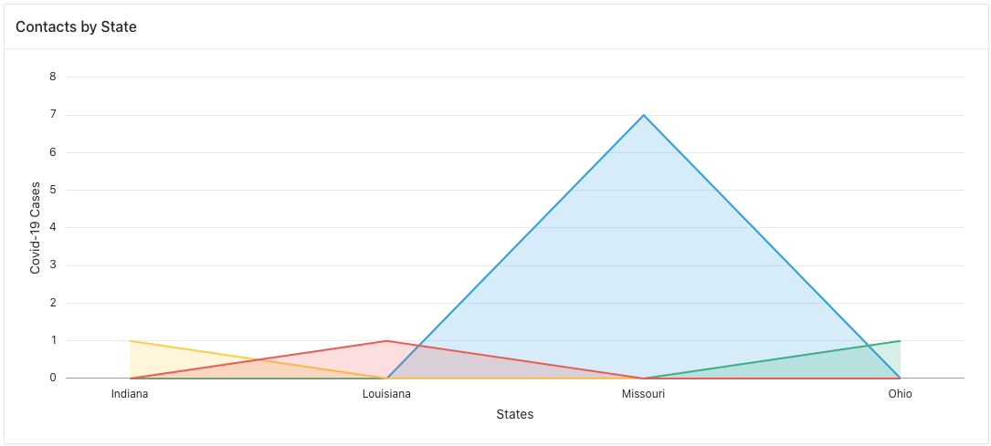
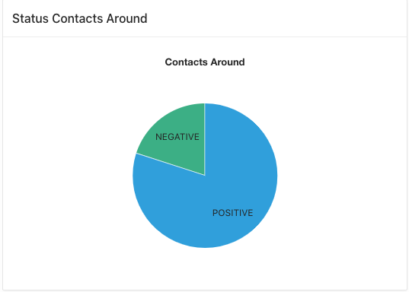
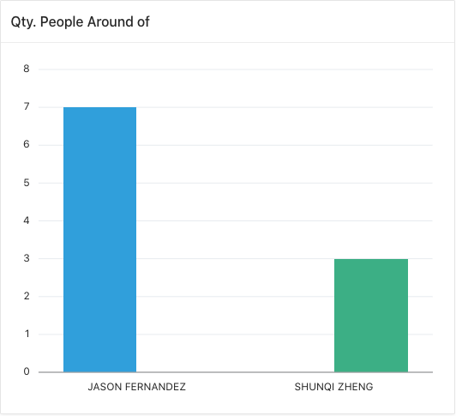
Reports Radar’s Dashboard

Slide 14
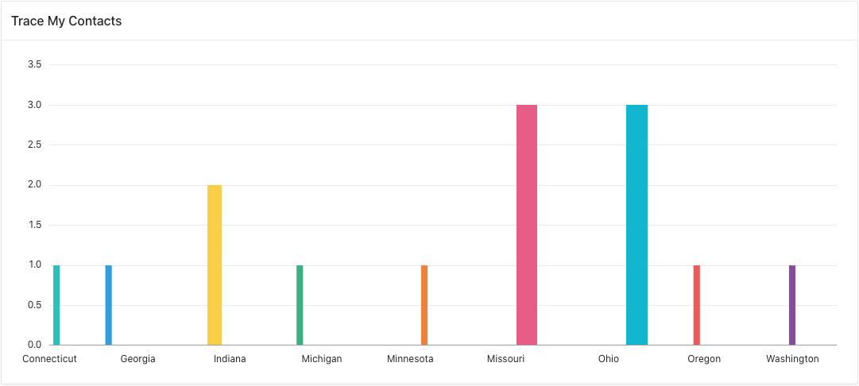
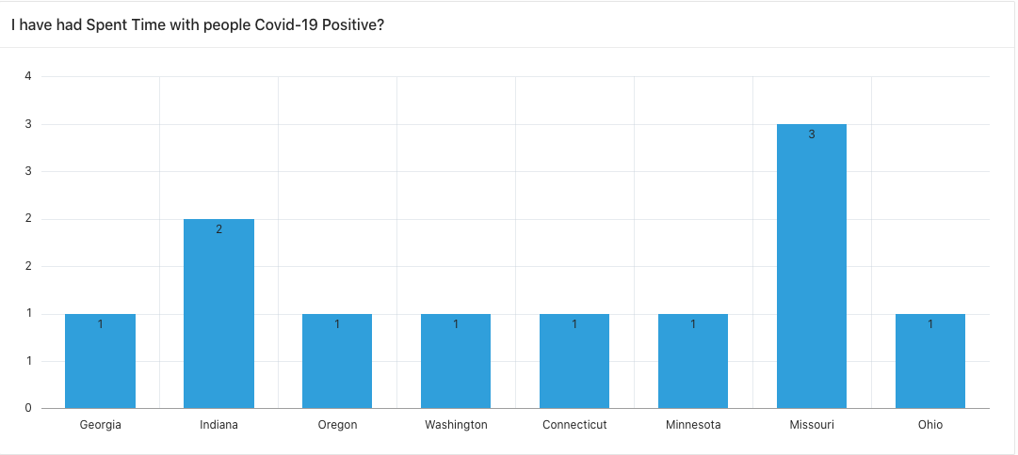
TRACE MY CONTACTS WHO ARE OUT OF USER SCOPE

Slide 15
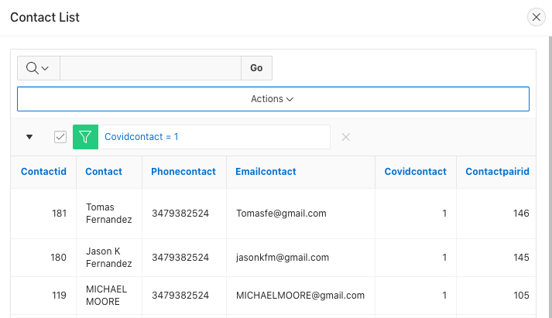
CONTACT LIST REPORT
This report is the solution to the issues
around people Covid-19 positive. Because
in an easy way sanitary authorities could have
Access to the people that could be Covi-19
Positive too.

Slide 16
Thank you
Jason Fernandez
Shunqi Zheng

