Slide 1
Virtual Database Technology
(for Distributed Database)
By Shunqi Zheng

Slide 2
Part 1: Introduction
Part 2: Related Research
Content
Part 3: Database Virtualization
Part 4: Recovery for Virtual Databases
Part 5: Conclusions
Part 6: References

Slide 3
1
Introduction

Slide 4
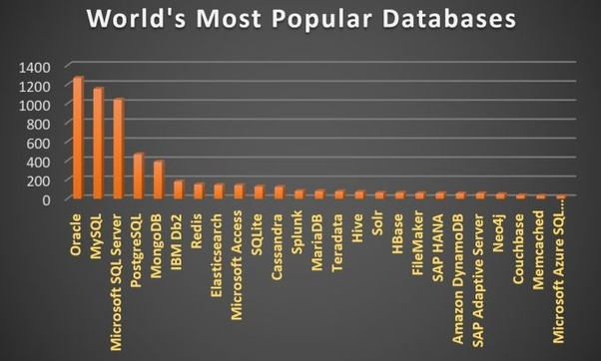
Introduction
Massive stored in different database types
---- Ubiquitous databases hereinafdatater :
Typically Much time spent (database selection & data collection) ×
Ideally Much time spent ( Data analysis and rule extraction) √

Slide 5
Introduction
Goal one: Virtualization Technology development:
Make people working with database much easier.
Goal Two: Virtualization Technology (*Problem remained):
Dealing with Incompatibility between the virtual database and the real databases.

Slide 6
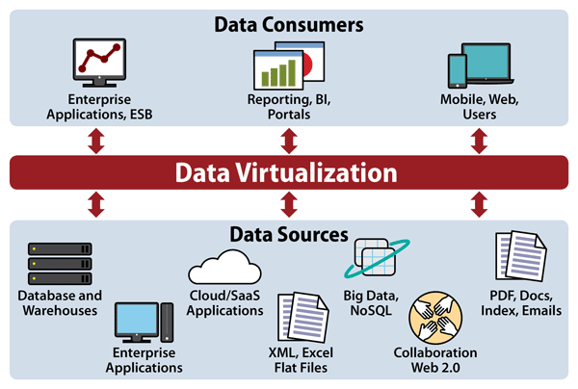
Introduction
General
Diagram:

Slide 7
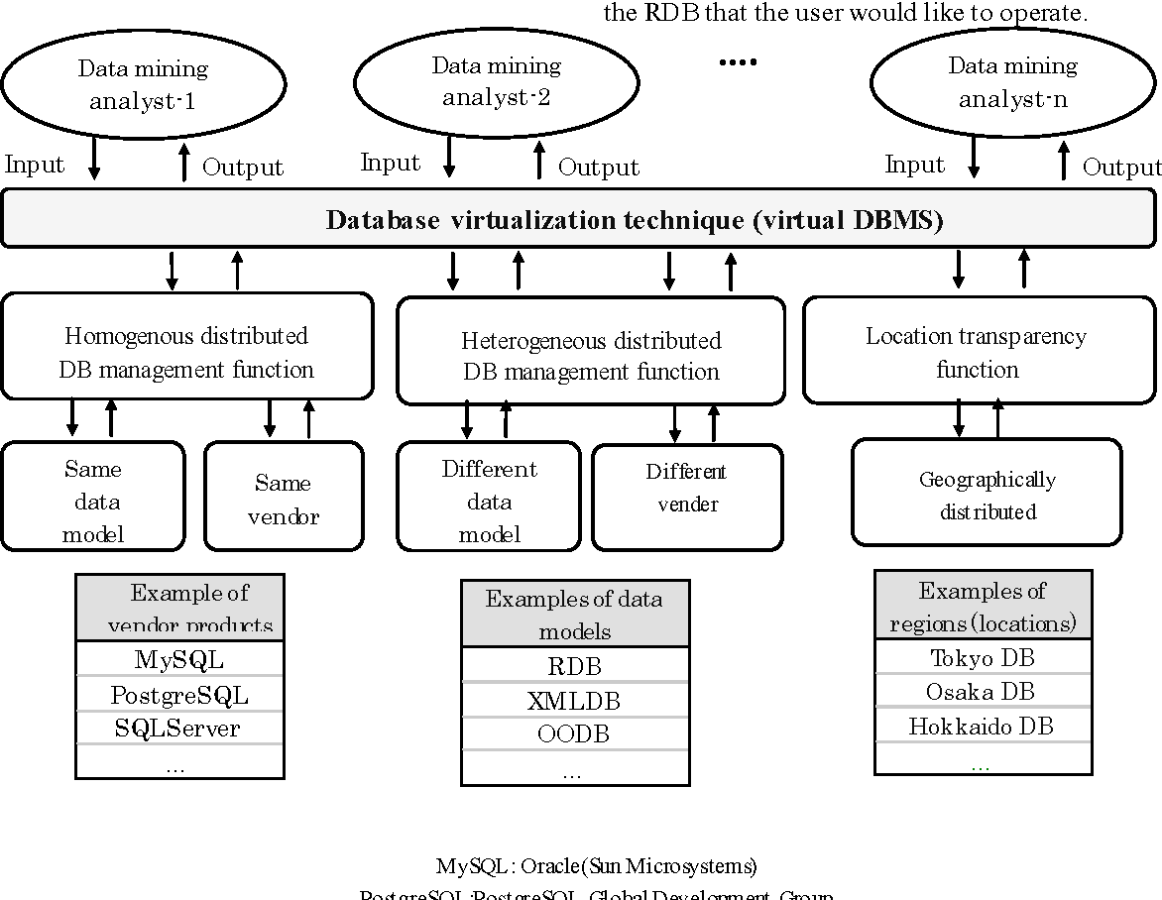
Introduction
Detailed
Diagram:

Slide 8
2
Related Research

Slide 9
Related Research
Related Research:
For data sources:
--- A way to disseminate information to all users (in a mobile computing environment) without fail.
--- A way to integrate data
--- A way to wrap data from various sources (RDBs, Web, and Excel files)
For XML data structure schema:
--- A XML-to-relational mapping framework and system
--- A mechanism (for modifying and querying database contents)
--- The cost-based XML storage (mapping engine and space)
--- The integration of XML
--- The common data model and schema based on XML

Slide 10
Related Research and Goal
Related Research:
Our research:
--- Examined XML schema advantages
--- Studied recovery techniques
Our goal:
Propose a means to recover the associated databases
--- allowing user to examine the virtual environment
--- ensure the integrity between virtual and real database.

Slide 11
3
Database Virtualization

Slide 12
Database Virtualization
Virtual Database Schema Definition
Visualization of Homogeneously Distributed Databases
a) XML Conversion Program
b) RDB Schema Conversion into XML
C) RDB Data Conversion into XML
Virtualization of Heterogeneously Distributed Databases

Slide 13
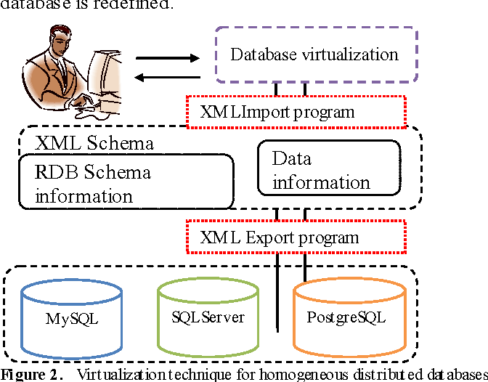
Distributed Database Virtualization

Slide 14
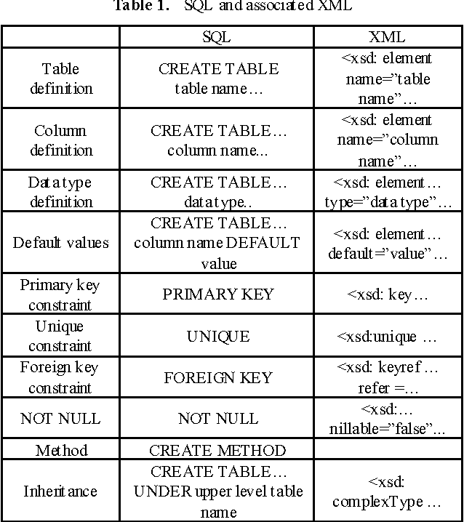
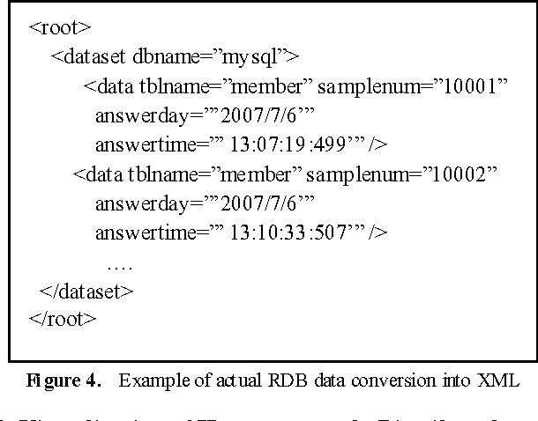
XML Data Conversion

Slide 15
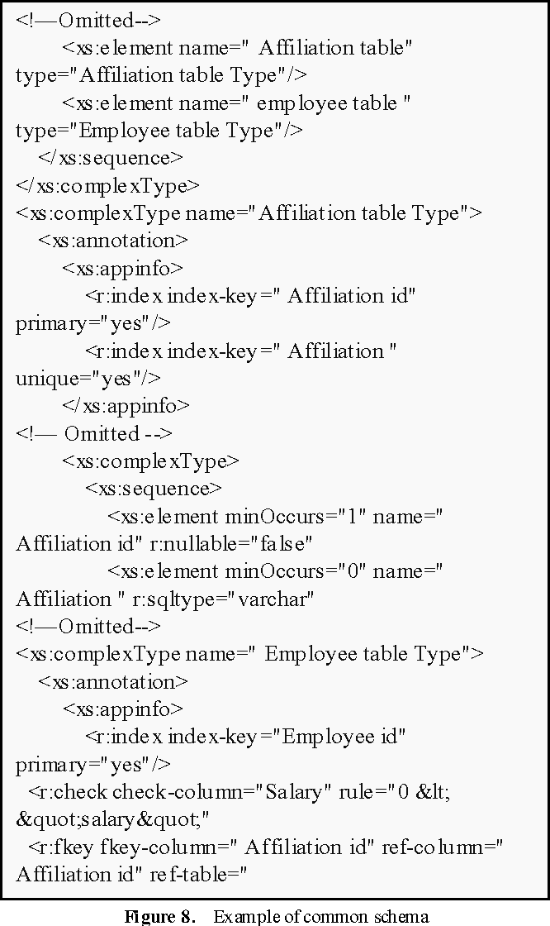
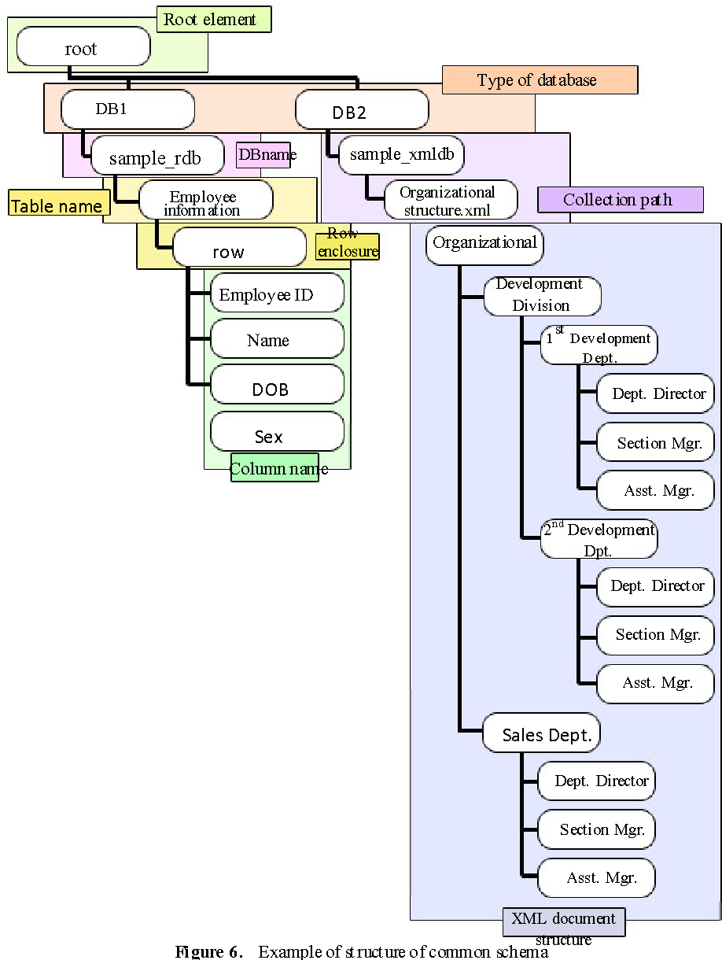
Common Schema

Slide 16
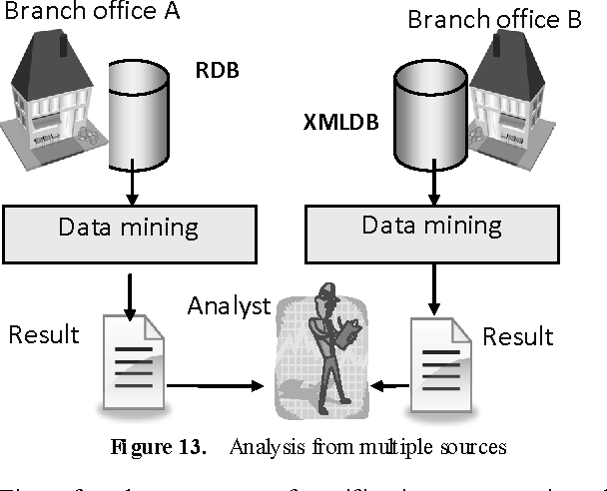
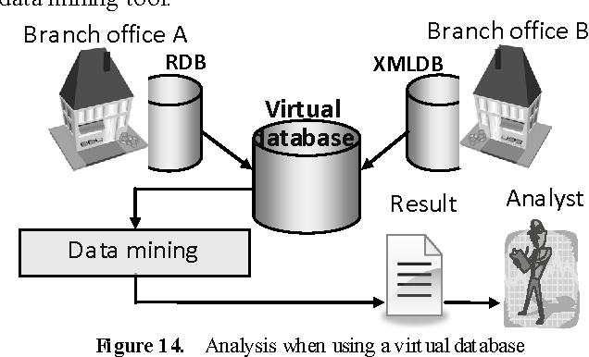
Analysis transition

Slide 17
3
Virtualization Recovery

Slide 18
Virtualization Recovery
A common schema should be prepared (XML && RDB)
An environment should be deployed
A log and back-up data needed
Combine these above into virtual DBMS

Slide 19
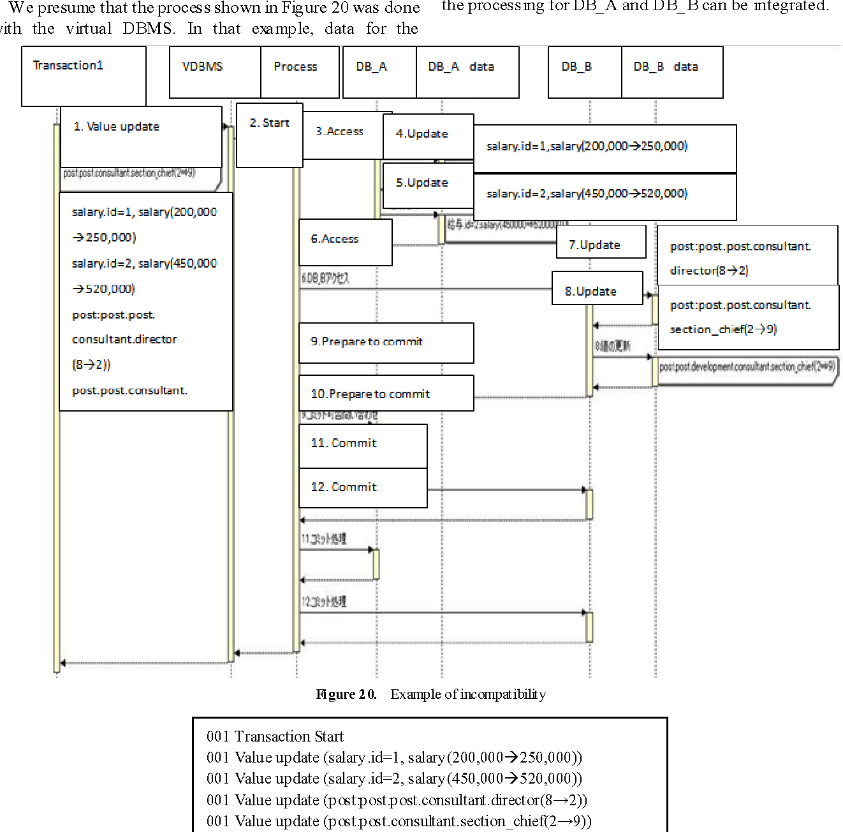
Example of incompatibility

Slide 20
Log for Virtualization system
An example of Log

Slide 21
4
References

Slide 22
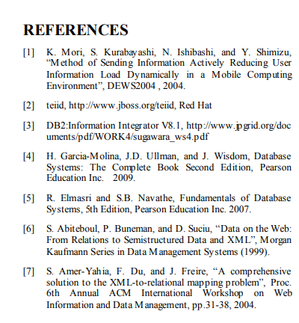
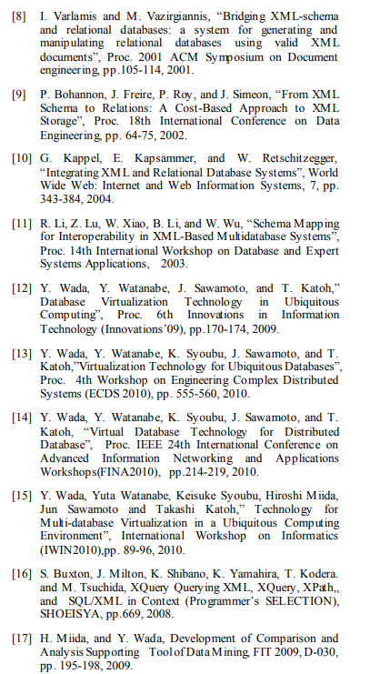
References

Slide 23
5
Conclusion

Slide 24
Conclusion
In this research,
A method of virtualization of ubiquitous databases
A unified fashion way of how XML describes this database schema.
To be continued on:
Examine procedure in system trouble recovery
Confirmation of compatibility of the log

Slide 25
THANK YOU FOR
WATCHING!!!

