Slide 1
資料預處理實務
影評

Slide 2
情緒分析 (sentiment analysis) 又稱為意見探勘 (opinion mining). 是使用 "自然語言處理", 文字分析等方法, 找出作者某些話題上的態度, 情感, 評價或情緒.
情緒分析的商業價值, 可以提早得知顧客對公司或產品觀感, 以調整銷售策略方向.
IMDb 網路資料庫 (Internet Movie Database), 是一個電影相關的線上資料庫. IMDb 開始於 1990 年, 自 1998 年起成為亞馬遜旗下的網站, 至今已經累積大量的電影資訊. IMDb 共收錄了四百多萬作品資料.
IMDb 資料集共有 50,000 筆 "影評文字", 分為訓練資料與測試資料各 25,000 筆,
每一筆 "影評文字" 都被標記成 "正面評價" 或 "負面評價".
我們希望能建立一個模型, 經過大量 "影評文字" 訓練後, 此模型能用於預測 "影評文字" 是 "正面評價" 或 "負面評價".

Slide 3
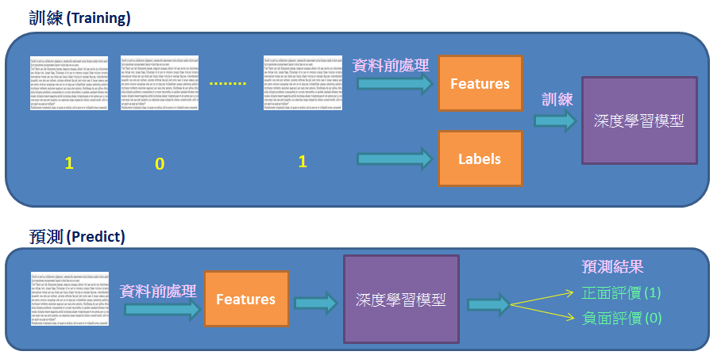

Slide 4
負評
Once again Mr. Costner has dragged out a movie for far longer than necessary. Aside from the terrific sea rescue sequences, of which there are very few I just did not care about any of the characters. Most of us have ghosts in the closet, and Costner's character are realized early on, and then forgotten until much later, by which time I did not care. The character we should really care about is a very cocky, overconfident Ashton Kutcher. The problem is he comes off as kid who thinks he's better than anyone else around him and shows no signs of a cluttered closet. His only obstacle appears to be winning over Costner. Finally when we are well past the half way point of this stinker, Costner tells us all about Kutcher's ghosts. We are told why Kutcher is driven to be the best with no prior inkling or foreshadowing. No magic here, it was all I could do to keep from turning it off an hour in.

Slide 5
正評
I went and saw this movie last night after being coaxed to by a few friends of mine. I'll admit that I was reluctant to see it because from what I knew of Ashton Kutcher he was only able to do comedy. I was wrong. Kutcher played the character of Jake Fischer very well, and Kevin Costner played Ben Randall with such professionalism. The sign of a good movie is that it can toy with our emotions. This one did exactly that. The entire theater (which was sold out) was overcome by laughter during the first half of the movie, and were moved to tears during the second half. While exiting the theater I not only saw many women in tears, but many full grown men as well, trying desperately not to let anyone see them crying. This movie was great, and I suggest that you go see it before you judge.

Slide 7
from keras.datasets import imdb
(train_data,train_labels),(test_data,test_labels) = imdb.load_data(num_words=10000)
num_words=10000意味著只保留訓練集中最常出現的前10000個詞，
不經常出現的單詞被拋棄—最終所有評論的維度保持相同。
變數train_data,test_data是電影評論的列表，每條評論由數字(對應單詞在詞典中出現的位置下標)列表組成。
train_labels,test_labels是0,1列表，0負面評論，1表示正面評論。
>>> train_data[0]
[1, 14, 22, 16, ... 178, 32]
>>> train_labels[0]
1

Slide 8
資料預處理
不能直接將list型別的資料送到神經網路中訓練，必須將list型別轉換為tensor張量型別。
有兩種轉換方式：
– 填充列表使每個列表長度都相同，然後轉換為整數型別的張量，形狀為(samples, word_indices),使用張量作為神經網路的第一層(Embedding層，能處理這樣的整數型別張量)；
– 將列表進行one-hot編碼，轉換成0、 1向量。然後用Dense網路層作為神經網路的第一層，處理浮點型別向量資料。
import numpy as np
def vectorize_sequences(sequences, dimension=10000):
results = np.zeros((len(sequences), dimension)) #資料集長度，每個評論維度10000
for i, sequence in enumerate(sequences):
results[i, sequence] = 1 # one-hot
return results
x_train = vectorize_sequences(train_data)
x_test = vectorize_sequences(test_data)
y_train = np.asarray(train_labels).astype('float32') # 向量化標籤資料
y_test = np.asarray(test_labels).astype('float32')

Slide 10
Linear & Tree-based models for IMDB Movie Review Classification
https://www.kaggle.com/azunre/tl-for-nlp-section2-1-2-4-movies
TL for NLP: section3.1_Movies_Word_Embeddin

Slide 11
共同部分
import random
import pandas as pd
## Read-in the reviews and print some basic descriptions of them
!wget -q "http://ai.stanford.edu/~amaas/data/sentiment/aclImdb_v1.tar.gz"
!tar xzf aclImdb_v1.tar.gz

Slide 12
Define Tokenization, Stop-word and Punctuation Removal Functions
Nsamp = 1000 # number of samples to generate in each class -
maxtokens = 200 # the maximum number of tokens per document
maxtokenlen = 100 # the maximum length of each token

Slide 13
Tokenization
def tokenize(row):
if row is None or row is '':
tokens = ""
else:
tokens = row.split(" ")[:maxtokens]
return tokens

Slide 14
Use regular expressions to remove unnecessary characters
import re
def reg_expressions(row):
tokens = []
try:
for token in row:
token = token.lower() # make all characters lower case
token = re.sub(r'[\W\d]', "", token)
token = token[:maxtokenlen] # truncate token
tokens.append(token)
except:
token = ""
tokens.append(token)
return tokens

Slide 15
Stop-word removal
Stop-words are words that are very common in text but offer no useful information that can be used to classify the text.
Words such as is, and, the, are are examples of stop-words.
The NLTK library contains a list of 127 English stop-words and can be used to filter our tokenized strings.
import nltk
nltk.download('stopwords')
from nltk.corpus import stopwords
stopwords = stopwords.words('english')
# print(stopwords) # see default stopwords
# it may be beneficial to drop negation words from the removal list,
# as they can change the positive/negative meaning
# of a sentence
# stopwords.remove("no")
# stopwords.remove("nor")
# stopwords.remove("not")

Slide 16
def stop_word_removal(row):
token = [token for token in row if token not in stopwords]
token = filter(None, token)
return token

Slide 17
Bag-of-words model

Slide 18
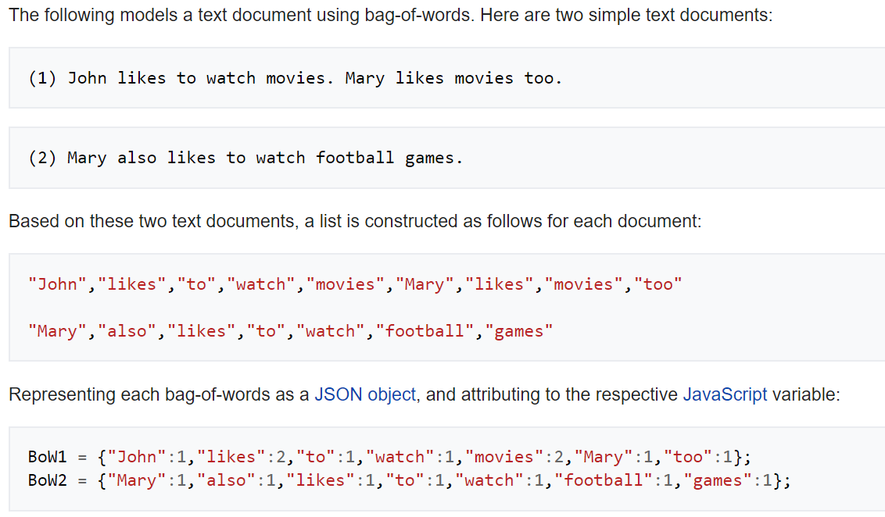
詞袋模型（英語：Bag-of-words model）是個在自然語言處理和信息檢索(IR)下被簡化的表達模型。
此模型下，一段文本（比如一個句子或是一個文檔）可以用一個裝著這些詞的袋子來表示，這種表示方式不考慮文法以及詞的順序。
詞袋模型被廣泛應用在文件分類，詞出現的頻率可以用來當作訓練分類器的特徵
https://en.wikipedia.org/wiki/Bag-of-words_model

Slide 19
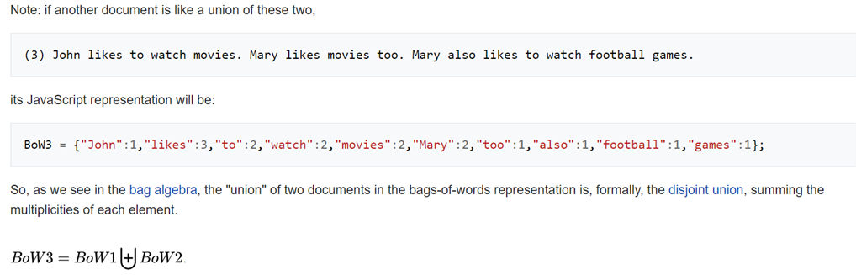

Slide 20
BoW1 = {"John":1,"likes":2,"to":1,"watch":1,"movies":2,"Mary":1,"too":1};
BoW2 = {"Mary":1,"also":1,"likes":1,"to":1,"watch":1,"football":1,"games":1};
BoW3 = {"John":1,"likes":3,"to":2,"watch":2,"movies":2,"Mary":2,"too":1,"also":1,"football":1,"games":1};
只有上述單字,且以BoW3 的順序為基準
(1) BoW1 = [1, 2, 1, 1, 2, 1, 1, 0, 0, 0]
(2) BoW2 = [0, 1, 1, 1, 0, 1, 0, 1, 1, 1]

Slide 21
Bag-of-words model
To interpret the text by making a numerical representation of it.
One way to do this is by using something called a "bag-of-words" model.
This model simply counts the frequency of word tokens for each email and thereby represents it as a vector of these counts.
** Assemble matrices function**
The assemble_bag() function assembles a new dataframe containing all the unique words found in the text documents.
It counts the word frequency and then returns the new dataframe.

Slide 22
def assemble_bag(data):
used_tokens = []
all_tokens = []
for item in data:
for token in item:
if token in all_tokens:
if token not in used_tokens:
used_tokens.append(token)
else:
all_tokens.append(token)
df = pd.DataFrame(0, index = np.arange(len(data)), columns = used_tokens)
for i, item in enumerate(data):
for token in item:
if token in used_tokens:
df.iloc[i][token] += 1
return df

Slide 23
Putting It All Together To Assemble Dataset
import os
import numpy as np
# shuffle raw data first
def unison_shuffle_data(data, header):
p = np.random.permutation(len(header))
data = data[p]
header = np.asarray(header)[p]
return data, header

Slide 24
# load data in appropriate form
def load_data(path):
data, sentiments = [], []
for folder, sentiment in (('neg', 0), ('pos', 1)):
folder = os.path.join(path, folder)
for name in os.listdir(folder):
with open(os.path.join(folder, name), 'r') as reader:
text = reader.read()
text = tokenize(text)
text = stop_word_removal(text)
text = reg_expressions(text)
data.append(text)
sentiments.append(sentiment)
data_np = np.array(data)
data, sentiments = unison_shuffle_data(data_np, sentiments)
return data, sentiments

Slide 25
train_path = os.path.join('aclImdb', 'train')
test_path = os.path.join('aclImdb', 'test')
raw_data, raw_header = load_data(train_path)
print(raw_data.shape)
print(len(raw_header))
(25000,)
25000

Slide 26
# Subsample required number of samples
random_indices = np.random.choice(range(len(raw_header)),size=(Nsamp*2,),replace=False)
data_train = raw_data[random_indices]
header = raw_header[random_indices]
print("DEBUG::data_train::")
print(data_train)
DEBUG::data_train::
[list(['best', 'bonnie', 'clyde', 'movie', 'seen', 'accurate', 'accounts', 'happened', 'doesnt', 'glorify', 'crimes', 'casts', 'pair', 'normal', 'light', 'give', 'movie', '', 'great', 'actorsrealistic', 'scenes', 'excellent', 'writers'])
list(['spoilers', 'galore', 'this', 'absolutely', 'awful', 'film', 'first', 'guy', 'medium', 'i', 'guess', 'hes', 'made', 'career', 'playing', 'super', 'doting', 'dads', 'it', 'ok', 'first', 'time', 'tried', 'scare', 'son', 'pretending', 'monsterbut', '', 'minutes', 'later', 'cloyingly', 'again', 'and', 'goes', 'film', 'moves', 'excruciating', 'real', 'time', 'at', 'one', 'point', 'i', 'started', 'imaging', 'days', 'later', 'i', 'reminded', 'story', 'line', 'next', 'dayin', 'early', 'afternoon', 'still', 'im', 'really', 'sure', 'couple', 'supposed', 'real', 'life', 'first', 'presented', 'sort', 'manhattan', 'yuppie', 'couple', 'grew', 'kid', 'but', 'drive', 'old', 'blue', 'volvo', 'those', 'types', 'stopped', 'driving', 'volvos', 'decades', 'ago', 'today', 'drive', 'priuses', 'but', '', 'im', 'sure', 'still', 'driving', 'volvosbr', 'br', 'ok', 'theres', 'wendigo', 'a', 'mysterious', 'indian', 'man', 'gives', 'boy', 'little', 'magic', 'wendigo', 'statue', 'tells', 'powerful', 'magic', 'cmonare', 'still', 'ancient', 'indian', 'mysteries', 'just', 'drive', 'home', 'pan', 'across', 'every', 'indian', 'statue'])

Slide 27
Display sentiments and their frequencies in the dataset, to ensure it is roughly balanced between classes
unique_elements, counts_elements = np.unique(header, return_counts=True)
print("Sentiments and their frequencies:")
print(unique_elements)
print(counts_elements)
Sentiments and their frequencies:
[0 1]
[ 974 1026]

Slide 28
Featurize and Create Labels
MixedBagOfReviews = assemble_bag(data_train)
# this is the list of words in our bag-of-words model
predictors = [column for column in MixedBagOfReviews.columns]
# expand default pandas display options to
# make emails more clearly visible when printed
pd.set_option('display.max_colwidth', 300)
MixedBagOfReviews
# you could do print(MixedBagOfReviews),
# but Jupyter displays this nicer for pandas DataFrames

Slide 29
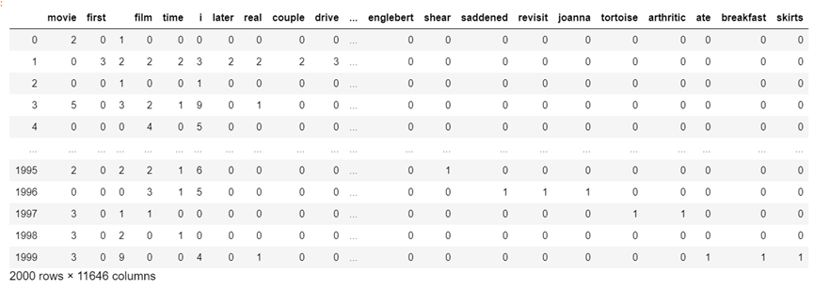

Slide 30
# split into independent 70% training and 30% testing sets
data = MixedBagOfReviews.values
idx = int(0.7*data.shape[0])
# 70% of data for training
train_x = data[:idx,:]
train_y = header[:idx]
# remaining 30% for testing
test_x = data[idx:,:]
test_y = header[idx:]
print("train_x/train_y list details, to make sure it is of the right form:")
print(len(train_x))
print(train_x)
print(train_y[:5])
print(len(train_y))
train_x/train_y list details, to make sure it is of the right form:
1400
[[2 0 1 ... 0 0 0]
[0 3 2 ... 0 0 0]
[0 0 1 ... 0 0 0]
...
[0 0 0 ... 0 0 0]
[1 0 0 ... 0 0 0]
[1 0 0 ... 0 0 0]]
[1 0 1 0 0]
1400

Slide 31
fastText embedding vectors

Slide 32
TL for NLP: section3.1_Movies_Word_Embeddin

Slide 33
Assemble Embedding Vectors
The following functions are used to extract fastText embedding vectors for each review
import time
from gensim.models import FastText, KeyedVectors
!ls
start=time.time()
FastText_embedding = KeyedVectors.load_word2vec_format("../input/jigsaw/wiki.en.vec")
end = time.time()
print("Loading the embedding took %d seconds"%(end-start))
__notebook_source__.ipynb aclImdb_v1.tar.gz kaggle_image_requirements.txt
aclImdb aclImdb_v1.tar.gz.1
Loading the embedding took 1169 seconds

Slide 34
def handle_out_of_vocab(embedding,in_txt):
out = None
for word in in_txt:
try:
tmp = embedding[word]
tmp = tmp.reshape(1,len(tmp))
if out is None:
out = tmp
else:
out = np.concatenate((out,tmp),axis=0)
except:
pass
return out

Slide 35
def assemble_embedding_vectors(data):
out = None
for item in data:
tmp = handle_out_of_vocab(FastText_embedding,item)
if tmp is not None:
dim = tmp.shape[1]
if out is not None:
vec = np.mean(tmp,axis=0)
vec = vec.reshape((1,dim))
out = np.concatenate((out,vec),axis=0)
else:
out = np.mean(tmp,axis=0).reshape((1,dim))
else:
pass
return out

Slide 36
import numpy as np
# shuffle raw data first
def unison_shuffle_data(data, header):
p = np.random.permutation(len(header))
data = data[p]
header = np.asarray(header)[p]
return data, header

Slide 37
# load data in appropriate form
def load_data(path):
data, sentiments = [], []
for folder, sentiment in (('neg', 0), ('pos', 1)):
folder = os.path.join(path, folder)
for name in os.listdir(folder):
with open(os.path.join(folder, name), 'r') as reader:
text = reader.read()
text = tokenize(text)
text = stop_word_removal(text)
text = reg_expressions(text)
data.append(text)
sentiments.append(sentiment)
data_np = np.array(data)
data, sentiments = unison_shuffle_data(data_np, sentiments)
return data, sentiments
train_path = os.path.join('aclImdb', 'train')
test_path = os.path.join('aclImdb', 'test')
raw_data, raw_header = load_data(train_path)
print(raw_data.shape)
print(len(raw_header))

Slide 38
# Subsample required number of samples
random_indices = np.random.choice(range(len(raw_header)),size=(Nsamp*2,),replace=False)
data_train = raw_data[random_indices]
header = raw_header[random_indices]
print("DEBUG::data_train::")
print(data_train)
DEBUG::data_train::
[list(['the', 'directors', 'cut', 'version', 'one', 'i', 'saw', 'long', 'type', 'movie', 'almost', 'two', 'hours', 'way', 'long', 'if', 'choice', 'definitely', 'go', 'nondirectors', 'cutbr', 'br', 'the', 'main', 'plot', 'almost', 'taken', 'all', 'movie', 'consists', 'main', 'part', 'several', 'murder', 'scenes', 'connected', 'feeling', 'theyre', 'shown', 'order', 'fill', 'movie', 'splatterish', 'violence', 'the', 'connection', 'revealed', 'latter', 'part', 'lack', 'context', 'bored', 'long', 'i', 'therebr', 'br', 'as', 'horror', 'movie', 'work', 'you', 'never', 'get', 'required', 'feel', 'characters', 'due', 'mediocre', 'acting', 'general', 'disposition', 'character', 'presented', '', 'minutes', 'later', 'character', 'dead', 'this', 'pictures', 'strong', 'side', 'lies', 'splatter', 'part'])

Slide 39
Display sentiments and their frequencies in the dataset, to ensure it is roughly balanced between classes
unique_elements, counts_elements = np.unique(header, return_counts=True)
print("Sentiments and their frequencies:")
print(unique_elements)
print(counts_elements)
Sentiments and their frequencies:
[0 1]
[ 983 1017]

Slide 40
Featurize and Create Labels
EmbeddingVectors = assemble_embedding_vectors(data_train)
print(EmbeddingVectors)
[[-0.07250428 -0.02761469 -0.1478848 ... 0.14344926 0.0716166
0.00817212]
[-0.06704681 -0.02430123 -0.1739931 ... 0.1393764 0.1908965
0.06567684]
[-0.05340912 -0.03200554 -0.15063585 ... 0.16902418 0.08941903
0.00209699]
...
[-0.01904686 -0.04611962 -0.20534602 ... 0.13719371 0.1643592
0.07999481]
[-0.15579307 -0.0124148 -0.13269857 ... 0.11967064 0.17055897
0.01267438]
[-0.05052713 -0.03807216 -0.15434606 ... 0.12438641 0.11319246
0.02017402]]

Slide 41
data = EmbeddingVectors
idx = int(0.7*data.shape[0])
# 70% of data for training
train_x = data[:idx,:]
train_y = header[:idx]
# # remaining 30% for testing
test_x = data[idx:,:]
test_y = header[idx:]
print("train_x/train_y list details, to make sure it is of the right form:")
print(len(train_x))
print(train_x)
print(train_y[:5])
print(len(train_y))

Slide 42
train_x/train_y list details, to make sure it is of the right form:
1400
[[-0.07250428 -0.02761469 -0.1478848 ... 0.14344926 0.0716166
0.00817212]
[-0.06704681 -0.02430123 -0.1739931 ... 0.1393764 0.1908965
0.06567684]
[-0.05340912 -0.03200554 -0.15063585 ... 0.16902418 0.08941903
0.00209699]
...
[-0.06434063 -0.0638198 -0.12337892 ... 0.15882063 0.08492141
-0.01164086]
[-0.05291646 -0.03687134 -0.21242349 ... 0.18171945 0.09208806
0.01074446]
[-0.08115448 -0.04664755 -0.14050297 ... 0.1007626 0.19478704
0.02694179]]
[0 1 0 0 0]
1400

Slide 43
Putting It All Together To Assemble Dataset

Slide 45
練習: SPAM email detection 垃圾郵件偵測
Linear & Tree-based models for Email Sentiment Classification
https://www.kaggle.com/azunre/tl-for-nlp-section2-1-2-4-emails

Slide 46
練習: fake News detection 假新聞偵測
Using ELMo for "fake news" detection/classification
https://www.kaggle.com/azunre/tl-for-nlp-sections4-2-4-4-fake-news-elmo

