Slide 1
Word-Embedding

Slide 2
Representing text as numbers
Machine learning models take vectors (arrays of numbers) as input.
When working with text, the first thing we must do come up with a strategy to convert strings to numbers (or to "vectorize" the text) before feeding it to the model.

Slide 3
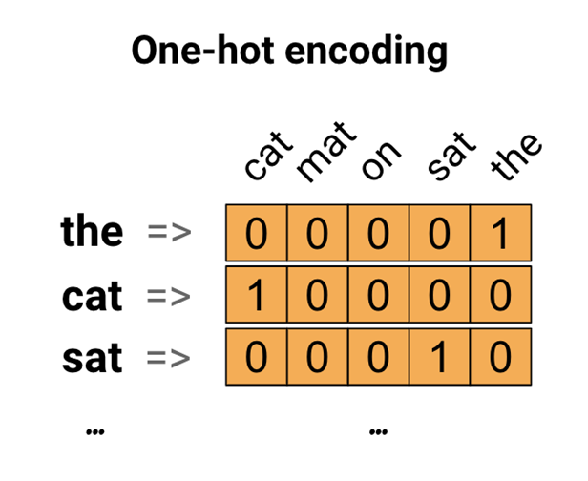
Representing text as numbers(1)
Consider the sentence
"The cat sat on the mat".
The vocabulary (or unique words) in this sentence is (cat, mat, on, sat, the).
To represent each word, we will create a zero vector with length equal to the vocabulary, then place a one in the index that corresponds to the word.
To create a vector that contains the encoding of the sentence, we could then concatenate the one-hot vectors for each word.
This approach is inefficient. A one-hot encoded vector is sparse (meaning, most indices are zero). Imagine we have 10,000 words in the vocabulary. To one-hot encode each word, we would create a vector where 99.99% of the elements are zero.

Slide 4
Representing text as numbers(2)
Encode each word with a unique number
Continuing the example above, we could assign 1 to "cat", 2 to "mat", and so on.
We could then encode the sentence "The cat sat on the mat" as a dense vector like [5, 1, 4, 3, 5, 2].
This appoach is efficient. Instead of a sparse vector, we now have a dense one (where all elements are full).
缺點有二:
The integer-encoding is arbitrary (it does not capture any relationship between words).
An integer-encoding can be challenging for a model to interpret. A linear classifier, for example, learns a single weight for each feature. Because there is no relationship between the similarity of any two words and the similarity of their encodings, this feature-weight combination is not meaningful.

Slide 5
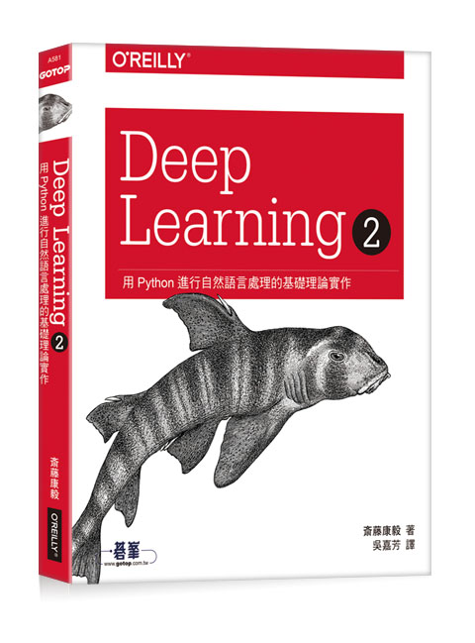
https://github.com/oreilly-japan/deep-learning-from-scratch-2

Slide 6
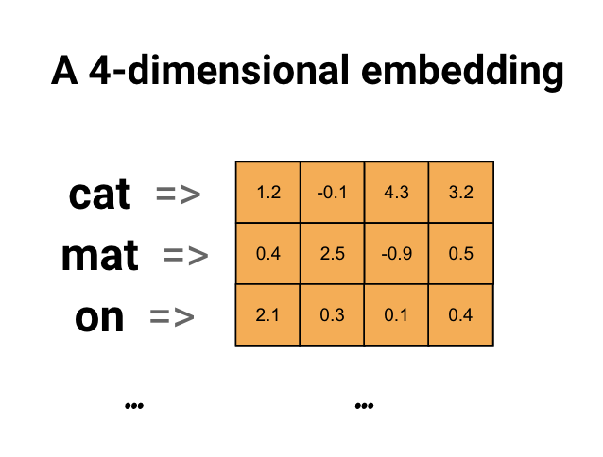
Representing text as numbers(3)
Word embeddings give us a way to use an efficient, dense representation in which similar words have a similar encoding.
word embedding
Importantly, we do not have to specify this encoding by hand.
An embedding is a dense vector of floating point values (the length of the vector is a parameter you specify). Instead of specifying the values for the embedding manually, they are trainable parameters (weights learned by the model during training, in the same way a model learns weights for a dense layer). It is common to see word embeddings that are 8-dimensional (for small datasets), up to 1024-dimensions when working with large datasets.
A higher dimensional embedding can capture fine-grained relationships between words, but takes more data to learn.

Slide 7

Representing text as numbers(3)
word embedding
Each word is represented as a 4-dimensional vector of floating point values.
Another way to think of an embedding is as "lookup table".
After these weights have been learned, we can encode each word by looking up the dense vector it corresponds to in the table

Slide 8
Learning embeddings from scratch
https://www.tensorflow.org/tutorials/text/word_embeddings

Slide 9
(train_data, test_data), info = tfds.load(
'imdb_reviews/subwords8k',
split = (tfds.Split.TRAIN, tfds.Split.TEST),
with_info=True, as_supervised=True)

Slide 10
Get the encoder (tfds.features.text.SubwordTextEncoder), and have a quick look at the vocabulary.
The "_" in the vocabulary represent spaces. Note how the vocabulary includes whole words (ending with "_") and partial words which it can use to build larger words:
encoder = info.features['text'].encoder
encoder.subwords[:20]
['the_', ', ', '. ', 'a_', 'and_', 'of_', 'to_', 's_', 'is_', 'br', 'in_', 'I_', 'that_', 'this_', 'it_', ' /><', ' />', 'was_', 'The_', 'as_']

Slide 11
Movie reviews can be different lengths.
We will use the padded_batch method to standardize the lengths of the reviews.
train_batches = train_data.shuffle(1000).padded_batch(10)
test_batches = test_data.shuffle(1000).padded_batch(10)

Slide 12
As imported, the text of reviews is integer-encoded (each integer represents a specific word or word-part in the vocabulary).
Note the trailing zeros, because the batch is padded to the longest example.
train_batch, train_labels = next(iter(train_batches))
train_batch.numpy()
array([[ 592, 5752, 7961, ..., 0, 0, 0], [7369, 7961, 5033, ..., 0, 0, 0], [ 19, 6382, 7961, ..., 5615, 297, 2760], ..., [ 62, 27, 9, ..., 0, 0, 0], [ 62, 32, 18, ..., 0, 0, 0], [ 62, 18, 11, ..., 0, 0, 0]])

Slide 13
embedding_dim=16
model = keras.Sequential([
layers.Embedding(encoder.vocab_size, embedding_dim),
layers.GlobalAveragePooling1D(),
layers.Dense(16, activation='relu'),
layers.Dense(1)
])
model.summary()

Slide 14
model.compile(optimizer='adam',
loss=tf.keras.losses.BinaryCrossentropy(from_logits=True),
metrics=['accuracy'])
history = model.fit(
train_batches,
epochs=10,
validation_data=test_batches, validation_steps=20)

Slide 15
import matplotlib.pyplot as plt
history_dict = history.history
acc = history_dict['accuracy']
val_acc = history_dict['val_accuracy']
loss=history_dict['loss']
val_loss=history_dict['val_loss']
epochs = range(1, len(acc) + 1)
plt.figure(figsize=(12,9))
plt.plot(epochs, loss, 'bo', label='Training loss')
plt.plot(epochs, val_loss, 'b', label='Validation loss')
plt.title('Training and validation loss')
plt.xlabel('Epochs')
plt.ylabel('Loss')
plt.legend()
plt.show()

Slide 16
plt.figure(figsize=(12,9))
plt.plot(epochs, acc, 'bo', label='Training acc')
plt.plot(epochs, val_acc, 'b', label='Validation acc')
plt.title('Training and validation accuracy')
plt.xlabel('Epochs')
plt.ylabel('Accuracy')
plt.legend(loc='lower right')
plt.ylim((0.5,1))
plt.show()

Slide 17
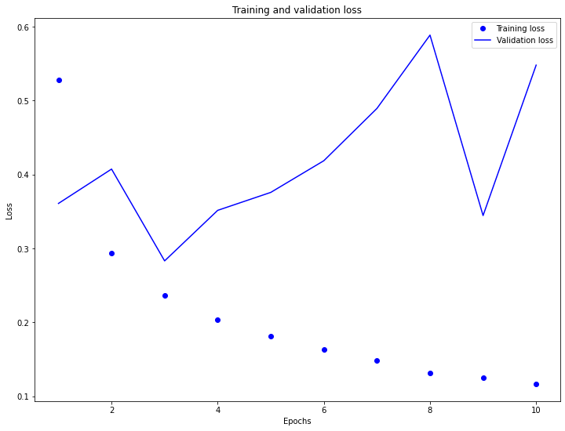

Slide 18
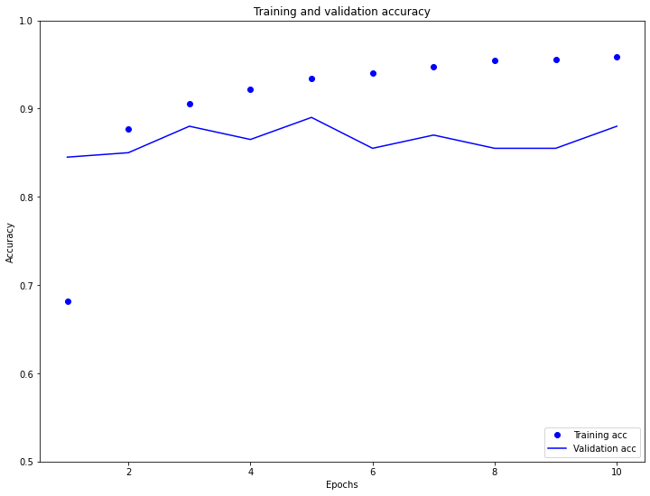

Slide 19
https://www.tensorflow.org/api_docs/python/tf/keras/layers/Embedding
tf.keras.layers.Embedding(
input_dim,
output_dim,
embeddings_initializer='uniform',
embeddings_regularizer=None,
activity_regularizer=None,
embeddings_constraint=None,
mask_zero=False,
input_length=None,
**kwargs
)

Slide 20
The Embedding layer can be understood as a lookup table that maps from integer indices (which stand for specific words) to dense vectors (their embeddings).
The dimensionality (or width) of the embedding is a parameter you can experiment with to see what works well for your problem, much in the same way you would experiment with the number of neurons in a Dense layer.
embedding_layer = layers.Embedding(1000, 5)
When you create an Embedding layer, the weights for the embedding are randomly initialized (just like any other layer).
During training, they are gradually adjusted via backpropagation.
Once trained, the learned word embeddings will roughly encode similarities between words (as they were learned for the specific problem your model is trained on).

Slide 21
Word2Vec

Slide 22
Word
Vector
Sentence(句子)
document(文件)
Document classification
(文件分類)

Slide 23
Archie used to live in New York, he then moved to Santa Clara. He loves apples and strawberries.
Word2vec model generates the vector representation for each of the words in the preceding text.

Slide 24
with word2vec model, we can learn the meaningful vector representation of a word which helps the neural networks to understand what the word is about.

Slide 25
兩種實作
1.CBOW model
(Continuous Bag-of-Words Model)
2.Skip-gram model

Slide 26
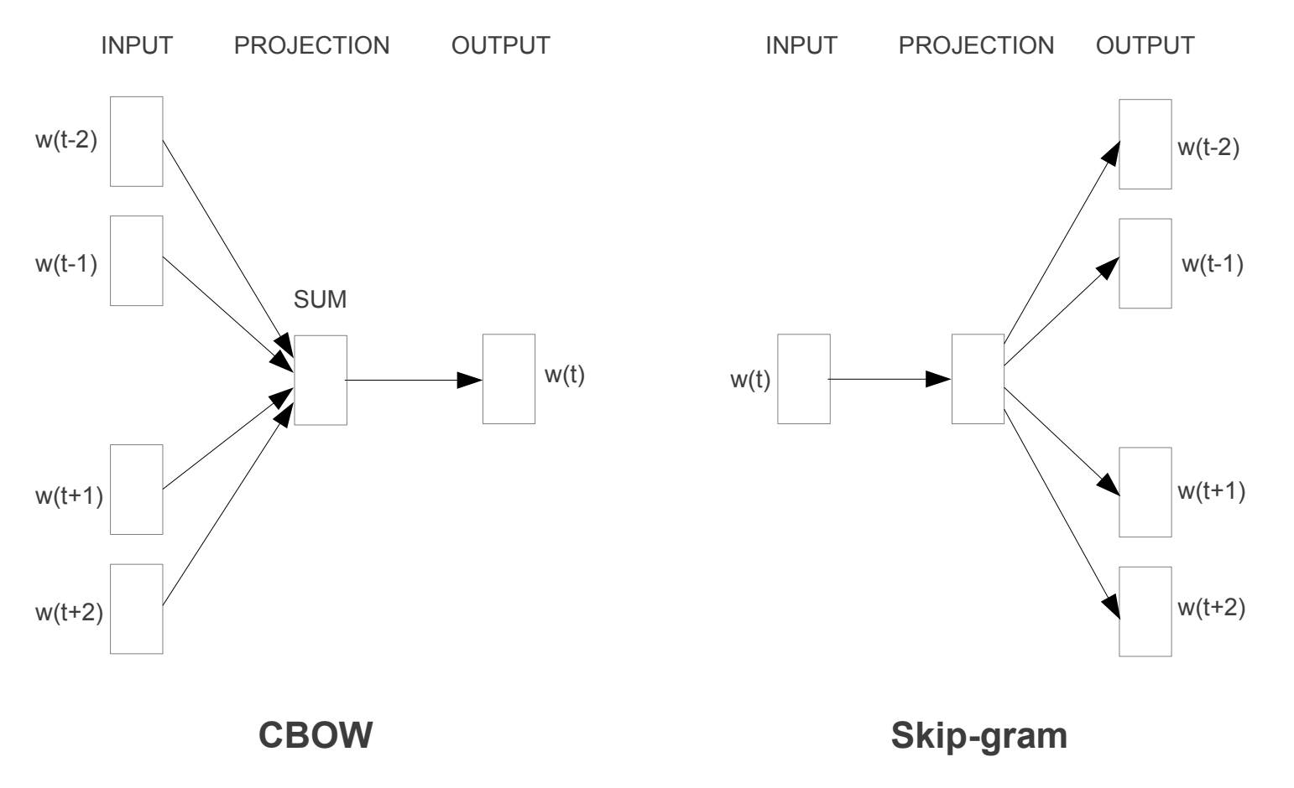

Slide 27
The Sun rises in the ____
east
If we were asked to predict the blank term in the preceding sentence, we would probably say east.
Why would we predict that the word east would be the right word here? Because we read the whole sentence, understood the context, and predicted that the word east would be an appropriate word to complete the sentence.

Slide 28
CBOW model
將一個詞所在的上下文中的詞作為輸入，而那個詞本身作為輸出，
也就是說，看到一個上下文，希望大概能猜出這個詞和它的意思
window

Slide 29
one-hot encoding
The Sun rises in the east
All the unique words we have in our corpus is called the vocabulary(詞彙表)

Slide 30
將一個詞所在的上下文中的詞作為輸入，而那個詞本身作為輸出，
也就是說，看到一個上下文，希望大概能猜出這個詞和它的意思
In the initial iteration, the network cannot predict the target word correctly.
But over a series of iterations, it learns to predict the correct target word using gradient descent. With gradient descent, we update the weights of the network and find the optimal weights with which we can predict the correct target word.

Slide 31
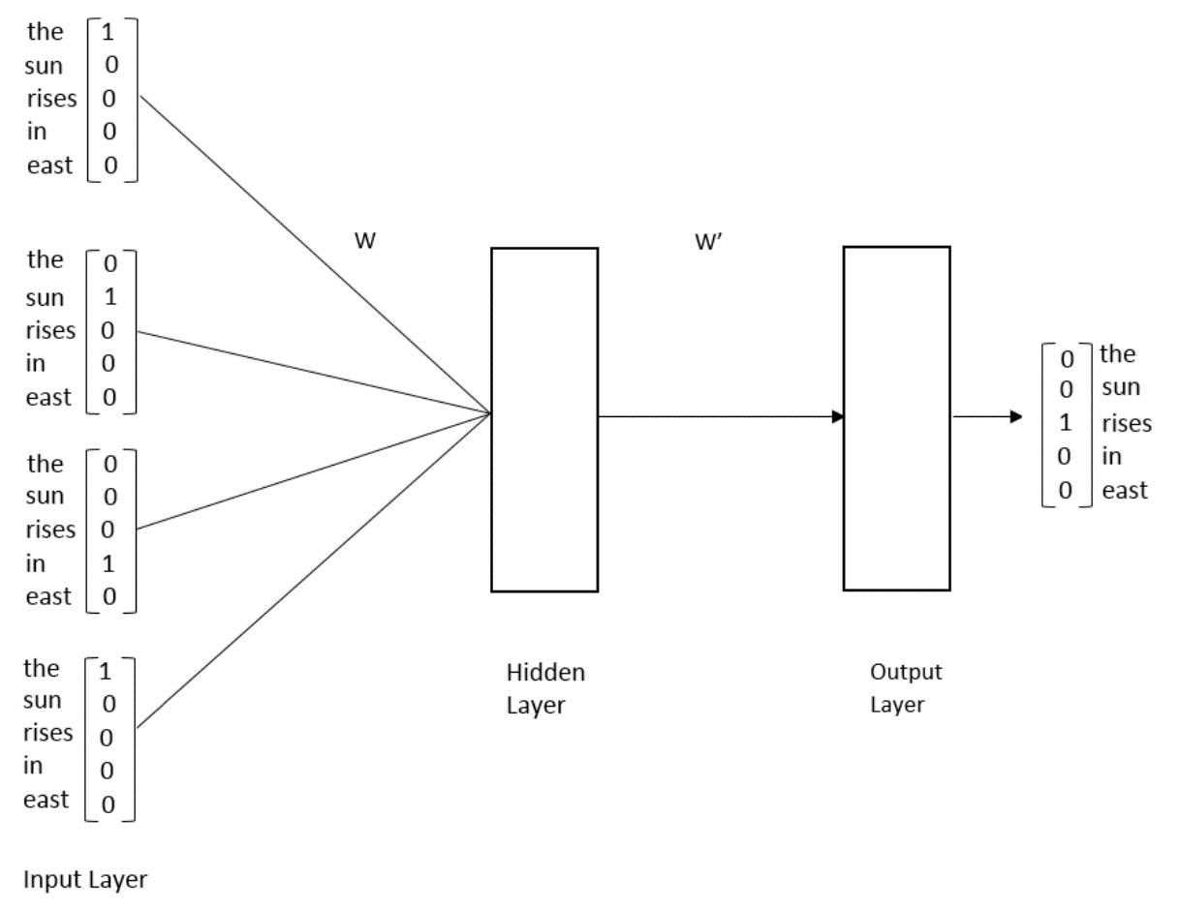
範例模型只有兩個權重weight
During the training process, the network will try to find the optimal values for these two sets of weights so that it can predict the correct target word.
It turns out that the optimal weights between the input to a hidden layer forms the vector representation of words. They basically constitute the semantic meaning of the words.
So, after training, we simply remove the output layer and take the weights between the input and hidden layers and assign them to the corresponding words.

Slide 32
訓練完後的W就是word embedding
例如底下的範例
the embedding for the word sun is [0.0, 0.3,0.3,0.6,0.1 ]

Slide 33
