Slide 1
AI4High::從資料科學到機器學習與人工智慧
AI4High::GAN
AI::Keras/Tensorflow Way

Slide 2
GAN

Slide 3
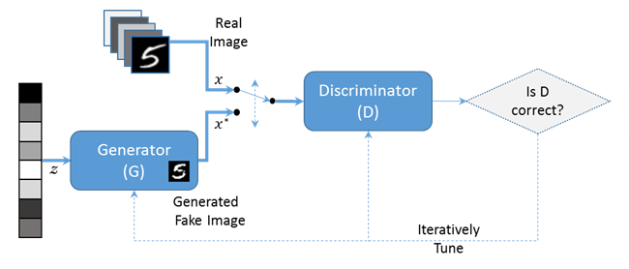
生成對抗網路(Generative Adversarial Network, GAN)
https://ithelp.ithome.com.tw/articles/10196828
GAN 同時訓練兩個神經網路，生成器(Generator, G)和鑑別器(Discriminator, D)，互相對抗激勵而越來越強。
生成器(Generator, G)輸入以常態分布的隨機噪音向量(Z)，產生相似於 MNIST 資料集的生成圖像，用以訓練鑑別器。
鑑別器(Discriminator, D)輸入 MNIST 圖像及生成圖像，並試圖判別 MNIST 圖像與生成圖像兩者之間的區別。

Slide 4
生成對抗網路(Generative Adversarial Network, GAN)
https://ithelp.ithome.com.tw/articles/10196828
鑑別器(Discriminator, D)，試圖讓自己的輸出最大化，判別成功
生成器(Generator, G)，試圖使鑑別器(Discriminator, D)輸出最小化，判別失敗
訓練過程反覆進行，GAN 兩個神經網路最後會收斂到一個平衡點，得到一個生成模型輸入隨機數字後可產生相似於 MNIST 資料集的生成圖像。

Slide 5
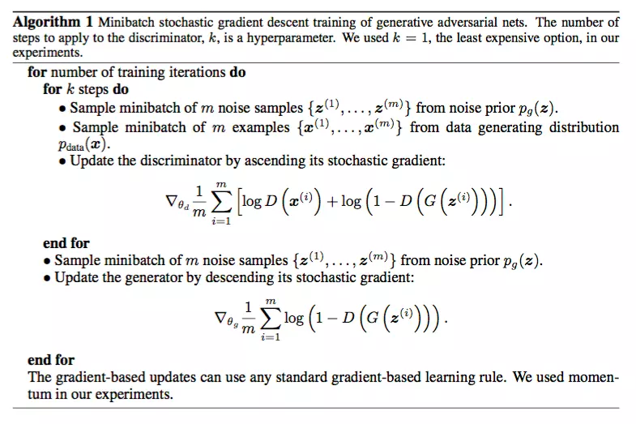

Slide 6
Tensorflow::GAN
TF/TF_GAN_MNIST_GOOD.ipynb
Keras::GAN
AI4high/Keras_GAN_DCGAN_CGAN.ipynb

Slide 7
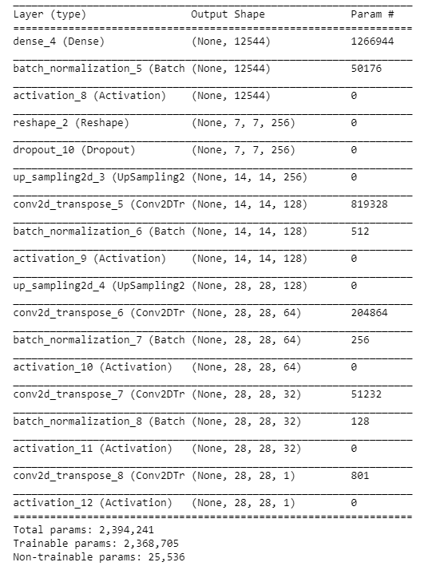
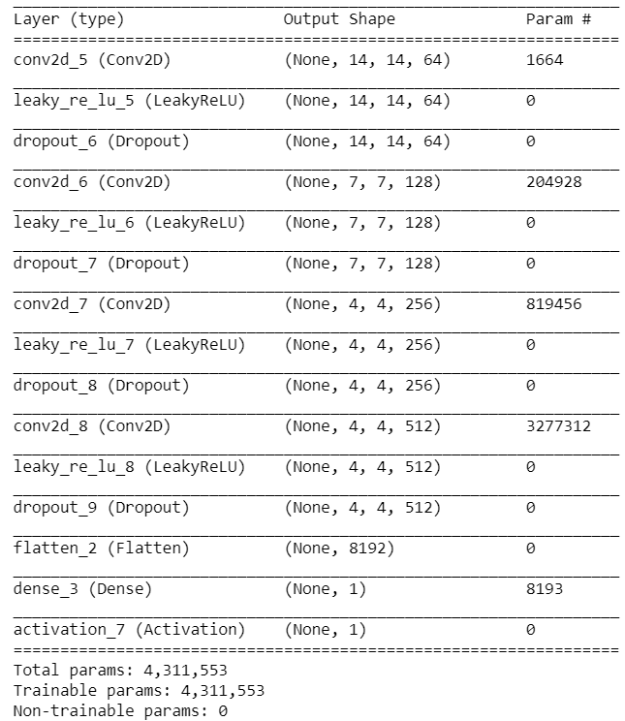
其他測試
Keras::GAN
Keras_DCGAN_MNIST_2.ipynb
AI4high/Keras_DCGAN_MNIST.ipynb
Keras DCGAN
不到 200 行代碼，教你如何用 Keras 搭建生成對抗網路（GAN）
https://www.leiphone.com/news/201703/Y5vnDSV9uIJIQzQm.html
DCGAN on MNIST using Keras

Slide 8
Tensorflow::GAN

Slide 9
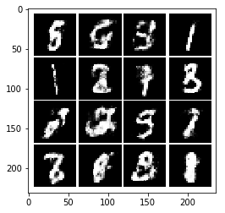
Generative Adversarial Nets in TensorFlow
https://wiseodd.github.io/techblog/2016/09/17/gan-tensorflow/
https://github.com/wiseodd/generative-models
TF/TF_GAN_MNIST_GOOD.ipynb
https://www.jianshu.com/p/08abd788d598
https://blog.csdn.net/u012223913/article/details/75051516

Slide 10
jonbruner/generative-adversarial-networks
https://github.com/jonbruner/generative-adversarial-networks
gau820827/GAN_tutorial
https://github.com/gau820827/GAN_tutorial
教電腦畫畫：初心者的生成式對抗網路(GAN)入門筆記（TensorFlow + Python3）
carpedm20/DCGAN-tensorflow
https://github.com/carpedm20/DCGAN-tensorflow

Slide 11
Keras::GAN

Slide 12
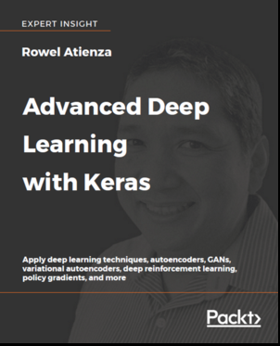
案例學習
1: INTRODUCING ADVANCED DEEP LEARNING WITH KERAS
2: DEEP NEURAL NETWORKS
3: AUTOENCODERS
4: GENERATIVE ADVERSARIAL NETWORKS (GANS)
5: IMPROVED GANS
6: DISENTANGLED REPRESENTATION GANS
7: CROSS-DOMAIN GANS
8: VARIATIONAL AUTOENCODERS (VAES)
9: DEEP REINFORCEMENT LEARNING
10: POLICY GRADIENT METHODS

Slide 13
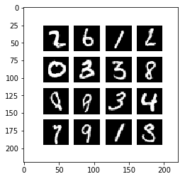
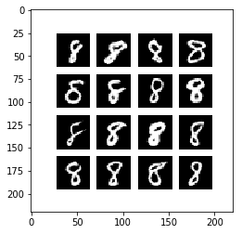
先看看執行成果 再討論程式碼
AI4high/Keras_GAN_DCGAN_CGAN.ipynb

Slide 14
dcgan-mnist-4.2.1.py
https://github.com/MyDearGreatTeacher/Keras/blob/master/BOOKS/advancedKeras/chapter4-gan/dcgan-mnist-4.2.1.py

Slide 15
from __future__ import absolute_import
from __future__ import division
from __future__ import print_function
from keras.layers import Activation, Dense, Input
from keras.layers import Conv2D, Flatten
from keras.layers import Reshape, Conv2DTranspose
from keras.layers import LeakyReLU
from keras.layers import BatchNormalization
from keras.optimizers import RMSprop
from keras.models import Model
from keras.datasets import mnist
from keras.models import load_model
import numpy as np
import math
import matplotlib.pyplot as plt
import os
import argparse

Slide 16
def build_generator(inputs, image_size):
""“
Build a Generator Model
Stack of BN-ReLU-Conv2DTranpose to generate fake images
Output activation is sigmoid instead of tanh in [1].
Sigmoid converges easily.
# Arguments
inputs (Layer): Input layer of the generator (the z-vector)
image_size: Target size of one side (assuming square image)
# Returns
Model: Generator Model
"""

Slide 17
image_resize = image_size // 4
# network parameters
kernel_size = 5
layer_filters = [128, 64, 32, 1]
x = Dense(image_resize * image_resize * layer_filters[0])(inputs)
x = Reshape((image_resize, image_resize, layer_filters[0]))(x)
for filters in layer_filters:
# first two convolution layers use strides = 2
# the last two use strides = 1
if filters > layer_filters[-2]:
strides = 2
else:
strides = 1
x = BatchNormalization()(x)
x = Activation('relu')(x)
x = Conv2DTranspose(filters=filters,
kernel_size=kernel_size,
strides=strides,
padding='same')(x)
x = Activation('sigmoid')(x)
generator = Model(inputs, x, name='generator')
return generator

Slide 18
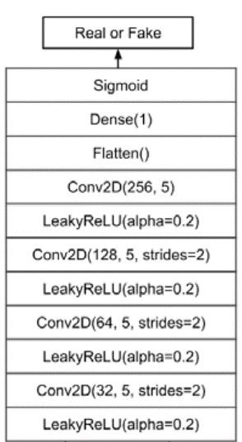
def build_discriminator(inputs):
""“
Build a Discriminator Model
Stack of LeakyReLU-Conv2D to discriminate real from fake.
The network does not converge with BN so it is not used here
unlike in [1] or original paper.
# Arguments
inputs (Layer): Input layer of the discriminator (the image)
# Returns
Model: Discriminator Model
"""

Slide 19
kernel_size = 5
layer_filters = [32, 64, 128, 256]
x = inputs
for filters in layer_filters:
# first 3 convolution layers use strides = 2
# last one uses strides = 1
if filters == layer_filters[-1]:
strides = 1
else:
strides = 2
x = LeakyReLU(alpha=0.2)(x)
x = Conv2D(filters=filters,
kernel_size=kernel_size,
strides=strides,
padding='same')(x)
x = Flatten()(x)
x = Dense(1)(x)
x = Activation('sigmoid')(x)
discriminator = Model(inputs, x, name='discriminator')
return discriminator

Slide 20
def train(models, x_train, params):
""“
Train the Discriminator and Adversarial Networks
Alternately train Discriminator and Adversarial networks by batch.
Discriminator is trained first with properly real and fake images.
Adversarial is trained next with fake images pretending to be real
Generate sample images per save_interval.
# Arguments
models (list): Generator, Discriminator, Adversarial models
x_train (tensor): Train images
params (list) : Networks parameters
"""

Slide 21
# the GAN models
generator, discriminator, adversarial = models
# network parameters
batch_size, latent_size, train_steps, model_name = params
# the generator image is saved every 500 steps
save_interval = 500
# noise vector to see how the generator output evolves during training
noise_input = np.random.uniform(-1.0, 1.0, size=[16, latent_size])
# number of elements in train dataset
train_size = x_train.shape[0]

Slide 22
for i in range(train_steps):
# train the discriminator for 1 batch
# 1 batch of real (label=1.0) and fake images (label=0.0)
# randomly pick real images from dataset
rand_indexes = np.random.randint(0, train_size, size=batch_size)
real_images = x_train[rand_indexes]
# generate fake images from noise using generator
# generate noise using uniform distribution
noise = np.random.uniform(-1.0, 1.0, size=[batch_size, latent_size])
# generate fake images
fake_images = generator.predict(noise)
# real + fake images = 1 batch of train data
x = np.concatenate((real_images, fake_images))
# label real and fake images
# real images label is 1.0
y = np.ones([2 * batch_size, 1])
# fake images label is 0.0
y[batch_size:, :] = 0.0
# train discriminator network, log the loss and accuracy
loss, acc = discriminator.train_on_batch(x, y)
log = "%d: [discriminator loss: %f, acc: %f]" % (i, loss, acc)

Slide 23
# train the adversarial network for 1 batch
# 1 batch of fake images with label=1.0
# since the discriminator weights are frozen in adversarial network
# only the generator is trained
# generate noise using uniform distribution
noise = np.random.uniform(-1.0, 1.0, size=[batch_size, latent_size])
# label fake images as real or 1.0
y = np.ones([batch_size, 1])
# train the adversarial network
# note that unlike in discriminator training,
# we do not save the fake images in a variable
# the fake images go to the discriminator input of the adversarial
# for classification
# log the loss and accuracy
loss, acc = adversarial.train_on_batch(noise, y)
log = "%s [adversarial loss: %f, acc: %f]" % (log, loss, acc)
print(log)

Slide 24
if (i + 1) % save_interval == 0:
if (i + 1) == train_steps:
show = True
else:
show = False
# plot generator images on a periodic basis
plot_images(generator,
noise_input=noise_input,
show=show,
step=(i + 1),
model_name=model_name)
# save the model after training the generator
# the trained generator can be reloaded for future MNIST digit generation
generator.save(model_name + ".h5")

Slide 25
def plot_images(generator,
noise_input,
show=False,
step=0,
model_name="gan"):
""“
Generate fake images and plot them
For visualization purposes, generate fake images
then plot them in a square grid
# Arguments
generator (Model): The Generator Model for fake images generation
noise_input (ndarray): Array of z-vectors
show (bool): Whether to show plot or not
step (int): Appended to filename of the save images
model_name (string): Model name
"""

Slide 26
os.makedirs(model_name, exist_ok=True)
filename = os.path.join(model_name, "%05d.png" % step)
images = generator.predict(noise_input)
plt.figure(figsize=(2.2, 2.2))
num_images = images.shape[0]
image_size = images.shape[1]
rows = int(math.sqrt(noise_input.shape[0]))
for i in range(num_images):
plt.subplot(rows, rows, i + 1)
image = np.reshape(images[i], [image_size, image_size])
plt.imshow(image, cmap='gray')
plt.axis('off')
plt.savefig(filename)
if show:
plt.show()
else:
plt.close('all')

Slide 27
def build_and_train_models():
# load MNIST dataset
(x_train, _), (_, _) = mnist.load_data()
# reshape data for CNN as (28, 28, 1) and normalize
image_size = x_train.shape[1]
x_train = np.reshape(x_train, [-1, image_size, image_size, 1])
x_train = x_train.astype('float32') / 255
model_name = "dcgan_mnist"
# network parameters
# the latent or z vector is 100-dim
latent_size = 100
batch_size = 64
train_steps = 40000
lr = 2e-4
decay = 6e-8
input_shape = (image_size, image_size, 1)

Slide 28
# build discriminator model
inputs = Input(shape=input_shape, name='discriminator_input')
discriminator = build_discriminator(inputs)
# [1] or original paper uses Adam,
# but discriminator converges easily with RMSprop
optimizer = RMSprop(lr=lr, decay=decay)
discriminator.compile(loss='binary_crossentropy',
optimizer=optimizer,
metrics=['accuracy'])
discriminator.summary()
# build generator model
input_shape = (latent_size, )
inputs = Input(shape=input_shape, name='z_input')
generator = build_generator(inputs, image_size)
generator.summary()

Slide 29
# build adversarial model
optimizer = RMSprop(lr=lr * 0.5, decay=decay * 0.5)
# freeze the weights of discriminator during adversarial training
discriminator.trainable = False
# adversarial = generator + discriminator
adversarial = Model(inputs,
discriminator(generator(inputs)),
name=model_name)
adversarial.compile(loss='binary_crossentropy',
optimizer=optimizer,
metrics=['accuracy'])
adversarial.summary()
# train discriminator and adversarial networks
models = (generator, discriminator, adversarial)
params = (batch_size, latent_size, train_steps, model_name)
train(models, x_train, params)

Slide 30
def test_generator(generator):
noise_input = np.random.uniform(-1.0, 1.0, size=[16, 100])
plot_images(generator,
noise_input=noise_input,
show=True,
model_name="test_outputs")

Slide 31
if __name__ == '__main__':
parser = argparse.ArgumentParser()
help_ = "Load generator h5 model with trained weights"
parser.add_argument("-g", "--generator", help=help_)
args = parser.parse_args()
if args.generator:
generator = load_model(args.generator)
test_generator(generator)
else:
build_and_train_models()

