Slide 1

Revolutionizing Communication: Real-time, Cost-Effective, Inclusive Sign Language Detection
Breaking down communication barriers through innovative technology

Slide 2
The Need for Accessible Communication
Sign Language Barriers
Lack of Interpreters
Approximately 466 million people globally have disabling hearing loss, with 3.15million people in Kenya.
Despite having 60,000 certified sign language interpreters, demand significantly outstrips supply, causing access issues for 50% of deaf individuals in public settings.

Slide 4
Challenges of Current Sign Language Solutions
1
Limited Accuracy
2
High Cost
Existing AI systems struggle with complex sign language variations
Professional interpreters are often expensive and unavailable
3
Lack of Inclusivity
Not all sign languages are supported by current technology

Slide 5
Our Innovative Approach to Sign Language Detection
Real-Time Detection
Cost-Effective
Accurate recognition of sign language gestures in real time
Affordable and accessible for individuals and organizations
Inclusive Design
Enhance Learning: Create a platform to teach and learn sign language more effectively.
Supporting a wide range of sign languages worldwide

Slide 6
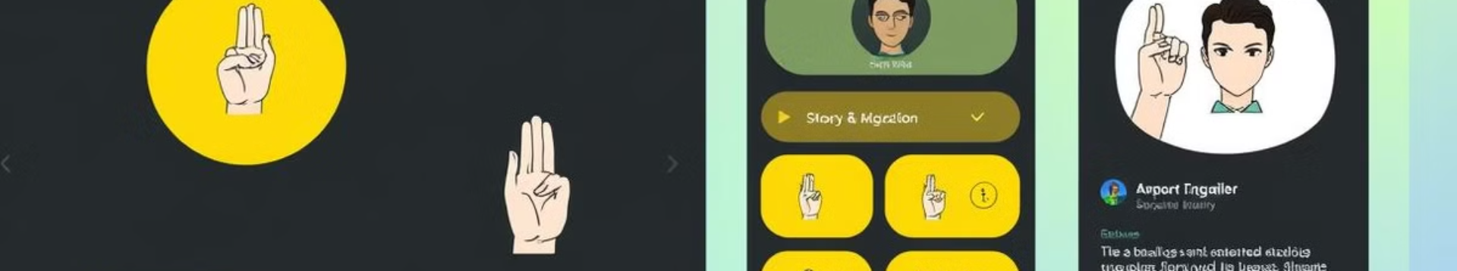




Key Features and Functionalities
Real-time Transcription
Multilingual Translation
Advanced Accessibility
Multi-language Support
Convert sign language into text for easy communication, supporting multiple languages like ASL, BSL, and ISL.
Translate detected gestures into text and spoken words using text-to-speech, supporting multiple output languages.
Integration with assistive technologies for seamless interaction and inclusivity.
Expanded gesture dataset recognizing ASL, BSL, ISL and more.

Slide 7
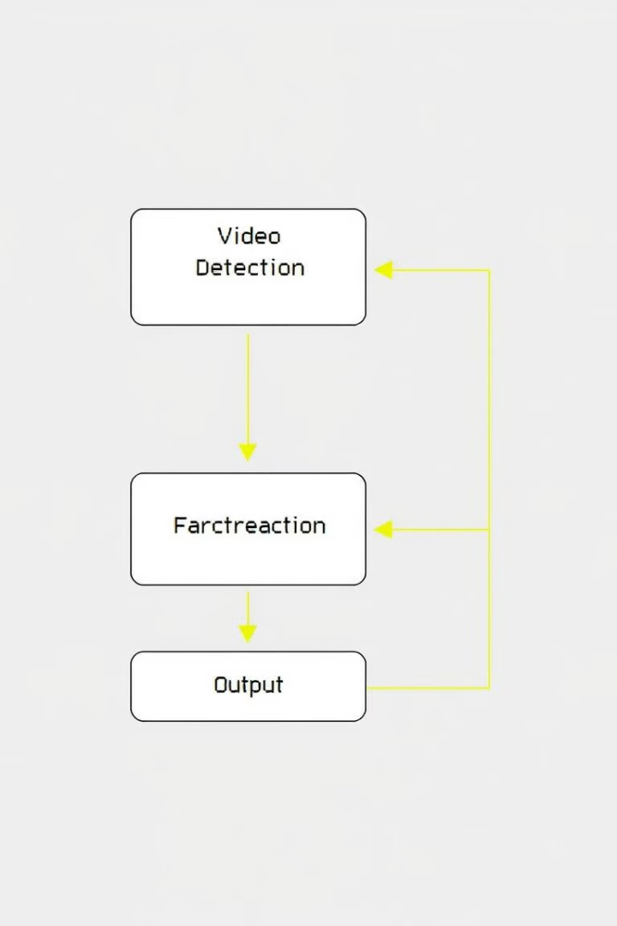
Technical Overview and Architecture
1
AI-Powered Engine
Utilizes deep learning algorithms for accurate sign language recognition
2
Data Collection and Training
Extensive dataset of sign language gestures for model training
3
Integration with Devices
Seamless integration with mobile devices, web platforms, and hardware

Slide 8




Real-World Use Cases and Impact
Healthcare
Improved communication between patients and medical professionals
Education
Enhanced learning experiences for deaf and hard-of-hearing students
Community Events
Greater accessibility and inclusion for deaf individuals in social settings

Slide 9



Conclusion and Future Developments
Empowering Communication
1
Creating a more inclusive and accessible world for all
Expansion and Growth
2
Supporting a wider range of sign languages and features
Global Impact
3
Bridging the communication gap across diverse cultures

Slide 10
Monetization Strategies
Mobile or Web App
Launch the project as a mobile or web application that translates sign language gestures in real-time. Offer a free version with ads or a paid version without ads.
Integration with Assistive Devices
Partner with companies that produce assistive devices for the hearing impaired, such as hearing aids and cochlear implants.
B2B Solutions
Offer the system to schools, businesses, or organizations for inclusivity programs and to improve communication with deaf and hard-of-hearing individuals.

