Slide 1
Discussion
26, September, 2019

Slide 2
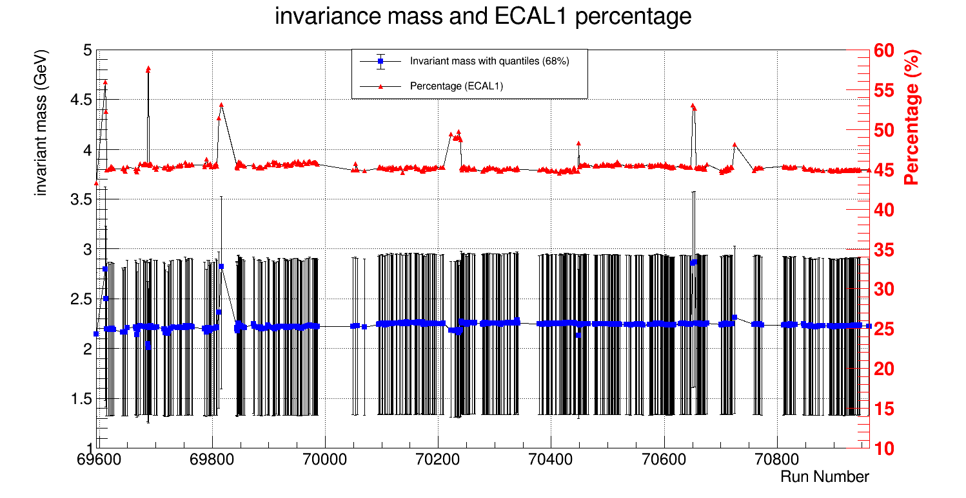

Slide 3
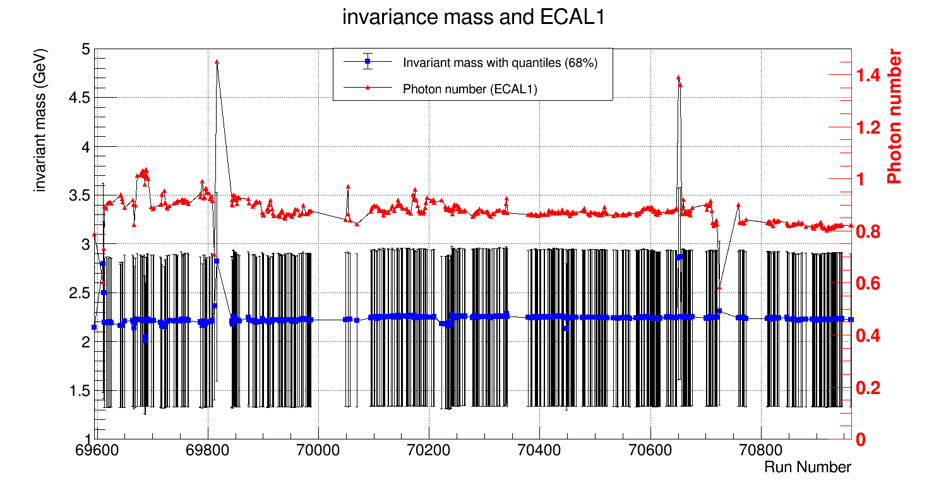

Slide 4
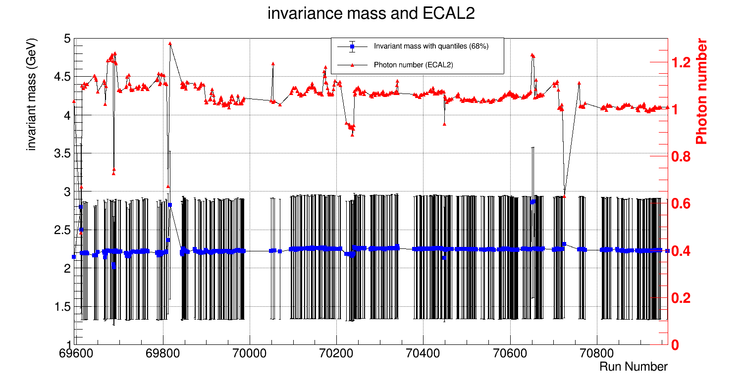

Slide 5
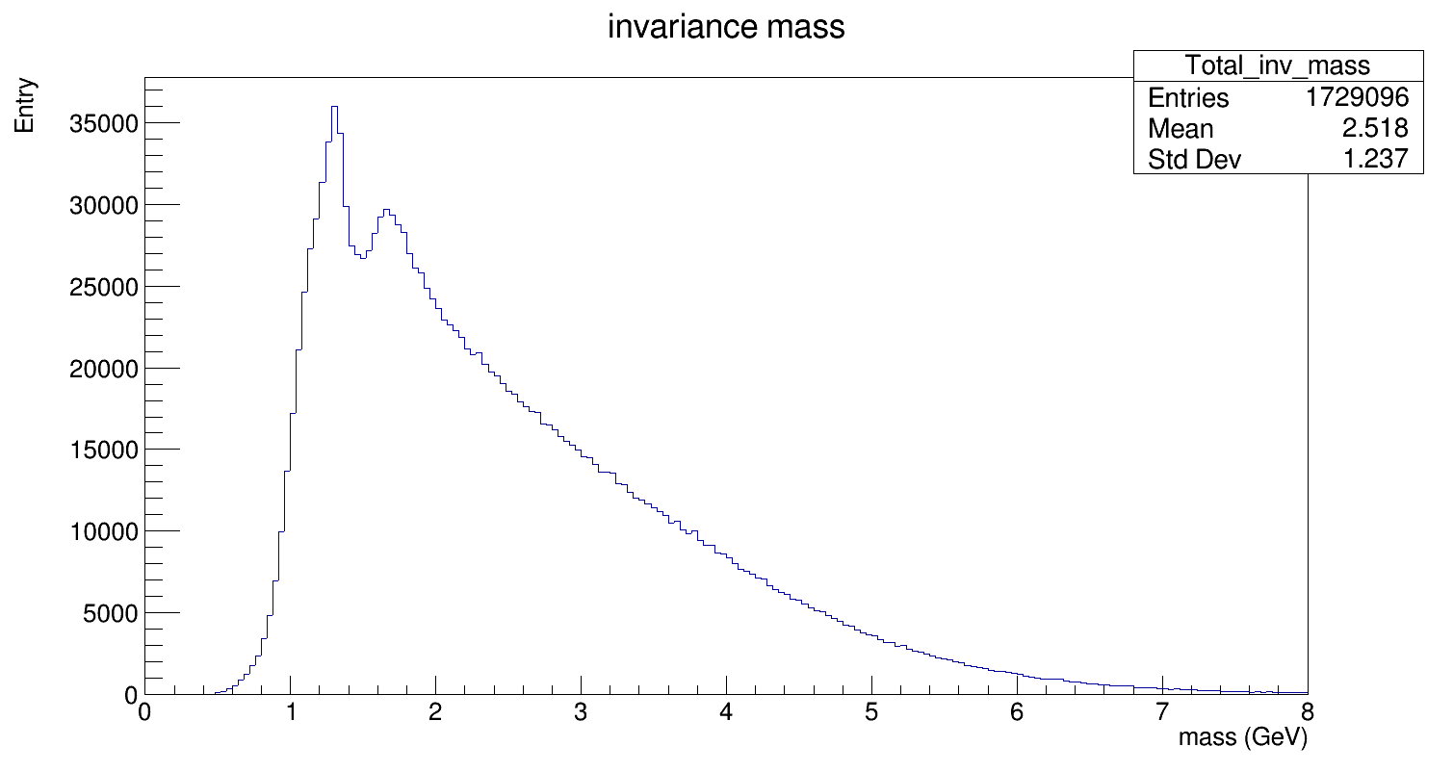
Normal shape of invariant mass distribution (Run = 69853)

Slide 6
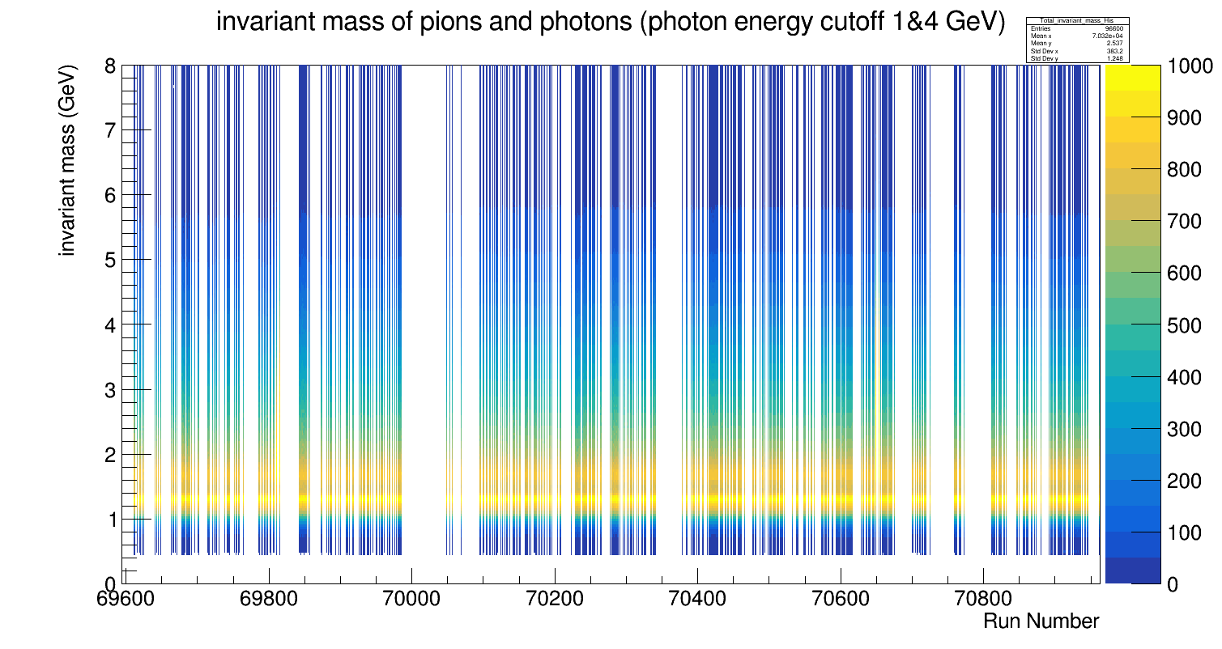
Normalized invariant mass distribution

Slide 7
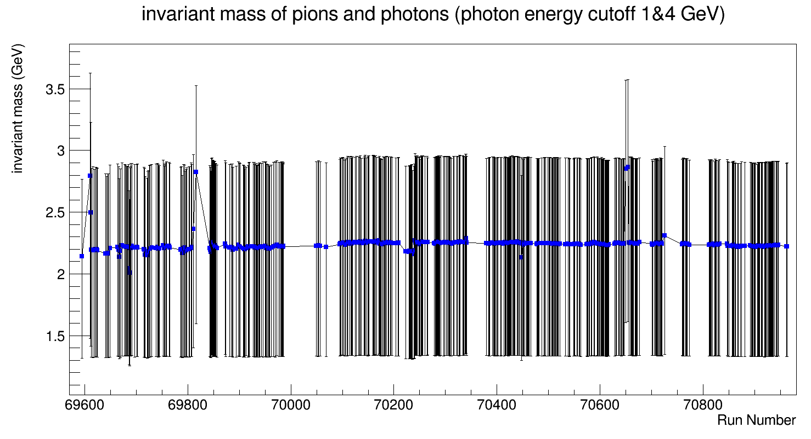
Invariant mass for each run
RunNumber = 69611, 69612

Slide 8
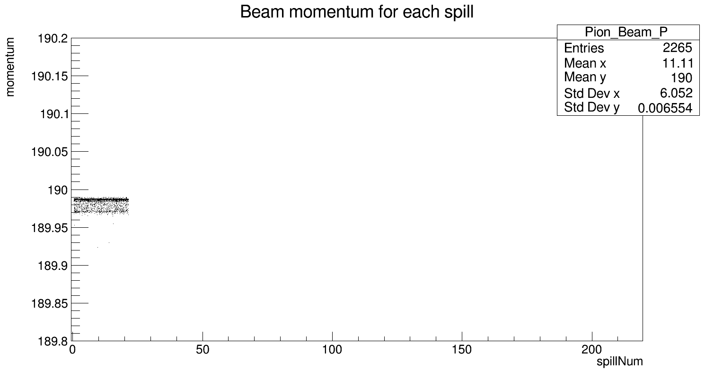
Uneven distribution of momentum (Run = 69611)

Slide 9
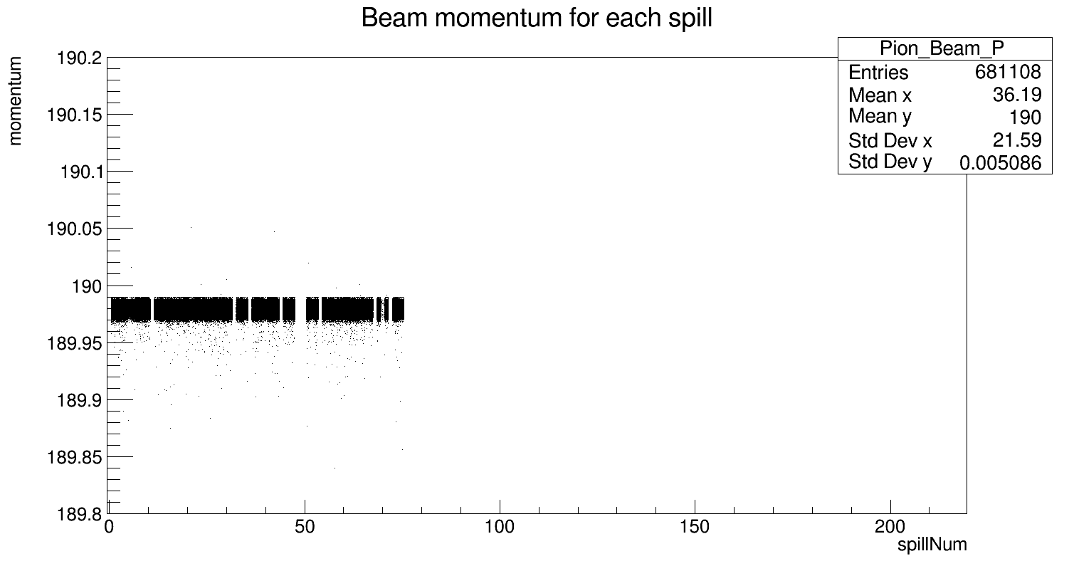
Normal even distribution of momentum (Run = 69690)

Slide 10
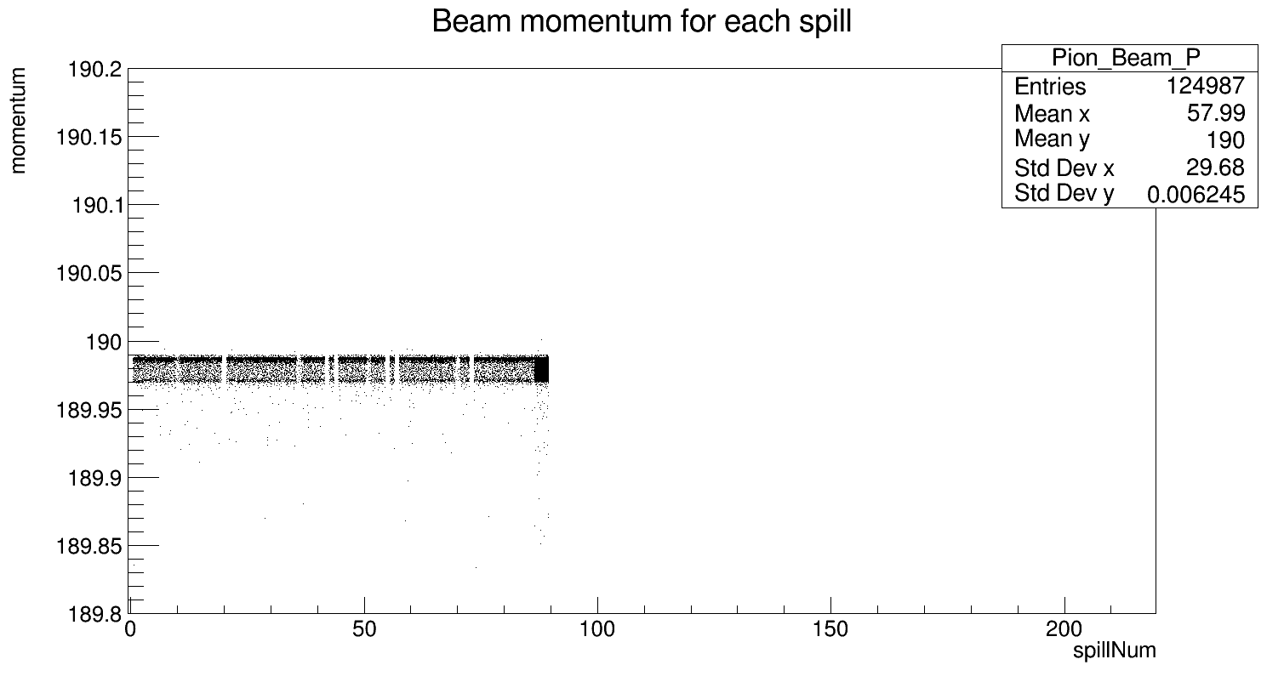
Uneven distribution of momentum (Run = 69612)

Slide 11
Invariant mass for each run
RunNumber = 69816

Slide 12
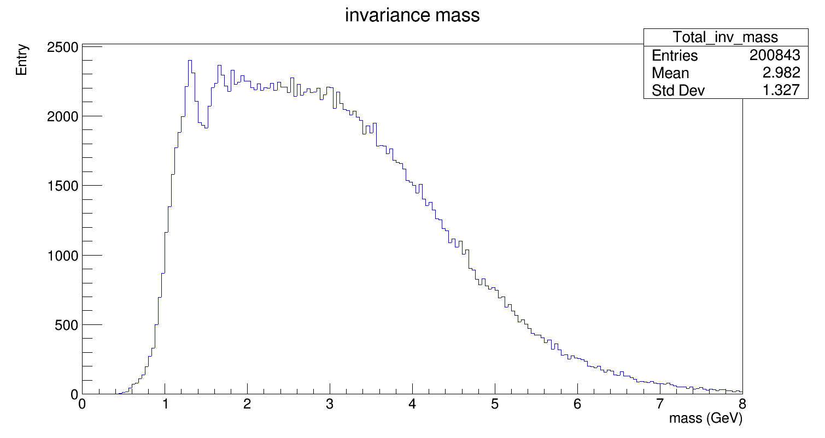
Abnormal shape of invariant mass distribution (Run = 69816)
FWHM

Slide 13
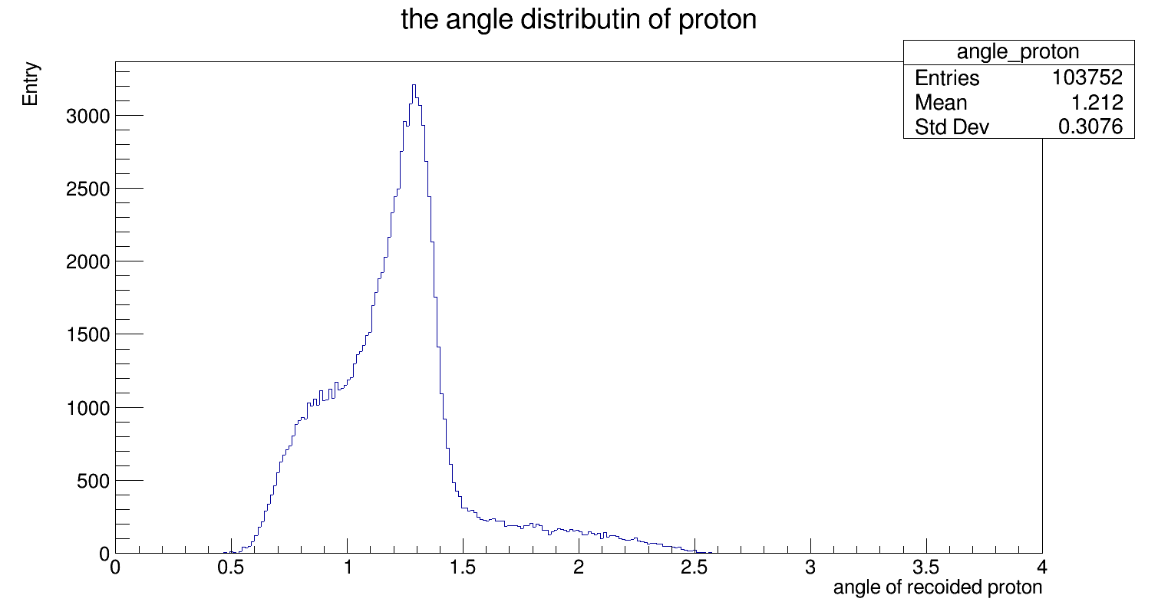
Abnormal shape of angle distribution of recoiled proton (Run = 69816)
The angle (theta) distribution of recoiled proton
width at 23% of maximal value

Slide 14
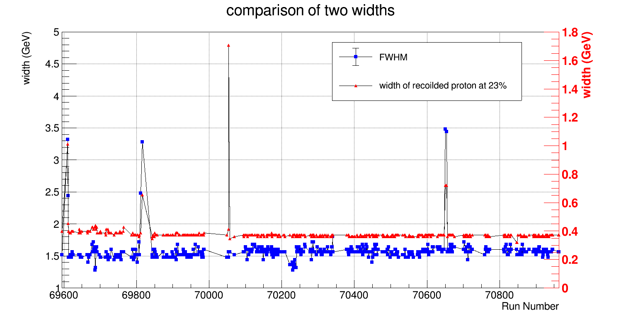
Comparison between the width of invariant mass and of scattering angle of recoild proton
RunNumber = 70054
RunNumber = 69816
RunNumber = 69816
RunNumber = 70650, 70655
RunNumber = 69811

Slide 15
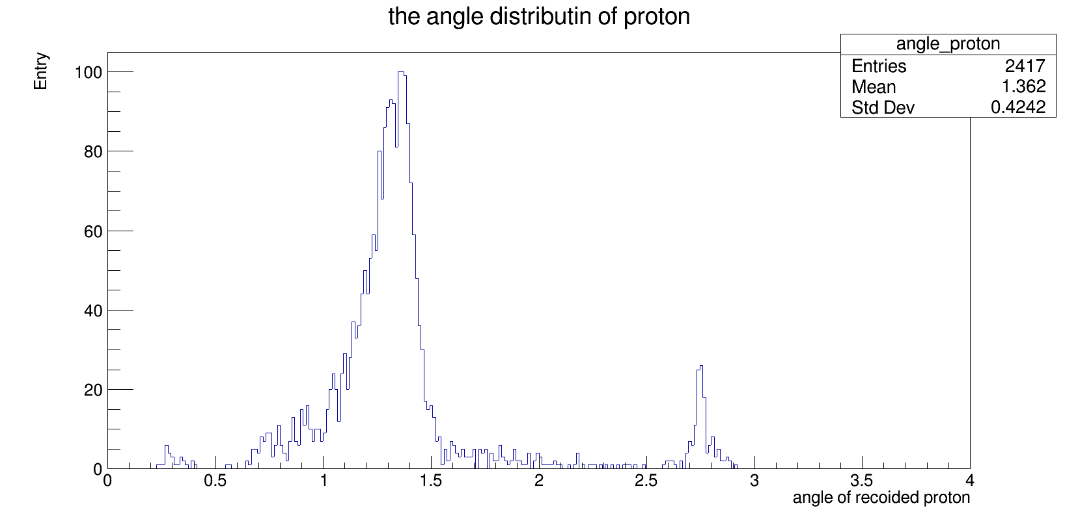
Abnormal shape of angle distribution of recoiled proton (Run = 70054)

Slide 16
End

