Slide 1
Discussion
19, September, 2019

Slide 2
Investigation of circle shape around scattering vertices

Slide 3
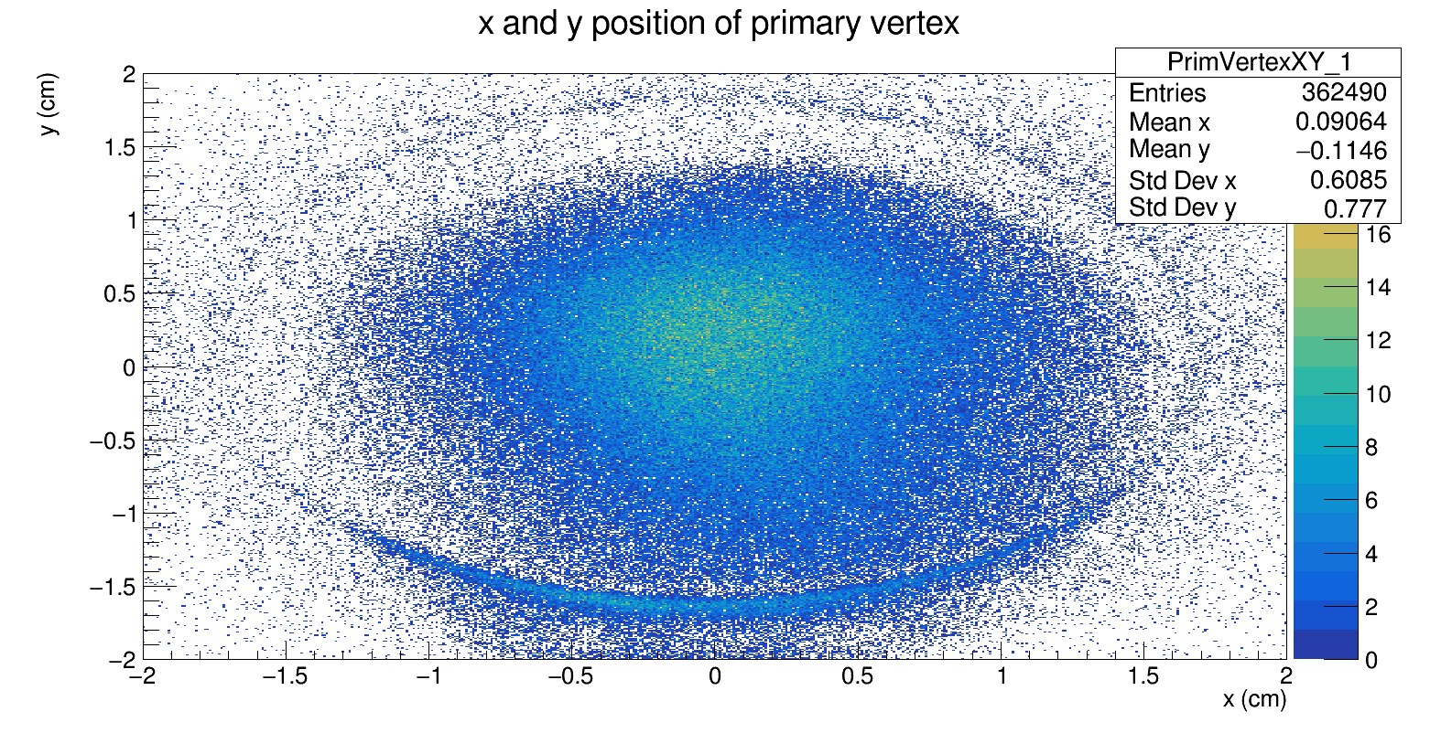
primary vertex with 1 outgoing particle
event number: 70069

Slide 4
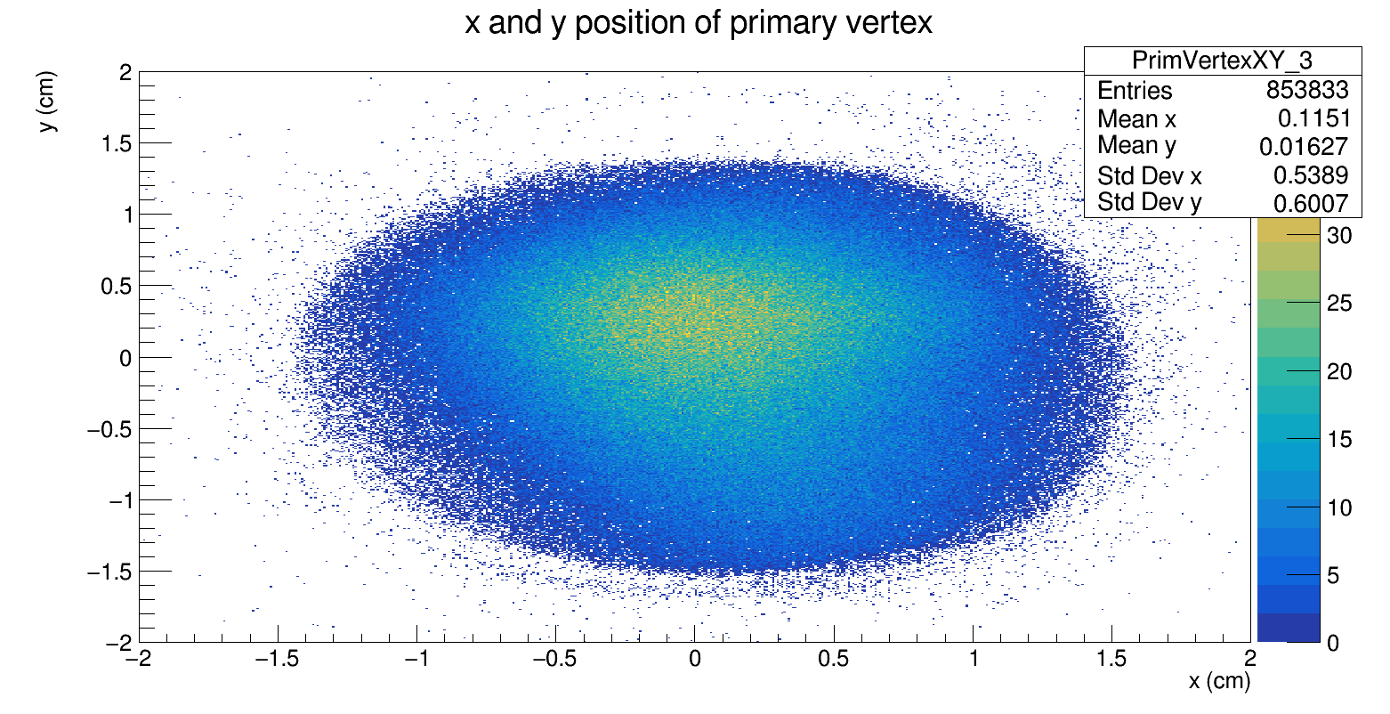
primary vertex with 3 outgoing particle
event number: 70069

Slide 5
Charged particles with no vertex connected

Slide 6
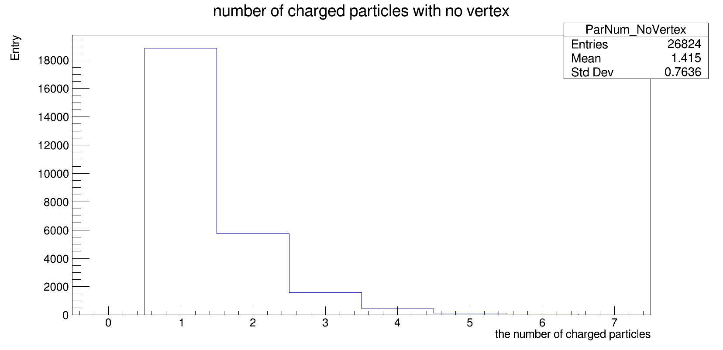
Charged particles with no vertex for one Run

Slide 7
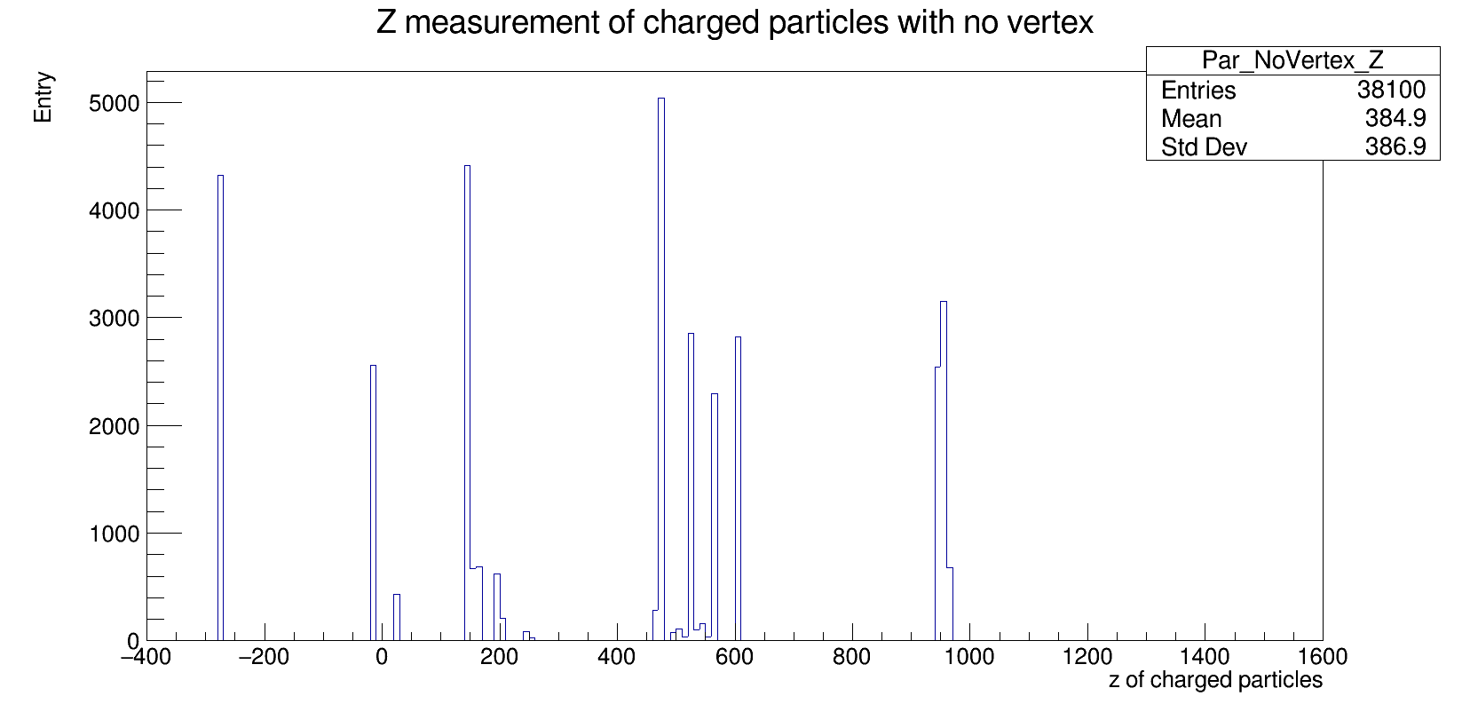
The starting point position of the particles
(cm)
target
20m

Slide 8
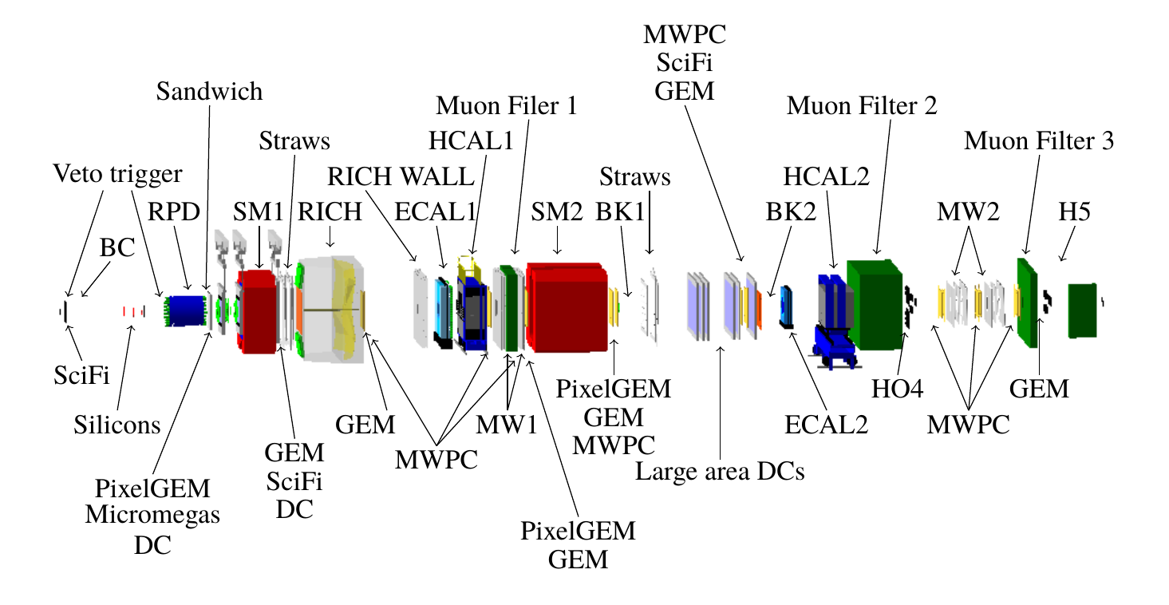
_{Layout of COMPASS detectors}
target
50m

Slide 9
Investigation of photons from different ECALs

Slide 10
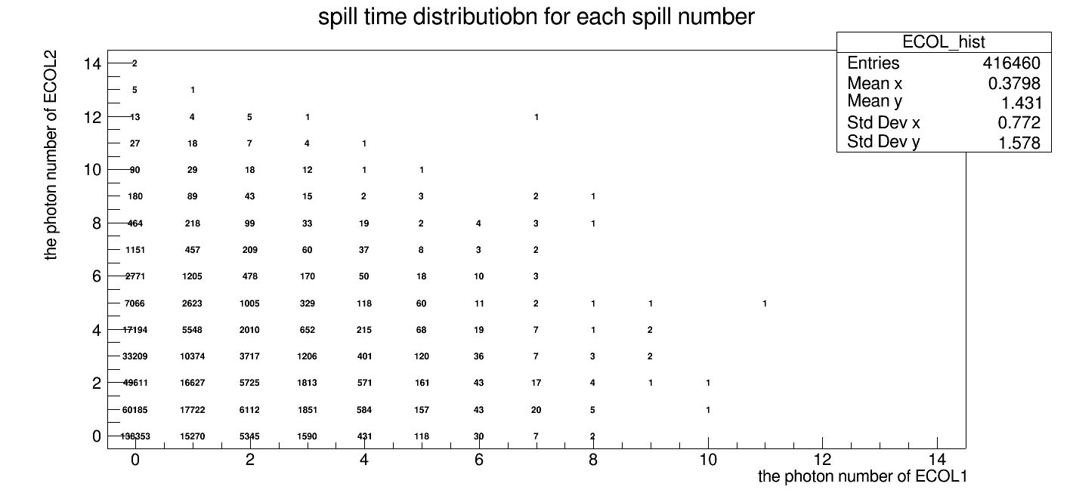
Event countings with number of photons from ECALs
ECAL2
ECAL1

Slide 11
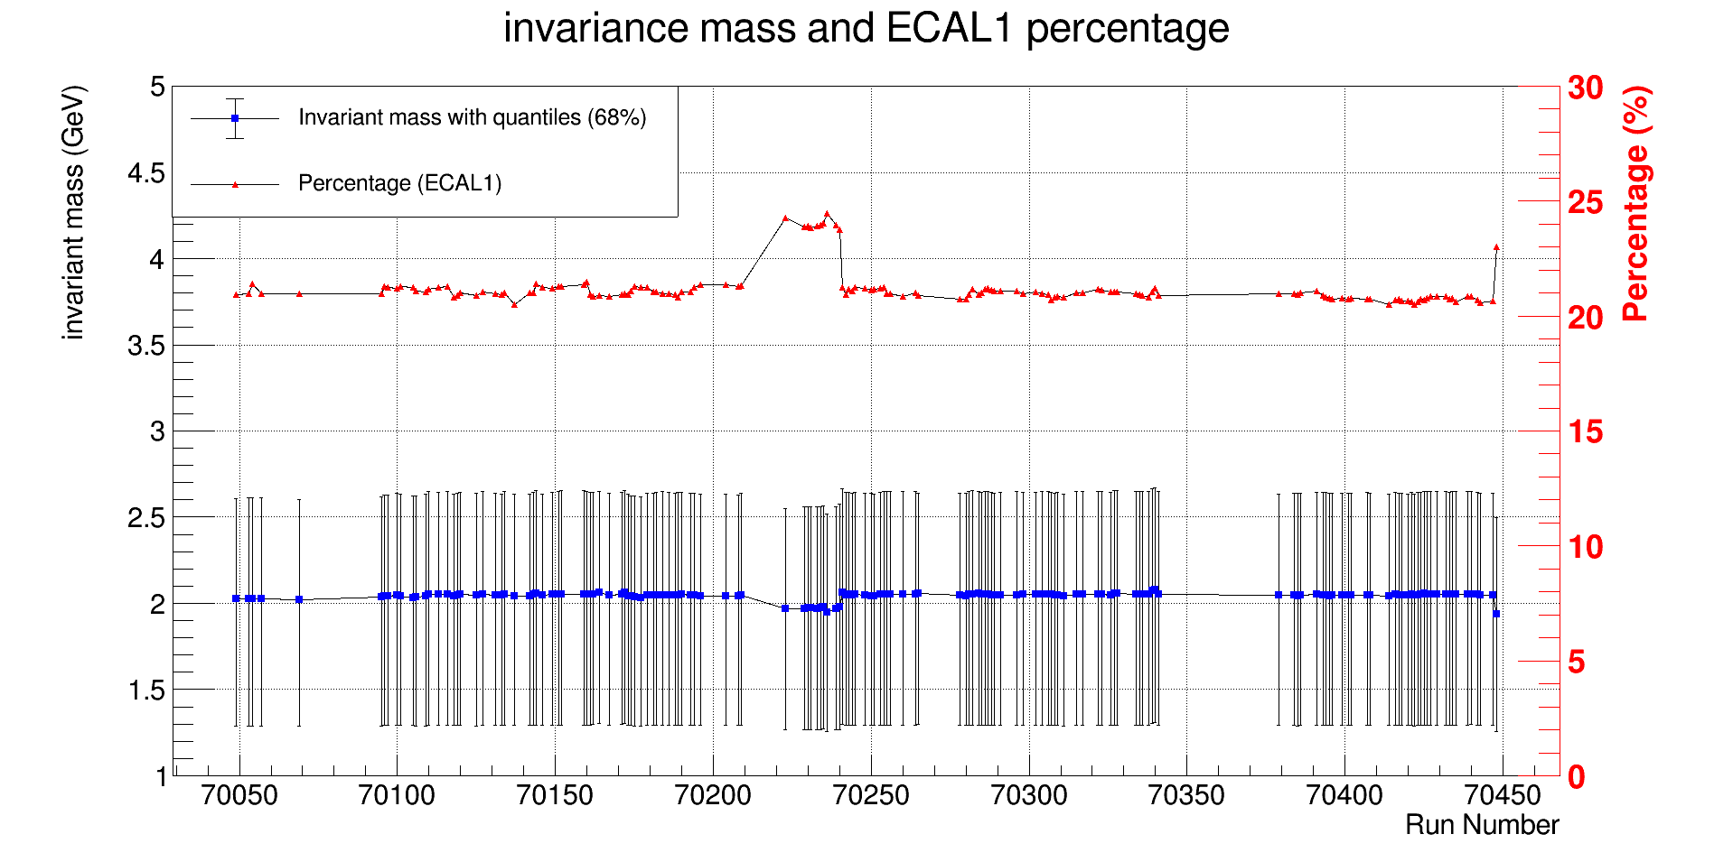
ECAL1 Photon percentage v. s. invariant mass
70223
70240

Slide 12
End

