Slide 1
Introduction to Pytorch
Abhishek Sharma
abhisheksharma@salesforce.com

Slide 2
Outline
Disclaimer
Pytorch : Overview
Machine Learning : Overview
Deep Learning : Building blocks
Pytorch : Labs
References

Slide 3
Pytorch
Deep learning framework
Keras
control
Tensorflow
Pytorch
Numpy/ matplotlib
Python

Slide 4
AI vs Machine Learning vs Deep Learning
Artificial Intelligence
Machine Learning
Deep Learning

Slide 5
Machine Learning
Algorithms that do the learning without human intervention.
Learning is done based on examples (aka dataset).
Goal:
learning function f: x ➔ y to make correct prediction for new input data
Choose function family (logistic regression, support vector machines)
Optimize parameters on training data: Minimize Loss ∑(f(x) - y)²

Slide 6
General ML approach
Training Phase:
Model
Training data
Feature Extraction
ML Algorithm

Slide 7
General ML approach
Testing Phase:
Model
(learnt during training phase)
Test data
predictions

Slide 8
Deep Learning

Slide 9
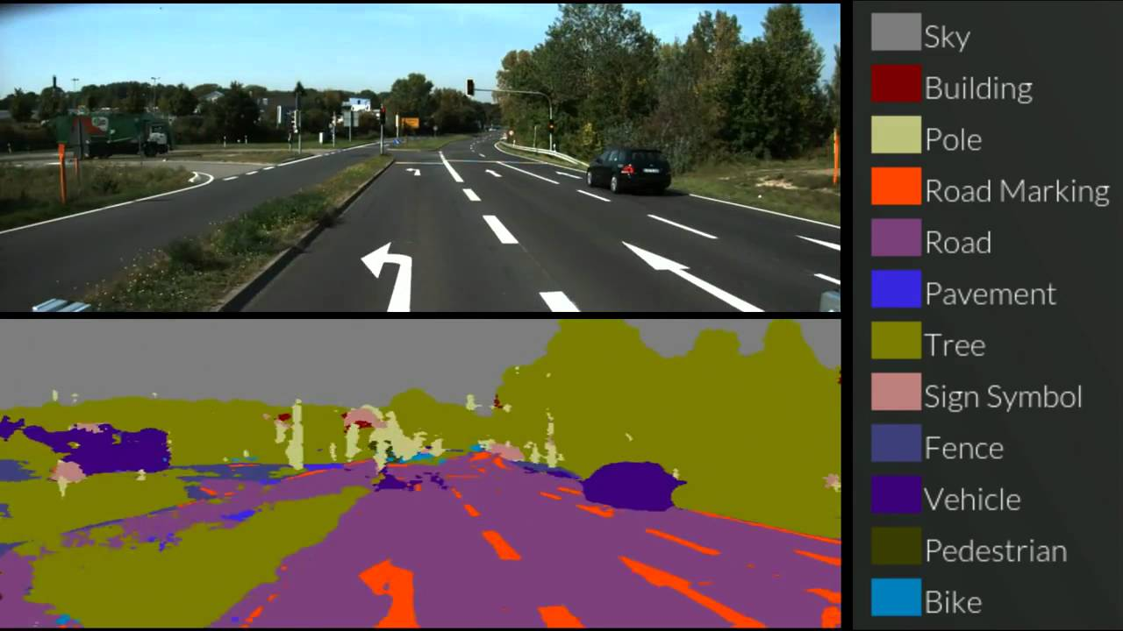
Self Driving Cars
Source: https://www.youtube.com/watch?v=kMMbW96nMW8

Slide 10
Linear Model
Matrix Formulation:
where:
y is a (n, 1) vector of predicted values.
X is the (n, m) input matrix
W is the (m, 1) weight vector – corresponds to the final coefficients of the model.
b is a constant – corresponds to the intercept of the model.

Slide 11
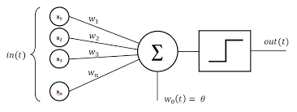
Perceptron
The Perceptron is an early Neural Network model.
Each Perceptron takes multiple inputs and outputs a binary value (0 or 1).
Uses step function to compute binary output.
Network of Connected Perceptrons make up model.
Picture: commons.wikimedia.org/Creative Commons

Slide 12
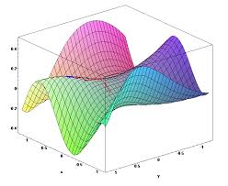
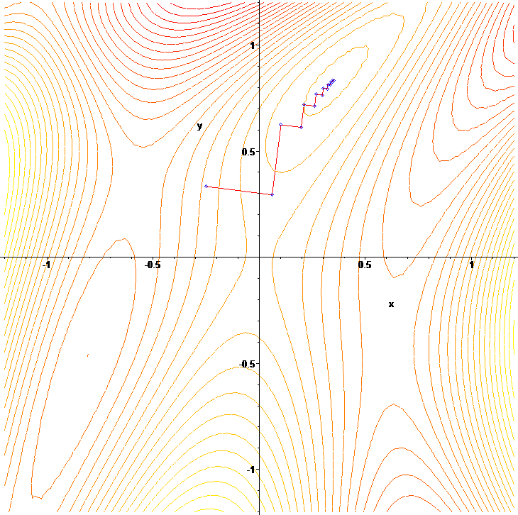
Loss Function
Visualization of Loss function for a system with 2 features.
Convex functions can be solved analytically.
Real life functions rarely convex.
Gradient Descent is a numerical optimization method to find optimal points in the space.
Guaranteed to find the global optima for convex functions.
Guaranteed to find local optima for non-convex functions.
Local optima usually “good enough” for high dimensional space.
Pictures: en.wikipedia.org/Creative Commons

Slide 13
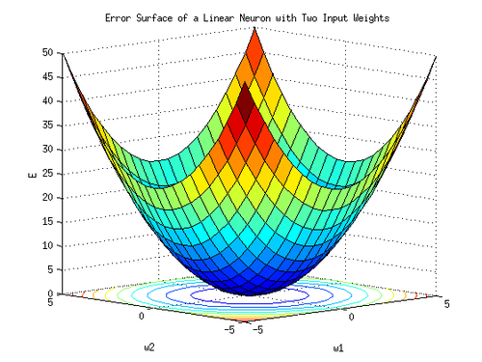


Gradient Descent
Assume locally convex Loss function.
Initialize weight vector W with random values.
Compute L(w)
Randomly change one (or some, or all values of W)
Compute new L(w) and difference.
Update W with the difference multiplied by learning rateη.
Repeat until W converges or
Picture: en.wikipedia.org/Creative Commons

Slide 14
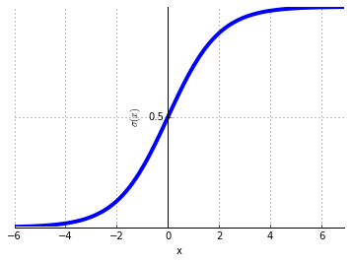

Sigmoid Neurons
Similar to Perceptron neurons, but can output a continuous value between 0 and 1.
Output is differentiable, so back-propagation is possible.
Called Activation Function in the literature.
Other Activation Functions in use now as well.

Slide 15
RELUs

Slide 16
Double Layer NN
X * W + b = Y
x
* W
+ b
= Y
x
* W1
+ b1
RELU
* W2
+ b1
= Y

Slide 17
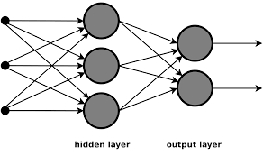

Fully Connected Networks
Inspired by biology – axons.
Every node in a layer is connected to every node in the layer following it.
Input to a layer is output of previous layer.
Weight vector shared within each layer.
Gradient of loss propagate backward to update weights in each layer.
Picture: commons.wikimedia.org/Creative Commons

Slide 18
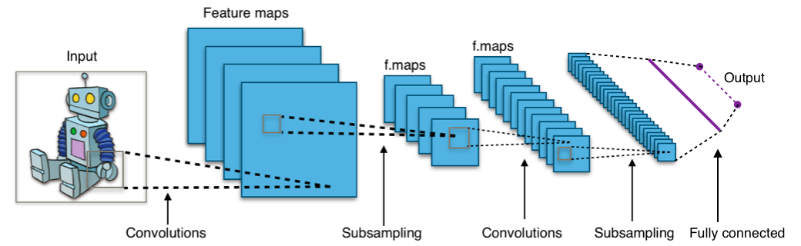
Convolutional Neural Networks
Inspired by biology – visual cortex.
Input is broken up into multiple small regions and processed by individual small networks.
Alternating sequence of convolution and pooling.
Convolution filter weights shared across image.
Picture: en.wikipedia.org/Creative Commons

Slide 19
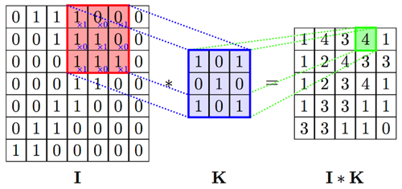
CNN (cont’d)
Convolution
source: http://online.cambridgecoding.com/notebooks/cca_admin/convolutional-neural-networks-with-keras

Slide 20

CNN (cont’d)
Pooling – max pooling over (2, 2) regions
Alternate layers of convolution and pooling result in production of “higher order features”.
FCN Layers classify higher order features into scores and classes with Softmax.

Slide 21
Numpy
https://github.com/abhi21/intro_to_ml_dl

Slide 22
Pytorch Lab
https://github.com/abhi21/pytorch-tutorial

Slide 23
Installation
./conda create --name=pytorch
source activate pytorch
./conda install numpy pyyaml setuptools cmake cffi
git clone git@github.com:pytorch/pytorch.git
cd pytorch
MACOSX_DEPLOYMENT_TARGET=10.9 CC=clang CXX=clang++ NO_DISTRIBUTED=1 python setup.py install

Slide 24
Pytorch Lab
Define the neural network that has some learnable parameters (or weights)
Iterate over a dataset of inputs
Process input through the network
Compute the loss (how far is the output from being correct)
Propagate gradients back into the network’s parameters
Update the weights of the network, typically using a simple update rule:
weight = weight - learning_rate * gradient

Slide 25
Double Layer NN
X * W + b = Y
x
* W
+ b
= Y
x
* W1
+ b1
RELU
* W2
+ b1
= Y

Slide 26
Pytorch Lab
http://pytorch.org/tutorials/beginner/transfer_learning_tutorial.html#convnet-as-fixed-feature-extractor

Slide 27
CNN Demo
http://cs.stanford.edu/people/karpathy/convnetjs/demo/cifar10.html
More resources on CNN
http://cs231n.github.io/convolutional-networks/
http://deeplearning.net/tutorial/lenet.html

Slide 28
References
http://pytorch.org/tutorials
http://www.cs.princeton.edu/courses/archive/spr08/cos511/scribe_notes/0204.pdf
https://classroom.udacity.com/courses/ud730/
http://cs231n.github.io

