Slide 1
Explainable-Christmas
Edwin Brown
Marcos Jacinto

Slide 2
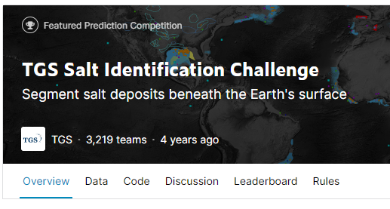
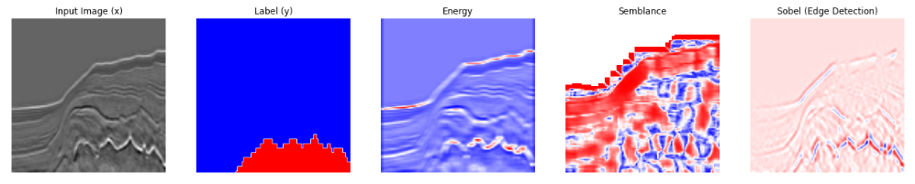
Introduction
Seismic images are used to visualise sub-surface geology.
Salt is a class of geology that is important to map. However, it is a time-consuming and requires highly skilled domain experts.
This is a classic semantic segmentation task and perfectly suited for deep learning.
However, it can be difficult to convince domain-experts to trust deep learning solutions because of their ‘black-box’ nature.
https://www.kaggle.com/c/tgs-salt-identification-challenge

Slide 3
Attribute Generation
Salt often has a different seismic character compared with other type of geological structures. ‘Attributes’ are calculated to represent different seismic characters.
By stacking the attributes as additional channels alongside the original input, SHAP values can be calculated to give an indication of which images contribute most the models prediction.

Slide 4
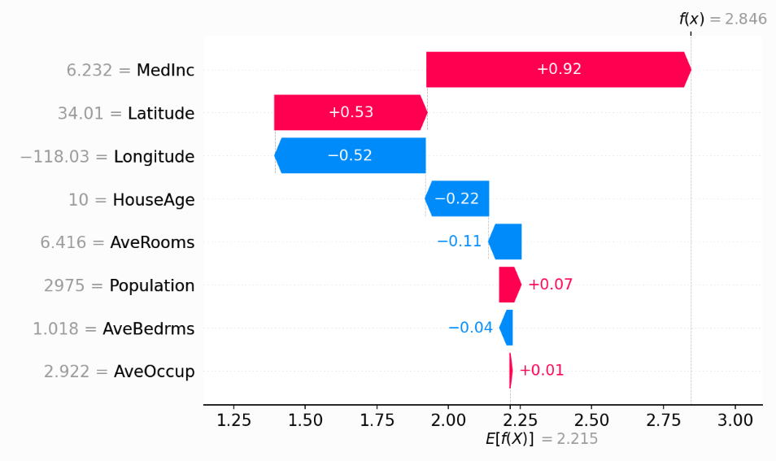
SHAP Values – Boston Housing Dataset - Example
Graph on the left is a waterfall plot of the SHAP values for each feature in the Boston Housing dataset.
All SHAP values added together equal the difference between the expected model output (E[f(x)]) and the current model output (f(x)).
From this plot, we can see that for the current prediction of 2.846, the most important feature is MedInc (Median Income), where as AveBedrms (average number of bedrooms) has very little impact on the prediction.
https://shap.readthedocs.io
House Price ($100K )

Slide 5
Results

Slide 6
Repository

Slide 7
Likes
Explainable AI is satisfying. It is important to understand why models make the predictions they do.
Data is open source and very easy to load/process.
Simple
Simple list of requirements

Slide 8
Dislikes
Computing the SHAP values isn’t optimized yet to GPUs. Very slow to generate SHAP values
No parameter tuning
No consideration of transfer learning
No in depth evaluation into segmentation performance.

Slide 9
Challenges and Further Work

Slide 10
Food for thought. .
“Deep learning also makes problem-solving much easier, because it completely automates what used to be the most crucial step in a machine learning workflow: feature engineering. “
Francois Chollet, Deep Learning with Python, 2021

Slide 11
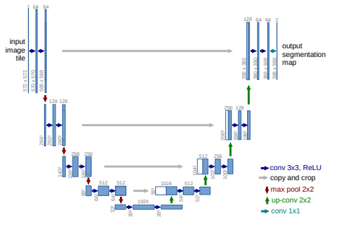
Model Summary
We used a U-Net model trained from scratch using Tensorflow's library.
During training, we used two NVIDIA GPUs from the provided cluster.
Ronnerberger et al. (2015)

Slide 12
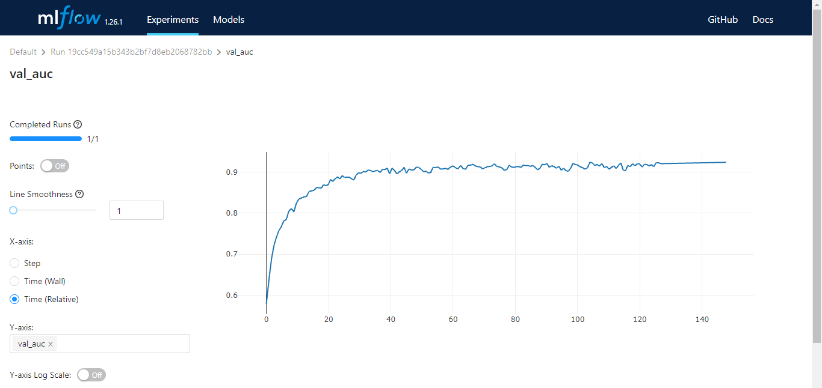
Model Training
Validation AUC: 92.4%
Validation Acc.: 88.8% Test AUC: 92.5%
Test Acc.: 87.7%

Slide 13
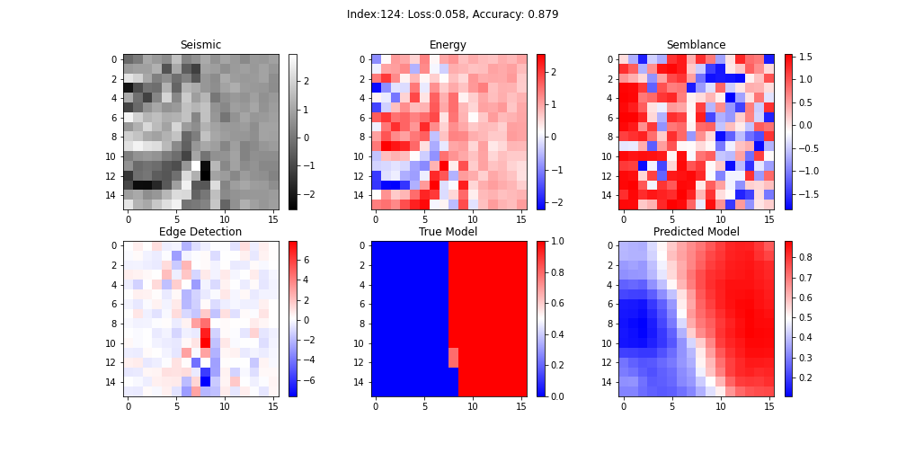
Model Evaluation
We had to reduce samples to 16x16

Slide 14
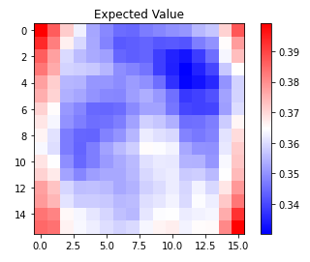
Shap Evaluation

Slide 15
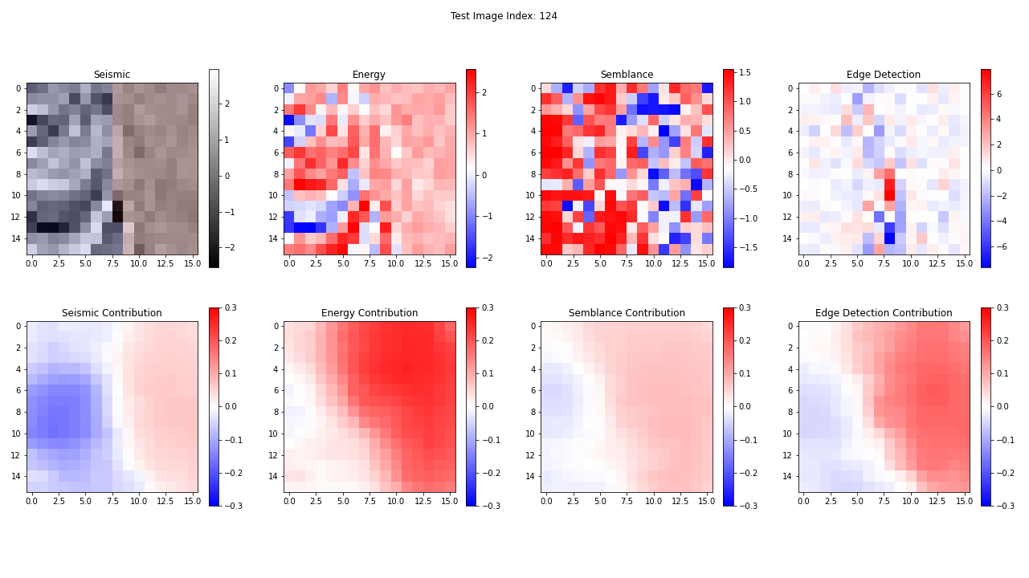
Shap Evaluation

Slide 16
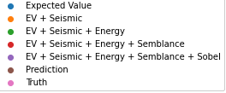
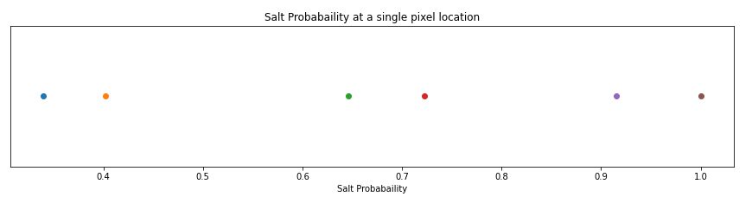
Shap Evaluation

Slide 17
Challenges

Slide 18
Conclusions & Further Work
Using SHAP to explain allowed us to:
Evaluate possible biases: all the attributes and the seismic data contribute to the predictions;
Complete data-driven approach;
Next steps:
Optimize a few parts of the code so it runs faster;
Reproducible pipeline and experiment tracking.

Slide 19
Food for thought. .
“Deep learning also makes problem-solving much easier, because it completely automates what used to be the most crucial step in a machine learning workflow: feature engineering. “
Francois Chollet, Deep Learning with Python, 2021

