Slide 1
Explainable-Christmas
Edwin Brown
Marcos Jacinto

Slide 2
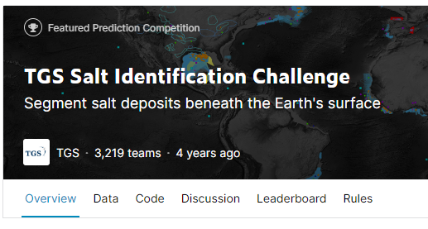
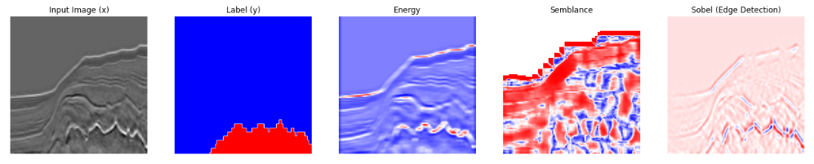
Introduction
Seismic images are used to visualise sub-surface geology.
Salt is a class of geology that is important to map. However, it is a time-consuming and requires highly skilled domain experts.
This is a classic semantic segmentation task and perfectly suited for deep learning.
However, it can be difficult to convince domain-experts to trust deep learning solutions because of their ‘black-box’ nature.
https://www.kaggle.com/c/tgs-salt-identification-challenge

Slide 3
Attribute Generation
Salt often has a different seismic character compared with other type of geological structures. ‘Attributes’ are calculated to represent different seismic characters.
By stacking the attributes as additional channels alongside the original input, SHAP values can be calculated to give an indication of which images contribute most the models prediction.

Slide 4
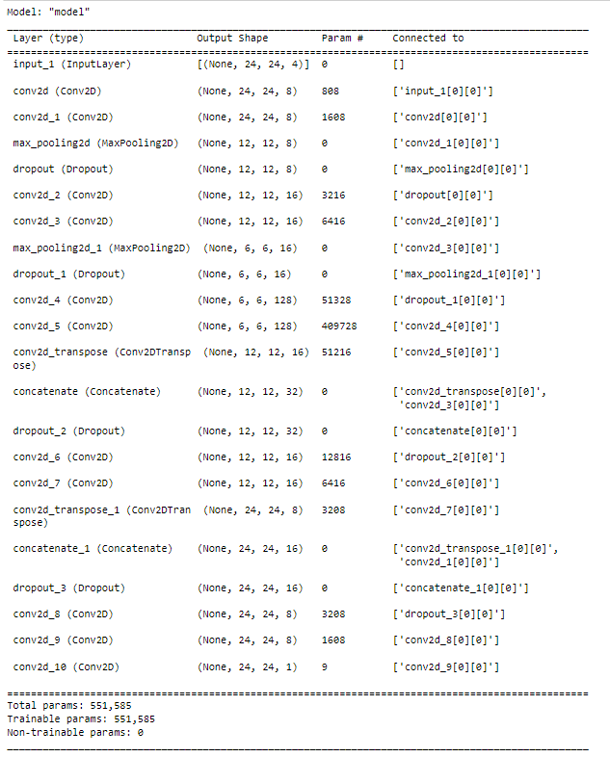
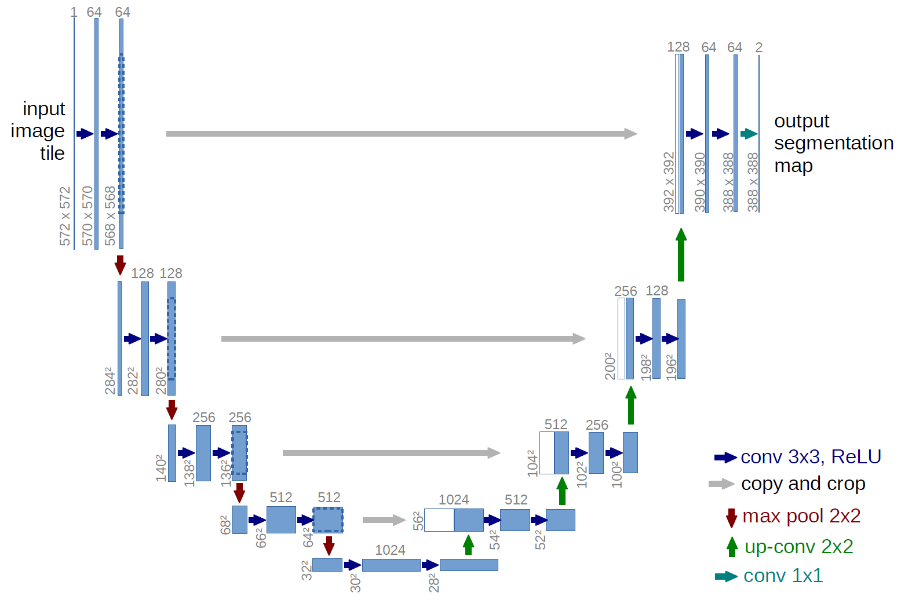
Model Architecture
U-Net Architecture
Built in Tensorflow/Keras
Ronneberger, Olaf, Philipp Fischer, and Thomas Brox. "U-net: Convolutional networks for biomedical image segmentation." International Conference on Medical image computing and computer-assisted intervention. Springer, Cham, 2015.

Slide 5
Learning Curves and Training Details

Slide 6
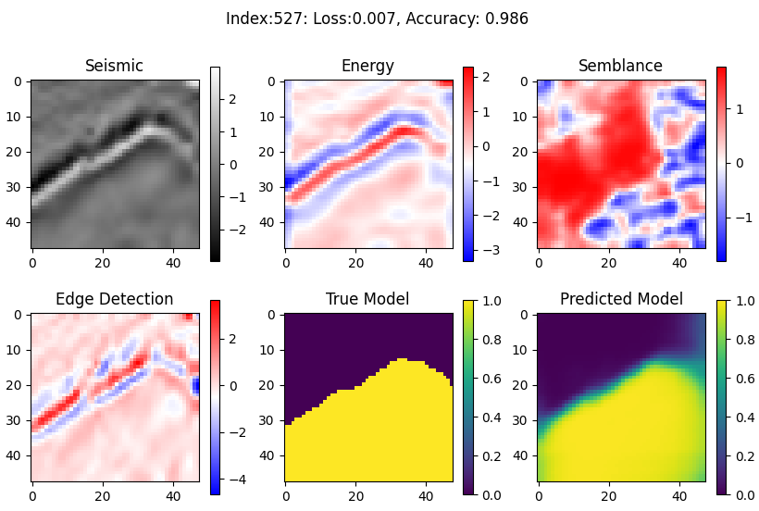
Segmentation Results

Slide 7
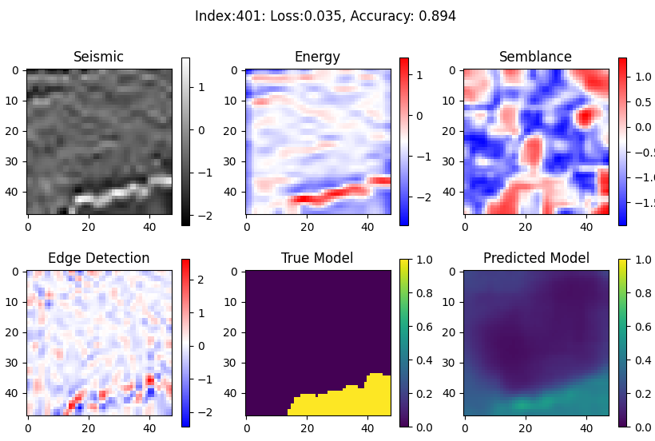
Segmentation Results

Slide 8
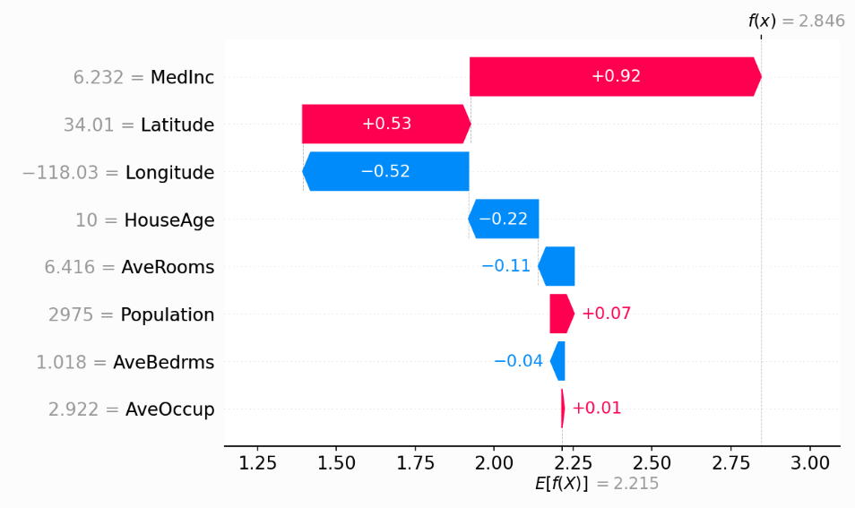
SHAP Values – Boston Housing Dataset - Example
Graph on the left is a waterfall plot of the SHAP values for each feature in the Boston Housing dataset.
All SHAP values added together equal the difference between the expected model output (E[f(x)]) and the current model output (f(x)).
From this plot, we can see that for the current prediction of 2.846, the most important feature is MedInc (Median Income), where as AveBedrms (average number of bedrooms) has very little impact on the prediction.
https://shap.readthedocs.io
House Price ($100K )

Slide 9
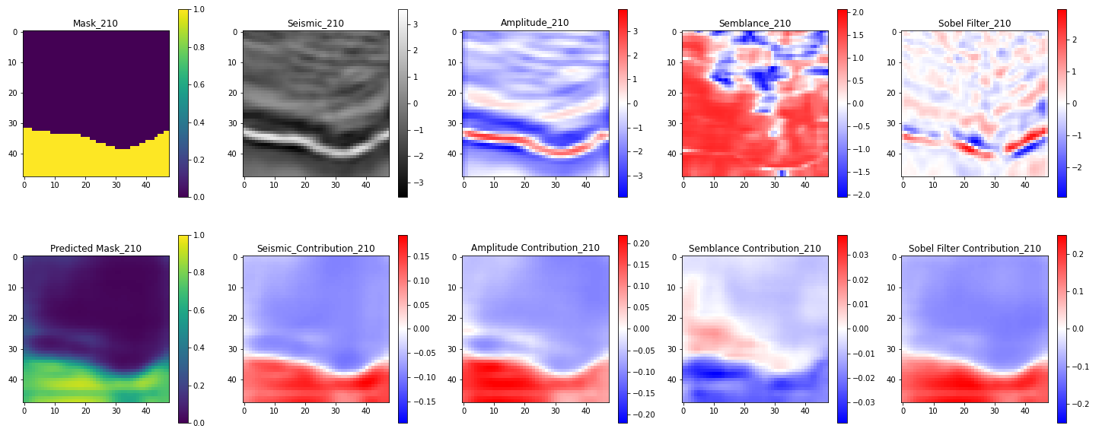
SHAP Values - Example
Feature Contributions
Semblance contribution is reducing the probability of salt in the predicted mask!

Slide 10
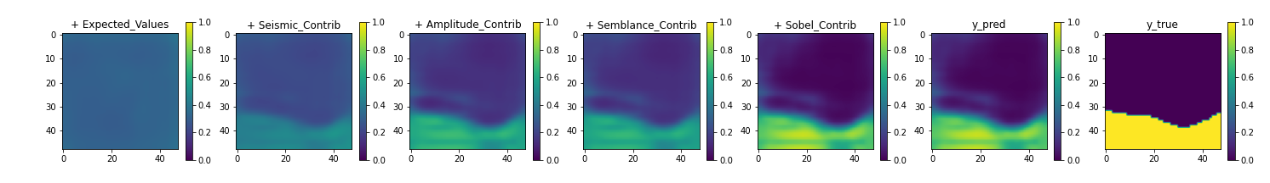
SHAP Values - Example
Sobel feature clearly contributes the most to reduce the background to 0 and increase the salt probability to 1.
Very little change from Amplitude to Semblance suggests the semblance feature is having much impact on the prediction.

Slide 11
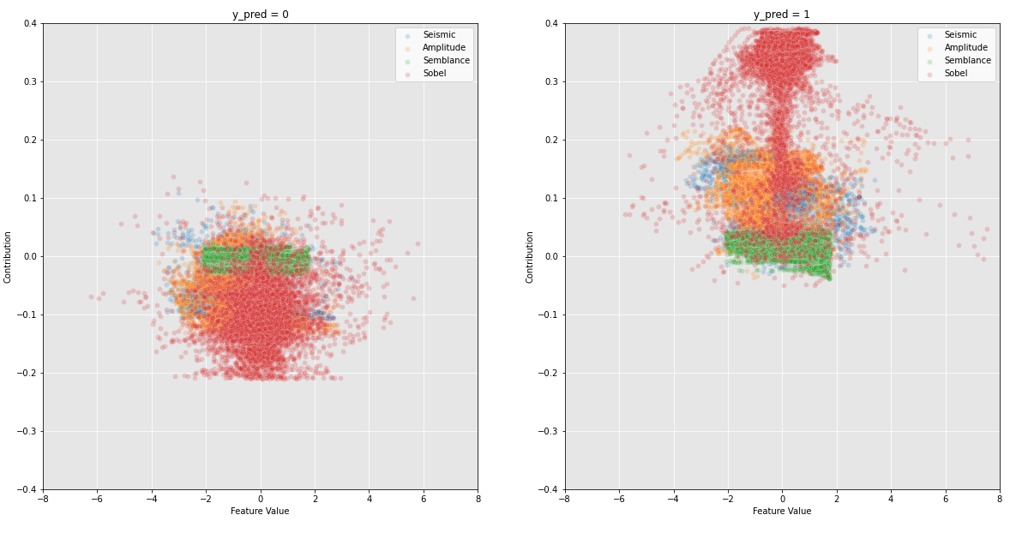
SHAP Values – Global Assessment
Feature value vs Feature Contribution. Different features are coloured. Plots are split into areas of images based on value of true mask
All features appear to have similar contributions in areas of no salt.
Note there appears to be no correlation between feature value and contribution. This is expected because spatial relationships are vital for image data. This is why CNNs are often superior to other ML models with image data.
Sobel feature clearly contributes the most to a positive salt prediction. Whereas, semblance is consistently the least contributing feature.

Slide 12
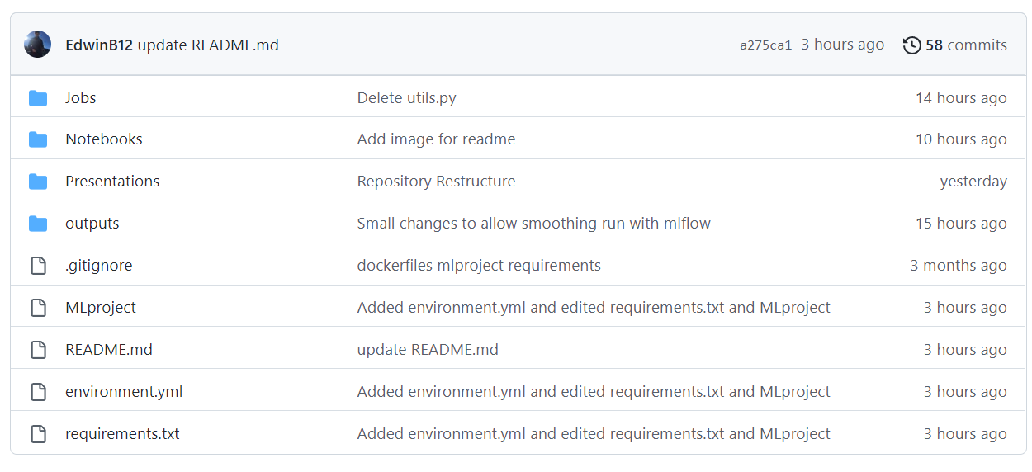
Repository

Slide 13
Positives
Clear conclusions. It can be seen that the Sobel feature is the most important, and semblance is the least important on the prediction of salt.
Explainable AI is satisfying. It is important to understand why models make the predictions they do.
Data is open source and easy to load/process.
Entire project is reproducible and although a little slow, doesn’t require specialised hardware.

Slide 14
Challenges and Further Work
Computing the SHAP values isn’t optimized yet to GPUs. Very slow to generate SHAP values
Baseline model performance could be improved with some regularisation such as augmentation.
Parameter tuning or transfer learning would likely improve performance too.
No in-depth evaluation into segmentation performance. Where does our current model struggle the most?

Slide 15
Food for thought. .
“Deep learning also makes problem-solving much easier, because it completely automates what used to be the most crucial step in a machine learning workflow: feature engineering. “
Francois Chollet, Deep Learning with Python, 2021

