Slide 1
Explainable Salt Segmentation
Edwin Brown
Marcos Jacinto
Team: Explainable Christmas

Slide 2
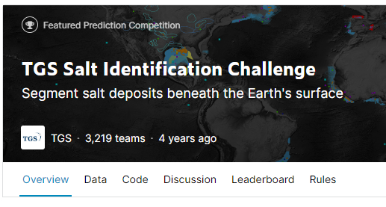
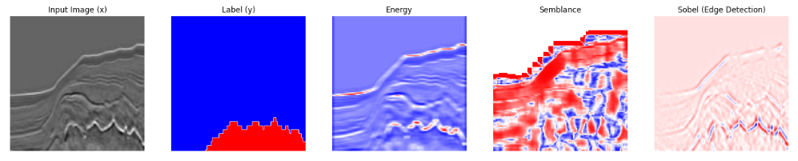
Introduction
Understand how each feature in a multi-input segmentation task contributes to the predicted mask.
https://www.kaggle.com/c/tgs-salt-identification-challenge
Seismic
Salt Mask

Slide 3
Attribute Generation
Original X and Y Pair
Generated Features
Low Wavelength Amplitude.
Red indicates areas of high spatial coherency within an image
Edge Detection Filter. Extreme values indicate a rapid contrast in values

Slide 4
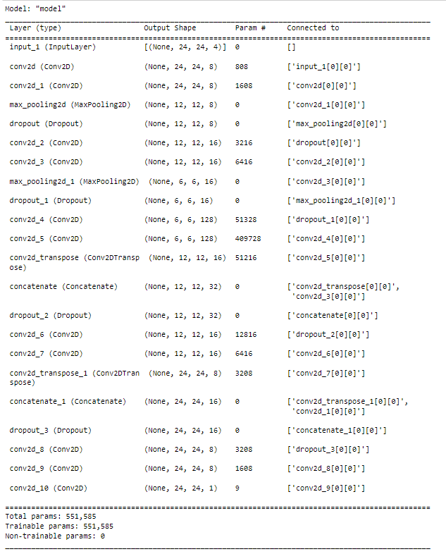
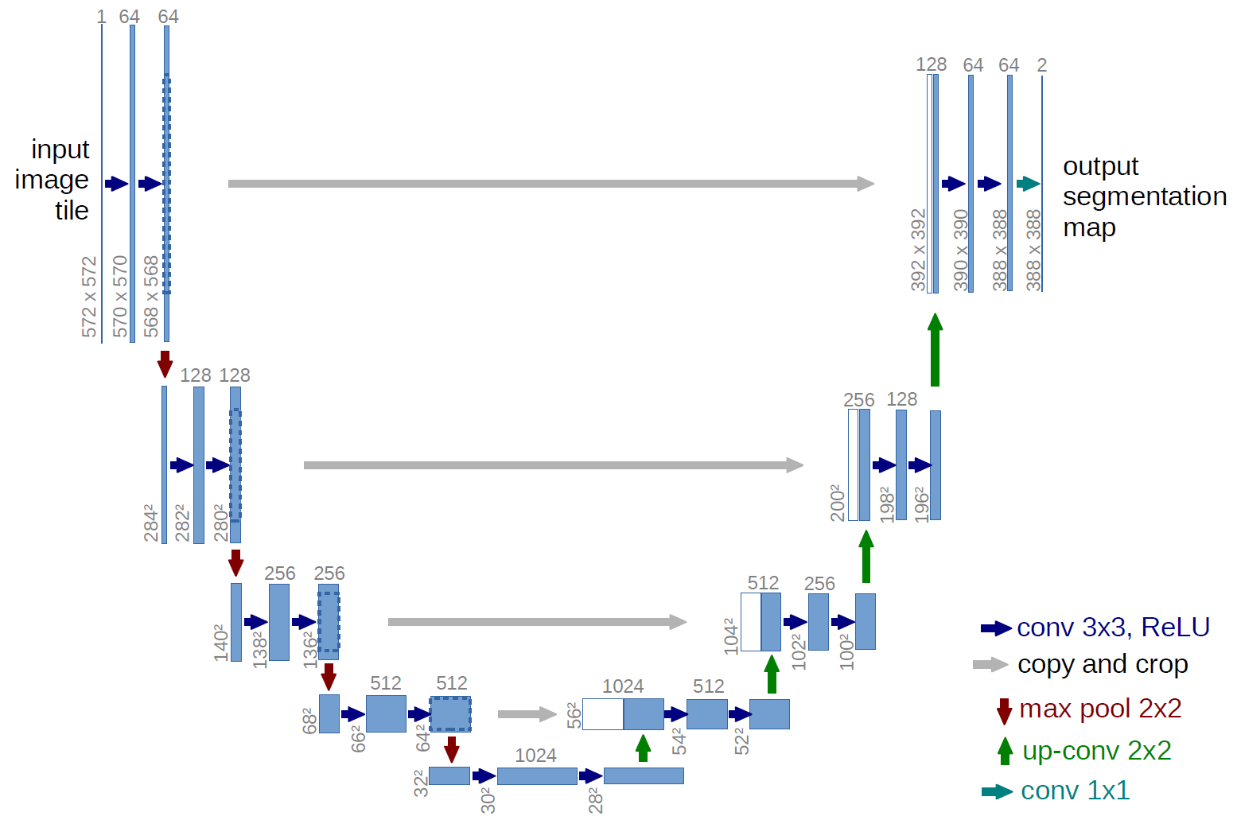
Model Architecture
U-Net Architecture
Built in Tensorflow/Keras
Ronneberger, Olaf, Philipp Fischer, and Thomas Brox. "U-net: Convolutional networks for biomedical image segmentation." International Conference on Medical image computing and computer-assisted intervention. Springer, Cham, 2015.

Slide 5
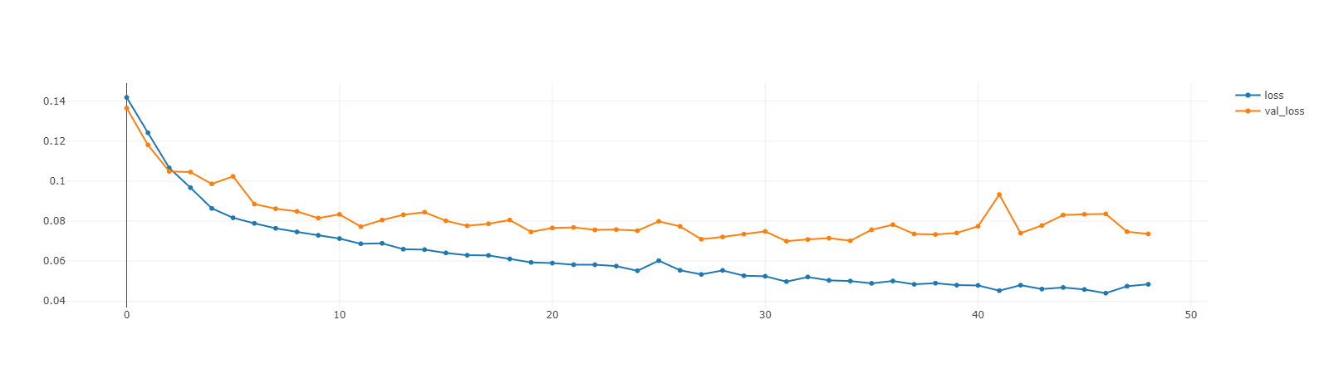
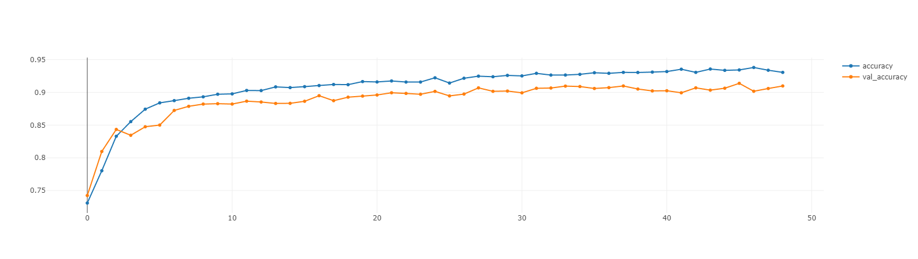
Learning Curves and Training Details
Data split into training, validation and test datasets.
Standardize input data
Scale masks to 0-1
~2500 training pairs
Batch Size – 32
Learning Rate – 0.001
Widening of gap between training and validation loss suggests overfitting

Slide 6
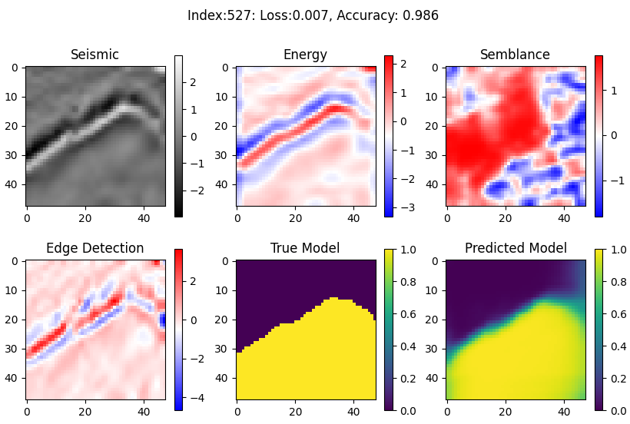
Segmentation Results

Slide 7
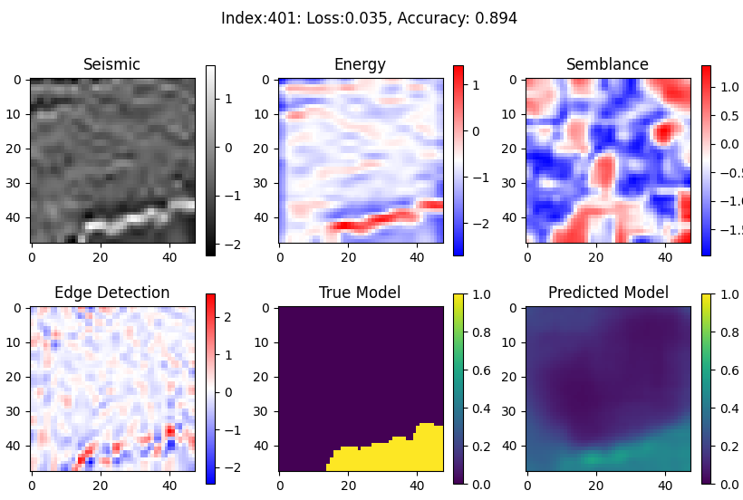
Segmentation Results

Slide 8
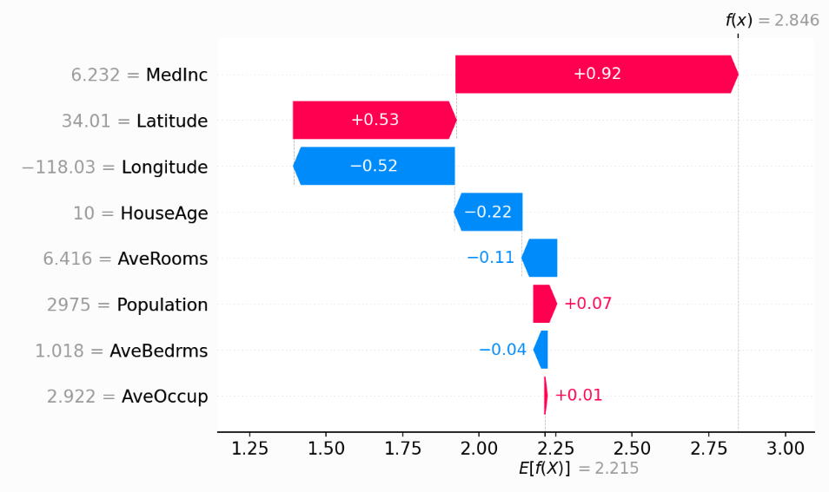
SHAP Values – Boston Housing Dataset - Example
https://shap.readthedocs.io
House Price ($100K )

Slide 9
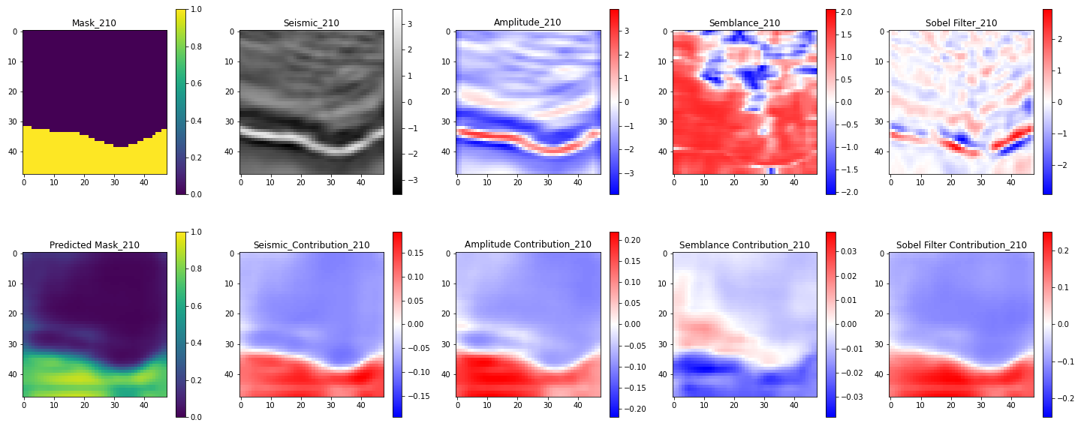
SHAP Values - Example
Feature Contributions
Semblance contribution is reducing the probability of salt in the predicted mask!

Slide 10
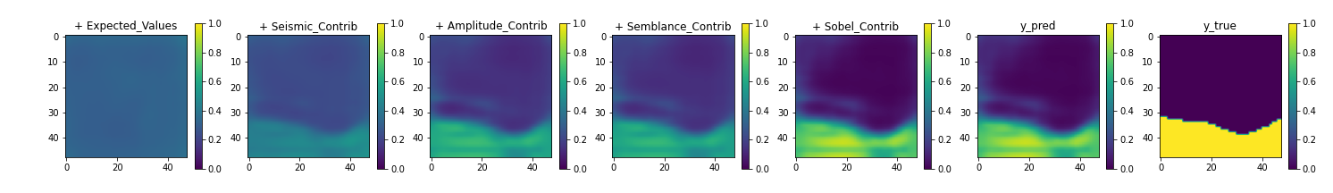
SHAP Values - Example
Sobel feature clearly contributes the most to reduce the background to 0 and increase the salt probability to 1.
Very little change from Amplitude to Semblance suggests the semblance feature is having much impact on the prediction.

Slide 11
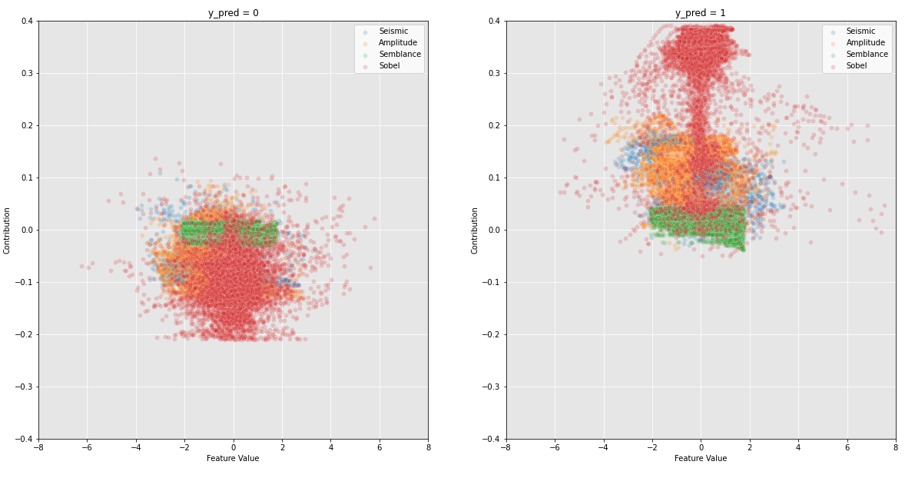
SHAP Values – Global Assessment
Feature value vs Feature Contribution. Different features are coloured.
Left Plot = No Salt, Right Plot = Salt
All features appear to have similar contributions in areas of no salt.
Note there appears to be no correlation between feature value and contribution. This is expected because spatial relationships are vital for image data. This is why CNNs are often superior to other ML models with image data.
Sobel feature clearly contributes the most to a positive salt prediction. Whereas, semblance is consistently the least contributing feature.

Slide 12
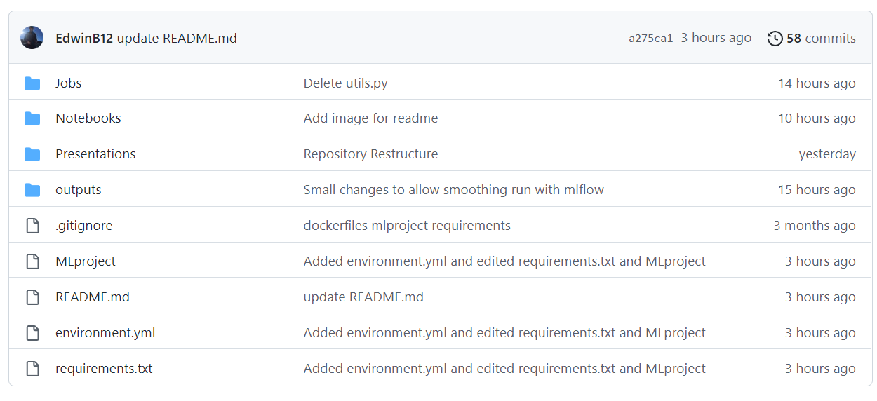
Repository

Slide 13
Positives
Clear conclusions. It can be seen that the Sobel feature is the most important, and semblance is the least important on the prediction of salt.
Explainable AI is satisfying. It is important to understand why models make the predictions they do.
Data is open source and the code is easy to run/edit.
Entire project is reproducible and although a little slow, doesn’t require specialised hardware.
Repository provides experiment tracking via MLFlow

Slide 14
Challenges and Further Work
Computing the SHAP values isn’t optimized yet to GPUs. Very slow to generate SHAP values
Baseline model performance could be improved with some regularisation such as augmentation.
Parameter tuning or transfer learning would likely improve performance too.
No in-depth evaluation into segmentation performance. Where does our current model struggle the most?
A refactor is probably required. Module names like ‘process data.py’ are not very helpful.

Slide 15
Food for thought. .
“Deep learning also makes problem-solving much easier, because it completely automates what used to be the most crucial step in a machine learning workflow: feature engineering. “
Francois Chollet, Deep Learning with Python, 2021

