Slide 1
Running Data Analysis
Analysis of running data recorded by watch, 03/12/2017 – 30/07/2019

Slide 2
Contents
Introduction
First Impressions
5k Data
10k Data
Other
Conclusion

Slide 3
Contents
Introduction
5k Data
10k Data
Other
Conclusion

Slide 4
Introduction

Slide 5
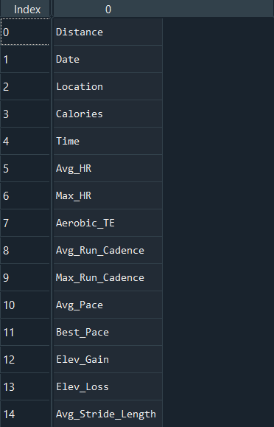
First Impressions
Attributes
260 Data Points
15 different data attributes
11 (maybe 12) different locations
Minimum Distance: 0.52km
Max Distance: 13.82km :O
Dates: 03/12/2017 – 30/07/2019

Slide 6
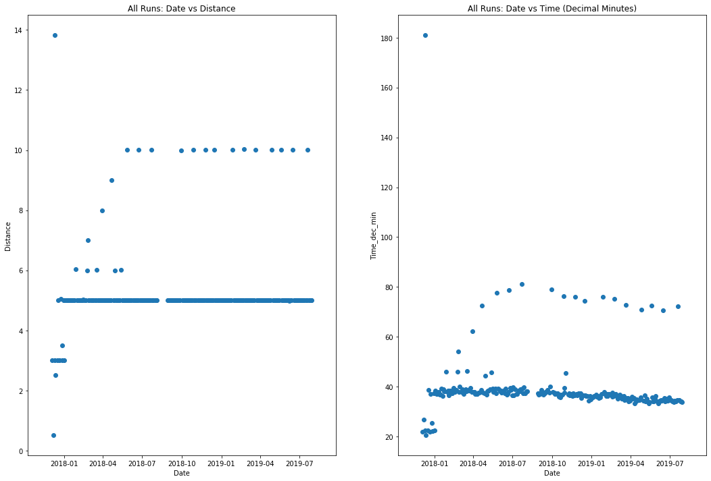

Slide 7
Set of 10k Runs
Set of 5k Runs

Slide 8
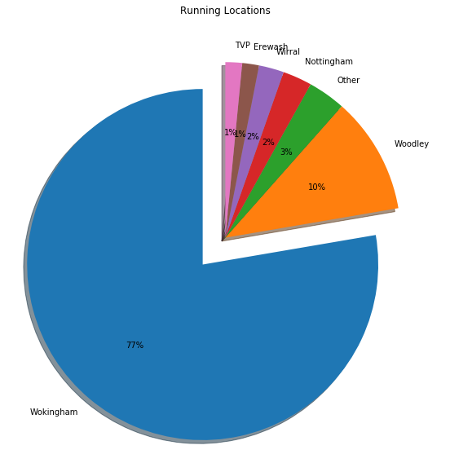
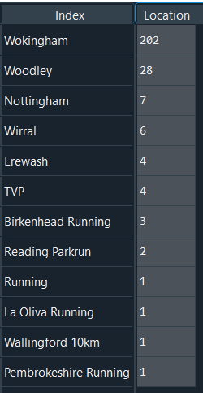
‘Other’

Slide 9
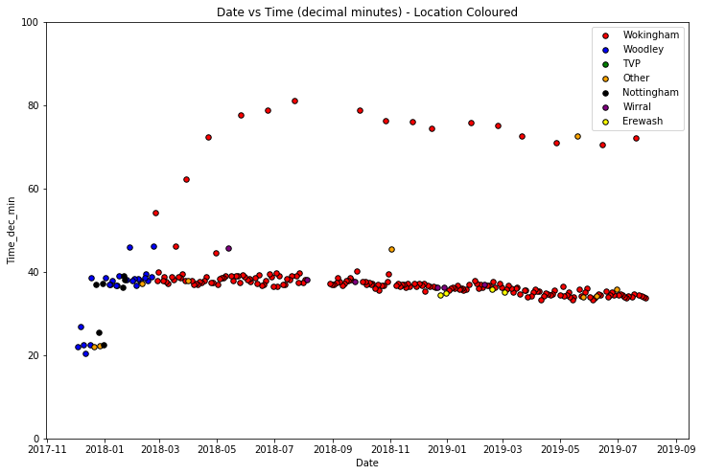

Slide 10
Axis limited to 100 minutes to avoid 180min outlier.
Periodic 10k runs
Approx. 1 month gap
Woodley runs are all before approx. March 2018.

Slide 11
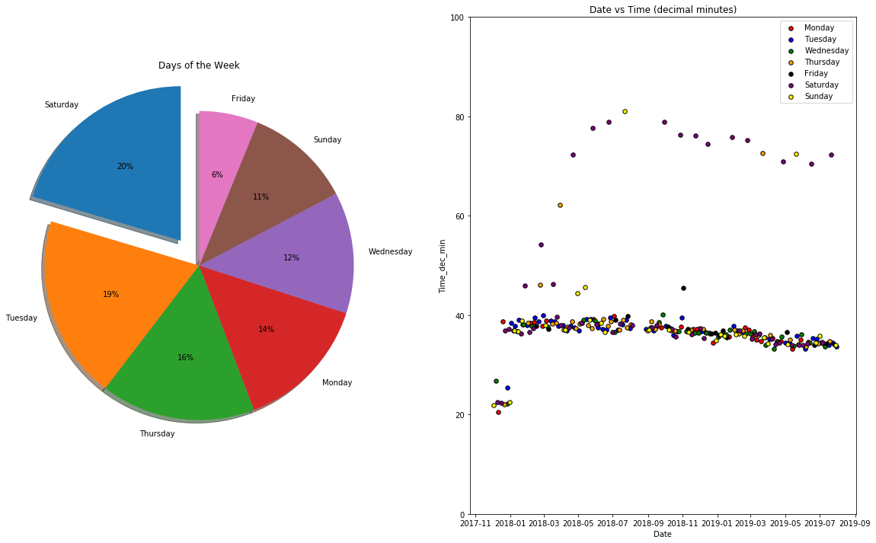

Slide 12
Fridays are a quiet day for running.
Axis limited to 100 minutes to avoid 180min outlier.
10k runs are dominated by Saturdays.
No clear trends across the 5k runs.

Slide 13
Contents
Introduction
5k Data
10k Data
Other
Conclusion

Slide 14
5K data
From the 260 data points recorded, 227 were recorded between the distances of 4.9 and 5.1km.
These datapoints will be referred to as 5km runs.
Next slides show some further analysis into the 5k runs.

Slide 15
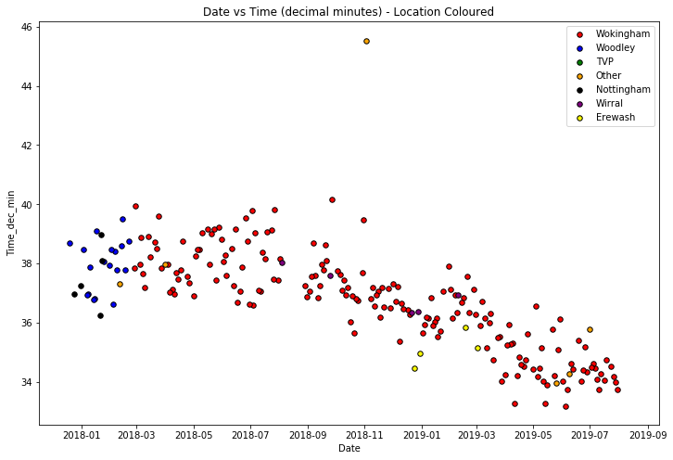

Slide 16
This was run at La Oliva, Fuerteventura!?!?
Lovely downward trend!
Erewash potentially a fast route?

