Slide 1
Running Data Analysis
Analysis of running data recorded by watch, 03/12/2017 – 30/07/2019

Slide 2
Contents
Introduction
First Impressions
5k Data
10k Data
Other
Conclusion

Slide 3
Contents
Introduction
5k Data
10k Data
Other
Conclusion

Slide 4
Introduction

Slide 5
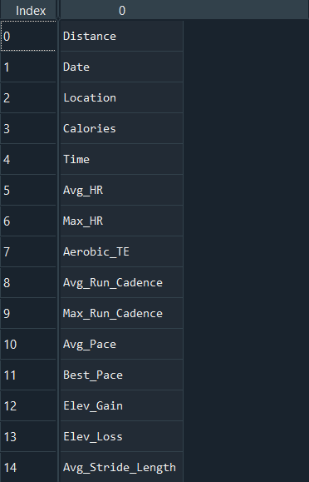
First Impressions
Attributes
260 Data Points
15 different data attributes
11 (maybe 12) different locations
Minimum Distance: 0.52km
Max Distance: 13.82km
Dates: 03/12/2017 – 30/07/2019

Slide 6
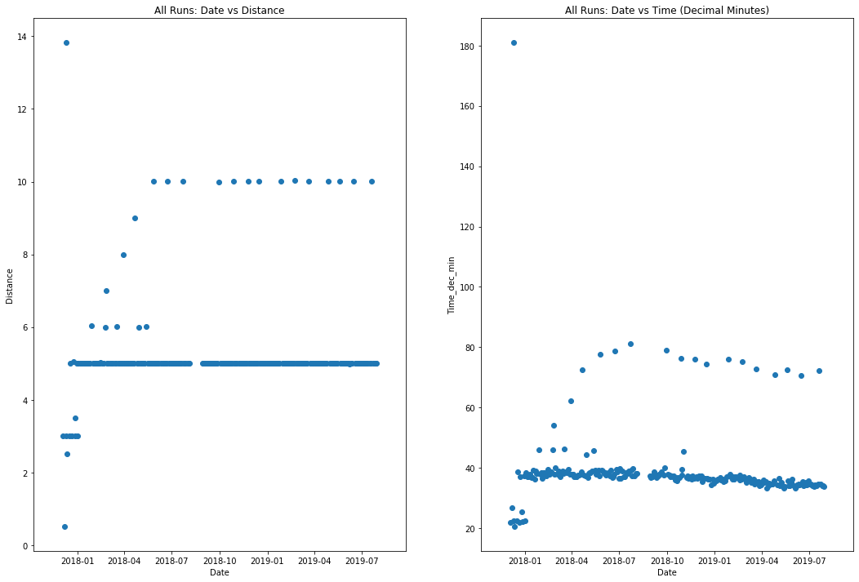

Slide 7
Set of 10k Runs
Set of 5k Runs

Slide 8
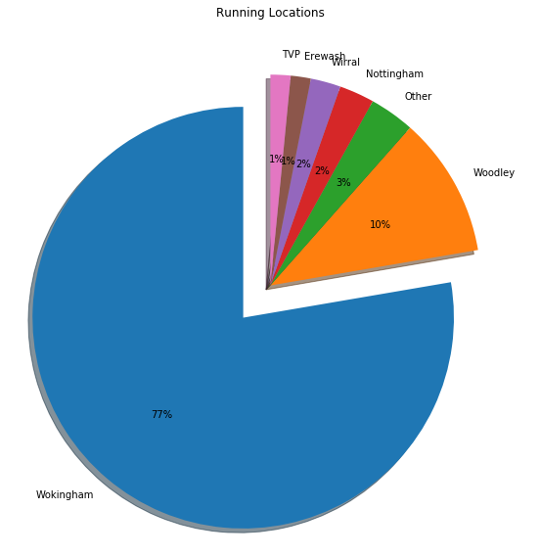
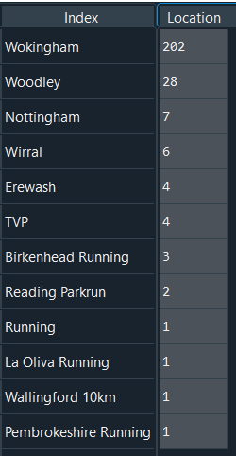
‘Other’

Slide 9
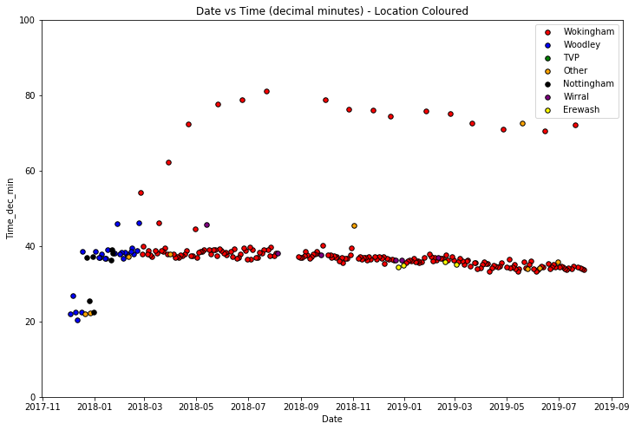

Slide 10
Axis limited to 100 minutes to avoid 180min outlier.
Periodic 10k runs
Approx. 1 month gap
Woodley runs are all before approx. March 2018.

Slide 11
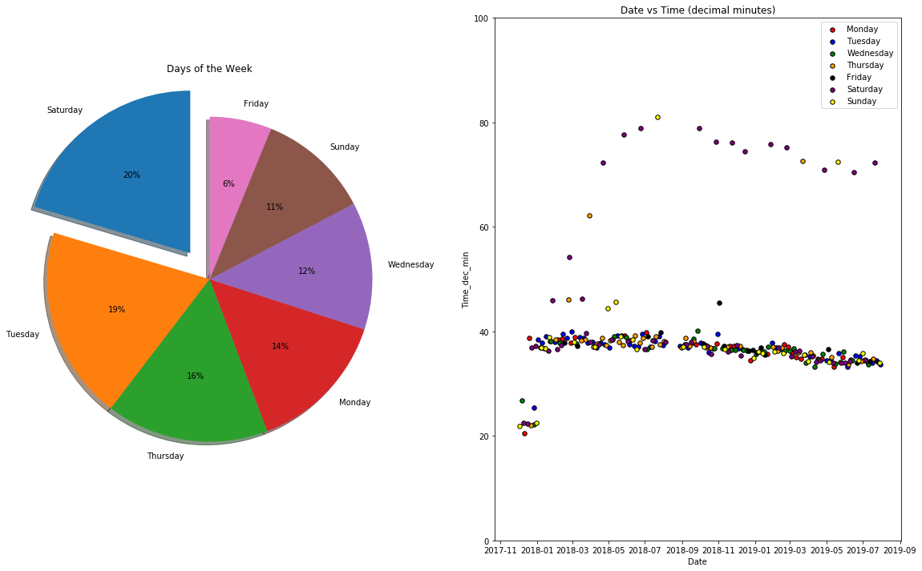

Slide 12
Fridays are a quiet day for running.
Axis limited to 100 minutes to avoid 180min outlier.
10k runs are dominated by Saturdays.
No clear trends across the 5k runs.

Slide 13
Contents
Introduction
5k Data
10k Data
Other
Conclusion

Slide 14
5K data
From the 260 data points recorded, 227 were recorded between the distances of 4.9 and 5.1km.
These datapoints will be referred to as 5km runs.
Next slides show some further analysis into the 5k runs.

Slide 15
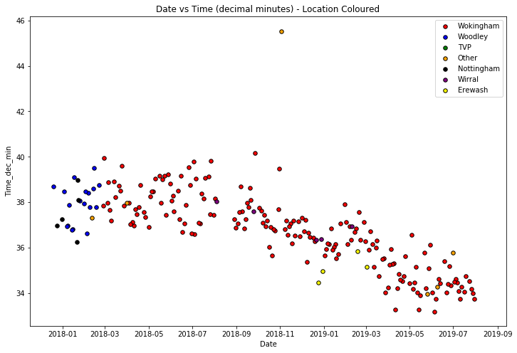

Slide 16
This was run at La Oliva, Fuerteventura!?!?
Lovely negative trend!
Erewash potentially a fast route?

Slide 17
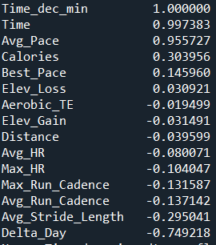
So how do other features relate to Time?
Features
R Value
R value is the ‘standard correlation coefficient’.
Statistical measure of the strength of the linear relationship between two variables.
1 is a perfect positive correlation, -1 is a perfect negative correlation, 0 is no correlation.
The next slides cross plot selected features (red arrows) with Time (decimal minutes).
However, ‘Delta Day’ has by far the strongest negative relationship. ‘Delta Day’ is the number of days since the first day in the dataset (in this case, 03/12/2017)

Slide 18
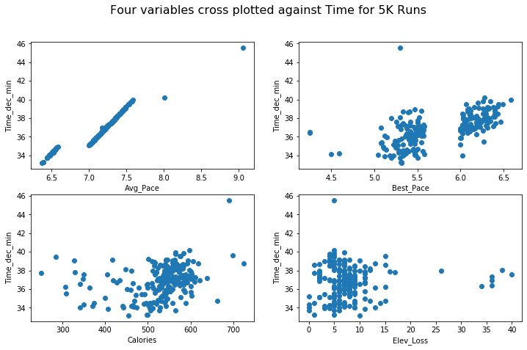
R = 0.96
R = 0.15
R = 0.3
R = 0.03

Slide 19
Strong positive relationship between average pace and time as is expected.
Much weaker correlation than average pace. This would probably be expected. Curious gap in the data between 5.6 and 6mins/km.
R = 0.96
R = 0.15
R = 0.3
Calories burnt are clustered around 500-600. An R value of 0.3 implies a much stronger relationship than is immediately visible by human eye.
No correlation visible here. Although this is almost certainly due to the limited range of the elevation. We would definitely expect a correlation between elevation and time with a more varied dataset.
R = 0.03
As companies don’t typically release their algorithms for calculating calories, this would be an interesting feature to explore further.

Slide 20
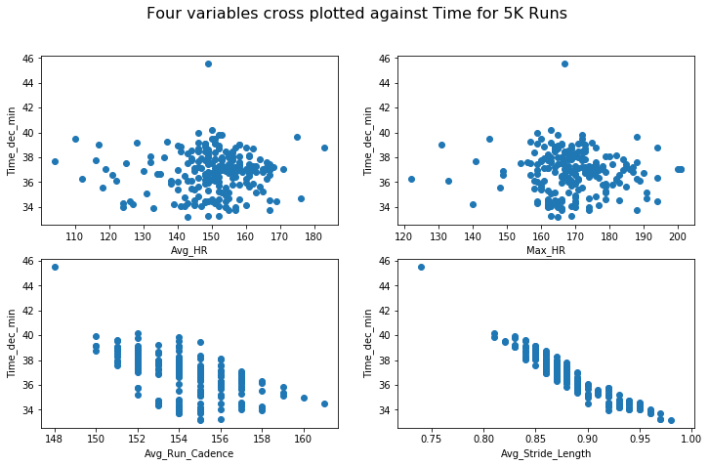
R = -0.08
R = -0.1
R = -0.13
R = -0.3

Slide 21
HR measurements show little correlation to time. The average HR is clustered 145-160 and max HR 160-180 bpm. Does a lack of correlation make sense here? Probably need to ask a health scientist. .
R = -0.08
R = -0.1
Gaps are due to the squashed axis and integer values.
R = -0.13
R = -0.3

Slide 22
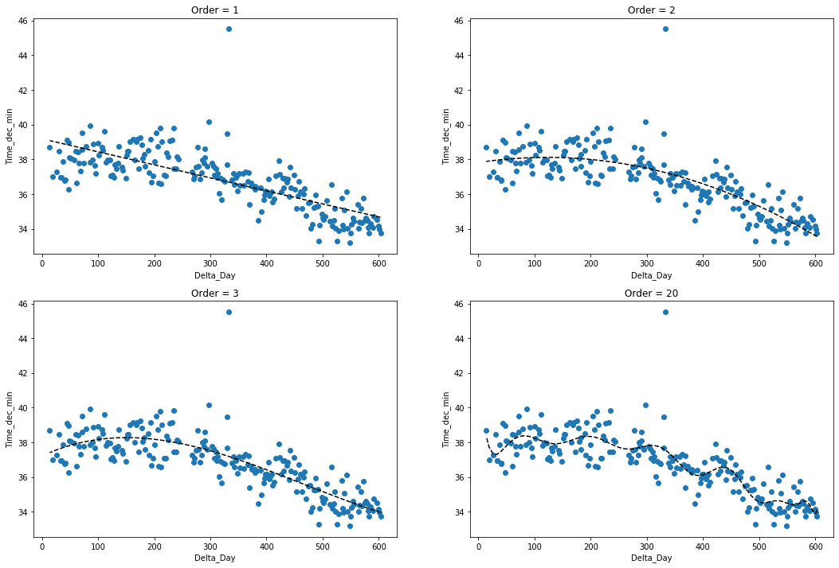

Slide 23
Linear and quadratic fits the data quite well but are they suitable for predicting future times?
Both quadratic and cubic trendlines have negative gradients before ~150 days. Is this sensible?
The best fit line is hopelessly overfit to the natural variance In the dataset.

Slide 24
Some other interesting stats. . .
Difference between slowest and quickest 5k run: 12 minutes and 2 seconds
Difference between slowest and quickest 5k run (discard La Oliva): 6 minutes and 59 seconds
Difference between earliest and latest date: 4 minutes and 57 seconds
Time improvement at Wokingham is: 6 minutes and 59 seconds
5k PB is: 33 minutes and 11 seconds

Slide 25
10K data
From the 260 data points recorded, 15 were recorded between the distances of 9.9 and 10.1km.
These datapoints will be referred to as 10km runs.
Next slides show some further analysis into the 10k runs.

