Slide 1
Running Data Analysis
Analysis of running data recorded by watch, 03/12/2017 – 30/07/2019

Slide 2
Contents
Introduction
First Impressions
5k Data
10k Data
Conclusion

Slide 3
Introduction
This presentation analyses a small running dataset where the data was collected on a fitness watch. The two main aims of this project are:
Practice of data handling on real, messy data
Assess whether this dataset is suitable for a machine learning project
Multiple plots are shown to broadly summarise the data before assessing specific relationships multiple features and the time taken to complete a run.
This has been done for practice/general fun.

Slide 4
Contents
Introduction
First Impressions
5k Data
10k Data
Conclusion

Slide 5
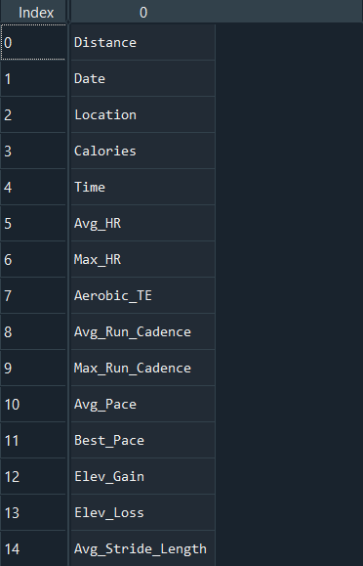
First Impressions
Attributes
260 Data Points
15 different data attributes
11 (maybe 12) different locations
Minimum Distance: 0.52km
Max Distance: 13.82km
Dates: 03/12/2017 – 30/07/2019
Note: A feature often seen on the y axis of plots is ‘Time_dec_min’. This is short hand for decimal minutes. Time was recorded in an awkward format so was converted to decimal minutes, e.g. 2:30 minutes would be 2.5 minutes. This is a little confusing but as we are generally looking at things on a scale of multiple minutes, it should not be a problem.

Slide 6
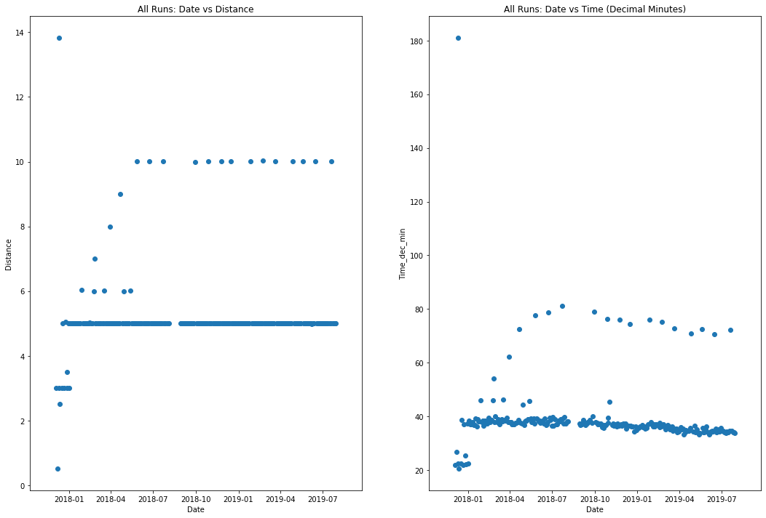

Slide 7
Set of 10k Runs
Set of 5k Runs

Slide 8
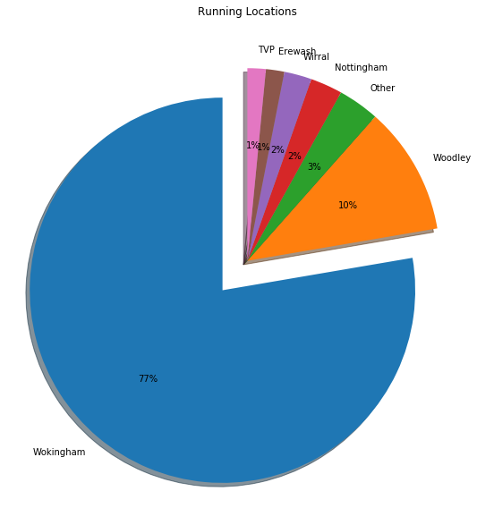
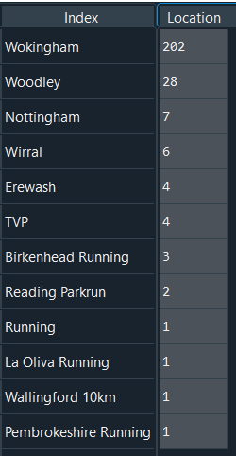
‘Other’

Slide 9
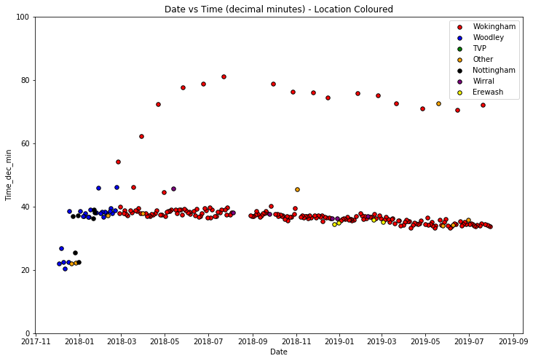

Slide 10
Axis limited to 100 minutes to avoid 180min outlier.
Periodic 10k runs
Approx. 1 month gap
Woodley runs are all before approx. March 2018.

Slide 11
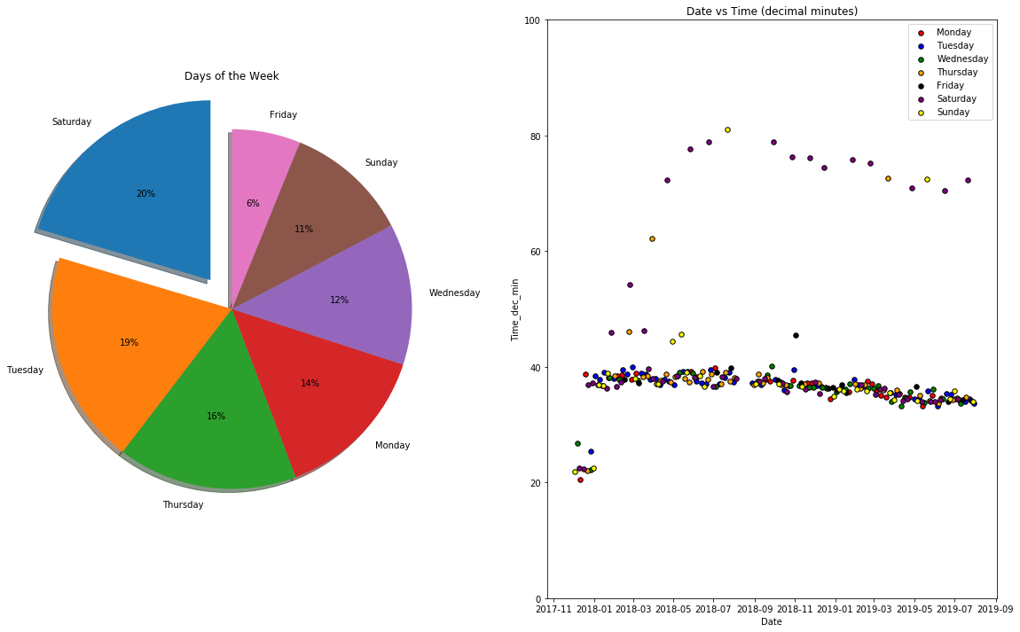

Slide 12
Fridays are a quiet day for running.
Axis limited to 100 minutes to avoid 180min outlier.
10k runs are dominated by Saturdays.
No clear trends across the 5k runs.

Slide 13
Contents
Introduction
First Impressions
5k Data
10k Data
Conclusion

Slide 14
5K data
From the 260 data points recorded, 227 were recorded between the distances of 4.9 and 5.1km.
These datapoints will be referred to as 5km runs.
Next slides show some further analysis into the 5k runs.

Slide 15
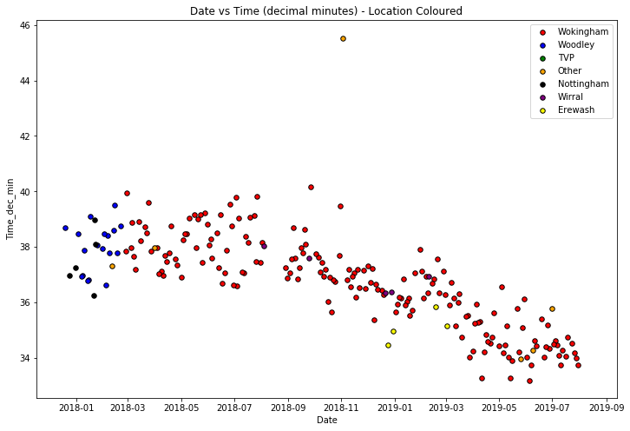

Slide 16
This was run at La Oliva, Fuerteventura!?!?
Lovely negative trend!
Erewash potentially a fast route?

Slide 17
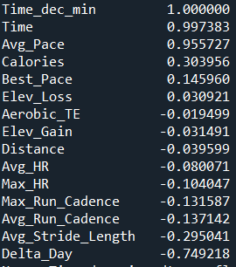
So how do other features relate to Time?
Features
R Value
R value is the ‘standard correlation coefficient’.
Statistical measure of the strength of the linear relationship between two variables.
1 is a perfect positive correlation, -1 is a perfect negative correlation, 0 is no correlation.
The next slides cross plot selected features (red arrows) with Time (decimal minutes).
However, ‘Delta Day’ has by far the strongest negative relationship. ‘Delta Day’ is the number of days since the first day in the dataset (in this case, 03/12/2017)

Slide 18
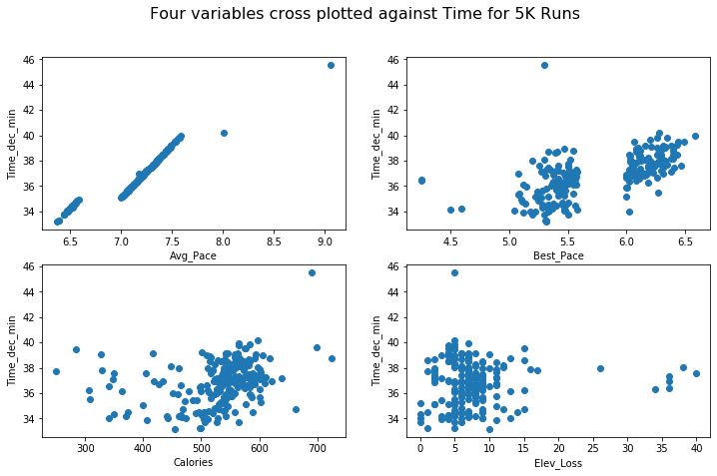
R = 0.96
R = 0.15
R = 0.3
R = 0.03

Slide 19
Strong positive relationship between average pace and time as is expected.
Much weaker correlation than average pace. This would probably be expected. Curious gap in the data between 5.6 and 6mins/km.
R = 0.96
R = 0.15
R = 0.3
Calories burnt are clustered around 500-600. An R value of 0.3 implies a much stronger relationship than is immediately visible by human eye.
No correlation visible here. Although this is almost certainly due to the limited range of the elevation. We would definitely expect a correlation between elevation and time with a more varied dataset.
R = 0.03
As companies don’t typically release their algorithms for calculating calories, this would be an interesting feature to explore further.

Slide 20
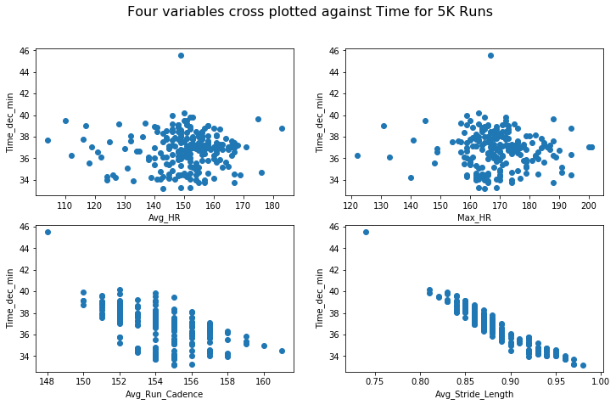
R = -0.08
R = -0.1
R = -0.13
R = -0.3

Slide 21
HR measurements show little correlation to time. The average HR is clustered 145-160 and max HR 160-180 bpm. Does a lack of correlation make sense here? Probably need to ask a health scientist. .
R = -0.08
R = -0.1
Gaps are due to the squashed axis and integer values.
R = -0.13
R = -0.3

Slide 22
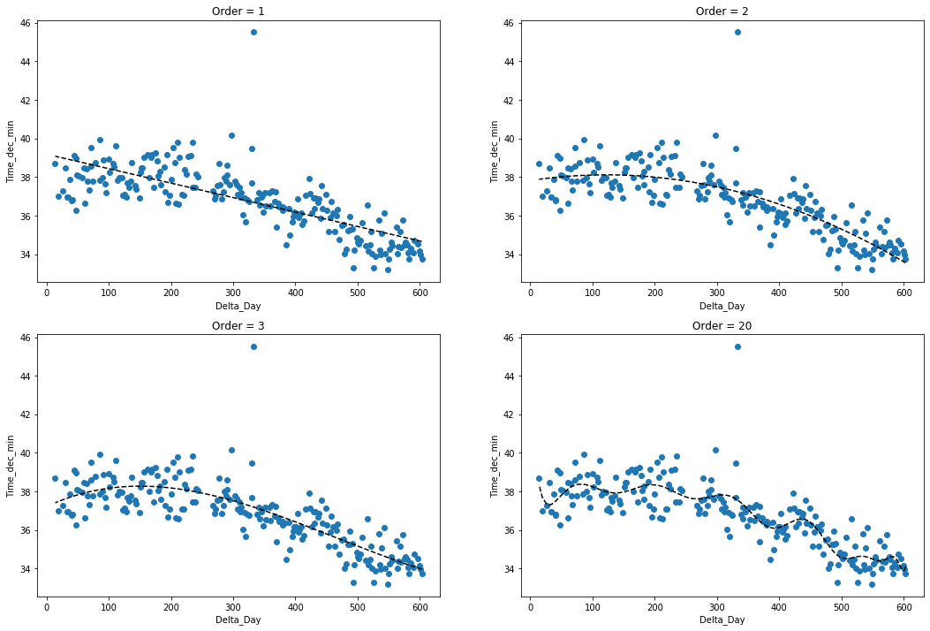

Slide 23
Linear and quadratic fits the data quite well but are they suitable for predicting future times?
Both quadratic and cubic trendlines have negative gradients before ~150 days. Is this sensible?
The best fit line for order 20 is hopelessly overfit to the natural variance In the dataset.

Slide 24
Some other interesting stats. . . (5km)
Difference between slowest and quickest 5k run: 12 minutes and 2 seconds
Difference between slowest and quickest 5k run (discard La Oliva): 6 minutes and 59 seconds
Difference between earliest and latest date: 4 minutes and 57 seconds
Time improvement at Wokingham is: 6 minutes and 59 seconds
5k PB is: 33 minutes and 11 seconds

Slide 25
Contents
Introduction
First Impressions
5k Data
10k Data
Conclusion

Slide 26
10K data
From the 260 data points recorded, 15 were recorded between the distances of 9.9 and 10.1km.
These datapoints will be referred to as 10km runs.
Next slides show some further analysis into the 10k runs.
Note: The 10k dataset is much smaller and therefore harder to draw reliable trends and conclusions.

Slide 27
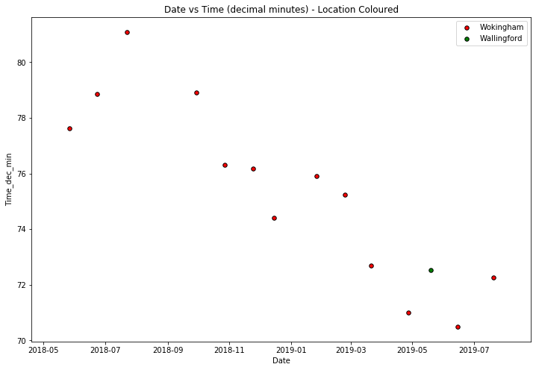

Slide 28
There was a data point (from Woodley) here but none of the other features were recorded so it has been thrown away.
Strong negative trend!

Slide 29
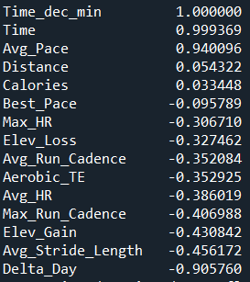
So how do other features relate to Time?
Features
R Value
Same exercise as 5k runs, we are looking at how the other features correlate with time taken to run 10k?
Generally stronger correlations found in this dataset, but this is most likely due to significantly less datapoints.
I am very dubious of these R values for this dataset.

Slide 30
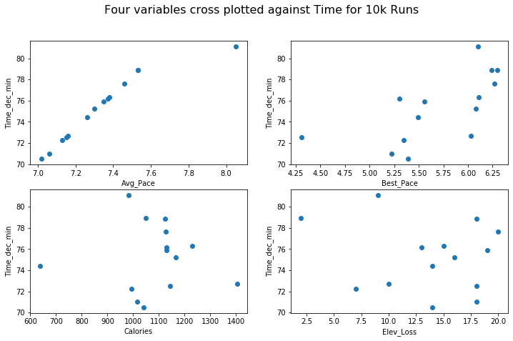
R = 0.94
R = -0.1
R = 0.03
R = -0.3

Slide 31
R = 0.94
R = -0.1
Considerable difference between correlations from best and average pace. Similar to 5k dataset. Difference between Avg_Pace and Best_Pace may be an interesting metric.. ?
R = 0.03
R = -0.3
Calories once again shows no correlation to the time.

Slide 32
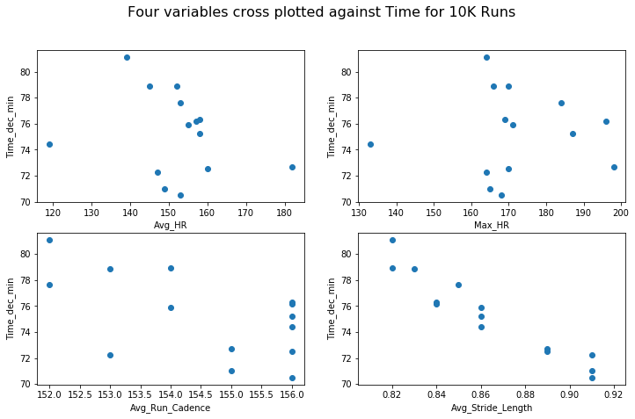
R = -0.39
R = -0.3
R = -0.35
R = -0.46

Slide 33
R = -0.39
Despite the R values, it looks like there is little correlation between HR and time.
R = -0.3
Once again, other than Delta Day, Run Cadence and Stride Length are showing the strongest negative correlations with time. This makes sense as a combination of these two factors surely controls the pace.
R = -0.35
R = -0.46

Slide 34
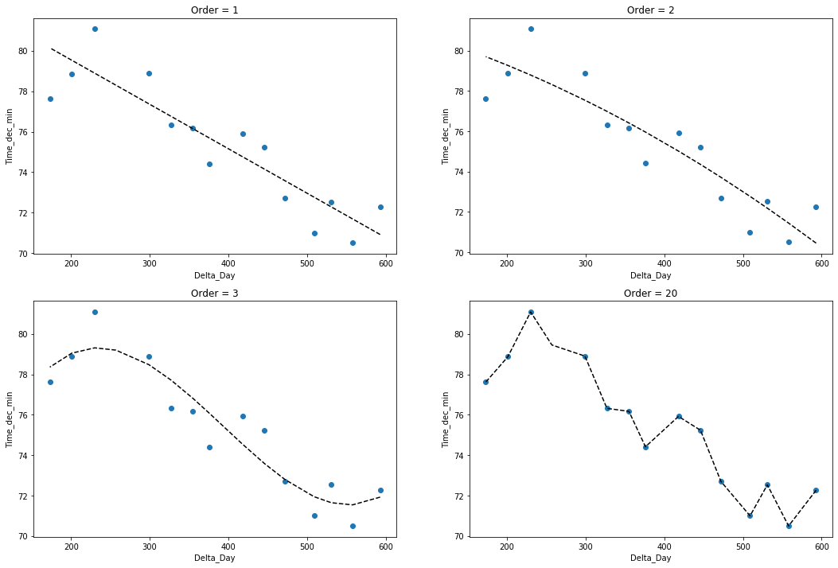

Slide 35
There is no need to look at higher order than a linear fit with this trend, especially due to the lack of data points increasing the chances of overfitting.

Slide 36
Some other interesting stats. . . (10km)
Difference between slowest and quickest 10k run: 10 minutes and 35 seconds
Difference between earliest and latest date: 5 minutes and 21 seconds
10k PB is: 1 Hour, 10minutes and 3 seconds

Slide 37
Conclusions
The data shows few surprises.
Both 5k and 10k runs show quicker times the later the run has been done indicating significant improvement!
Could future times be predicted using machine learning methodology?
Which features would be useful in estimating future times?
Is there more data available?
What other relationships exist other than in relation to time? Calories?

Slide 38
Finally. . .
You ran 1379.65 kms for a total time of 171:35:33 (hh:mm:ss) (over 7 days of running!!), over 603 days, burning 146646 calories between the 03/12/12 – 30/07/19.
WELL DONE! ☺

