Slide 1
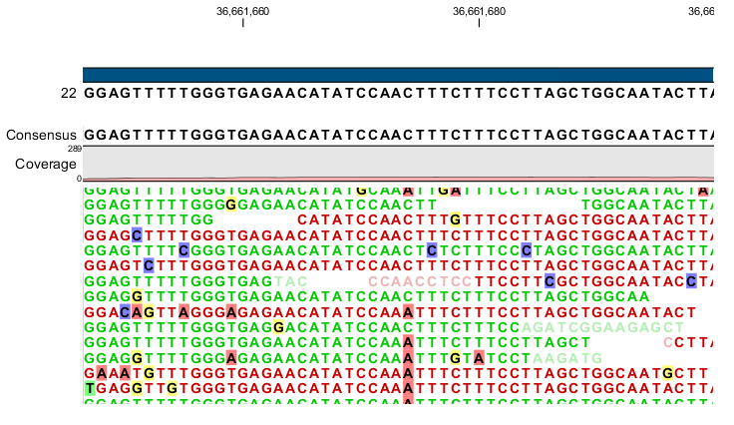
Reference
Sequence
NGS reads

