Slide 1
Isolation: Big problem, big impact.

Slide 2
Problem delimitation
1
A small part of a big problem

Slide 3
Why isolation?
At first we wanted to work on a solution for the biggest problems that affect the society of Yucatan such as Alcoholism, Obesity and cardio-vascular diseases, but, being these, problems of great complexity, we decided to work on one of the main causes of these problems : the isolation.

Slide 4
Big problems
In 2018, Yucatan recorded a record, with 226 cases of suicide. In 2019 the suicide rate is one case per day.
Mexico is among the 15 countries that consume more alcohol and Yucatán one of the 3 states with more diseases derived from alcoholism.
In Mexico, 70% of Mexicans are overweight.

Slide 5
What is isolation?
Social isolation may be recognized by the lack of mutual interaction with other peoples of the society and also determined by some situational factors like little social network, infrequent interaction and rare participation in social activities.

Slide 6
A person is a person through other persons; you can’t be human in isolation; you are human only in relationships. – Desmond Tutu

Slide 7
Isolation as a CURRENT problem
Isolation leads to depression, psychological well being and other social and cognitive impairments.

Slide 8
Internet as the main cause currently
The present study has investigated the effect of internet usage on social isolation of under graduate students.
Excessive use of Internet often affects close relationship and creates social problems.
Sometimes Internet addicted individual fail to communicate well in face-to-face situations

Slide 9
In an interconnected world, people feel more and more alone.
Social isolation is killing us.
- Deloitte

Slide 10
Software solution?

Slide 11
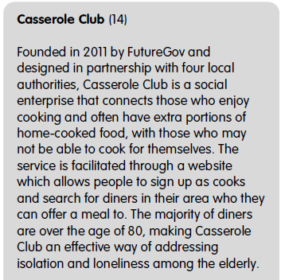
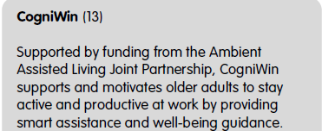
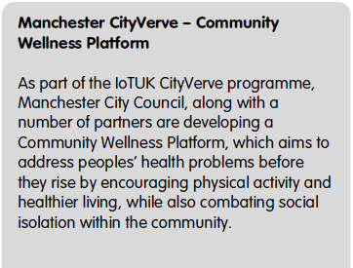
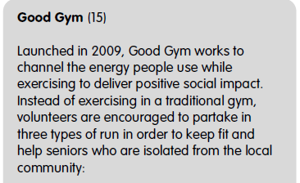
Pioneer solutions in the theme (IOT UK)

Slide 12
Resources
Deloite’s article: https://www2.deloitte.com/mx/es/pages/dnoticias/articles/mundo-interconectado-con-tecnologia.html
American Journal of Educational Research. 2018, 6(4), 361-364. DOI: 10.12691/education-6-4-10
Internet of Thing United Kingdom: SOCIAL ISOLATION AND LONELINESS IN THE UK, With a focus on the use of technology to tackle these conditions

