Slide 1

Explore house sales trends in Northwestern County with our Regression Modelling Project.
By Group 14

Slide 2
GROUP MEMBERS;
ALEX KASWII
LEONARD KOYIO
CECILIA NGUNJIRI
LEILA NYAMBURA
EDWIN MBUTHIA

Slide 3
Executive Summary
Overall, this project provided valuable insights into home valuation and the impact of renovations. By leveraging data on homes in King County, we developed a reliable predictive model and quantified the benefits of renovations, supporting homeowners and stakeholders in making informed decisions in the real estate market. This model can serve as a useful tool for real estate agencies, homeowners, and urban developers, guiding strategic investments and enhancing property values.

Slide 4
Outline
Business problem
Objectives
Analysis
Results
Conclusion
Recommendations

Slide 5
Business Problem
This project addresses the problem of developing a reliable and accurate predictive model for house prices using linear regression, incorporating a comprehensive set of independent variables to improve prediction accuracy.

Slide 6
Objectives
1. Develop a model that accurately predicts the value of a house based on its features.
Investigate the most important features in homes to create an accurate model for estimating home value.
2. Explore and quantify the relationship between renovations and property value and refine the model based on the results.
Determine whether renovations affect home prices. If a relationship exists, quantify it and refine the model to improve accuracy.
3. Offer tailored recommendations to homeowners based on their property characteristics and market conditions.
Provide homeowners with accurate property valuations and advise on whether renovations would be a worthwhile investment if they intend to sell.
By analyzing housing data, this project will develop a predictive model to guide homeowners in making strategic renovation investments that enhance property value. This model will also support stakeholders in urban development by providing a reliable tool for estimating housing prices.

Slide 7
Data Understanding
The data used in this project is from Data/kc_house_data.csv – This is a csv file which mainly contains information on home features in King County. Features like number of bedrooms, bathrooms, floors, the year the houses were built, the year the houses were renovated, proximity to a waterfront, square footage of the home and their prices. It contains 21597 rows and 21 columns.

Slide 8
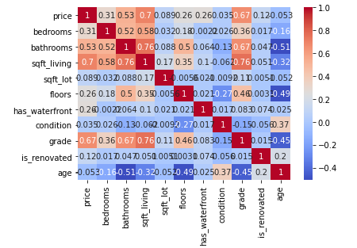
Correlation Matrix
We used a correlation heatmap to graphical representation how different independent variables are related to the dependent variable (price) in the dataset.
Deep red color represent stronger positive correlations.
Deep blue colors represent stronger negative correlations.

Slide 9
Data Cleaning
Before starting on the analysis we drop duplicated rows and columns from the dataset that are not that relevant in helping us come up with the models.
We later filled missing values in the ‘waterfront’ (house has a waterfront) and ‘yr_renovated’ (year the house was renovated) columns with zeros, the assumption being that the houses have no waterfronts and/or they have not been renovated. This is because the percentage of null values for ‘year renovated’ and approximately 20% significance and may have affected our analysis if we dropped the rows.
Lastly we changed the ‘yr_built’ variable name to ‘age’.

Slide 10
Analysis 1: Linear Regression Model for Prediction of Housing Prices
The model(s) assist in the investigation of the most important features in homes to create an accurate model for estimating home value.
Features selected for the analysis:
sqft_living - square footage of the home
grade - overall grade given to the housing unit, based on King County grading system
bathrooms - Number of Bedrooms/House
bedrooms - Number - of bathrooms/bedrooms
has_waterfront - House which has a view to a waterfront
floors - Total floors (levels) in house
is_renovated - house was renovated
sqft_lot - square footage of the lot
age – How old the house is
condition - How good the condition is ( Overall )
From the correlation matrix above:
Top Predictors - sqft_living, grade, bathrooms, bedrooms, has_waterfront, floors, is_renovated, sqft_lot, age, condition.

Slide 11
Results: Simple Linear Regression Model
A. Simple Linear Regression Model
First, we created a model with the top predictor, sqft_living, and progressively added other predictors while evaluating the performance of our model.
Model 1 - Performance Interpretation:
After building and validating the model we found:
The Mean Square Error (MSE) value of 26,997,058,887.54 indicates that there is a significant average squared error between the actual and predicted prices. This suggests that there is room for improvement in the model.
The Mean Absolute Error (MAE) value of 132,831.78 tells us that, on average, our model's predictions are off by about 132,831.78 dollars.
The R² value of 0.35 means that 35% of the variability in house prices is accounted for by the model based on square footage alone. This indicates a moderate level of explanatory power, but it also suggests that other factors not included in this model are influencing house prices.
In summary, while this simple linear regression model provides a basic understanding of how house prices vary with the size of the living area, its performance metrics indicate that it may not be sufficiently accurate for precise predictions. Including additional features could potentially improve the model's accuracy.

Slide 12
Results: Multiple Linear Regression Model
B. Multiple Linear Regression Model
To improve the performance of our model, we added other key features in our simple model and evaluated its performance.
We then created an additional model with the auxiliary features which did not have a very high correlation with the price and evaluated to verify if our model improves.
The most accurate model across the metrics of errors and R-squared was chosen
Using 2 different sets of predictor variables, we come up with 2 different models.
Model 1 variables: 'sqft_living', 'grade', 'bathrooms', 'bedrooms', 'floors'
Model 2 variables: 'sqft_living', 'grade', 'bathrooms’, 'bedrooms', 'floors’, 'has_waterfront', 'is_renovated', 'sqft_lot', 'condition', 'age'

Slide 13
Results: Multiple Linear Regression Model cont’
Model 2 - Performance Interpretation:
After building and validating the model we found:
The MSE value of 23,757,545,024.30 indicates a significant average squared error between the actual and predicted prices, though it is slightly lower than the simple linear regression model, suggesting a better fit.
The MAE value of 122,306.05 tells us that, on average, our model's predictions are off by about 122,306.05 dollars.
The R² value of 0.43 means that 43% of the variability in house prices is accounted for by the model based on the features included. This indicates an improvement over the simple linear regression model and suggests that including multiple features provides a better explanation of house prices.
In summary, this multiple linear regression model provides a more comprehensive understanding of how various features influence house prices compared to the simple linear regression model. However, the performance metrics indicate that there is still room for improvement, and incorporating additional relevant features might further enhance the model's accuracy.

Slide 14
Results: Multiple Linear Regression Model cont’
Model 2 - Performance Interpretation:
After building and validating the model we found:
The MSE value of 23,757,545,024.30 indicates a significant average squared error between the actual and predicted prices, though it is slightly lower than the simple linear regression model, suggesting a better fit.
The MAE value of 122,306.05 tells us that, on average, our model's predictions are off by about 122,306.05 dollars.
The R² value of 0.43 means that 43% of the variability in house prices is accounted for by the model based on the features included. This indicates an improvement over the simple linear regression model and suggests that including multiple features provides a better explanation of house prices.
In summary, this multiple linear regression model provides a more comprehensive understanding of how various features influence house prices compared to the simple linear regression model. However, the performance metrics indicate that there is still room for improvement, and incorporating additional relevant features might further enhance the model's accuracy.

Slide 15
Results: Multiple Linear Regression Model cont’
Model 3 - Performance Interpretation:
Higher R² Value: With an R² value of 0.56, this model explains a significant portion of the variance in house prices, making it more reliable than the previous models.
Lower Errors: Both the MSE (18203549025.413246) and MAE (105665.88359227464) are lower in this model compared to previous ones, indicating more accurate and reliable predictions.
Comprehensive Features: By including multiple relevant features, this model provides a more detailed and nuanced understanding of how different factors affect house prices, leading to better-informed decisions for stakeholders.
In summary, this final multiple linear regression model offers improved predictive accuracy and reliability by incorporating a broader range of features. This makes it a valuable tool for predicting house prices and making informed real estate decisions.

Slide 16
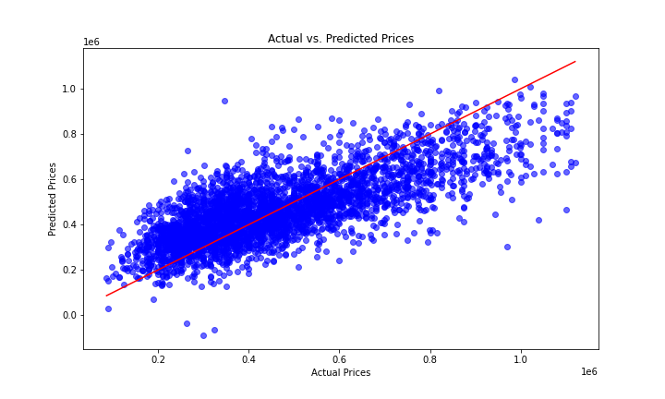
Scatter plot of Actual vs. Predicted Prices

Slide 17
Scatter Plot Interpretation
In this plot:
- The x-axis represents the actual prices of the houses.
- The y-axis represents the predicted prices.
- The red diagonal line represents the line of perfect prediction, where the predicted price equals the actual price.
Interpretation
- The points cluster around the diagonal line, indicating that the model's predictions are generally close to the actual prices.
- There is a noticeable spread around the line, suggesting some prediction errors, which is expected in any regression model.

Slide 18
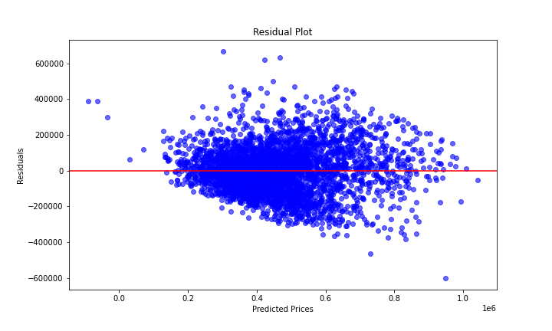
Residual Plot

Slide 19
Residual Plot Interpretation
Interpretation
- The residuals are randomly distributed around the zero line, indicating that there is no bias in the predictions.
- Most residuals fall within a reasonable range, with some outliers indicating larger prediction errors for certain houses.

Slide 20
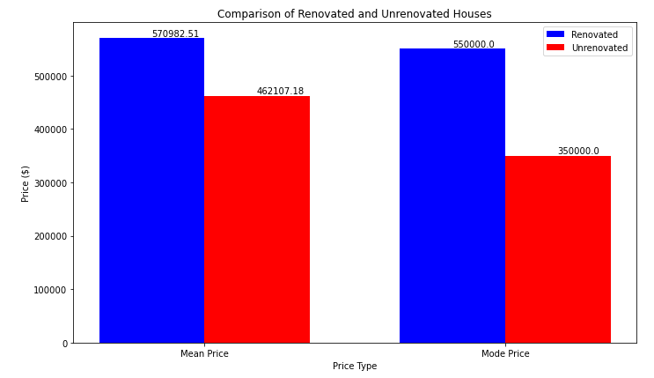
Results: Relationship between renovations and property value cont’

Slide 21
Results: Relationship between renovations and property value
From the results, houses that have undergone renovations have a higher mean price by approximately $110,000 and a higher mode price by $200,000 compared to houses without renovations. This indicated that, on average, renovated houses sell for higher prices. However, this comparison does not account for other differences between the houses.
To further understand the impact of renovations on home prices, we used our predictive model:
Conclusion: Based on our analysis and predictive model, we can conclude that renovations positively impact the valuation of a home. Renovated properties not only have higher mean and mode prices but are also predicted to be valued higher by approximately $7,500 when other factors are held constant.

Slide 22
Conclusion
Accurate Prediction Model:
Developed a multiple linear regression model to predict house values.
Key predictors: square footage, grade, bathrooms, bedrooms, floors, waterfront presence, renovation status, lot size, condition, and house age.
2. Quantified Renovation Impact:
Analyzed the relationship between renovations and property value.
Findings: Renovated houses have higher average prices.
Predictive model indicates renovations can increase home value by about $7,500.
3.Tailored Recommendations:
Provided homeowners with property valuations and renovation advice.
Informed and strategic renovation decisions lead to better financial outcomes.

Slide 23
Conclusion cont’
Overall Insights:
The project offers valuable insights into home valuation and renovation impact.
Leveraging King County data, we developed a reliable predictive model and quantified renovation benefits.
This model serves real estate agencies, homeowners, and urban developers, guiding strategic investments and enhancing property values.

Slide 24
Recommendations
Recommendations for Homeowners Willing to Sell
Renovations: If planning to sell, consider renovating your home. Our analysis suggests renovations that cost no more than $7,500 can increase your home’s value by the same amount, ensuring a good return on investment.
Recommendations for Homeowners Looking to Enhance Property Value
For those aiming to boost property value for future sales, focus on the following improvements:
Living Area: Expanding the square footage significantly enhances value.
Quality: Upgrading the overall grade and finish of the house.
Bathrooms: Adding or improving bathrooms adds substantial value.
Maintenance: Keeping the house in excellent condition is crucial.

Slide 25
Recommendations cont’
2. For Real Estate Agents
- Utilize Predictive Model for Pricing: Leverage the predictive model developed in this project to provide accurate and data-driven property valuations. This can help in setting competitive listing prices and in negotiations with buyers and sellers.
- Advise Clients on Strategic Renovations: Use the insights from this project to advise clients on which renovations are likely to yield the highest returns. Guide them on cost-effective upgrades that can significantly enhance property value.
- Highlight Renovated Properties: When marketing homes, emphasize the benefits of recent renovations. Highlighting the positive impact of renovations on home value can attract more potential buyers and justify higher asking prices.

Slide 26
Recommendations cont’
3. For Urban Developers
- Focus on High-Value Features: When planning new developments or refurbishing existing properties, prioritize features that have been shown to significantly impact home value, such as higher square footage, multiple bathrooms, and high-grade materials.
- Waterfront Properties: Given the premium associated with waterfront properties, developers should consider opportunities to develop or enhance properties with waterfront access. Ensure these properties are marketed effectively to highlight their unique selling points.
- Incorporate Modern, High-Quality Design: Ensure that new developments meet high standards of design and construction. Modern, well-designed homes with high-quality finishes are more attractive to buyers and can command higher prices.

Slide 27
Overall, this project has provided valuable insights into home valuation and the impact of renovations. By leveraging data on homes in King County, we have developed a reliable predictive model and quantified the benefits of renovations, supporting homeowners and stakeholders in making informed decisions in the real estate market. This model can serve as a useful tool for real estate agencies, homeowners, and urban developers, guiding strategic investments and enhancing property values.

Slide 28
THANK YOU!
PHASE 2 PROJECT – GROUP 14
JUNE 19, 2024

