Slide 1

BUILDSIGHT
Send inspectors where they're
needed, first.
A satellite-and-AI triage layer for Hong Kong's building-inspection system.
RISK
Low
Moderate
High
Critical
HONG KONG · 2026
Notes:
Lead with the product and the city, not a tragedy. Tagline first. Stakes land on slide 5.

Slide 2

02 / THE SCALE
One of the world's oldest, densest building stocks —
ageing faster than it can be inspected.
~50,000
~30,000
~10,000
BUILDINGS ACROSS
HONG KONG
AGED 30+ YEARS
(≈ 60% OF THE STOCK)
PAST 50 YEARS OLD
Public / surveyors'-institute figures. Our exact ingested counts appear on slide 9.
BUILDSIGHT · Hong Kong Building-Inspection Triage
02 / 12
Notes:
Public / surveyors'-institute figures. Our exact ingested counts (51,037 / 34,908 / 12,162) are on slide 9.

Slide 3
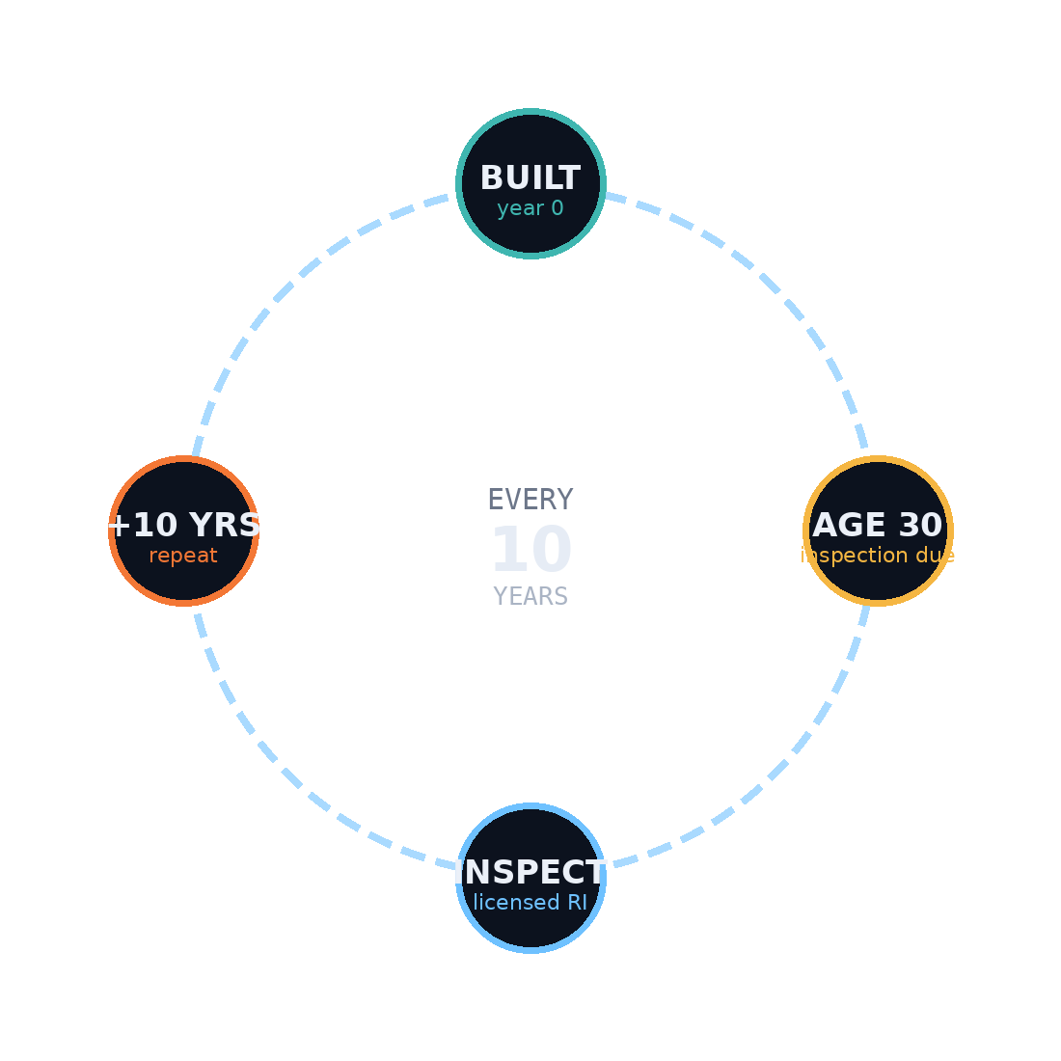
03 / THE LAW
By law, every old building must be
inspected — on a fixed clock.
Mandatory Building Inspection Scheme (MBIS)
Buildings 30+ years must be inspected by a licensed Registered Inspector once every 10 years.
~2,500
$50–200k
MANDATORY INSPECTIONS
REQUIRED / YEAR
HK$ PER BUILDING,
BEFORE ANY REPAIR
THE 10-YEAR CYCLE
BUILDSIGHT · Hong Kong Building-Inspection Triage
03 / 12
Notes:
MBIS: 30+ buildings, licensed RI every 10 years. ~2,500/yr derived load; fee HK$50–200k per building before repairs. Source: MBIS Inspection.md, Building resource overview.md.

Slide 4
04 / THE GAP
The bottleneck isn't the law.
It's capacity.
REQUIRED / YEAR
~2,500
AT TODAY'S PACE,
CLEARING THE BACKLOG TAKES
ACTUALLY SELECTED — AND FALLING
~20
~2,000
~12,000 buildings never even selected
Notices left outstanding 5+ years
YEARS
BUILDSIGHT · Hong Kong Building-Inspection Triage
Audit Commission, end-2019 (MBIS).
04 / 12
Notes:
~2,000/yr selected and falling vs ~2,500 required; ~12,000 never selected; ~20-yr backlog; notices 5+ yrs. Backlog '~20 years' is the end-2019 Audit Commission MBIS finding (cite the scheme).

Slide 5

05 / THE STAKES
This is money — and lives.
Wang Fuk Court fire
November 2025 · 168 lives lost.
Falling-concrete incidents have recurred across the city since 2023 — the exact failure mode of un-triaged ageing facades.
HK$93.1B
per year in repair, maintenance,
alteration & addition work
34.3% of all HK construction
The question is not whether to inspect old buildings — it's which ones first.
BUILDSIGHT · Hong Kong Building-Inspection Triage
05 / 12
Notes:
CAREFUL FRAMING: Wang Fuk Court fire, Nov 2025, 168 lives. Do NOT claim it was inspected 16 times under MBIS — those were Labour Dept site-safety checks of the renovation, not MBIS structural inspections. Confirm exact falling-concrete incident count before quoting it. RMAA HK$93.1B/yr (34.3%) from Building resource overview.md.

Slide 6
06 / OUR SOLUTION
A triage layer in front of
the inspection system.
PILLAR A
PILLAR B
Prioritise
Screen cheaply
Fuse building data with satellite radar to rank every block by risk — so inspectors go to the worst first, not down an arbitrary age queue.
Phones for interiors, drones for facades, and an edge AI model that auto-flags cracks — the first visual look, made near-free.
→ Then the licensed inspector goes where it actually matters.
BUILDSIGHT · Hong Kong Building-Inspection Triage
06 / 12
Notes:
Always say augment / triage / screen — never replace the statutory inspection.

Slide 7
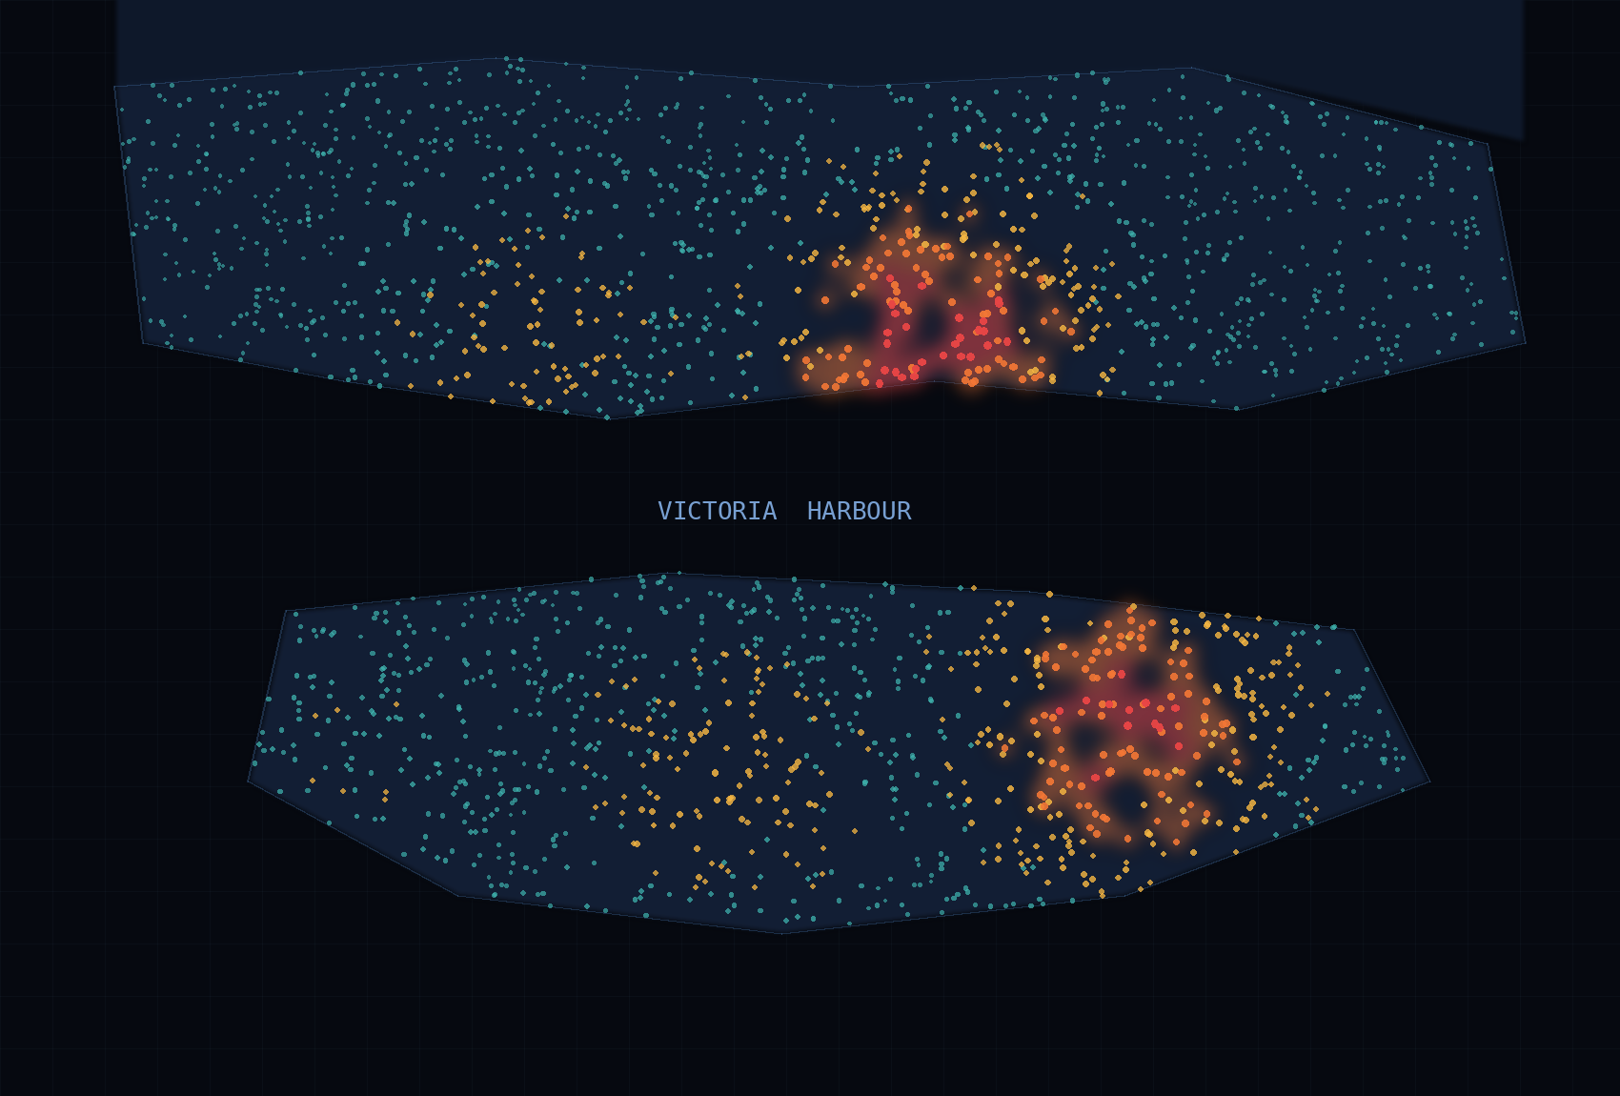

07 / PILLAR A — PRIORITISE
A risk engine that ranks inside
the 30+ cohort.
Building fundamentals
Age · height · use class · structure · district
Statutory-notice history
2,056 inspection / repair notices as labels
InSAR ground motion
Sentinel-1 radar — mm/yr movement, any age
13.4% precision@500 · 2.3× lift
InSAR lifts top-100 precision 7.0% → 8.0% — right where a dispatcher looks first.
0 – 100 RISK SCORE PER BUILDING · ALL 51,037 BLOCKS
Sentinel-1 InSAR
117 interferograms
BUILDSIGHT · Hong Kong Building-Inspection Triage
07 / 12
Notes:
Metrics reproducible from model/train_baseline.py. Trained only on the 30+ cohort (34,908 buildings, 1,998 positives, 5.7% base rate). 13.4% precision@500 = 2.3x lift; InSAR lifts top-100 precision 7.0%→8.0%.

Slide 8
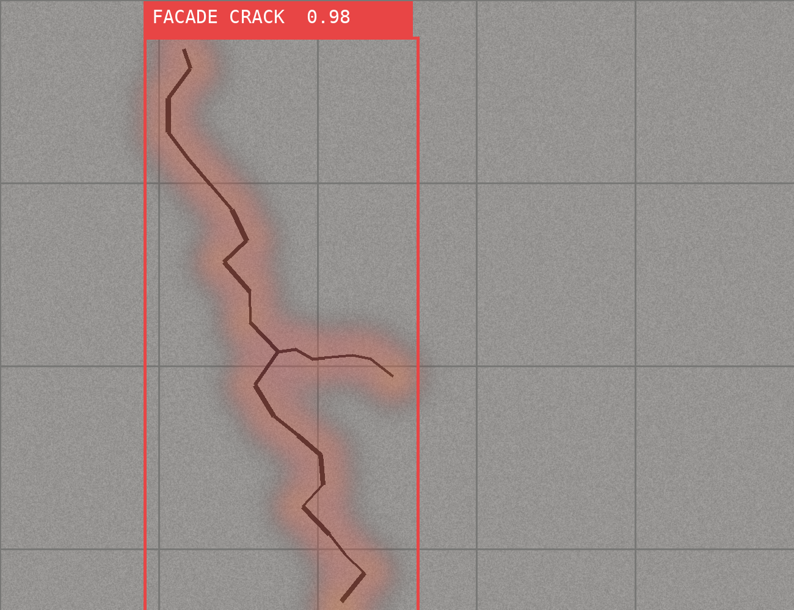
08 / PILLAR B — SCREEN CHEAPLY
Tier-1 visual screening that
runs on a drone or a phone.
Phones capture interiors. Drones capture facades. A computer-vision model flags cracks, spalling and road damage automatically.
99.3%
0.992
TEST ACCURACY
MACRO F1
~16 MB
~40 ms
EFFICIENTNET-B0
PER PATCH, ON CPU
Edge-capable — no datacentre in the loop. Accuracy measured on open crack datasets.
LIVE DEMO · DROP A PHOTO → CRACK HEATMAP + SEVERITY
BUILDSIGHT · Hong Kong Building-Inspection Triage
08 / 12
Notes:
99.3% test accuracy / 0.992 macro F1 measured on OPEN datasets (Ozgenel concrete + CRACK500 pavement), ~24k patches — NOT HK facades yet. Do not present the old unverified '98%' target. EfficientNet-B0, 4.0M params, ~16MB, ~40ms/patch CPU.

Slide 9
09 / PROOF — WE BUILT THIS
Not a mockup. Real data,
a working dashboard, a live demo.
51,037
2,056
342,350
117
BUILDINGS INGESTED
NOTICE LABELS JOINED
FOOTPRINTS W/ HEIGHT
SENTINEL-1 INTERFEROGRAMS
Working dashboard React · TypeScript · MapLibre · Supabase — auth + row-level security.
Ground-motion signal on 7,885 blocks · live drag-and-drop crack-CV demo.
BUILDSIGHT · Hong Kong Building-Inspection Triage
09 / 12
Notes:
De-risk: real ingested data + working dashboard (React+TS+MapLibre+Supabase, auth+RLS) + live crack-CV Gradio demo. Ground-motion signal on 7,885 blocks (15.4%).

Slide 10
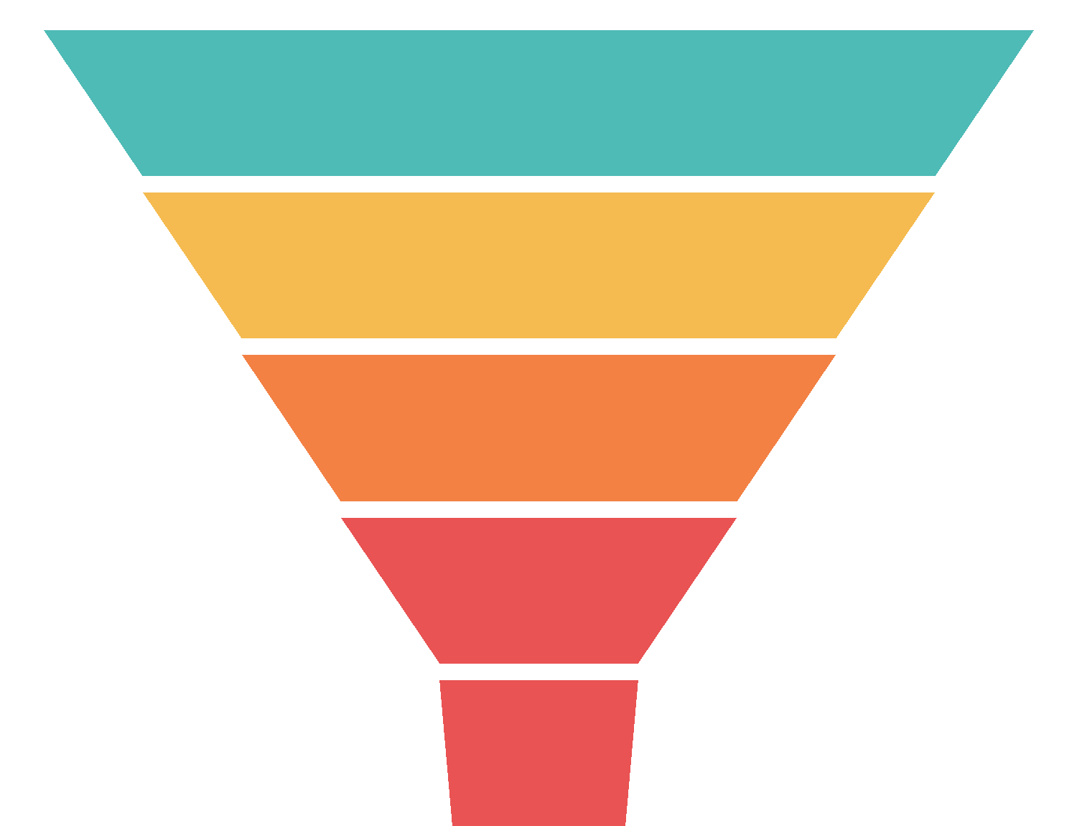
10 / THE VALUE
From 50,000 buildings down to
the few that need a human.
50,000
Early signal
Flags under-30 buildings that are already moving
34,908
Smart triage
Ranks the 30+ cohort by real risk, not age
~12,000
Near-free Tier-1
Drone + phone + edge CV collapse the visual look
Top 500
Fewer Tier-2
Costly physical inspections (HK$50–200k) only where needed
SEND A HUMAN
BUILDSIGHT · Hong Kong Building-Inspection Triage
10 / 12
Notes:
Funnel: 50,000 → 34,908 (30+) → ~12,000 unselected → top-500 risk-ranked → small 'send a human' set. Four wins: early signal under-30, triage 30+, near-free Tier-1, fewer Tier-2 (HK$50–200k each).

Slide 11
11 / POSITIONING
Augments the licensed inspector.
Never replaces the statutory inspection.
BUILDSIGHT — triage layer
WHO PAYS · WHO BENEFITS
Rank · screen · dispatch (our upstream wedge)
Buyer
Buildings Department / government
Owners
Lower wasted inspection cost
Public
Safer buildings, sooner
↓
BD Building Score System
Re-ranks which unselected buildings to notice first
↓
Statutory inspection
Licensed RI · certified Tier-2 grade — legally locked
BUILDSIGHT · Hong Kong Building-Inspection Triage
11 / 12
Notes:
Defensible wedge: prioritisation UPSTREAM of the certified inspection (MBIS Inspection.md §3). Feeds BD's existing Building Score System. Buyer = BD/government; beneficiaries = owners + public.

Slide 12

BUILDSIGHT
Same inspectors. Same law.
A fraction of the wasted trips.
THE ASK A pilot with the Buildings Department on one district — plus access to notice + incident data.
Notes:
Memorable last line + the ask: pilot with BD on one district; access to notice + incident data.

