Slide 1
Product
Management
Contract Management
ProductRegistered
Contract
(Aggregate)
Product
Customer (readmodel)
Product (readmodel)
CustomerRegistered
Customer Management
Functionality:
Register a new Contract
Change the amount of the loan on the contract
Change the term of a contract
Cancel a contract
Customer

Slide 2
Contract Management
Service
Command API
Query API
Message receiver
Write model
Read model
Read model
Read model
Message broker
Other
Services

Slide 3
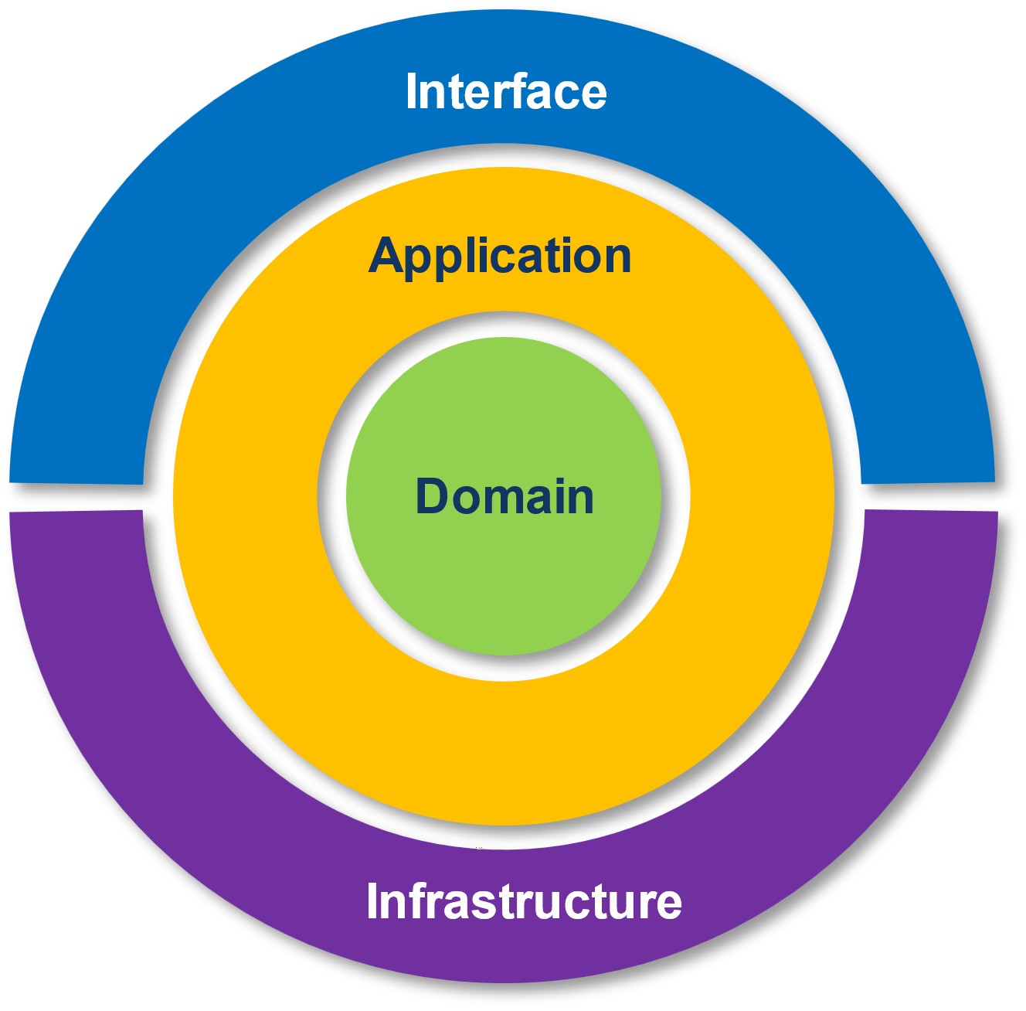
Microservice
Interface Layer
Command API
Message Receiver
Query API
Application Layer
Command
Handlers
Event
Handlers
Projections
Query
Handlers
Domain Layer
Aggregates
Infrastructure Layer
Write model
Repository
Event Publisher
Event Consumer
Read model
Repository
Write model
Message broker
Read model

Slide 4
interface layer
application layer
Microservice
domain layer
infrastructure layer
Unit Of Work
Unit Of Work
Command
Domain Event
Command
API
Process-Manager / Saga
Message
Receiver
Integration Event
Other
Services
Command
Handler
Projection
Event
Handler
Command
Handler
Projection
Event
Handler
eventual
consistency
Aggregate
strong
consistency
Write model (ES)
Read model
Message broker

Slide 5
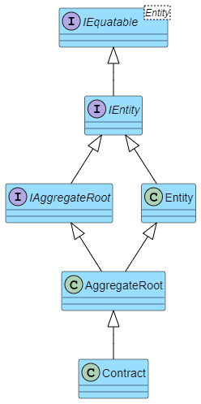

Slide 6
Relational Order data
Event Sourced Order Aggregate
Order was Created
Order
OrderId | CustomerId | Email | Status
1 | C554465 | nick@xyz.com | Shipped
2 | C559132 | null | In progress
3 | C557126 | jim@xyz.com | Confirmed
Item 029 was added
Item 891 was added
Item 734 was added
Not available in the relational data-model
Item 891 was removed
OrderLine | OrderLine
Id | OrderId | ProductId
1 | 1 | 192
2 | 3 | 029
3 | 2 | 125
4 | 2 | 076
5 | 3 | 1077
Customer info was added
Order was confirmed
Order was reopened
Item 743 was removed
Item 1077 was added
Order was confirmed

Slide 7
Aggregate
Name | Data type | Key
AggregateId | string | PK
AggregateVersion | ulong
Event
Name | Data type | Key
Id | uniqueid | PK
AggregateId | ulong | FK
Version | ulong
Timestamp | datetime
EventType | string
EventData | string

Slide 8
ContractAggregate
AggregateId | AggregateVersion
C123 | 1
C456 | 3
C789 | 2
ContractEvent
AggregateId | Version | Timestamp | EventType | EventData
C123 | 1 | 2021-11-01T16:29:22Z | ContractRegistered | { "contractNumber": "C123", "contractAmount": 500000, ... }
C456 | 1 | 2021-12-14T10:31:01Z | ContractRegistered | { "contractNumber": "C456", "contractAmount": 25000, ... }
C456 | 2 | 2021-12-14T10:33:58Z | ContactAmountChanged | { "contractNumber": "C456", "newAmount": 30000 }
C789 | 1 | 2022-02-13T13:05:41Z | ContractRegistered | { "contractNumber": "C789", "contractAmount": 10000, ... }
C456 | 3 | 2022-02-20T08:27:19Z | ContractCancelled | { "contractNumber": "C456", "reason": "Divorce" }
C789 | 2 | 2022-03-10T14:02:33Z | ContractTermChanged | { "contractNumber": "C789", "newTerm": 60 }

Slide 9
ContractAggregate
AggregateId | AggregateVersion
C123 | 1
C456 | 3
C789 | 2
ContractEvent
AggregateId | Version | Timestamp | EventType | EventData
C123 | 1 | 2021-11-01T16:29:22Z | ContractRegistered | { "contractNumber": "C123", "contractAmount": 500000, ... }
C456 | 1 | 2021-12-14T10:31:01Z | ContractRegistered | { "contractNumber": "C456", "contractAmount": 25000, ... }
C456 | 2 | 2021-12-14T10:33:58Z | ContactAmountChanged | { "contractNumber": "C456", "newAmount": 30000 }
C789 | 1 | 2022-02-13T13:05:41Z | ContractRegistered | { "contractNumber": "C789", "contractAmount": 10000, ... }
C456 | 3 | 2022-02-20T08:27:19Z | ContractCancelled | { "contractNumber": "C456", "reason": "Divorce" }
C789 | 2 | 2022-03-10T14:02:33Z | ContractTermChanged | { "contractNumber": "C789", "newTerm": 60 }
Notes:
- Show ContractManagement/Infrastructure/Persistence/ServiceDBContext.cs

