Slide 1

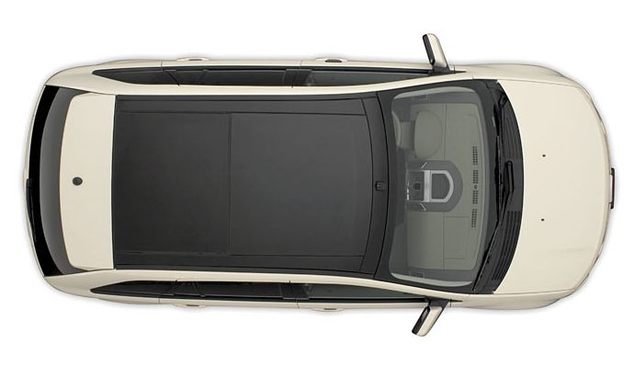
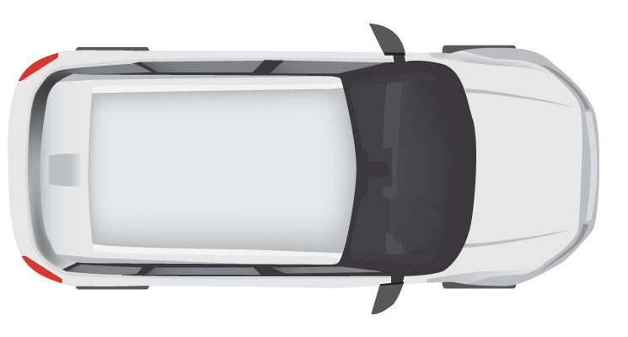
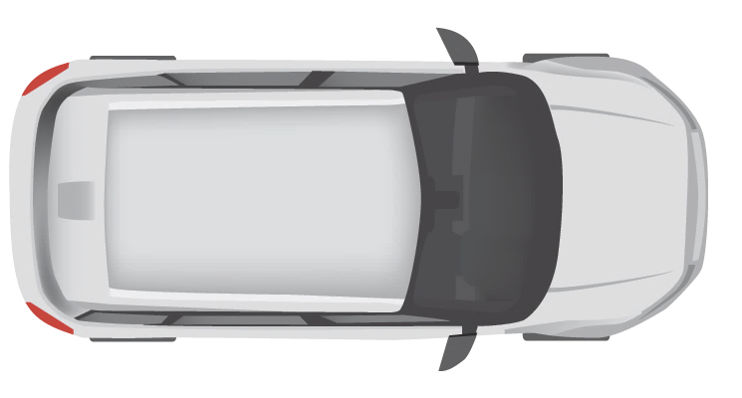
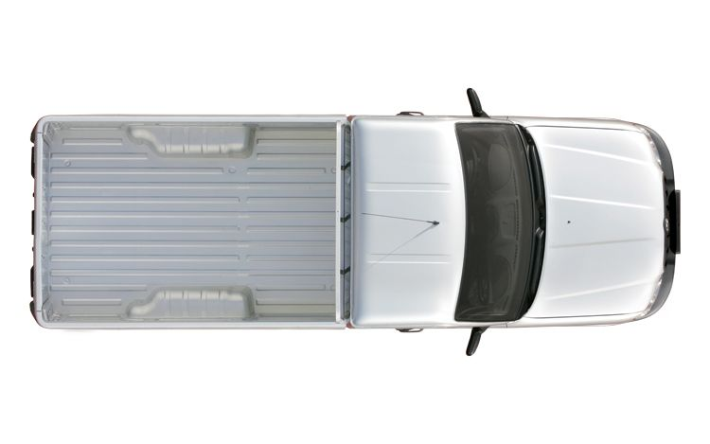


10 km
Entry Cam 1
Exit Cam 1
Entry Cam 2
Exit Cam 2
Entry Cam 3
Exit Cam 3
TrafficControl
Service
Measurements
Service
CO2
Sensor

Slide 2
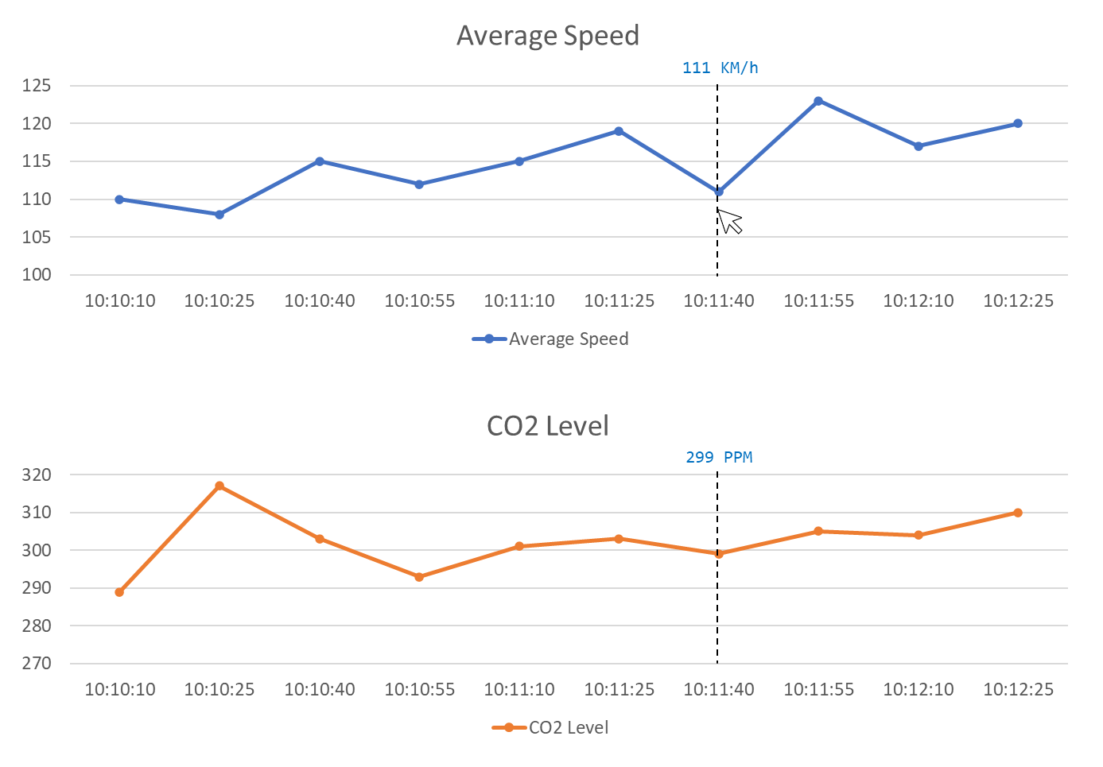
Simulation
Camera
Simulation
Camera
Simulation
Camera
Simulation
Traffic
Control
Service
/entrycam
/exitcam
Measurements
Service
/averageSpeed
/metrics
CO2 Sensor
Simulation
/co2Level

Slide 3
Simulation
Traffic Control Service
Measurements Service
Dashboard
Camera
Simulation
CO2 Sensor
Simulation
/entrycam
/exitcam
/average Speed
/co2 Level
/metrics
Dashboard
POST VehicleRegistered
Random
Interval
Store VehicleState
POST VehicleRegistered
Get VehicleState
Calculate Average Speed
POST AverageSpeedMeasured
Calculate and store Overall Average Speed
[Every 15 seconds]
POST CO2LevelMeasured
Generate and store sample point
GET Metrics

Slide 4

111 KM/h
299 PPM

Slide 5


Redis
State Management
Simulation
Camera
Simulation
Sidecar
Traffic
Control
Service
Sidecar
Camera
Simulation
Service invocation
/entrycam
Camera
Simulation
/exitcam
Redis
Measurements
Service
Publish / Subscribe
/averageSpeed
/co2Level
/metrics
CO2 Sensor
Simulation

